Slide 2
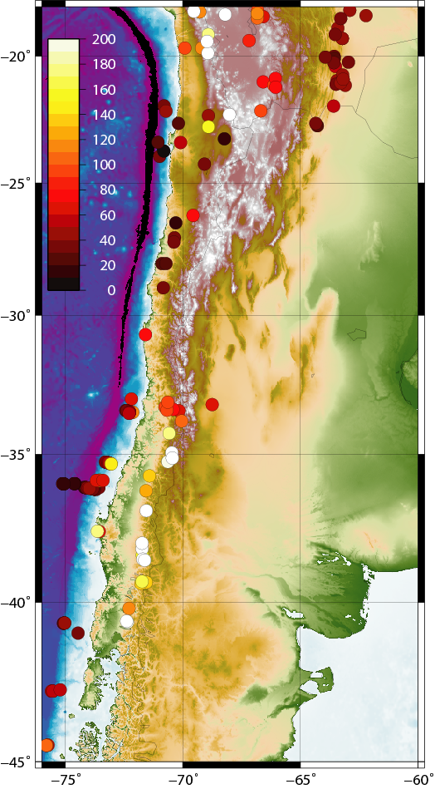
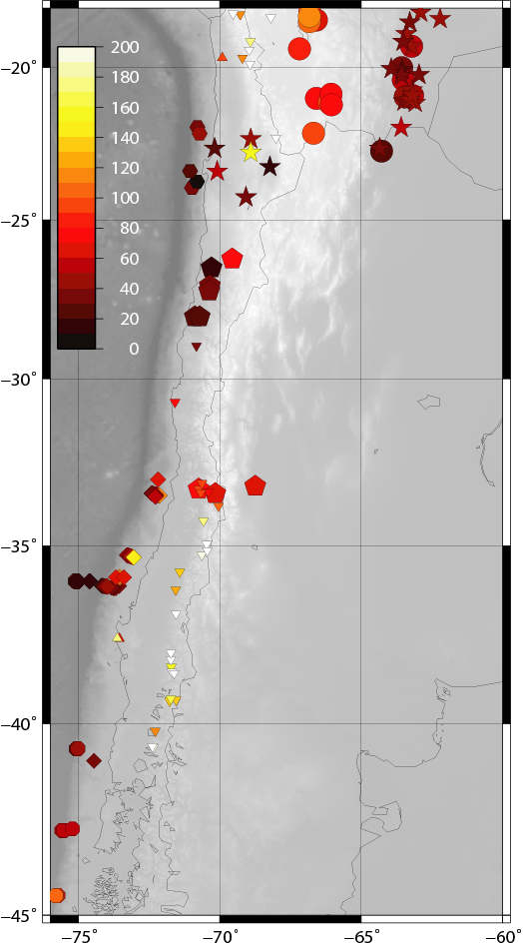
HEAT FLOW MEASUREMENTS IN THE CENTRAL AND SOUTHERN ANDES
Uyeda and Watanabe (1982)
Henry and Pollack (1988)
Borehole
Springer and Foster (1998)
QUALITY
CINCA (1995)
Grevemeyer et al (2003, 05, 06)
Submarine Geophysics
TIPTEQ (2002)
Hamza and Muñoz (1996)
Hotspring Geochemistry
Hamza et al (2005)

