Slide 1
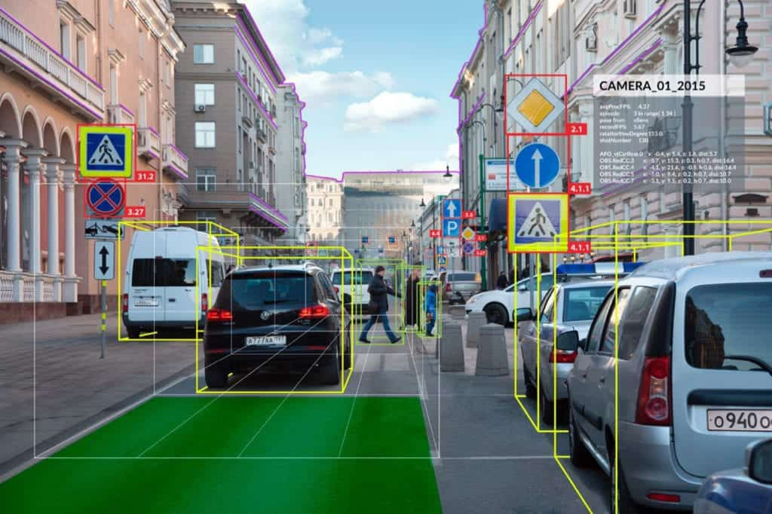

Introduction to OpenCV

Slide 2
Drawing with OpenCV
cv2.line: Draws a line on image, starting at a specified (x, y)-coordinate and ending at another (x, y)-coordinate
cv2.circle: Draws a circle on an image specified by the center (x, y)-coordinate and a supplied radius cv2.rectangle: Draws a rectangle on an image specified by the top-left corner and bottom-right corner (x, y)-coordinates
cv2.ellipse: Draws an ellipse on an image
cv2.polylines: Draws the outline of a polygon specified by a set of (x, y)-coordinates
cv2.fillPoly: Draws a polygon, but instead of drawing the outline, instead fills in the polygon
cv2.arrowedLine: Draws an arrow pointing from a starting (x, y)-coordinate to an ending (x, y)-coordinate
Further Reading –
https://docs.opencv.org/3.4/d3/d96/tutorial_basic_geometric_drawing.html

Slide 3
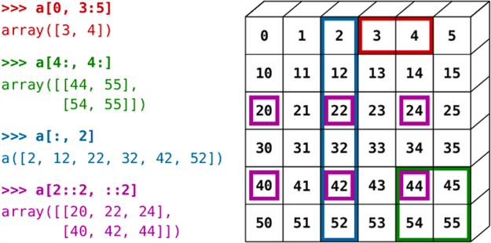








Cropping Images
(Source - https://pyimagesearch.com/2021/01/19/crop-image-with-opencv)

Slide 4
Cropping Images
When we crop an image, we want to remove the outer parts of the image we are not interested in. We commonly refer to this process as selecting our Region of Interest.
image cropping by using NumPy array slicing.
When applying NumPy array slicing to images, we extract the ROI using the following syntax:
Region of Interest = image[startY:endY, startX:endX]
The startY:endY slice provides our rows (since the y-axis is our number of rows) while startX:endX provides our columns (since the x-axis is the number of columns) in the image.
Further Reading –
https://pyimagesearch.com/2021/01/19/crop-image-with-opencv/

Slide 5


Rotate Images
Rotation by an angle 𝚹 can be defined by constructing a matrix M, in the form
Given an (x, y) Cartesian Plane, this matrix can be used to rotate a vector degrees (counter clockwise) about the origin. Usually the origin is the centre of the image
From the original image “I”, the rotated image “R”, is obtained by simple matrix multiplication: R = I x M
OpenCV provides ability to
Scale (resize) an image
Provide an arbitrary rotation centre around which to perform the rotation
Modified rotation matrix, “M” –
Here ⍺ = scale x cos and β = scale x sin and c_{x} and cy are the respective (x, y) co-ordinates around which rotation is performed.
Further Reading –
https://pyimagesearch.com/2021/01/20/opencv-rotate-image/

Slide 6
Morphological Operations
Morphological operations are simple transformations applied to binary or grayscale images. More specifically, we apply morphological operations to shapes and structures inside of images.
We can use morphological operations to increase the size of objects in images as well as decrease them. We can also utilize morphological operations to close gaps between objects as well as open them.
Morphological operations “probe” an image with a structuring element. This structuring element defines the neighbourhood to be examined around each pixel. And based on the given operation and the size of the structuring element we are able to adjust our output image.
These image processing operations are applied to grayscale or binary images and are used for pre-processing for OCR algorithms, detecting barcodes, detecting license plates, and more.
Proper use of morphological operations can allow you to avoid more complicated (and computationally expensive) machine learning and deep learning algorithms.
Further Reading –
https://pyimagesearch.com/2021/04/28/opencv-morphological-operations/

Slide 7
Text Skew correction with OpenCV and Python (Deskew)
Three steps –
Detect the block of text in the image.
Compute the angle of the rotated text.
Rotate the image to correct the skew.
Pre-processing –
Convert the image to grayscale and flip the foreground and background to ensure foreground is “white” and background is “black” (the part of the image we are not interested in is dark).
Remember –
To compute minimum rotated bounding box - the cv2.minAreaRect function returns angle values in the range [-90, 0). As the rectangle is rotated clockwise the angle value increases towards zero. When zero is reached, the angle is set back to -90 degrees again and the process continues.
Further reading
https://docs.opencv.org/3.4/d4/d61/tutorial_warp_affine.html
https://gist.github.com/russss/922be97d2a65eb534744c5a4054ff88d

Slide 8
Correcting Blurred Images (Laplacian Operator)
Variation of the Laplacian method
Take a single channel of the image (preferably grayscale) and convolve it with 3x3 Kernel
Compute the variance (square of standard deviation) of the response
If the variance falls below a pre-defined threshold, then the image is considered blurry; otherwise, the image is not blurry.
Laplacian operator is used to measure the 2nd derivative of an image. The Laplacian highlights regions of an image containing rapid intensity changes, (like the Sobel and Scharr operators). And, just like these operators, the Laplacian is often used for edge detection.
The assumption here is that if an image contains high variance, then there is a wide spread of responses, both edge-like and non-edge like, representative of a normal, in-focus image.
But if there is very low variance, then there is a tiny spread of responses, indicating there are very little edges in the image. As we know, the more an image is blurred, the less edges there are.

Slide 9
Correcting Blurred Images
the trick here is setting the correct threshold which can be quite domain dependent. Too low of a threshold and you’ll incorrectly mark images as blurry when they are not. Too high of a threshold then images that are blurry will not be marked as blurry
Further reading –
Blog
https://pyimagesearch.com/2015/09/07/blur-detection-with-opencv
Research Paper
Analysis of focus measure operators for shape-from-focus
Diatom Autofocusing in Brightfield Microscopy: a Comparative Study

Slide 10
Correcting Blurred Images (Fast Fourier Transform)
The downside is that the Laplacian method required significant manual tuning to define the “threshold” at which an image was considered blurry or not. If you could control your lighting conditions, environment, and image capturing process, it worked quite well — but if not, you would obtain mixed results.
Consider computing the Fast Fourier Transform of the image and then examining the distribution of low and high frequencies
if there are a low number of high frequencies, then the image can be considered blurry.
However, defining what is a low number of high frequencies and what is a high number of high frequencies can be quite problematic, often leading to sub-par results. In practice, FFT blur detector is far more robust and reliable than the variance of the Laplacian method.
The Fast Fourier Transform is a convenient mathematical algorithm for computing the Discrete Fourier Transform. It is used for converting a signal from one domain into another.
Think of FFT as an image processing tool that represents an image in two domains
Fourier (i.e., frequency) domain
Spatial domain

Slide 11
Correcting Blurred Images (Fast Fourier Transform)
FFT represents the image in both real and imaginary components. By analyzing these values, we can perform image processing routines such as blurring, edge detection, thresholding, texture analysis, and yes, even blur detection.
Further Reading –
Blog
https://pyimagesearch.com/2020/06/15/opencv-fast-fourier-transform-fft-for-blur-detection-in-images-and-video-streams/
Research Paper
https://homepages.inf.ed.ac.uk/rbf/HIPR2/fourier.htm
Lecture
https://faculty.cc.gatech.edu/~afb/classes/CS4495-Fall2014/slides/CS4495-Frequency.pdf

