Slide 1



Workshop outline
DAY 1:
DAY 2:
Concept
Main tools
→ Practical part 1
Terminal vs GUI
Handling merge conflicts
Example workflows
Tips ‘n tricks
→ Practical part 2
Github tour
Git-Github syncing
→ Practical part 1
Github collaboration
Git: down the rabbit hole
→ Practical part 2

Slide 2
Github tour

Slide 3
Some more Git

Slide 4
Extended tool-set
Reset
Stash
Rebase
Diff
Notes:
Tools will be explained as commands for terminal but concepts transfer to GUI

Slide 5
How to correct your mistakes
> git commit --amend
Applies a single commit to HEAD
VS merge VS rebase
Usecases:
  Hotfixes
  Get specific code
a - b - c - d Main
\
e - f - g Feature
a - b - c – d - f Main
\
e - f - g Feature

Slide 6
How to correct your mistakes
> git reset [commit]
Applies a single commit to HEAD
VS merge VS rebase
Usecases:
  Hotfixes
  Get specific code
a - b - c - d Main
\
e - f - g Feature
a - b - c – d - f Main
\
e - f - g Feature

Slide 7
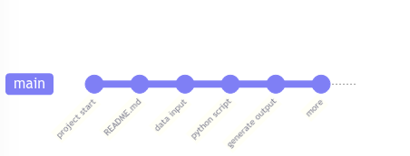
Rebase a branch
2 schools of Git thought:
  Git is the detailed history of what happened in a project
→ git merge
  Git is a clean history of changes
  → git rebase (+ git merge)

Slide 8
Explore changes
> git diff [branch1..branch2 | ref1..ref2 | commit1..commit2]
View changes/differences between commits

Slide 9
Secret power-tool
> git rebase -i
Rebase

Slide 10
Check your working tree’s status
> git status
Find most relevant info
  Where am I (HEAD)?
  Which files have been modified with respect to the parent commit?
  Which files are not being tracked?
  Which files have been staged?
  Are there any merge conflicts? → How to proceed explained
  Are there any errors? → Solution 99.9% of cases indicated

Slide 11
Down the rabbit hole

Slide 12
Cherry-pick commits
> git cherry-pick [commit]
Applies a single commit to HEAD
VS merge VS rebase
Usecases:
  Hotfixes
  Get specific code
a - b - c - d Main
\
e - f - g Feature
a - b - c – d - f Main
\
e - f - g Feature

Slide 13
Tips ‘n tricks
Find common commit ancestor
> git merge-base [branch1] [branch2]

Slide 14
Example commits
> git cherry-pick [commitSHA]
Applies a single commit to HEAD
VS merge VS rebase
Usecases:
  Hotfixes
  Get specific code
a - b - c - d Main
\
e - f - g Feature
a - b - c – d - f Main
\
e - f - g Feature

Slide 15
Syncing local and remote repos

Slide 16
More terminologies
Remote (repository)
Local (repository)
Push: “Send” local changes to remote
Pull: “Receive” changes from remote

Slide 17
Syncing tags

Slide 18
Tag sync
> git push origin [tagName]
Push one tag
View remote tags: directly in remote repository platform
> git push origin --tags
Delete branch
> git push origin --delete [tagName]
Delete remote tag

Slide 19
Git/Github overview

Slide 20
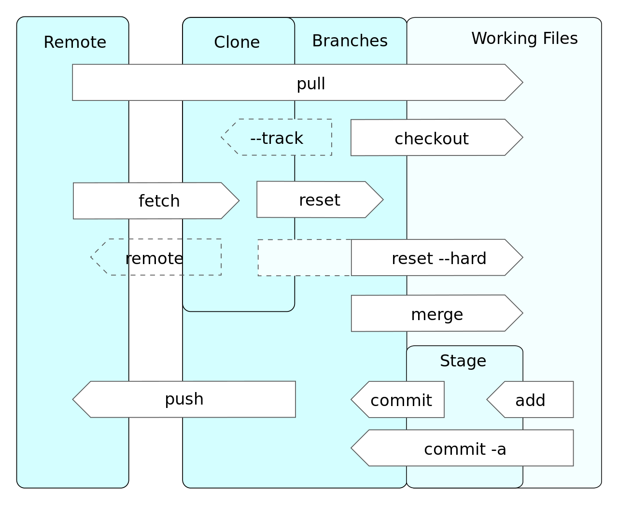
Git/Github overview

Slide 21
Extra: typical situations

