Slide 1



/
workshop
Mon 09th Oct. 2023 – Ian Dirk Fichtner

Slide 2
Workshop outline
DAY 1:
DAY 2:
Concept
Main tools
→ Practical part 1
Terminal vs GUI
Git merge
Example workflows
Tips ‘n tricks
→ Practical part 2
Github tour
Git-Github syncing
→ Practical part 1
Github collaboration
Git: down the rabbit hole
→ Practical part 2

Slide 3
What is Git?

Slide 4

=
Version control system
Store snapshots of your project and its files
Directed acyclic graph
Linux, MacOS, Windows
Usually used in combination with Github, Gitlab etc

Slide 5
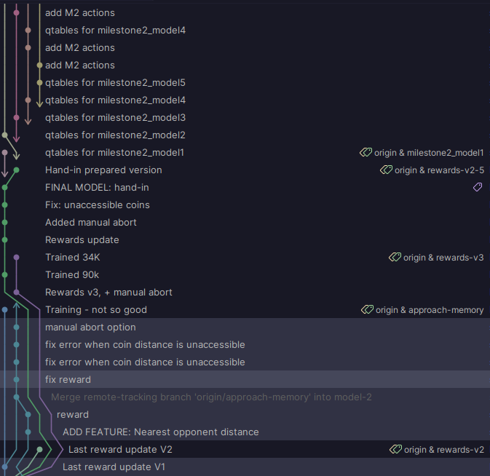
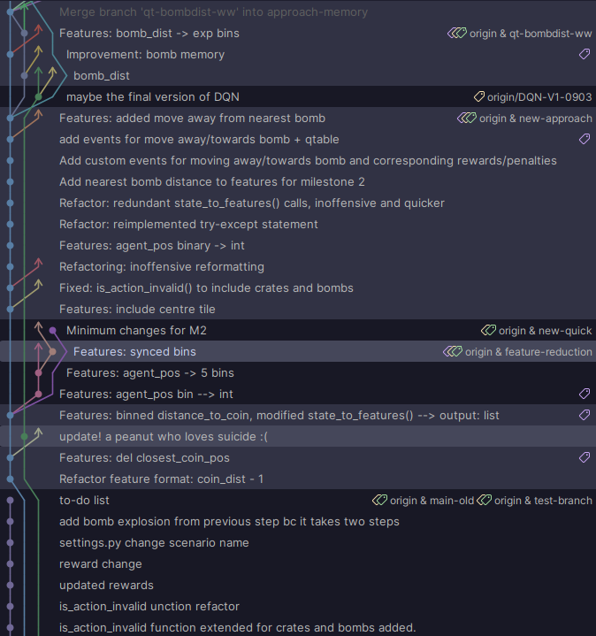
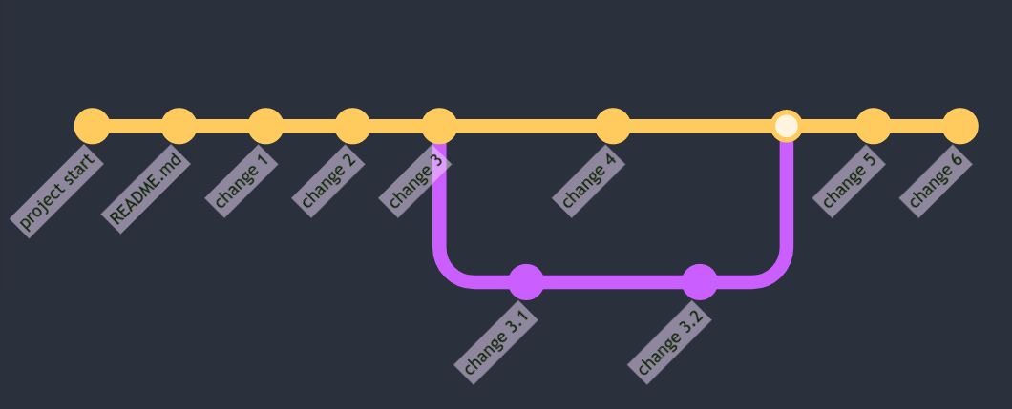
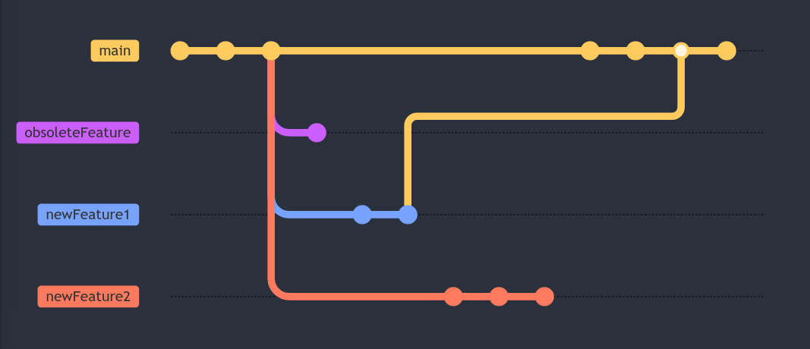
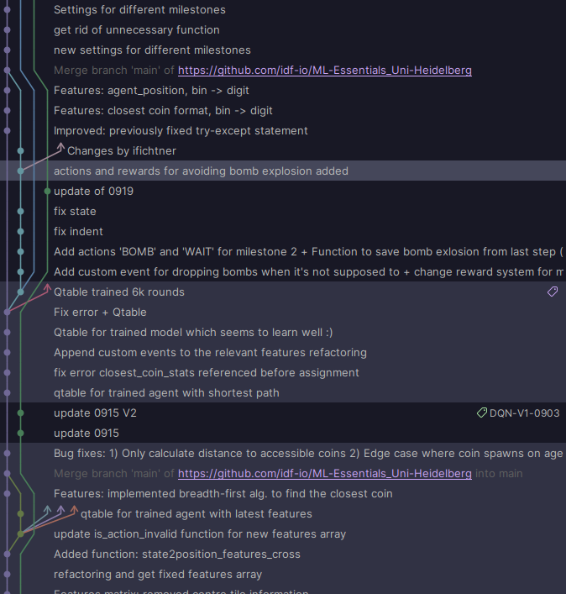
What can I do with git?
Keep a record of file history
Manage and organize changes (features) of a project
Play with different versions of a file e.g. model parameters

Slide 6

2 ways of perceiving Git
Simplistic: Branching versions of your work
Complete: DAG of commits and references
→ Choose your view depending on intent of usage
https://www.hitc.com/static/uploads/2021/09/Screenshot-2021-09-08-2.02.40-PM.png

Slide 7
Behind the scenes
Commit history DAG (Immutable, append-only)
Mutable stage
Working directory
References
  HEAD (where you are)
  Branches (heads)
    → dynamic,
    current branch follows HEAD
  Tags
    → static
Stored in .git/
Commits are identified via SHA
and contain metdata (author, date...)
V1.0
HEAD
m
m
m
+
+
+
+
Commit history
Stage
Working
tree

Slide 8
Terminologies
Commit
Commit history
Working tree
Stage (=index,cache)
Reference (branch, HEAD, tags)
Directed acyclic graph (DAG)

Slide 9
Your tool-set

Slide 10
Tool-set
Init/Clone
Commit (+ add)
Status
Log
Checkout
Branch
Merge
Tag
Commit history
(HEAD, branches, tags)
HEAD
Stage
Working tree
checkout
commit
add
branch
Restore --staged
merge
Restore
tag
Notes:
Tools will be explained as commands for terminal but concepts transfer to GUI

Slide 11
Check your working tree’s status
> git status
Find most relevant info
  Where am I (HEAD)?
  Which files have been modified with respect to the parent commit?
  Which files are not being tracked?
  Which files have been staged?
  Are there any merge conflicts? → How to proceed explained
  Are there any errors? → Solution 99.9% of cases indicated

Slide 12
View your commit history
> git log
> git log [file]
Commit hash, message, author + email, date, local and remote references (branches, tags, HEAD)
Only current branch parent commits
> git log --all --oneline –decorate --graph
Only view commit has, message and references
View all commits (also other branches

Slide 13
Getting started: 2 options
> git init
> git clone [URL]
Initiates repository in current folder
In other words:
  Creates the .git directory
  No root commit yet!
Download the exact state of an online (remote) repo to your computer (local)

Slide 14
Make your commit history
> git add [file1] [fileN]
Add files to the index/staging area
> git add .
> git add [--all, -A]

Slide 15
Make your commit history
> git commit -m “Commit message”
Make a snapshot of the current state of your working tree
You “commit” to a certain state → Irreversible (as of first)
Conventions:
  Make many short commits → history is easier to track (tags for bigger milestones)
  Keep the message short and identifieable
    “After pre-processing the data files x and y performed UMAP with n_epochs=1000”
    “Added UMAP to analysis X”

Slide 16
Make your commit history
Edit files
> git add [newFile] [modifiedFile] [deletedFile]
> git commit -m “Commit message”
Why does `git add` exist?
Lets you selectively commit work to the history

Slide 17
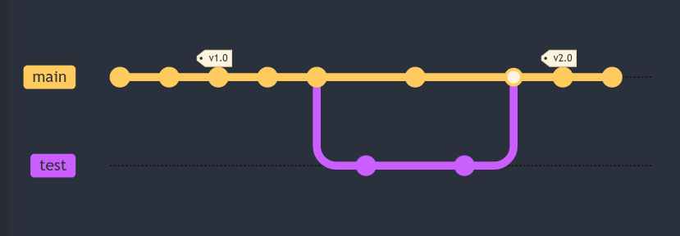

Time travel
> git checkout [branch, tag, commit]
Switch to a different state of the project
Important: understand detached HEAD state
Error if:
  Not commited modified files
Untracked files follow you wherever
Personally, I discourage the use of the newer `git switch` command. It’s easier to remember but never forces you to understand how git actually works
HEAD
HEAD
HEAD

Slide 18
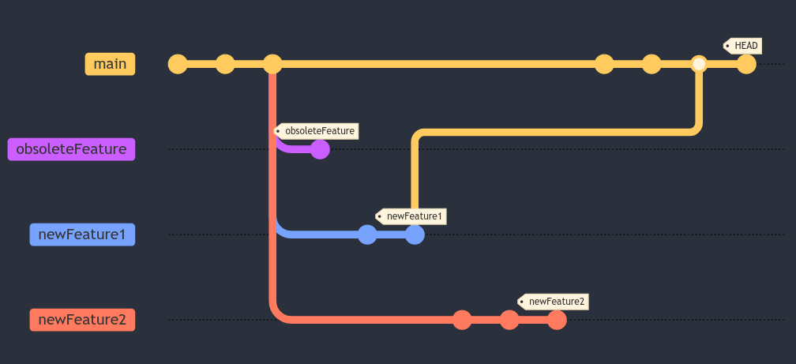
Branch out
> git branch [newBranchName]
Make a new travelling reference

Slide 19
Branch out
> git branch -m [newBranchName]
Rename the current branch
> git branch -d [BranchName]
Delete branch
> git branch -D [BranchName]
Delete branch with unmerged changes

Slide 20
Tag your commits
Tag = static reference
> git tag [newTagName]
Make a new tag in the current commit (HEAD)
> git tag [newTagName] [commitSHA]
Make a new tag in the indicated commit

Slide 21
Tag your commits
> git tag
Show all local tags
> git tag -d [tagName]
Delete tag

Slide 22
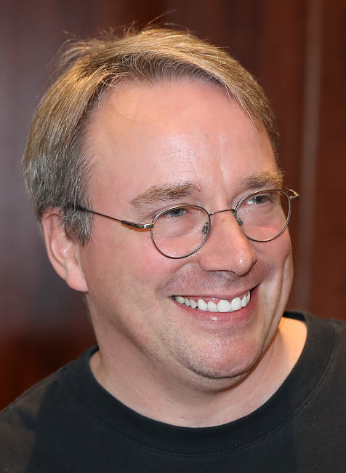
Fun fact time!
Git was originally created by Linus Torwalds, the creator of the Linux kernel
#GOAT
https://en.wikipedia.org/wiki/Linus_Torvalds#/media/File:Lc3_2018_(263682303)_(cropped).jpeg

Slide 23
Tool-set
Init/Clone
Commit (+ add)
Status
Log
Checkout
Branch
Merge
Tag
Commit history
(HEAD, branches, tags)
HEAD
Stage
Working tree
checkout
commit
add
branch
Restore --staged
merge
Restore
tag
Notes:
Tools will be explained as commands for terminal but concepts transfer to GUI

Slide 24
Practical session part 1:
Try git out

Slide 25
Fuse two branches
Situation:
  You started making changes in a new branch
  You finished those changes
  You liked them and want to update the code in your main branch (or any other arbitrary branch) with these changes
> git merge [branchWithChanges]

Slide 26
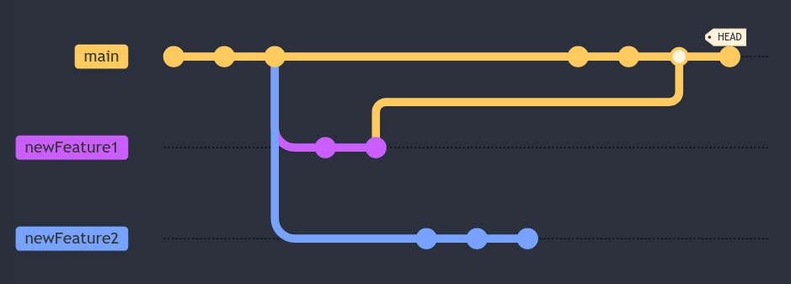
Fuse two branches
> git checkout [branch to update]
> git merge [branch with changes]
> git branch -d [obsolete branch]

Slide 27
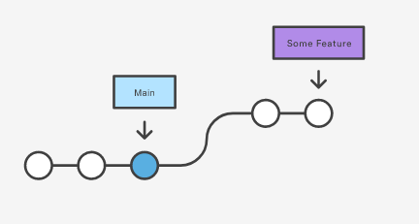
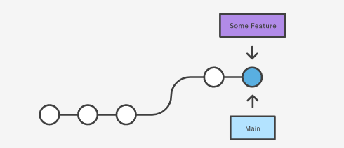
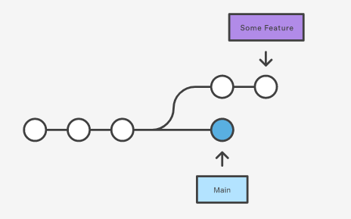
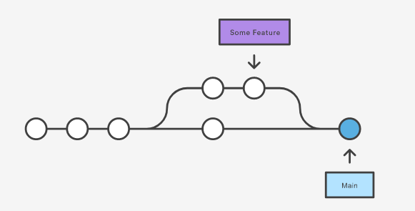
Merge types
Fast forward merge
3-way merge
https://www.atlassian.com/git/tutorials/using-branches/git-merge

Slide 28
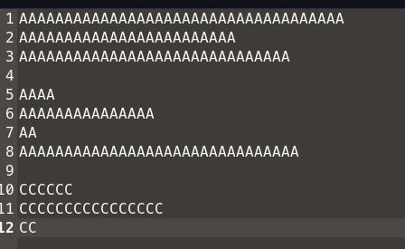
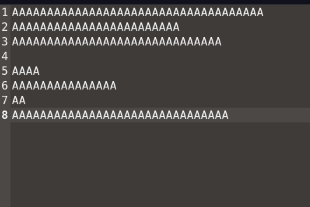
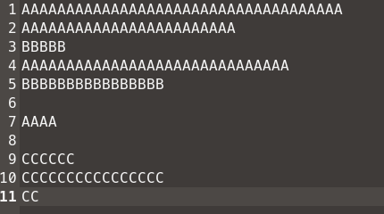
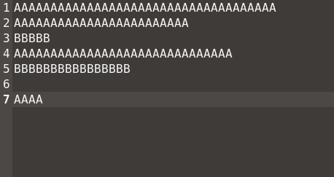
Git knows what’s best
Git is very powerful
Git will solve most code merging problems for you!
MAIN
Common ancestor commit
Merge
New branch

Slide 29
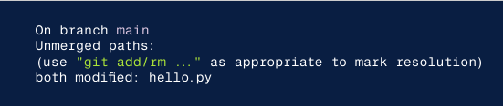
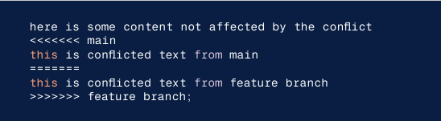
Merge conflicts
Git detects when a merging branch has changed the same file in the same place as the current branch
Enter merge conflict mode
  → Uses familiar add + commit workflow
Visual markers in conflicted files: <<<<<<<, =======, and >>>>>>>
Fix conflicted sections manually
Git add
Git commit
https://www.atlassian.com/git/tutorials/using-branches/git-merge

Slide 30
terminal vs GUI

Slide 31
GUI clients
GitHub desktop (Windows, macOS)
GitKraken ($$$)
Many IDEs (integrated development environment) offer Git and Github integration:
  VS Code
  Pycharm
  None for RStudio

Slide 32
Terminal | GUI
Know/Look up commands → Granular control | Given command operations → Limited control
Terminal takes getting used to | Pretty interface
Oftentimes slower navigation | Oftentimes faster navigation
Forces you to learn Git | You can survive by knowing the basics

Slide 33
Example workflows

Slide 34
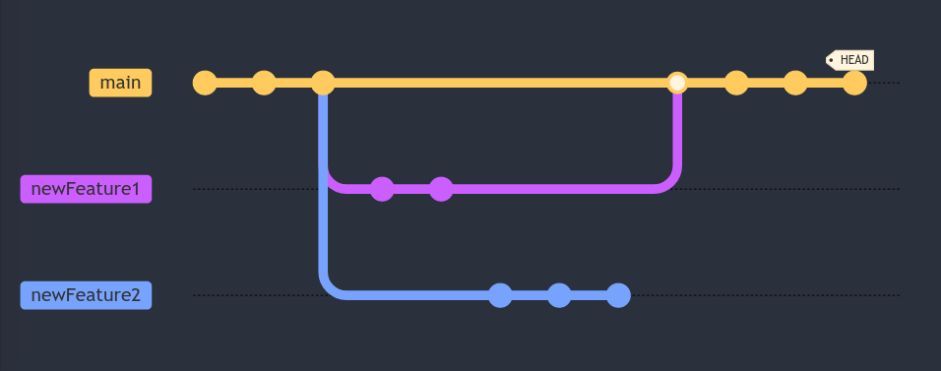
Example workflows
Work on MAIN
  → Test new changes in branches and then merge
Keep MAIN untouched
  → Work always on branches until ripe then merge

Slide 35
Tips ‘n tricks

Slide 36
Time travel safely
Rest assured: git is very clever and won’t let you be reckless
Save/Backup your data
    git commit → git reset -i
    git stash
    git branch
    Duplicate entire repository → before major actions
Never work in a detached HEAD state

Slide 37
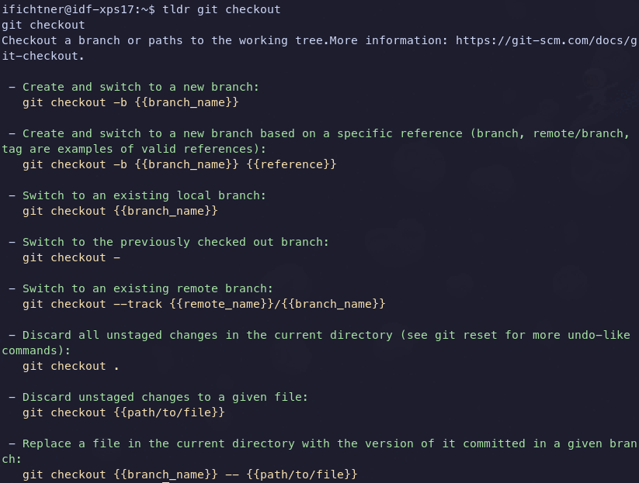
Install `tldr package`
on UNIX-based OS
for quick help

Slide 38
Time travelling
Untracked files will follow you around to anywhere
> git checkout [branch] – [file]
Bring individual files from other commits to your working tree

Slide 39
Miscellaneous
> git add [--interactive | -i]
Select what to do with individual files
> git checkout -b [newBranchName]
Create a new branch and move to it

Slide 40
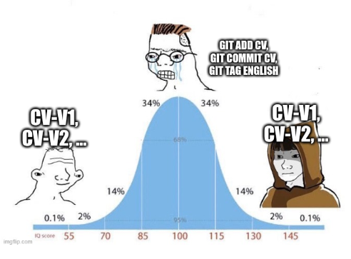
Git is a state of mind
Start to rely less on where files are and more on keywords that you define every time you make a new branch or tag
  Easier navigation
  Focus on the work and less on `Where is this one file or code that I wrote two days ago?`
Only use it where it makes sense

Slide 41
Practical session part 2:
Handle some merge conflicts

