Slide 1

DexPool from DigiU
dex and auto
Crosschain decentralized exchange
Multichain liquidity pool

Slide 2
Problem
Poor user experience when moving assets through blockchains
Absence of trully decentralized exchanges
Liquidity is stack on isolated chains

Slide 3
Solution
Build dex with possibility to swap assets between chains with less user effort
Create chain independent liquidity
t
Use existing cross-chain production ready solutions to integrate chains ( chainlink )
Adopt Metamask to connect two chains same time

Slide 4
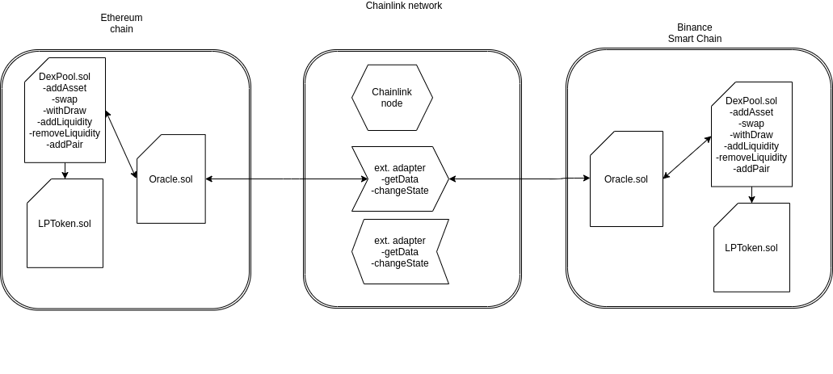

Slide 5
BlockchainLab@DigiUhttps://digiu.ai/
Boris Povar
Sergey Pylypiv
Alexandr Atroshchenko
Bogdan Sivochkin

