Slide 1
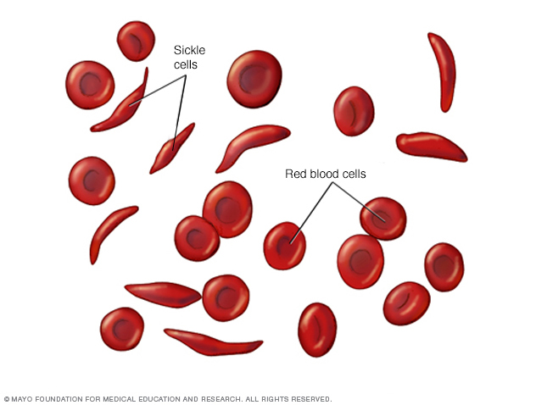
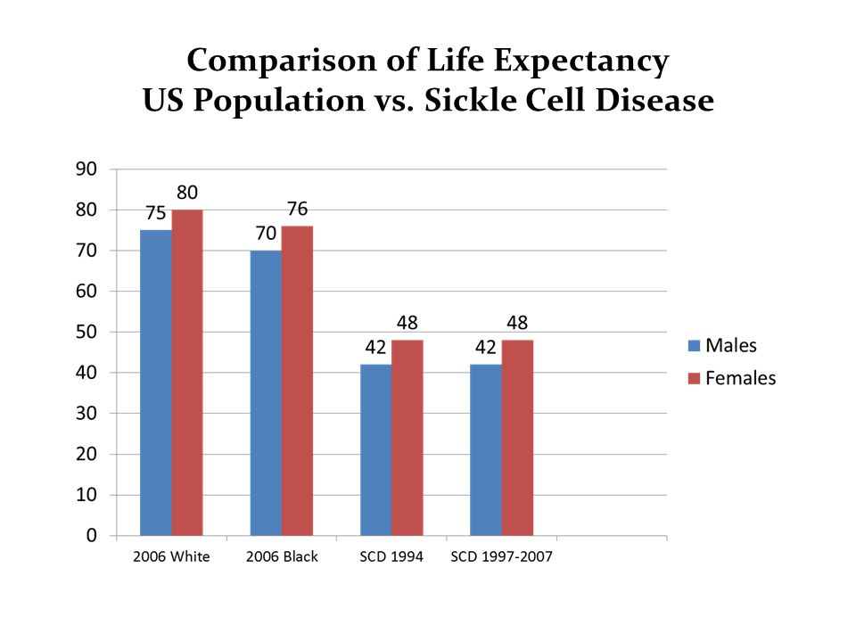

SICKLE CELL ANEMIA
What is Sickle Cell Anemia?
Sickle Cell anemia is a mutation of the blood inherited from birth. An abnormal hemoglobin causes sickled/distorted red blood cells. The sickled/distorted red blood cells are fragile and are at a high risk of rupture, which in turn will cause unwanted side effects, due to a low blood cell count.
How to test for Sickle Cell anemia?
Blood is drawn from veins for adults or a finger or heel for children. They take that blood sample and test for hemoglobin S, the defective form of hemoglobin. If you have hemoglobin S, then you will be diagnosed with sickle cell anemia.
How you get Sickle Cell anemia?
Sickle Cell Anemia Prognosis
If you inherit the sickle cell gene from both of your parents, then you will get the disease. If you inherit one sickle cell gene, then you are a carrier of it and could possible pass it down to one of your offspring.
A person with sickle cell anemia automatically has a lower life expectancy. Look at the comparison below of life expectancy between US Population vs. Sickle Cell Anemia. They die quicker because they are more prone to diseases.
Treatment
Bone Marrow Transplant
Vaccinations: Because of the high risk of infection.
Blood Transfusions: Replaces red blood cells
Symptoms of Sickle Cell anemia
Episodes of pain
Painful swelling of hands and feet
Frequent infections
Delayed growth
Vision Problems
Permanent Cures
There is one way to get rid of sickle cell anemia and that is a bone marrow transplant. The death risk is very high with this procedure. Usually they only do the transplant on people younger that 16. The older you get decreases your chance of surviving the procedure.
Contact
References
Ian Gregory, Eric Harkness, Jennifer Hopkins, and Matthew Knieling
Putnam County Health Department
pchealth@fakemail.com
www.putnamcountytnhealthdept.com/
931-555-5555
www.medicinenet.com/sickle_cell/article.htm
www.mayoclinic.org/diseases-conditions/sickle-cell-anemia/diagnosis-treatment/drc-20355882

