Slide 1
TEST – DRIVEN
DEVELOPMENT

Slide 2
Contents
Origin.
Introduction
Cost of development
Cost of fixing faults
What is TDD?
What Can be Tested?
Aspects of TDD
Methodology
TDD Stages
TDD Life Cycle
Advantages of TDD
Disadvantages of TDD
Example
Other Techniques of TDD

Slide 3
Origin
Test-Driven Development is a core part of the agile process formalized by Kent Beck called eXtreme Programming (XP).
XP originally had the rule to test everything that could possibly break. Now, however, the practice of testing in XP has evolved into Test-Driven Development.
Do not need to adopt XP in order to practice TDD and gain the benefit from it.

Slide 4
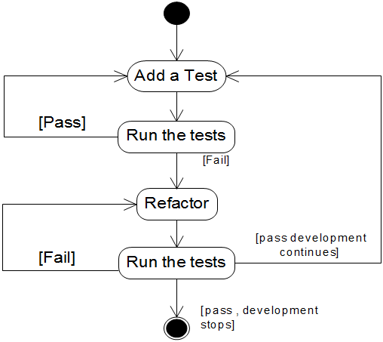
Introduction to TDD

Slide 5
Introduction
Traditional Approach
  Test last
Problems with Traditional
  Errors in production
  Programmer moves onto other projects
  Test and code written by different programmers
  Tests based on outdated information
  Infrequent testing
  Fixes that create other problems

Slide 6
Test Driven Development
Test-driven development (TDD), also called test-driven design, is a method of software development in which unit testing is repeatedly done on source code.
The concept is to "get something working now and perfect it later."
After each test, refactoring is done and then the same or a similar test is performed again.
The process is iterated as many times as necessary until each unit is functioning according to the desired specifications.
Test-driven development is part of a larger software design paradigm known as Extreme Programming (XP).

Slide 7
Cost of development
Cost
Time
Traditional
TDD
Notes:
Turnover in people
Increase in complexity due to interactions between components of the system

Slide 8
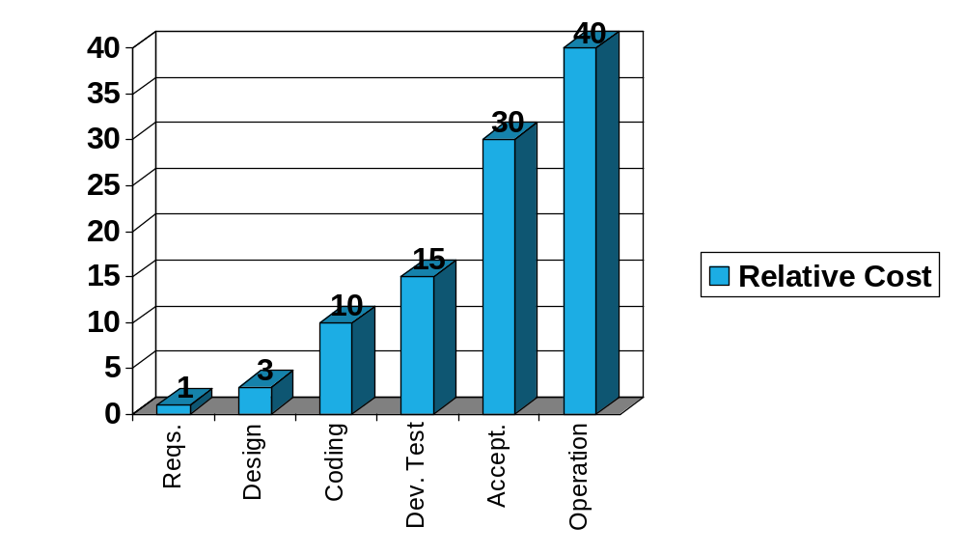
Cost of fixing faults
Notes:
These were the minimum ratios, the maximum was 1000 to 1 between operation and requirements phases!
Absolute costs are usually significantly greater than expected for faults found especially in the Operation phase (figures of $10,000 - $150000 are often quoted by organisations such as HP). Do you know what the typical rework cost (time/money) is for a fault reported by users in the field? It is these costs and those associated with rework from dynamic testing that are significantly reduced by using reviews - a static testing technique that is also more efficient at finding faults than dynamic testing in terms of faults found per hour of testing.

Slide 9
What is TDD?
TDD is a technique whereby you write your test cases before you write any implementation code
  Forces developers to think in terms of implementer and user
Tests drive or dictate the code that is developed
  “Do the simplest thing that could possibly work”
    Developers have less choice in what they write
An indication of “intent”
  Tests provide a specification of “what” a piece of code actually does – it goes some way to defining an interface
  Some might argue that “tests are part of the documentation”
  Could your customers/clients write tests?

Slide 10
What is TDD?
“Before you write code, think about what it will do.
Write a test that will use the methods you haven’t even written yet.”
A test is not something you “do”, it is something you “write” and run once, twice, three times, etc.
  It is a piece of code
  Testing is therefore “automated”
  Repeatedly executed, even after small changes
“TDD is risk averse programming, investing work in the
near term to avoid failures later on”

Slide 11
What Can be Tested?
Valid Input
In-valid Input
Exceptions
Boundary Conditions
Everything that should be possible break.

Slide 12
Aspects of TDD
Features
  High level user requirements
  User story
Customer Tests
  Customer identified acceptance tests
Developer Tests
  Tests developed during software construction

Slide 13
Methodology
Test first – Code last
  You may not write production code unless you’ve first written a failing unit test
Test more – Code more
  You may not write more of a unit test than is sufficient to fail
Test again – Code again
  You may not write more production code than is sufficient to make the failing unit test pass

Slide 14
TDD Stages
Write a test
Refactor code
(and test)
Compile
Run test,
watch it pass
Fix compile errors
Write code
Run test,
watch it fail

Slide 15
TDD Stages
The Extreme Programming Explored , Bill Wake describes the test cycle:
Write a single test
Compile it. It shouldn’t compile because you’ve not written the implementation code
Implement just enough code to get the test to compile
Run the test and see it fail
Implement just enough code to get the test to pass
Run the test and see it pass
Refactor for clarity and “once and only once”
Repeat

Slide 16
Life Cycle
Write Test
Compile
Refactor As Needed
Run & See the Fail

Slide 17
Why does TDD work?
The (sometimes tedious) routine leads the programmers to think about details they otherwise don’t (because they’ve bitten off more than they can chew)
Specifically, test cases are thought through before the programmer is allowed to think about the “interesting part” of how to implement the functionality
Encourages “divide-and-conquer”
Programmers are never scared to make a change that might “break” the system
The testing time that is often squeezed out of the end of a traditional development cycle cannot be squeezed out.

Slide 18
Advantages of TDD
TDD shortens the programming feedback loop
TDD promotes the development of high-quality code
User requirements more easily understood
Reduced interface misunderstandings
TDD provides concrete evidence that your software works
Reduced software defect rates
Better Code
Less Debug Time.

Slide 19
Disadvantages of TDD
Programmers like to code, not to test
Test writing is time consuming
Test completeness is difficult to judge
TDD may not always work

Slide 20
Example
We want to develop a method that, given two Integers, returns an Integer that is the sum of parameters.

Slide 21
Example (cont.)
Test
Integer i =
new Integer(5);
Integer j =
new Interger(2);
Object o = sum(i,j);
Method

Slide 22
Example (cont.)
Test
Integer i =
new Integer(5);
Integer j =
new Interger(2);
Object o = sum(i,j);
Method
public static Object sum(Integer i,
Integer j) {
return new Object();
}

Slide 23
Example (cont.)
Test
Integer i =
new Integer(5);
Integer j =
new Interger(2);
Object o = sum(i,j);
if (o instanceof
Integer)
return true;
else
return false;
Method
public static Object sum(Integer i,
Integer j) {
return new Object();
}

Slide 24
Example (cont.)
Test
Integer i =
new Integer(5);
Integer j =
new Interger(2);
Object o = sum(i,j);
if (o instanceof
Integer)
return true;
else
return false;
Method
public static Integer sum(Integer i,
Integer j) {
return new Integer();
}

Slide 25
Example (cont.)
Test
Integer i =
new Integer(5);
Integer j =
new Interger(2);
Object o = sum(i,j);
if ((o instanceof
Integer) &&
((new Integer(7))
.equals(o))
return true;
else
return false;
Method
public static Integer sum(Integer i,
Integer j) {
return new Integer();
}

Slide 26
Example (cont.)
Test
Integer i =
new Integer(5);
Integer j =
new Interger(2);
Object o = sum(i,j);
if ((o instanceof
Integer) &&
((new Integer(7))
.equals(o))
return true;
else
return false;
Method
public static Integer sum(Integer i,
Integer j) {
return new Integer(
i.intValue() +
j.intValue());
}

Slide 27
Other Techniques of TDD

Slide 28
Technique 1
Identify a “smallest possible” change to be made
Implement test and (the one line of) code for that change (see previous slide)
Run all tests
Save test and code together in source control system
Repeat

Slide 29
Technique 2
Test and implement a low-level function (using previous Techniques)
Test and implement a higher-level function that invokes the lower-level function
Test all the logic in the higher-level function as expected; use as many tests as necessary
Include one test that convinces you that the higher-level function called the lower-level one

Slide 30
Technique 3
Build higher- and higher-level tests
Build tests that represent user actions such as entering a piece of data and hitting “OK”
Build tests that string together a series of user actions that represent Acceptance Test cases
Demonstrate the Acceptance Tests to the user(s) regularly

Slide 31
Conclusion
More code has to be written using TDD but that isn’t the bottleneck in Software Development
Techniques have to be learned by developers and enforced by managers
User Interface testing is the hardest
Resulting unit tests most valuable when run as part of an automated build process

