Slide 1
CLASSIFICATION TREE METHOD

Slide 2
Objective
Generating error-sensitive, low redundancy set of test case specifications.
High probability to detect a fault in the test object.
This method is applicable for both White box and black box kind of testing.
The input for this method is functional specification of the test object
CTM incorporates several well-known approaches for test case specification, e.g. equivalent partitioning, and boundary value analysis

Slide 3
Example - CTM
Consider systems that measures distances in a range of some meters,e.g. the distance to a wall in a room.
In this kind of system, a radar or sonar is used to send a signal and measure the time taken to receive the reflected signal.
In sonar system temperature of the room will influence the calculation, for different temperature values testing will be done
Temperature is a test relevant object.
But for radar systems temperature is not a test relevant aspect.

Slide 4
Classification of values
Each test relevant aspect may take different set of values
The values are divided into classes according to the equivalence partitioning method.
Values assigned to same class are said to be Equivalent for the test behavior of the test object will be same for all the values of that class.

Slide 5
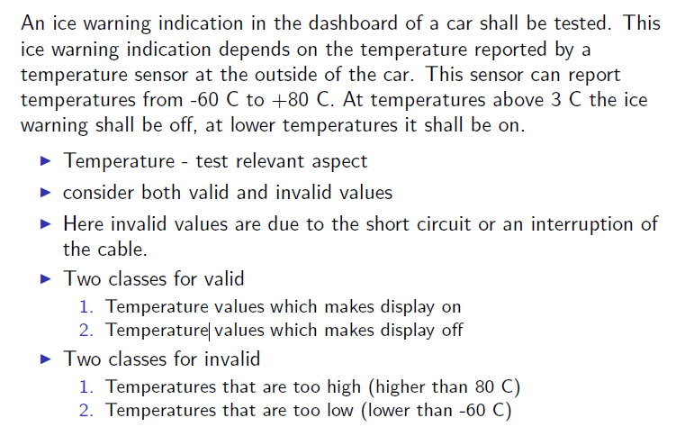

Slide 6
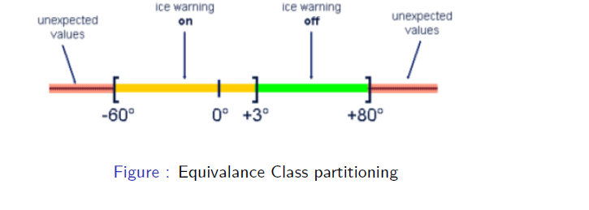

Slide 7
Repeated Equivalence Partitioning
An equivalence class can be sub-divided according to additional aspects.
It reduces complexity, each class is considered individually and sub-divided if it is needed.
In the above example no consideration is for sign of the temperature
To avoid this consequence, divide the class further according to the sign of the temperature.

Slide 8
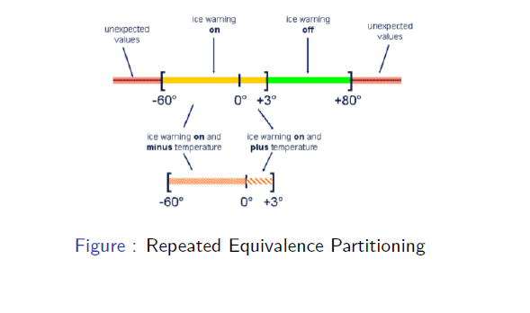

Slide 9
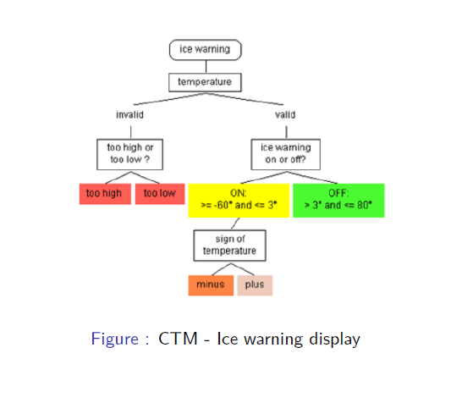

Slide 10
THANKU

