Slide 1
Technical Writing formal reports
Instructor:
Dr. Mohammad Abdel-Majeed

Slide 2
formal reports
Formal reports presented in special way to emphasis the importance of their contents.
Formal reports are used to present recommendations or results of research, perceived importance to the community and company policy.
The difference between formal and informal reports is in the changed perception caused by the formal presentation.

Slide 3
Informal vs formal reports
Elements unique to the formal report are
the front material
the method of presenting the body.
Other elements—appendixes, reference sections, introductions, conclusions, and recommendations—are often associated with the formal report but do not necessarily make the report formal;

Slide 4
Elements of formal reports
Elements for formal reports are used to orient readers to the report’s topics and organization
Front material
Presenting the body of the report
Ending material

Slide 5
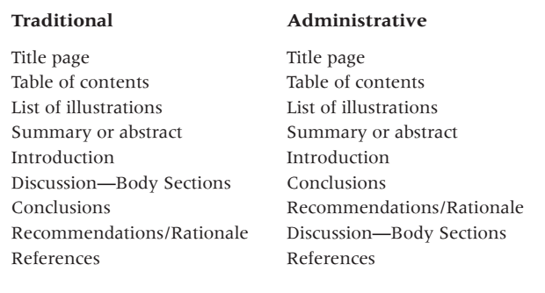
formal reports

Slide 6
Elements of formal reports
1. Front material
transmittal correspondence is a memo or letter that directs the reports to someone. The memo is internal , the letter is external.
The correspondence contains :
The title of the reports
A statement ( if requested)
The purpose and scope of the report
An explanation of problem encountered
Acknowledgement

Slide 7
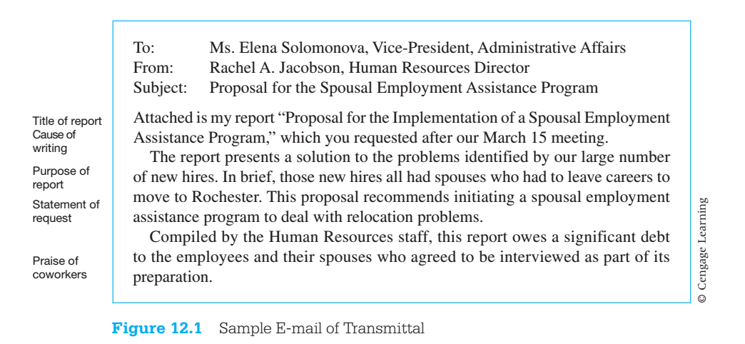

Slide 8
Elements of formal reports
Front material
Title page
Place all the elements at the left margin (ANSI). (Center all the elements if local policy insists.)
Name the contents of the report in the title.
Use either all caps or initial caps and lowercase letters; use boldface when appropriate. Do not use “glitzy” typefaces, such as outlined or cursive fonts.
Include the writer’s name and title or department, the date, the recipient’s name and title or department, and a report number (if appropriate).

Slide 9
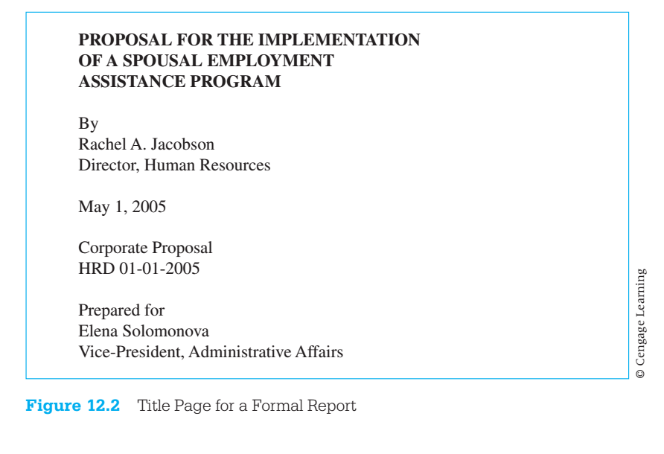
Elements of formal reports
Front material
Title page

Slide 10
Elements of formal reports
Front material
Title page
Table of contents
Title the page Table of Contents.
Present the name of each section in the same wording and format as it appears in the text. If a section title is all caps in the text, place it in all caps in the table of contents.
Do not underline in the table of contents; the lines are so powerful that they overwhelm the words.
Do not use “page” or “p.” before the page numbers.
Use only the page number on which the section starts.
Set margins so that page numbers align on the right.
Present no more than three levels of heads; two is usually best.
Use leaders, a series of dots, to connect words to page numbers.

Slide 11
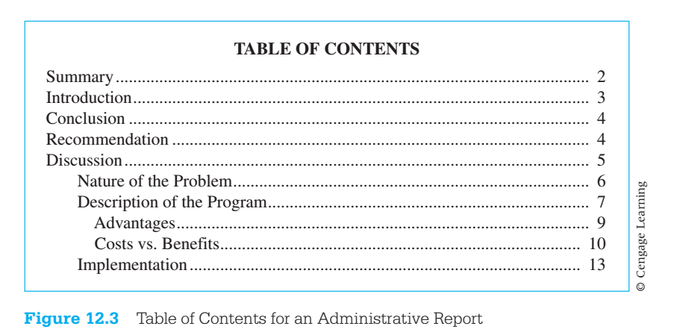
Elements of formal reports
Front material
Title page
Table of contents

Slide 12
Elements of formal reports
Front material
Title page
Table of contents
3. List of illustrations
Use the title List of Illustrations if it contains both figures and tables; list figures first, then tables.
If the list contains only figures or only tables, call it List of Figures or List of Tables.
List the number, title, and page of each visual aid.
Place the list on the most convenient page. If possible, put it on the same page as the table of contents.

Slide 14
Elements of formal reports
Front material
Title page
Table of contents
List of illustrations
4. Summary or Abstract
The report’s purpose and the problem it addresses.
The conclusions.
The major facts on which the conclusions are based.
The recommendations.

Slide 15
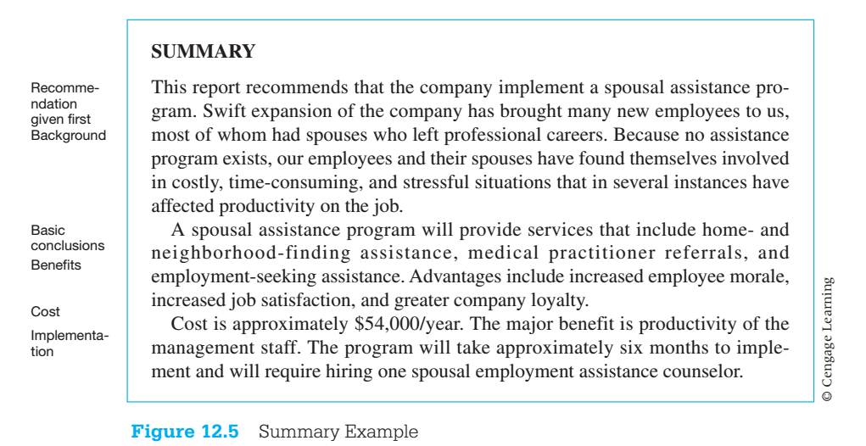

Slide 16
Elements of formal reports
Front material (cont.)
5. Introduction
Purpose statement
State the purpose clearly. Use one of two forms: “The purpose of this report is to present the results of the investigation” or “This report presents the results of my investigation.”
Use the present tense.
Name the alternatives if necessary.
Scope statement: scope statement reveals the topics covered in a report. Follow these guidelines:
In feasibility and recommendation reports, name the criteria; include statements explaining the rank order and source of the criteria.
In other kinds of reports, identify the main sections, or topics, of the report.
Specify the boundaries or limits of your investigation.
Procedure statement(Methodology statement)
Explain all actions you took: the people you interviewed, the research you performed, the sources you consulted.
Write this statement in the past tense.
Select head for each section
Background statement

Slide 19
Elements of formal reports
Front material (cont.)
6. Conclusions and Recommendations
Writers may place these two sections at the beginning of the report or at the end.
Choose the beginning if you want to give readers the main points first and if you want to give them a perspective from which to read the data in the report.
Choose the end if you want to emphasize the logical flow of the report, leading up to the conclusion.
In many formal reports, you present only conclusions because you are not making a recommendation.

Slide 20
Elements of formal reports
Front material (cont.)
Conclusions and Recommendations
Conclusions
Relate each conclusion to specific data. Don’t write conclusions about material you have not discussed in the text.
Use concise, numbered conclusions.
Keep commentary brief.
Add inclusive page numbers to indicate where to find the discussion of the conclusions

Slide 21
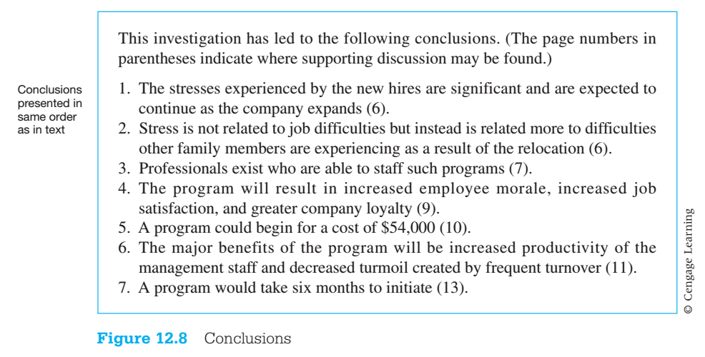

Slide 22
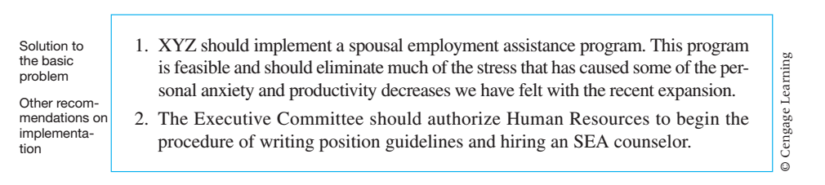
Elements of formal reports
Front material (cont.)
6. Conclusions and Recommendations
Conclusions
Recommendations
Number each recommendation.
Make the solution to the problem the first recommendation.
If the rationale section is brief, add it to the appropriate recommendation.
If the rationale section is long, make it a separate section.

Slide 23
Elements of formal reports
2. Body of the formal report
Pagination
Indicating chapter divisions
Laying out pages (ch 6 covers different column formats)

Slide 24
Elements of formal reports
Body of the formal report
Paginating
Assign a number to each piece of paper in the report, regardless of whether the number actually appears on the page.
Assign a page number to each full-page table or figure.
Place the numbers in the upper right corner of the page with no punctuation, or center them at the bottom of the page either with no punctuation or with a hyphen on each side (-2-).
Consider the title page as page 1. Do not number the title page. Most word processing systems allow you to delete the number from the title page.
In very long reports, use lowercase roman numerals (i, ii, iii) for all the pages before the text of the discussion. In this case, count the title page as page i, but do not put the i on the page. On the next page, place a ii.
Paginate the appendix as discussed in “End Material” (later).
Use headers or footers (phrases in the top and bottom margins) to identify the topic of a page or section.

Slide 25
Elements of formal reports
Body of the formal report
Paginating
Use Chapter Divisions
To make the report “more formal,” begin each new major section at the top of a page (see Example 12.2, which starts on p. 373).

Slide 26
Elements of formal reports
End Material: The end material (glossary and list of symbols, references, and appendixes) is placed after the body of the report.
Glossary and List of symbols
Place each term at the left margin, and start the definition at a tab (two or three spaces) farther to the right. Start all lines of the definition at this tab.
Alphabetize the terms
References
The list of references (included when the report contains information from other sources) is discussed along with citation methods in Appendix B.
Appendix
Refer to each appendix item at the appropriate place in the body of the report.
Number illustrations in the appendix in the sequence begun in the body of the report.
For short reports, continue page numbers in sequence from the last page of the body.
For long reports, use a separate pagination system. Because the appendixes are often identified as Appendix A, Appendix B, and so on, number the pages starting with the appropriate letter: A-1, A-2, B-1, B-2.

