Slide 1
Virtual Presentation - Computer Vision
By : Harsh V. Siddhapura

Slide 2
TABLE OF CONTENTS
Introduction
Aim of the system
Background Details
Language and Modules
Selecting the Project Development Strategy – Iterative Model
Iterative Model – Diagram
DFD (Data Flow Diagram)
Activity Diagram
Input / Output Design
Testing Approach Use
Testing Cases
Limitation of system
Future Scope of System
Bibliography

Slide 3
1. Introduction

Slide 4
Project Description
Project Title : Virtual Presentation - Computer Vision
Institution : Smt.K.B Parekh College of Computer Science.
Language : Python.
Front End Tools : Tkinter , TTKBootstrap.
Back End Tools : CVZone, Mediapipe.
System : Windows 11.

Slide 5
2.Project Introduction

Slide 6
ABOUT PROJECT
The aim of this project is to ease the present the presentations to all the users, it will reduce the efforts of changing slides by an single signal of hand of speaker.
This software gives power in hand of speaker and so he can easily change the slides.
It will reduce the bad expression moments of speaker and so he is able to see himself during speech so it will train him just like he trained in front of mirror practice.
To highlight details in slide will also do by user so he can highlight by fingers and erase it also.
It gives confidence to perform in stage. You can also abstract the images in .png format from.PPTX and from .PDF files.
You can also reuse the old presentation stored in your temp-data folder so it will launch again for presentation.

Slide 7
OBJECTIVES OF SYSTEM:
Easy to Control Slides
Total Control in users hand
Handy Operates
Works on Hand Detection
Use Computer Vision
Converts the File to PNG Format for good resolution.

Slide 8
Non – Functional Requirements
Convert PPTX or PDF files to PNG Image files.
Create a folder and rename file in sequence implicitly while opening the presentation window.

Slide 9
Functional Requirements
To operate presentation in way of user wants to present.
Total control of presentation should be in the hand of speaker.
Use of Computer Vision abilities and webcam of computer or external camera.
A GUI (Graphical User Interface) from Interaction with Files and operate useful and useless presentation files.

Slide 10
Hardware Specifications
2 GB+ RAM
Win 7 + version
Web Cam or Camera
PPTX or PDF files

Slide 11
Software Specifications
Python 3.10+ version
mediapipe==0.8.11
numpy==1.24.2
cvzone==1.5.6
pdf2image==1.15.1
Pillow==9.4.0
ttkbootstrap==1.10.1
Virtualenv
pywin32==305
Poppler-23.01.0

Slide 12
Python
Python is a high-level, general-purpose programming language. Its design philosophy emphasizes code readability with the use of significant indentation.
Python is dynamically typed and garbage-collected. It supports multiple programming paradigms, including structured (particularly procedural), object-oriented and functional programming. It is often described as a "batteries included" language due to its comprehensive standard library.
Guido van Rossum began working on Python in the late 1980s as a successor to the ABC programming language and first released it in 1991 as Python 0.9.0.[36] Python 2.0 was released in 2000. Python 3.0, released in 2008, was a major revision not completely backward-compatible with earlier versions. Python 2.7.18, released in 2020, was the last release of Python 2.
Python consistently ranks as one of the most popular programming languages.

Slide 13
Iterative Model
As per the requirement of the project, I have decided to select the Iterative Model as a strategy of developing the project, because as the project stands alone and it needed to change and maintain the paths of system frequently so I decided to go with Iterative Model.
In this Model, I can start with some of the software specifications and develop the first version of the software. After the first version if there is a need to change the software, then a new version of the software is created with a new iteration. Every release of the Iterative Model finishes in an exact and fixed period that is called iteration.
In this project I had created different models of this project in separate files and the combine at developing phase, wherever I need to change I can easily change in module and try in different way to test the model, so it become lengthy but also easy to understand the flow of data and rectify the errors.

Slide 14
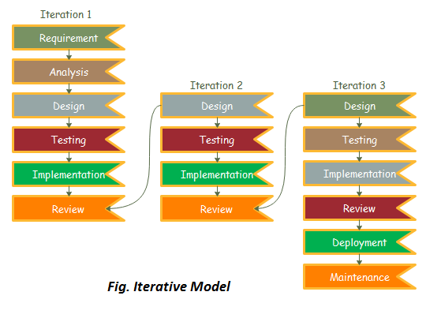
Iterative Model – Diagram

Slide 15
DFD (Data Flow Diagram)
Data Flow Diagram (DFD) is a graphical representation of data flow in any system. It is capable of illustrating incoming data flow, outgoing data flow and store data. Data flow diagram describes anything about how data flows through the system.
Sometimes people get confused between data flow diagram and flowchart. There is a major difference between data flow diagram and flowchart. The flowchart illustrates flow of control in program modules. Data flow diagrams illustrate flow of data in the system at various levels. Data flow diagram does not have any control or branch elements.

Slide 16
Level 0 DFD
The zero level data flow diagram shows the basic way the user will get interact with the project and how he will use the software.
It is also known as a context diagram. It’s designed to be an abstraction view, showing the system as a single process with its relationship to external entities. It represents the entire system as a single bubble with input and output data indicated by incoming/outgoing arrows.

Slide 17
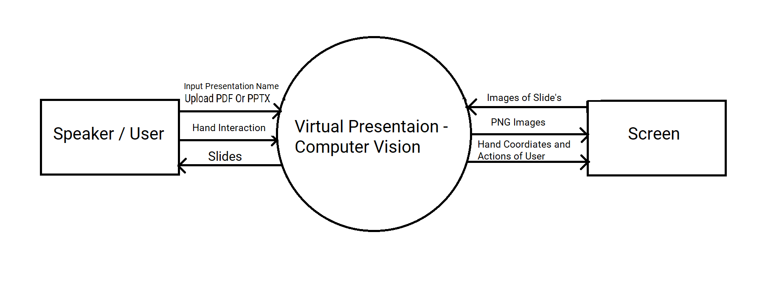
Diagram

Slide 18
Level 1 DFD
In 1-level DFD, the context diagram is decomposed into multiple bubbles/processes. In this level, we highlight the main functions of the system and breakdown the high-level process of 0-level DFD into sub-processes.
The second level DFD shows the how the implicit way it works in background and renders the slides as per the user given in the PPT or PDF file.

Slide 19
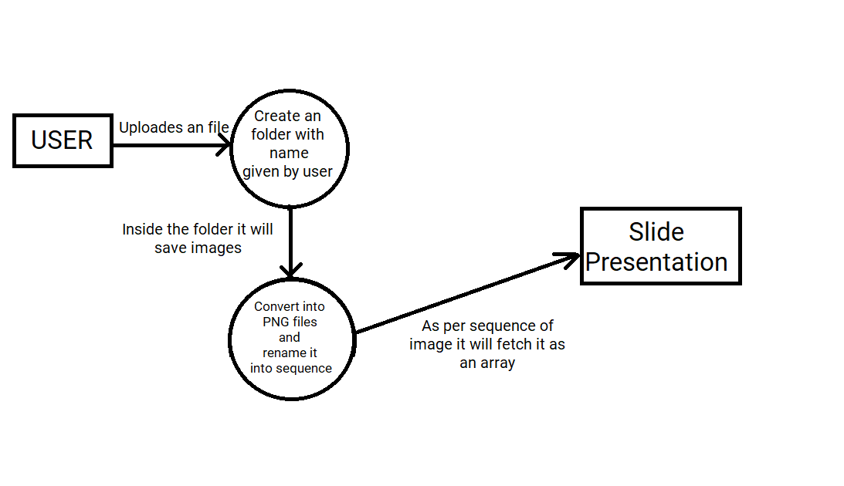
Diagram

Slide 20
Level 2 DFD
In Level 2 DFD we can easily see the total working of software in detail manner with the flow of the data.
2-level DFD goes one step deeper into parts of 1-level DFD. It can be used to plan or record the specific/necessary detail about the system’s functioning.

Slide 21
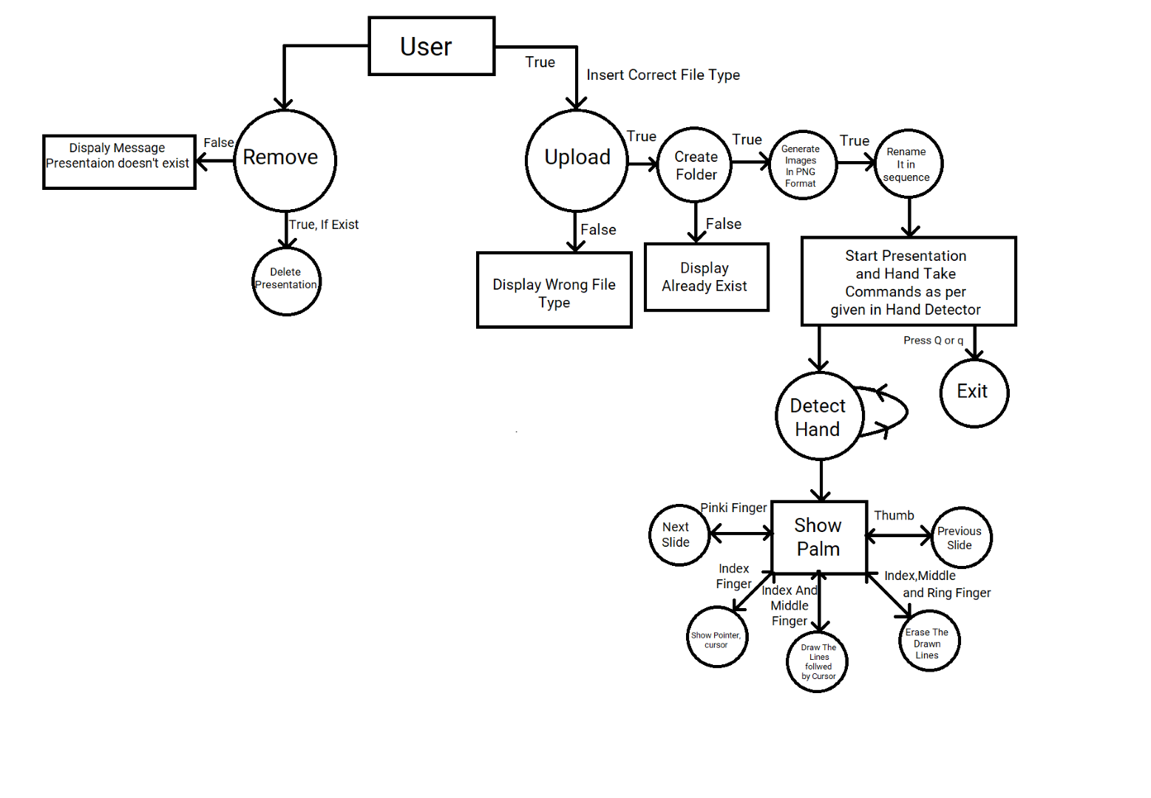
Diagram

Slide 22
Activity Diagram
Activity Diagram is basically a flowchart to represent a flow from one activity. The activity can be described as an operation of the system. The basic purpose of activity diagram is to capture the dynamic behaviour of the system. It is also called as an object-oriented flowchart.
The purpose of an activity diagram can be described as –
Draw the activity flow of a system.
Describe the sequence from one activity to another.
Describe the parallel, branched and concurrent flow of the system.

Slide 23
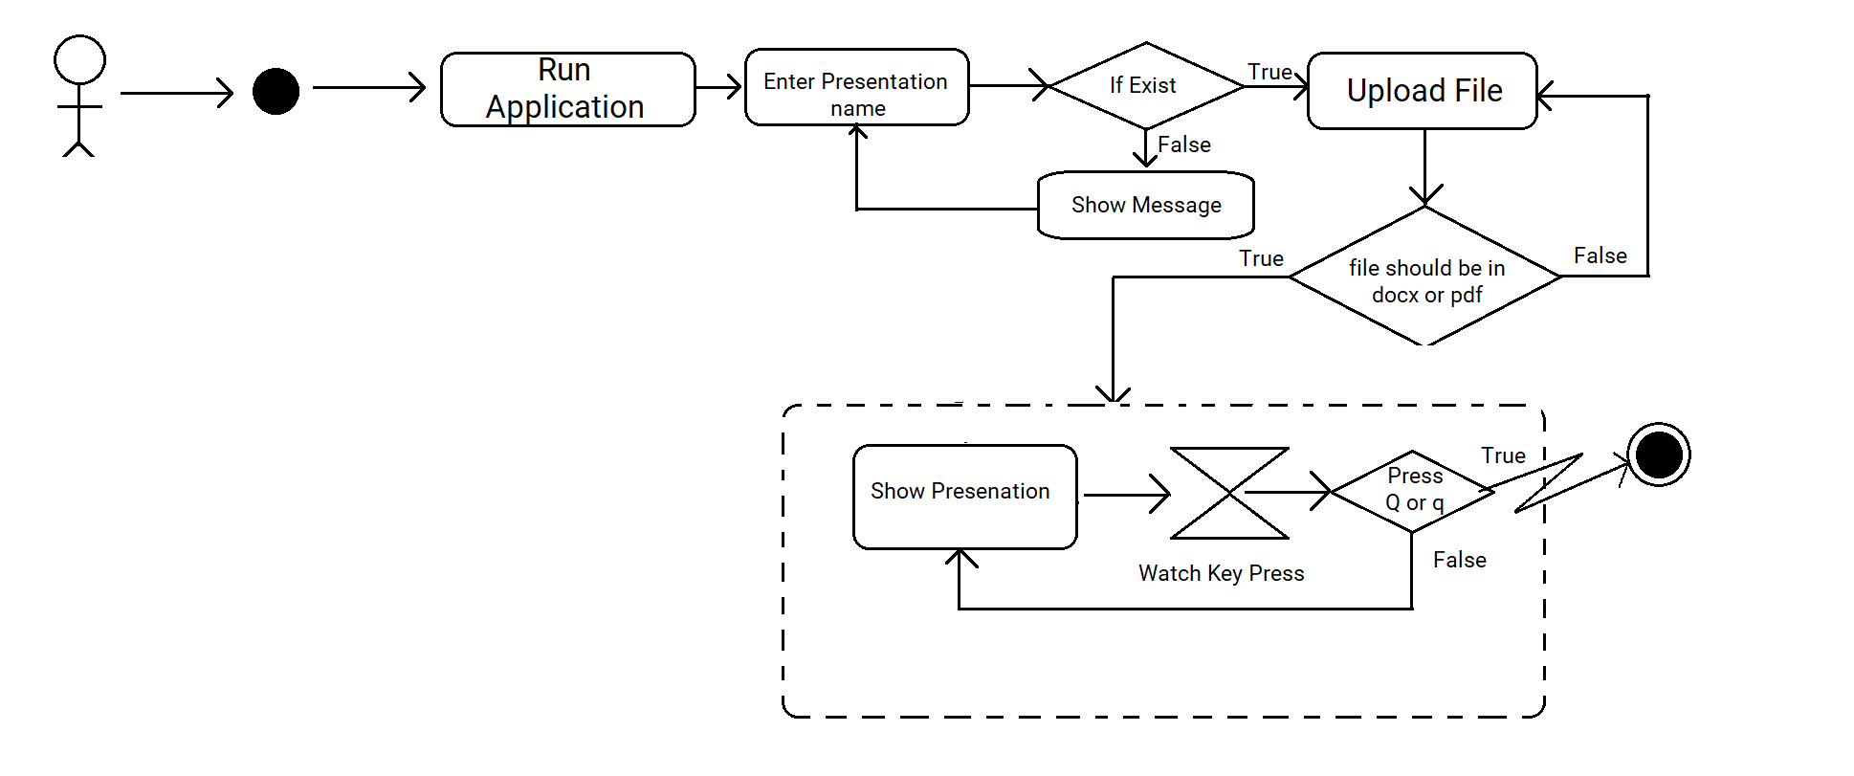
Diagram

Slide 24
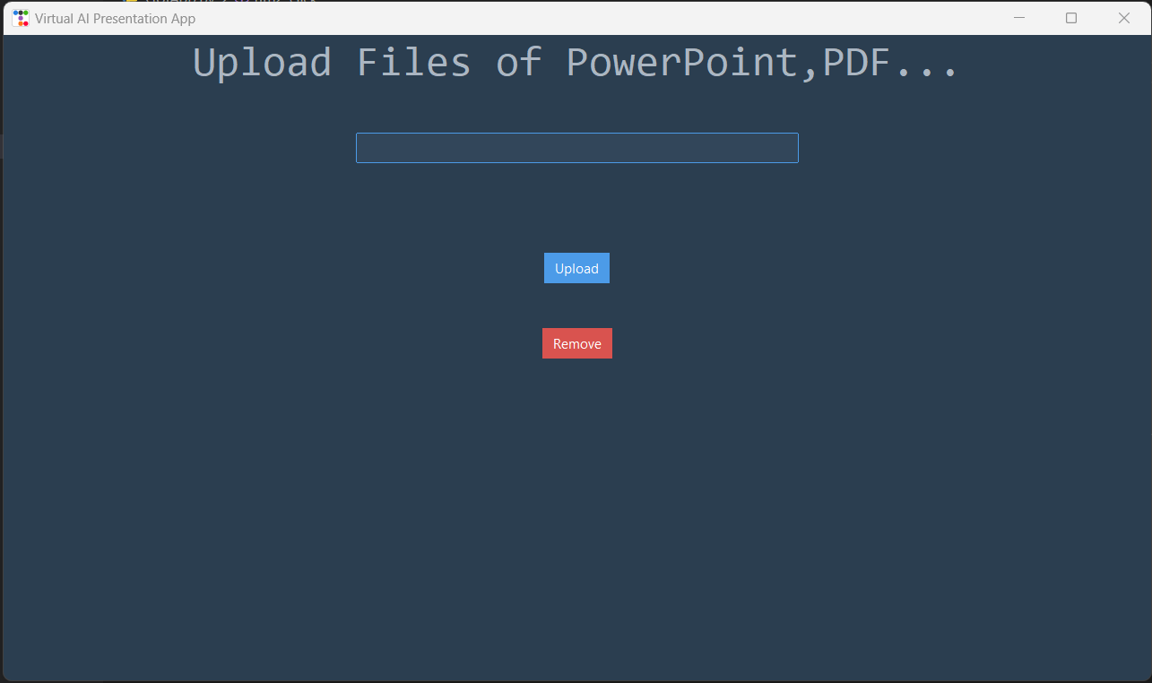
Welcome Screen.

Slide 25
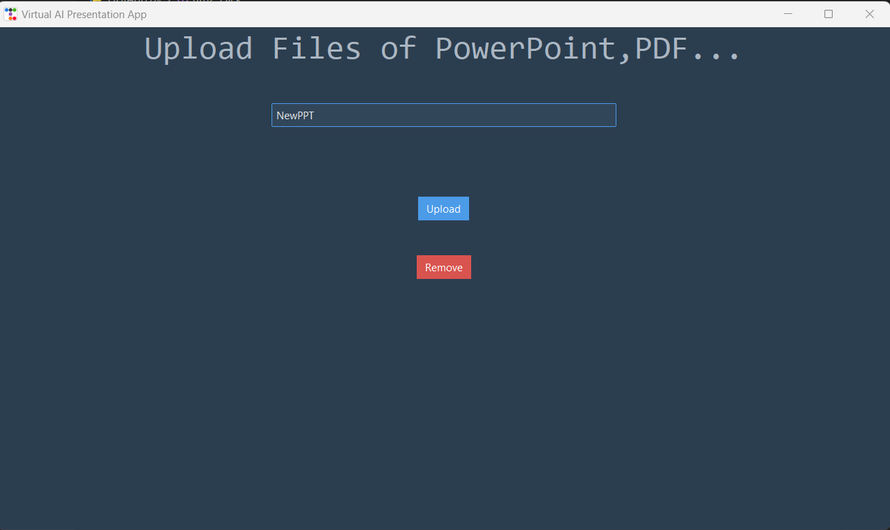
Enter Presentation name and click Upload.

Slide 26
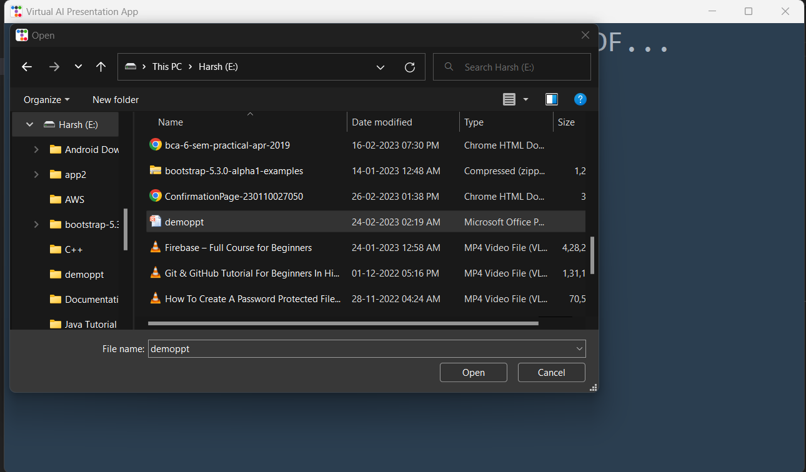
Upload file PPTX or PDF.

Slide 27
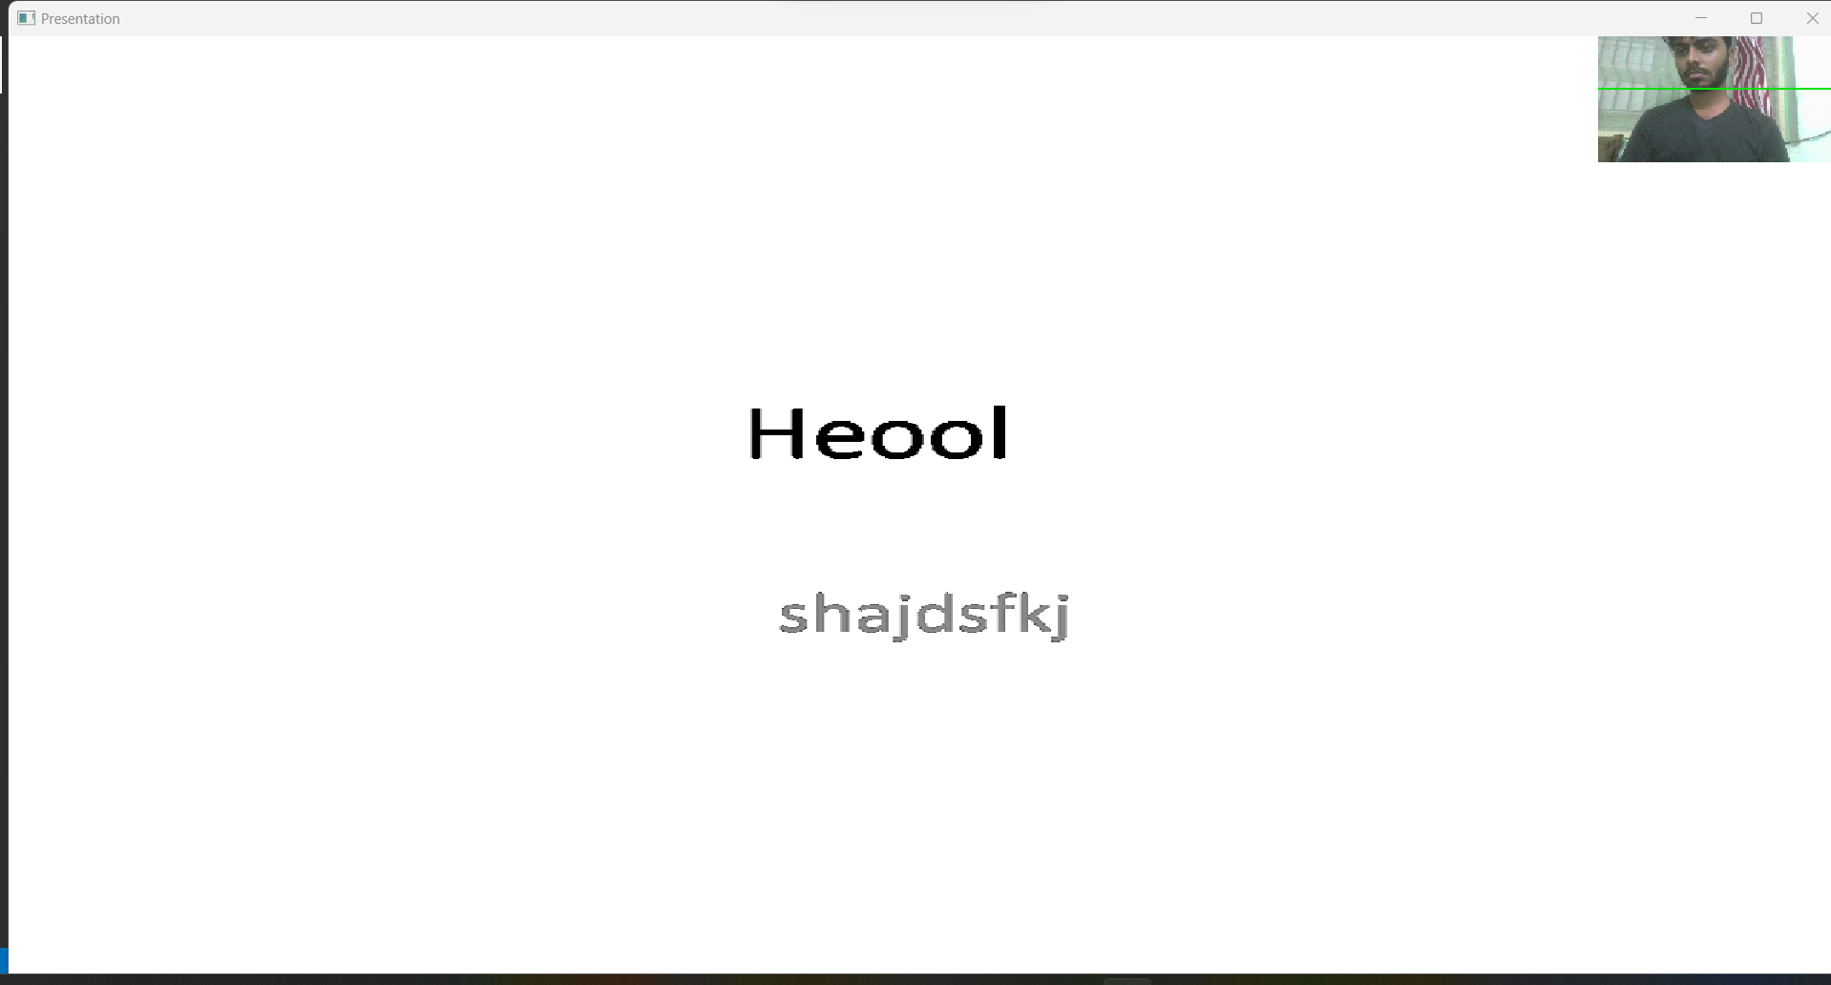
Presentation Starts.

Slide 28
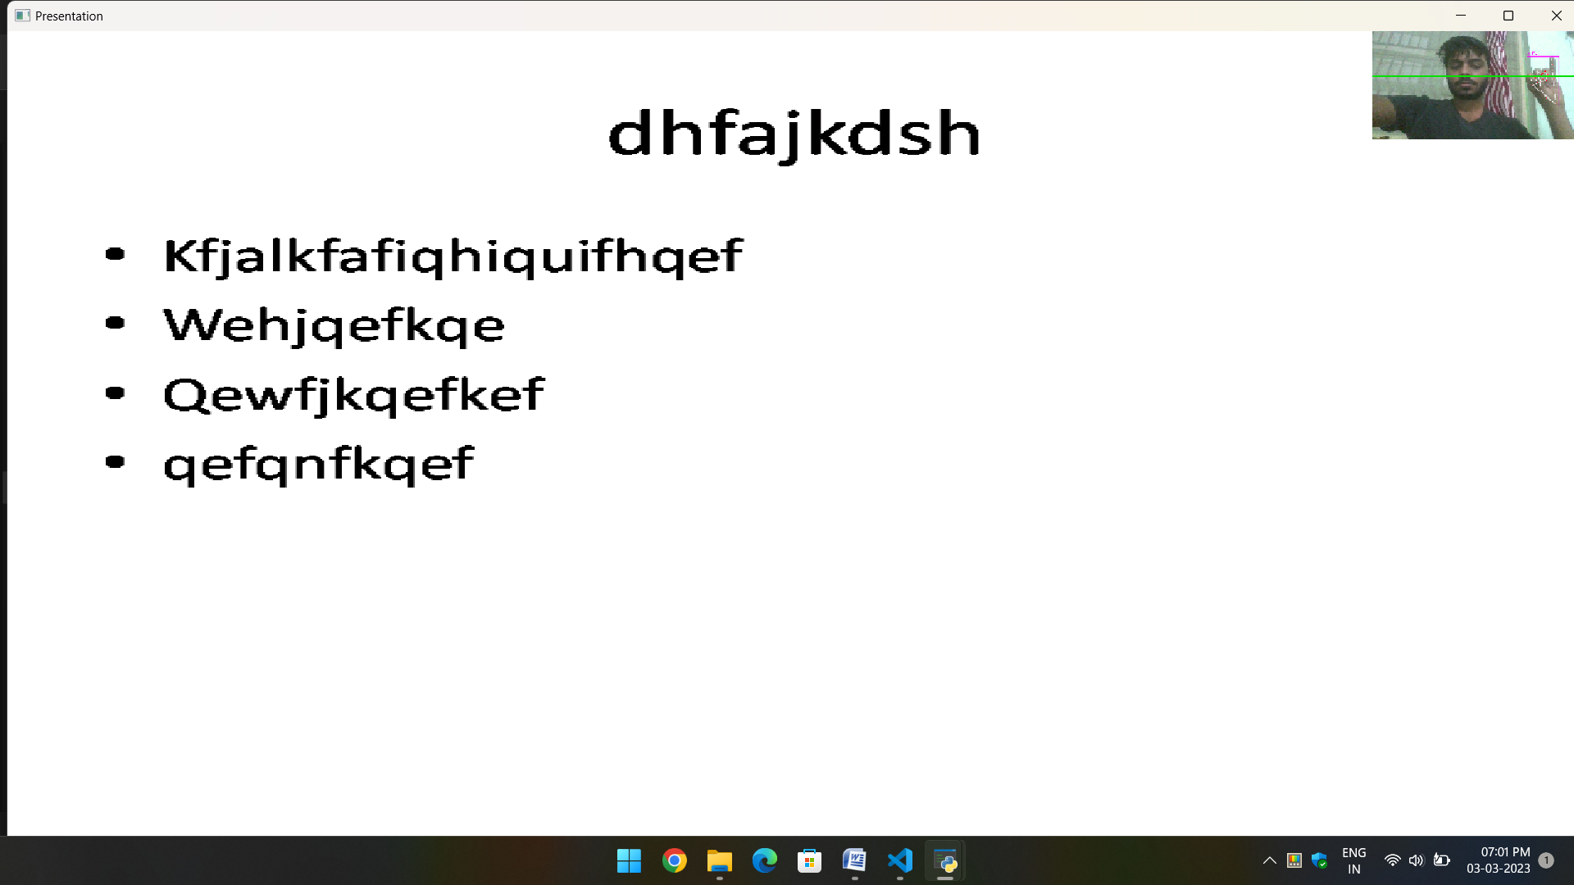
Operation Slides using Hand Signs ,Next Slide.

Slide 29
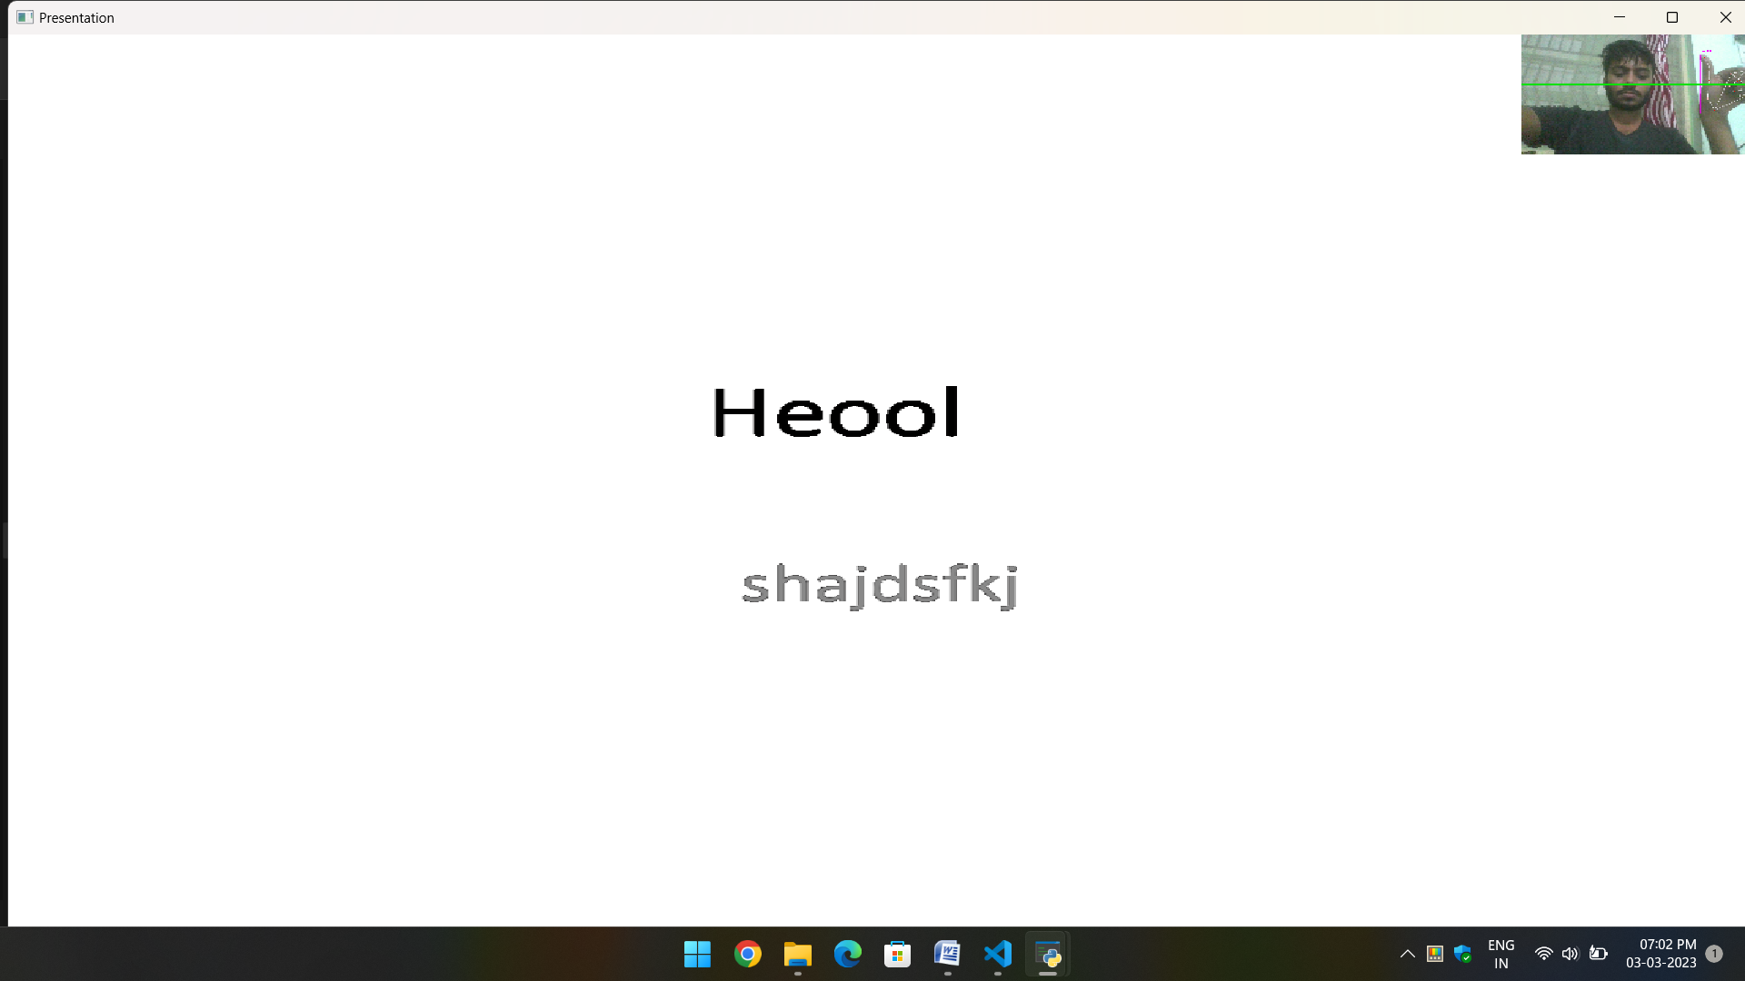
Previous Slide using Thumb Sign.

Slide 30
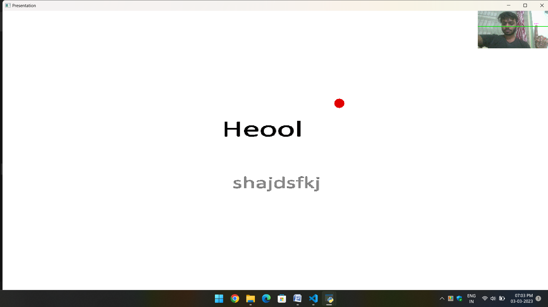
To Point On something show Index finger.

Slide 31
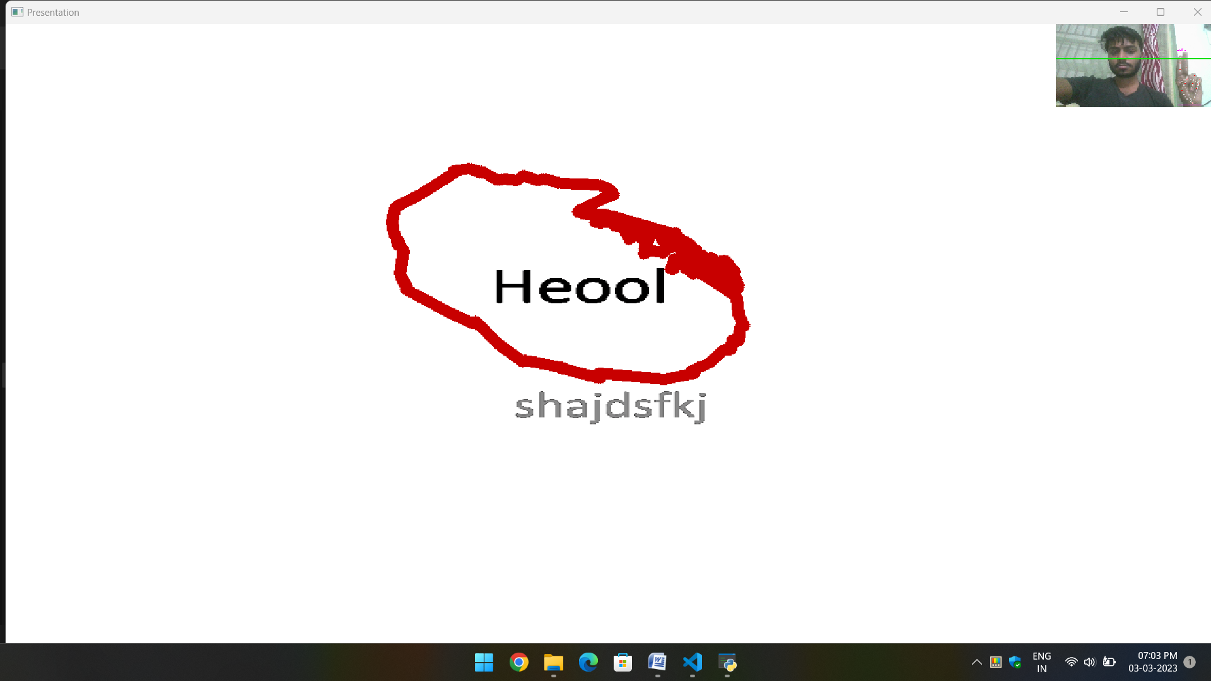
To highlight in image or mark something use two finger Index finger and middle finger.

Slide 32
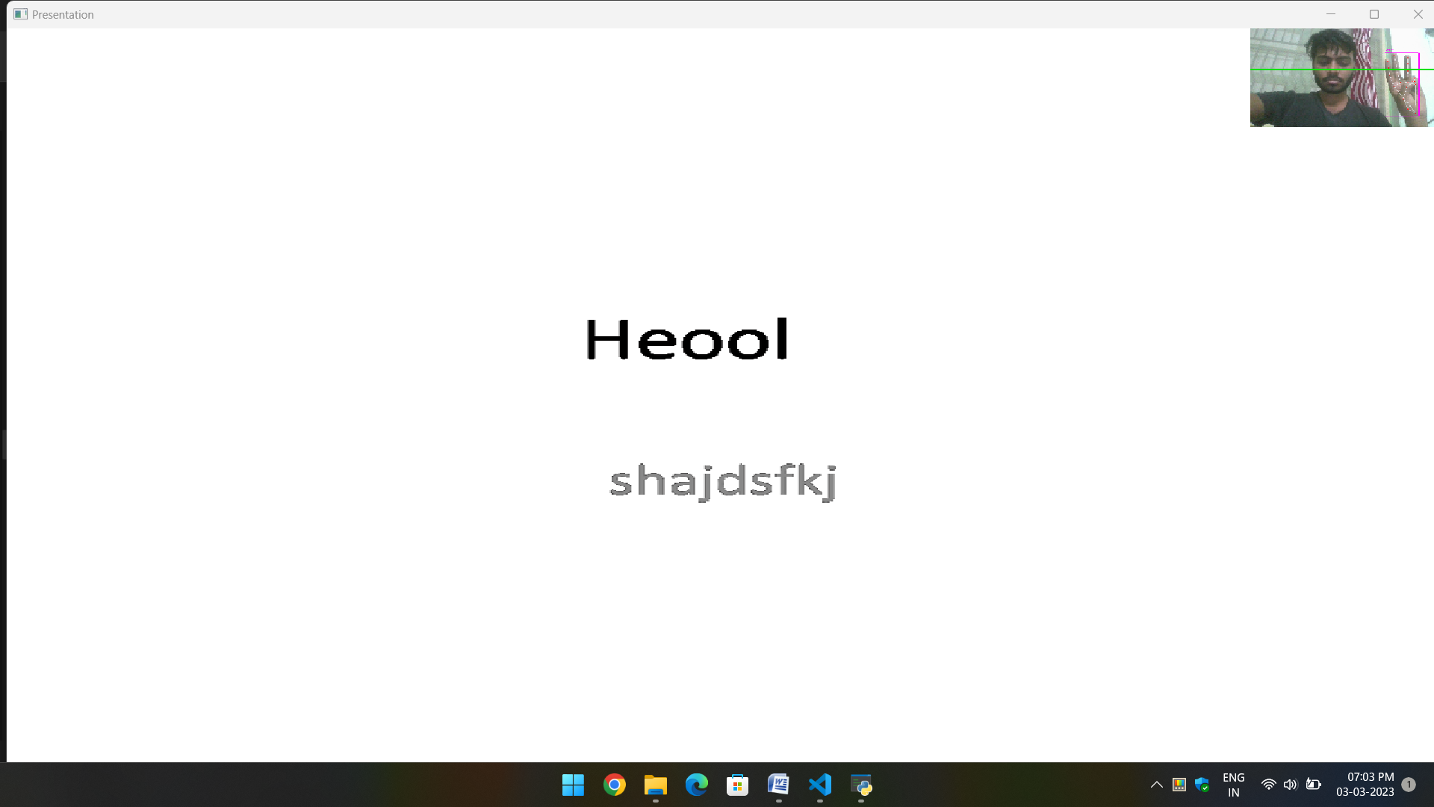
To erase the done show three fingers.

Slide 33
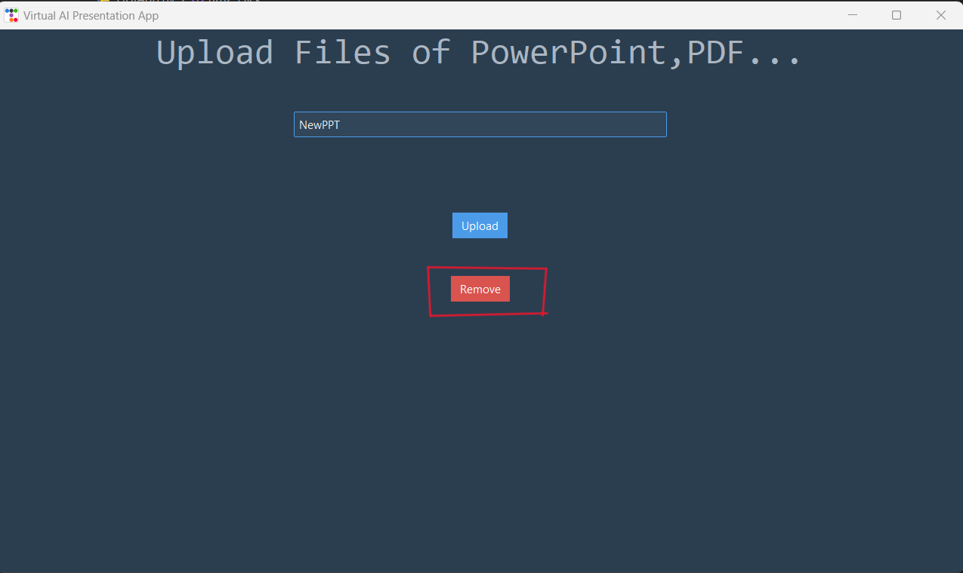
Press Q or q to exit Presentation. To rerun the Presentation again write presentation name and press upload again.

Slide 34
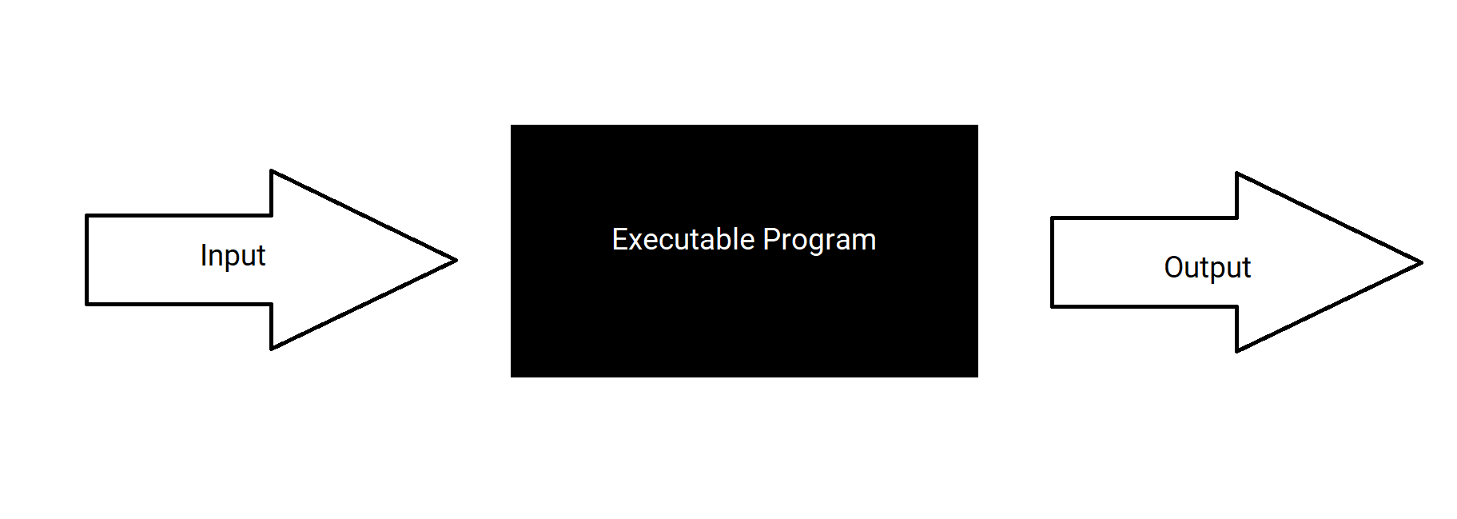
Testing Approach Use
Black Box Testing :
Black box testing is a type of software testing in which the functionality of the software is not known. The testing is done without the internal knowledge of the products. It is also called Functional testing. Black-box testing focuses on software’s external attributes and behavior. This type of testing looks at an application’s software expected behavior from the user’s point of view.
Diagram

Slide 35
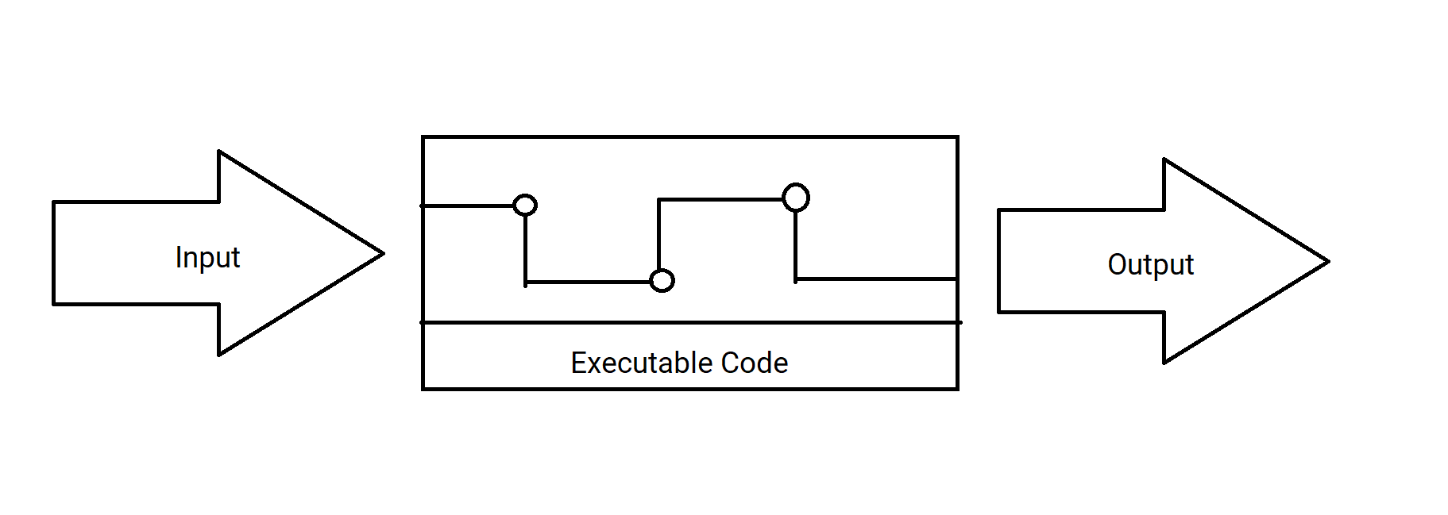
White Box Testing :
White-box testing or glass-box testing is a software testing technique that tests the software by using the knowledge of internal data structures, physical logic flow, and architecture at the level of source code. This testing works by looking at testing from the developer’s point of view. This testing is also known as glass box testing, clear box testing, structural testing, or non-functional testing.
Diagram.

Slide 36
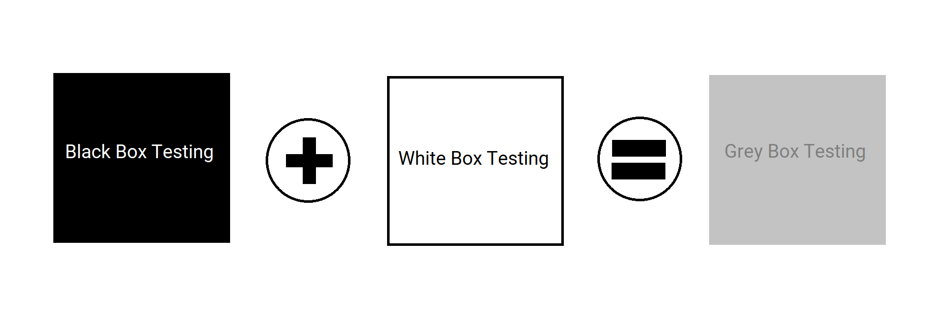
Gray Box Testing :
Gray Box Testing is a combination of the Black Box Testing technique and the White Box Testing technique in software testing. The gray-box testing involves inputs and outputs of a program for the testing purpose but test design is tested by using the information about the code. Gray-box testing is well suited for web application testing because it factors in a high-level design environment and the inter-operability conditions.
Diagram

Slide 37
Conclusion
Limitation of system
Future scope of System
Bibliography
Less file support
Less user interactive system
No recovery
The all limitation can be full field and make still better.
Only webcam support is provided but at future multiple camera can also be get in support.
Google.com
Youtube.com
StackOverflow.com
GeeksForGeeks.com

