Slide 1
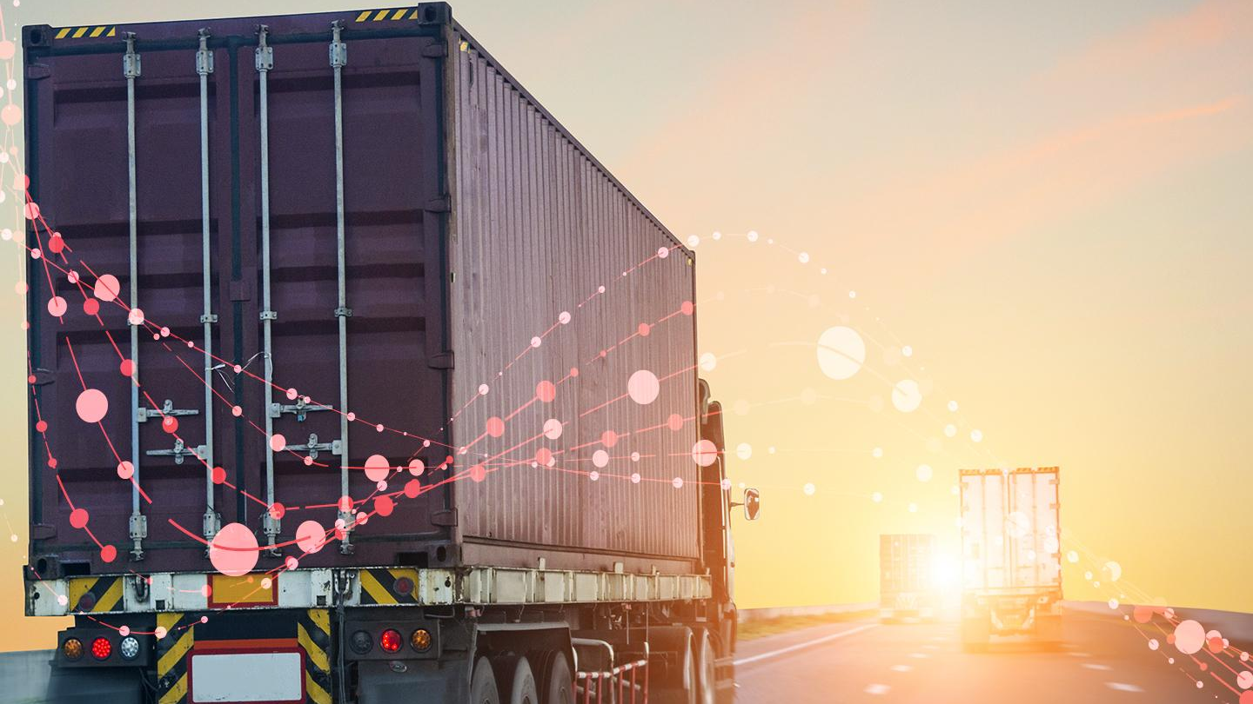
MON-O-LOG
Monitoring Logistics Data and Adding Value

Slide 2
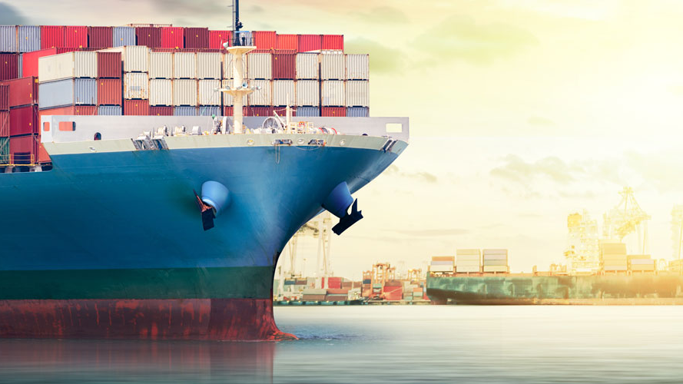
CHALLENGE
In the area of Logistics,
Detect fraudulent shipments and detect suspicions.
Enable more transparency with regards to carbon emissions.
PAIN POINTS
Transparency of information between actors.
Manual intervention at multiple levels.

Slide 3

FACTS
Logistics contributes over 10% to CO2 emissions in Supply Chain.
Transportation contributes to 29% of US Greenhouse emissions.
Sweden needs annual decrease of emission by 5-8% to meet its 2045 target of net-zero emissions.
OECD Due Diligence Guidance demand that supply chain managers verify purchased goods as ‘‘conflict-free’’.
TOOLS and SOURCES
Ericsson Connected Logistics Solution
Vehicles Mechanics Information
GeoLocation Based Services

Slide 4
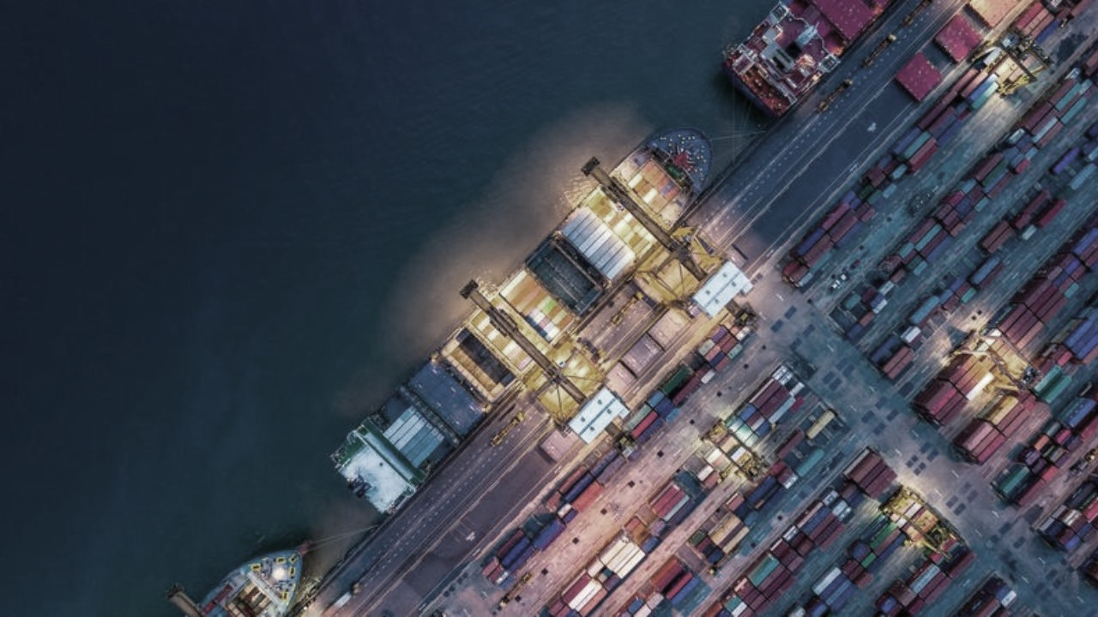
CONTEXT TO SOLUTION
Ericsson Connected Logistics Chain (CLC) offers a supply chain data exchange platform based on the Internet of Logistics concept.
CLC enables everyone involved to share and receive needed information timely and accurately, in an open, collaborative manner
Such a tool, enables data enrichment by various partners using simple APIs
It also allows a fast and effective digitization transformation in your Supply Chain.

Slide 5


