Slide 1
NUTRIFIT
Group Members:
Ilirjana Didani,
Klea Laro,
Kleard Jaupi,
Minella Bishka
Irsi Hida
EPOKA UNIVERSITY
MAY 31 2023

Slide 2
Table of contents
01
02
03
04
05
06
Introduction
Overall Description
External Interface Requirements
System Features
Other Nonfunctional Requirements
Other Requirements

Slide 3
01
Introduction

Slide 4
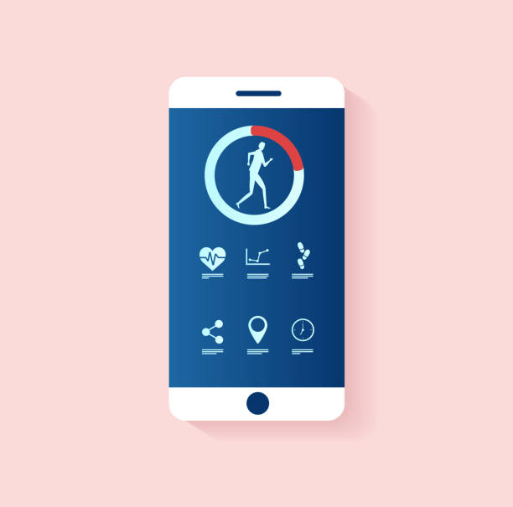
Introduction
Nutrifit is a workout and meal planning application that helps users achieve their fitness goals by providing personalized meal plans and workout routines.
The scope of this SRS is to describe the software requirements for the entire Nutrifit system, including all its features and functionalities. It covers both the front-end user interface and the backend functionality required to support it.

Slide 5

Introduction
The Nutrifit software offers a variety of features and functionalities, including the ability to create and customize workout and meal plans, track progress, and receive personalized recommendations based on user data.
The software is designed for individuals who are looking to improve their fitness and health, including gym-goers, athletes, and fitness enthusiasts. Nutrifit can be used in a variety of settings, including at home, at the gym, or on the go, making it a flexible and accessible tool for users.

Slide 6
02
Overall Description

Slide 7
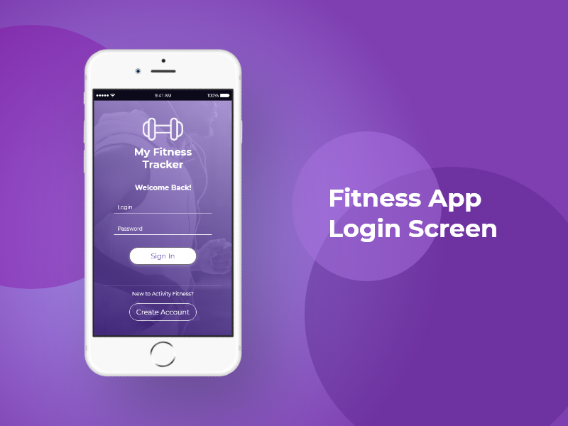
Product function and prospective
Nutrifit is designed to be a standalone product, but it may interface with other systems or components in the future. Any interfaces between Nutrifit and other systems will be identified and documented in the External Interface Requirements section of this SRS. A high-level diagram of the Nutrifit system and its major components is provided in the System Features section.
Nutrifit must provide the succeeding major functions:
1.User registration and profile creation,
2.Input and tracking of workout plans
3.Personalized workout and meal plan recommendations

Slide 8
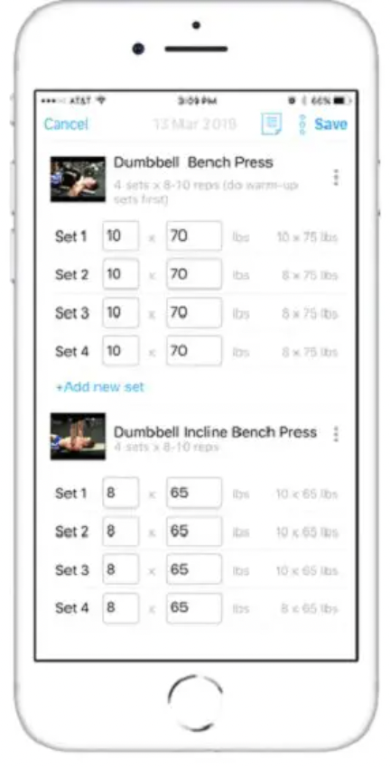
User Classes and Characteristics
1. General users: These are individuals who are interested in tracking their meals and workouts to improve their overall fitness.They are interested in improving their fitness and want a simple and user friendly interface to track their meals and workouts.
2. Fitness enthusiasts: These are individuals who are passionate about fitness and have a good understanding of nutrition and exercise.They have a good understanding of nutrition and exercise and want to use Nutrifit to track their progress and achieve their fitness goals.
3. Personal trainers: These are individuals who have a high level of expertise in nutrition and exercise and work with clients to create personalized meal and workout plans.They are comfortable with technology and may require advanced features such as progress tracking and data analytics

Slide 9
Design and Implementation Constraint
Ktu zgjithi vet ca duhet me u shkrujt

Slide 10
03
External Interface Requirements

Slide 11
3.1 User Interfaces
1. Dashboard: The dashboard module is designed to deliver a succinct yet informative overview of the user's fitness progress and goals. It showcases a comprehensive range of fitness-related data such as the number of steps taken, calories burned, and workout duration.
2. Exercise tracker: The workout tracker module is an essential component of the app, intended to allow users to log and monitor their workout progress with accuracy and ease. Users can input a diverse range of data such as the type of exercise they performed, the duration, and the intensity level, which are then aggregated to provide detailed progress reports.
3. Exercise Library: The exercise library module aims to provide users with a comprehensive selection of exercises tailored to their fitness requirements.. Using filters for various criteria such as body parts, equipment, and exercise type, users can easily customize their workout plans and achieve their fitness goals.
4. Personalized recommendations: The personalized recommendations module is a powerful feature that harnesses user data such as workout history, goals, and preferences to provide customized suggestions for workouts, exercises, and nutrition. The recommendations are based on several factors such as the user's fitness level, available equipment, and other pertinent considerations

Slide 12

3.2 Hardware Interfaces
1. Bluetooth-enabled equipment: Our fitness application possesses the capability to connect with Bluetooth-enabled equipment such as treadmills, stationary bikes, or weightlifting machines.
2. Audio devices: Nutrifit leverages audio devices such as headphones or speakers, to provide optimal guidance and feedback during workouts.
3. Camera and sensors: Nutrifit will exploit the camera and sensors present on a user's device to track their movements and deliver feedback on their form.
4. Voice assistants: Our application will integrate with voice assistants such as Amazon Alexa or Google Assistant, to offer hands-free control and feedback during workouts.

Slide 13
3.3 Software Interfaces
Nutrifit will interface with the subsequent software components:
Database: Nutrifit will use a MySQL database to store user information, workout templates, and meal plans.
Operating System: Nutrifit will be developed using mostly Java programming language and will be compatible with any operating system that supports Java.
Libraries: Nutrifit will use the Spring Framework for dependency injection and inversion of control.
Integrated Commercial Components: Nutrifit will integrate with the Stripe payment gateway to handle subscription payments.
Data Items and Messages-Nutrifit will receive these data items and messages:
1.User profile information, including name, email address, and password
2.User preferences for workout templates and meal plans
3.The workout and meal plan templates, which will be stored in the database Payment information, including credit card details and subscription status

Slide 14

Communications Interfaces
This section describes the requirements associated with these functions, including:
1.Email-Nutrifit will require email functionality to enable users to reset their passwords, receive notifications, and communicate with support personnel.
2.Web Browser- Nutrifit will provide a web-based interface that users can access using standard web browsers, such as Google Chrome, Safari.
3.Network Server -Communications Protocols Nutrifit will communicate with external systems using standard network protocols, such as HTTP, File Transfer Protocol (FTP), and Secure Shell (SSH).
4.Security and Encryption Nutrifit- will implement appropriate security measures to protect user data and prevent unauthorized access.

Slide 15
04
4. System Features

Slide 16
System Features
Zgjidhe vet ca do shkruhet

Slide 17
05
5.Other Nonfunctional Requirements

Slide 18
Performance Requirements
1. Speed: The swiftness and responsiveness of the fitness application are of paramount importance, as users anticipate immediate outcomes when interacting with the software. 2. Scalability: The software's scalability is a crucial aspect that should be taken into account during the developmental process. It should be capable of handling a multitude of users without any performance issues
3. Reliability: The reliability of the fitness application is essential, and it must be available to users at all times.
4. Security: The security of the fitness application is of utmost importance, and all user data and information must be protected from unauthorized access or breaches.
5. Compatibility: The fitness application must be compatible with different operating systems and devices, such as iOS, Android, and web browsers to ensure maximum accessibility to users.
6. Usability: The usability of the fitness application should be optimized to ensure ease of use and seamless navigation
7. Customization: The fitness application should allow users to personalize their experience by setting their own fitness goals, tracking their progress,

Slide 19

Safety Requirements
1. Security: Nutrifit must be designed with privacy and security in mind. User data should be encrypted and protected from unauthorized access, both during transit and at rest.
2. Accuracy and Precision: The application should provide accurate and precise information to the user, including real-time feedback on their heart rate, calorie burn, and other fitness metrics.
3. Health and Medical Considerations: The application should consider the user's health and medical history when providing workout recommendations and progress tracking. The app should be able to identify potential risks or limitations that may affect the user's ability to perform certain exercises safely
4.Safety Guidelines: The application should provide clear and concise safety guidelines and warnings for each exercise, including any potential hazards or risks associated with the exercise.

Slide 20

Security Requirements
1. Secure Authentication: The application should require users to authenticate themselves securely, preferably through multi-factor authentication. This will help prevent unauthorized access to user accounts.
2. Data Encryption: All user data and information should be encrypted, both in transit and at rest, to prevent unauthorized access and protect user privacy.
3. Secure Data Storage: User data and information should be stored securely in a database or server, with appropriate security controls in place to prevent data breaches and ensure data integrity
4. Regular Updates and Patches: The application should be updated regularly to fix any security vulnerabilities or bugs that could be exploited by hackers. 5. Secure APIs: If the application uses APIs to integrate with third-party services or devices, the APIs should be secure and protected from unauthorized access or attacks.

Slide 21
Software Quality Attributes
1. Functionality: The fitness application should function as intended, with all features and functionalities working correctly and as expected. The application should allow users to set goals, track progress, and provide feedback on workouts.
2. Usability: The application should be user-friendly and easy to use, with a clear and intuitive user interface
3. Reliability: The fitness application should be reliable, with minimal downtime or technical issues
4. Performance: The application should be fast and responsive, with minimal lag time or delays.
5. Security: The fitness application should be secure, with all user data and information protected from unauthorized access or breaches.
6. Maintainability: The application should be maintainable, with easy-to-understand code and a straightforward development process.

Slide 22

Business Rules
1. Membership: The fitness application should have clear rules around membership, including how users sign up, what information they need to provide, and what fees they may be required to pay
2. Billing: The application should have clear billing rules, including how users are charged for using the app, what payment methods are accepted, and what happens if a user cancels their membership.
3. Exercise Restrictions: The application should have clear rules around workout restrictions, particularly for users with pre-existing medical conditions or injuries.
4. Use of Personal Information: The application should have clear rules around the use of personal information, including how user data is collected, stored, and used.

Slide 23
06
6. Other Requirements

Slide 24

Maintenance Plan
Bug fixes and performance enhancements: Regular maintenance involves addressing software bugs, glitches, and performance issues
Compatibility updates: The software should remain compatible with the latest operating systems, web browsers, and mobile devices. Regular updates might be required to ensure seamless integration with new technologies and platforms.
User feedback and support: Gathering user feedback and addressing user suggestions is important for improving the softwaremless integration with new technologies and platforms.
Data management and backups: Implementing robust data management practices, including regular backups and disaster recovery plans, ensures that user data is safe and can be restored in case of any unforeseen circumstances.

Slide 25
Software Evolution
Feature enhancements: Regularly adding new features and functionalities based on user needs and market trends is crucial for the software's evolution. This could involve introducing new workout routines, meal planning options, integration with wearable devices, or providing personalized recommendations.
User interface and user experience improvements: Continuously refining the user interface (UI) and user experience (UX) based on feedback and usability testing can enhance the software's intuitiveness and efficiency.
Performance optimization: Regularly reviewing and optimizing the software's performance to ensure it runs smoothly and efficiently, even as the user base and data volume grow.
Overall, the maintenance plan and software evolution should focus on ensuring the software remains user-friendly, reliable, secure, and up-to-date with the latest user expectations, while incorporating improvements and new features to meet evolving needs.

Slide 26
THANK YOU!
Do you have any questions?

