Slide 1
JAWS: Job-Aware Workload Scheduling for the Exploration of Turbulence Simulations
Notes:
Presenting joint work b/w jhu and purdue on a data-driven, batch scheduler named JAWS that exploits data sharing across multiple queries to improve throughput performance in scientific databases

Slide 2
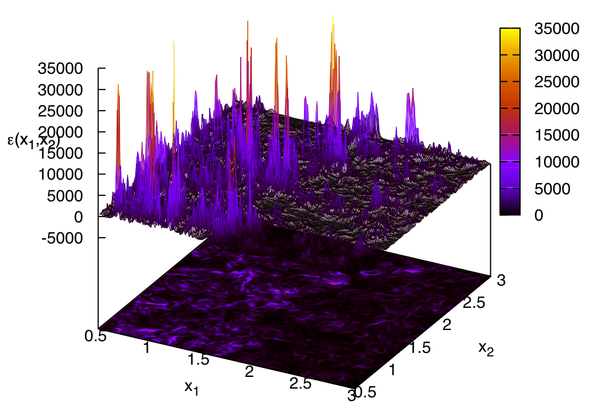
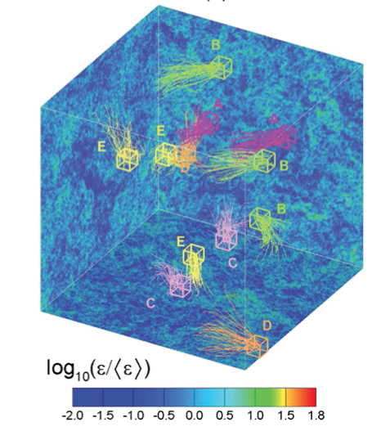
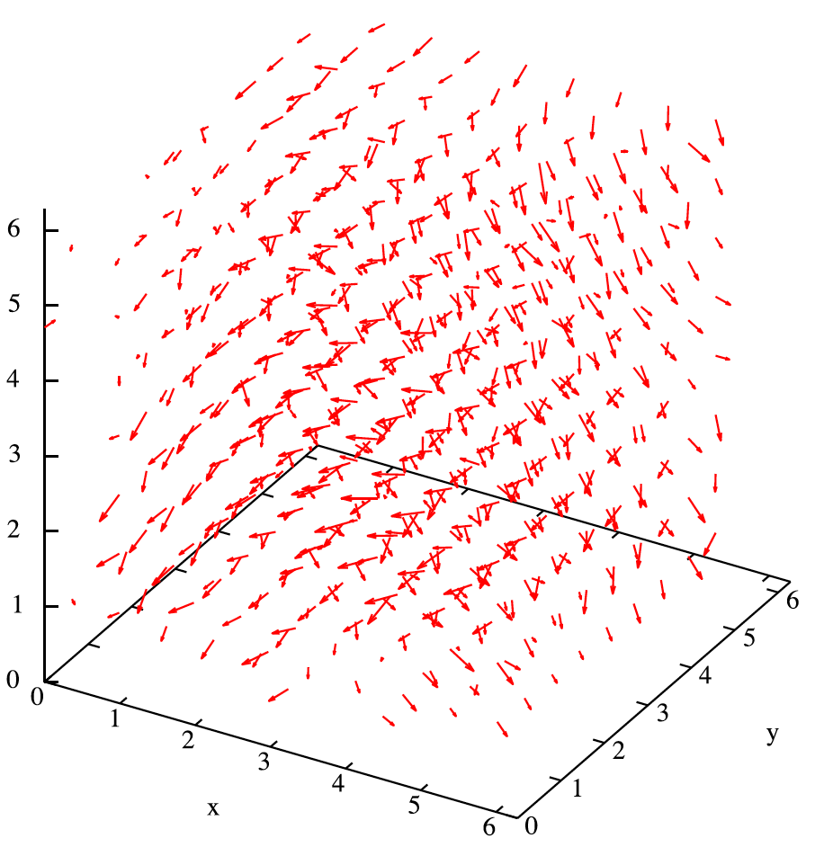
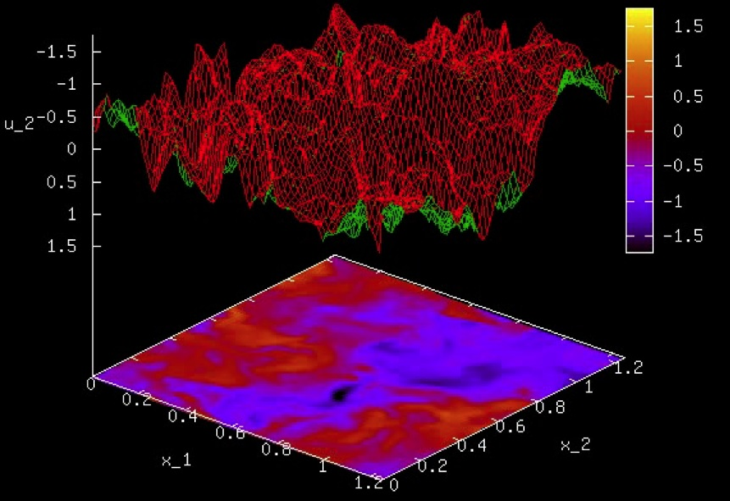
Problem
Ensure high throughput for concurrent accesses to peta-scale Scientific datasets
Turbulence Database Cluster
  A new approach to data exploration
    Traditionally analyze dynamics on the fly
    Large simulations out of reach for many Scientists
  Stores complete space-time histories of DNS
  Exploration by querying simulation result
  27TB (velocity and pressure data on 1024³ grid)
  Available to wide community over the Web
Notes:
This includes Scientific domains in physics, astronomy, and computation biology that are accumulating data rapidly
Traditionally, scientists ran the simulation and analyzed the results dynamically on the fly, need infrastructure
Our cluster preserve computational effort of the simulation
Scientists perform spatial and temporal exploration of turbulent flows by querying the simulation results
Made simulations accessible to broad turbulence community

Slide 3
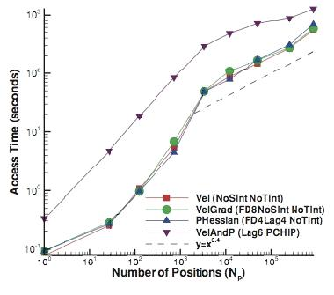
Pitfalls of Success
Enable new class of applications
  Iterative exploration over large space-time
  Correlate, mine, extract at petabyte scale
Heavily used and data intensive queries
  50,275,005,460 points queried
  Hundreds of thousands of queries/month
  I/O bound queries (79-88% time
  on loading data)
  Scan large portions of DB lasting
  hours-days
Single user can occupy the
entire system for hours
Notes:
Wildly successful since deployment in 2007
Opens up new applications that are traditionally too expensive, I.e. tracking evolution of turbulent structions with positions of hundreds of thousands of particles distributed over the entire span of space and time
How expensive these queries can become, we must now contend with growth in users
Not atypical for single user to occupy…

Slide 4
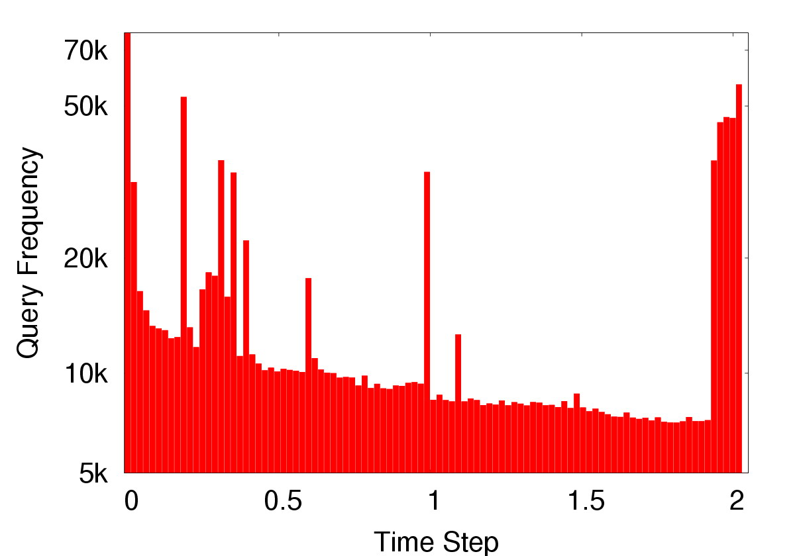
Addressing I/O Challenges
I/O contention and congestion from concurrent use
Significant data reuse between queries
  Many large queries access the same data
  Lends to batch scheduling
  I.e. particles may cluster in turbulence structures
Notes:
Faced with congestion of data intensive queries from multiple users running simultaneously, we alleviate performance bottlenecks for concurrent experiments by scientists on the same data
Many large queries reuse the same data, which lends the system to batch scheduling
Because repeatedly querying particles clustered in turbulent structures
70% of queries reuse simulation results from a dozen timesteps
Data is indexed and partitioned by spatial or temporal attributes
Workloads that perform full database scans or range query against a clustered index that scan large portions of the table)

Slide 5
A Batch Scheduling Approach
Co-schedule queries accessing the same data
  Eliminate redundant accesses to the disk
  Amortize I/O cost over multiple queries
Job-aware schedule for queries w/ data dependencies
Trade-offs b/w arrival order
and throughput
Scales with workload saturation
  Up to 4x improvement in throughput
Notes:
So what be we mean by alleviating I/O contention?
Many of the queries in the workload are part of a larger experiment. These queries must be executed one after another in sequence due to data dependencies

Slide 6
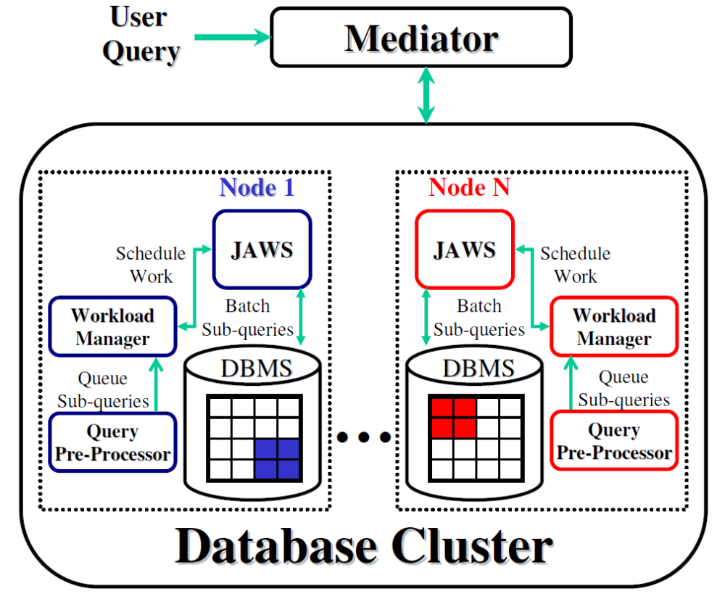
Architecture
Universal addressing scheme for partitioning, addressing, and scheduling
Data organization
  64³ atoms (8MB)
  Morton order index
  Spatial and temporal
  partitioning
JAWS scheduling at
each node
Notes:
Some key characteristic relevant to scheduling, unit of I/O is 8MB

Slide 7
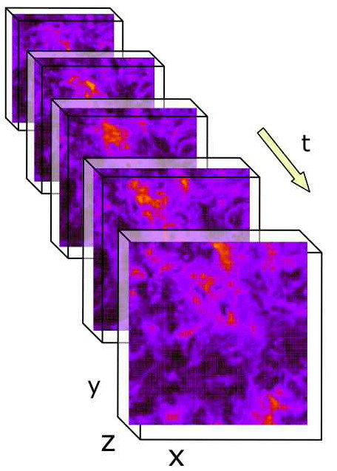
LifeRaft: Data-Driven Batch Scheduling
Turbulence DB
Data Access by Query
Co-schedule by Sub-query
Decomposition
Batch Sched.
R2
Q1 | Q2 | Q3
Q1
R1 | R2 | R3
Query
Results
R1
Q1 | Q3
Q2
R2 | R3 | R4
Q1 | Q2
R3
Q3
R1 | R2
R3
Q2
Decompose into sub-queries based on data access
Co-schedule sub-queries to amortize I/O
Evaluate data atoms based on utility metric
  Amount of contention (queries per data atom)
  Age (queuing time) of oldest query (arrival order)
  Balance contention with age via tunable parameter
Notes:
JAWS is built on prior work on batching scheduling in Astronomy databases
Given an online sequence of queries with potentially multiple queries executing simultaneously, minimize redundant I/O
Decompose queries into sub-queries based on data
Then co-schedule sub-queries accessing the same data to amortize I/O cost
Key is to reorder the sub-queries by either processing them in contention order (to amortize each I/O over more queries and maximize throughput) or arrival order (to avoid indefinite wait times and minimize response time)
User tunable parameter to balance throughput and response time factors
Each sub-query is a set of positions that fall within a single atom
Sub-queries can be executed in any order and the query result is obtained by combining sub-query results
Co-scheduling evaluates all sub-queries whose positions fall within the same atom (potentially processing queries out of arrival order to maximize data sharing and amortize cost of data access over more queries)
Account for wait time of queries in scheduling
Tuning alpha to 0 biases scheduling by contention in order to maximize throughput by amortizing data access over more queries and tuning alpha to 1 schedules queries in arrival order to prevent starvation
Query contain list of position to perform computation
Identify atoms containing each position
Output list of sub-queries for each query
Co-schedule sub-queries
Evaluate sub-queries accessing the same atom in single pass
Favors high contention (amortize I/O over more queries)
Select atoms by decreasing aged workload throughput
U(i) = U_{t}(i)(1-α) + E(i)α
U_{t}(i): amount of contention (# of queried positions per atom)
E(i): age (queuing time) of oldest sub-query pending for atom (inspired by disk-drive head scheduling)
Balance two factors with tunable α parameter
4096 8MB atoms per timestep
Morton order serves as the space filling curve that provides a linear ordering of atoms on disk while preserving spatial locality

Slide 8
A Case for Job-Aware Scheduling
Job-awareness yields additional I/O savings
  Greedy LifeRaft miss data sharing between jobs
  Incorporate data-dependency to identify redundancy
Job₁
R1
R3
R4
LifeRaft
R2
R3
R4
Job₂
Job₃
R2
R3
R4
Job₁
R1
R3
R4
JAWS
R2
R3
R4
Job₂
Job₃
R2
R3
R4
Execution Time
Notes:
We found that turbulence workload consists of many jobs with data dependencies
Queries may exhibit data dependencies in that the next query reuse results of its predecessors, for example, particle tracking in which the position of a particle at the next time step depends on the result of the query at the previous time step
Applying LifeRaft to Turbulence is sub-optimal since it does not account for data sharing opportunities between different jobs. Instead, our algorithm annotate these sharing opportunities prior to scheduling.
Accounting for this provides significant I/O savings
JAWS finish 33% faster by delaying the execution of Job2 and Job3 so that access to R3 and R4 are co-scheduled and accessed only once
Nodes are individual queries, arrows indicate execution order within a job, value inside each node denote data region accessed (queries sharing the same value access the same set of atoms from the same time step)

Slide 9
JAWS: Poly-Time Greedy Algorithm
Precedence Edge ( ): Subsequent queries in a job must wait for predecessors
Gating Edge ( ): Queries with data sharing and are evaluated at the same time
Scheduler evaluate queries in the graph from left to right
j₁
R1
R2
R4
R5
j₂
R2
R3
R4
R6
j₃
R1
R4
R5
R6
Notes:
Construct a precedence graph based on the input workload, then mark sharing opportunities with gating edges in the graph. Finally, the scheduler walks the graph from left to right

Slide 10
JAWS: Poly-Time Greedy Algorithm
Dynamic program phase: identify data sharing b/w job pairs
  DP based on Needleman-Wunsch algorithm for every pair of jobs
  Maximize score (i.e. data sharing): 1 if two queries exhibit data sharing and are co-scheduled, 0 otherwise
  Complexity O(n²m²)
j₁
R1
R2
R4
R5
j₁
R1
R2
R4
R5
j₂
0
0
0
0
0
R1
0
1
1
1
1
j₂
R1
R4
R5
R6
R4
0
1
1
2
2
R5
0
1
1
2
3
Precedence Edge
Gating Edge
R6
0
1
1
2
3
Notes:
Based on the NW (wun-shhh) algorithm designed to find the best global alignment between two string sequences
Each alignment is marked by gating edges
For n jobs and m average queries per job

Slide 11
JAWS: Poly-Time Greedy Algorithm
Merge phase: merge pairwise DP solutions
  Sort job pairs based on # of gating edges
  Merge gating edges b/w pairs of jobs greedily
  Complexity O(n³m²) (typically sparse graphs up to ~3000 edges)
j₁
R1
R2
R4
R5
j₁
R1
R2
R4
R5
j₁
R1
R2
R4
R5
j₂
R2
R3
R4
R6
j₃
R1
R4
R5
R6
j₂
R2
R3
R4
R6
j₃
R1
R4
R5
R6
j₁
R1
R2
R1
R4
R4
R5
R5
R1
R6
R4
R5
R6
j₃
j₃
j₂
R2
R3
R4
R6
j₂
R2
R3
R4
R6
Notes:
Retain gating edges if they do not cause a deadlock in scheduling
Up to 50 simultaneous jobs with 20 queries on averages

Slide 12
JAWS: Scheduling Example
R1
R2
R4
R5
j₁
QUEUE
WAIT
WAIT
WAIT
R2
R3
R4
R6
j₂
READY
WAIT
WAIT
WAIT
R1
R4
R5
R6
j₃
QUEUE
WAIT
WAIT
WAIT
Example
Three jobs j₁, j₂, j₃
No caching
Single region at a time
Precedence Edge
Gating Edge
Notes:
Each query can have four states: WAIT if its predecessor queries have no been evaluated, READY is only gating constraints are unsatisfied (does not depend on predecessor, waiting to be co-scheduled), QUEUE if a query can be executed immediately, and DONE if it has completed execution

Slide 13
JAWS: Scheduling Example
R1
R2
R4
R5
j₁
DONE
QUEUE
WAIT
WAIT
Time 1
j₁
R1
R2
R3
R4
R6
j₂
QUEUE
WAIT
WAIT
WAIT
j₃
R1
R1
R4
R5
R6
j₃
DONE
READY
WAIT
WAIT
Precedence Edge
Gating Edge

Slide 14
JAWS: Scheduling Example
R1
R2
R4
R5
j₁
DONE
DONE
READY
WAIT
Time 2
j₁
R2
R2
R3
R4
R6
j₂
DONE
QUEUE
WAIT
WAIT
j₂
R2
R1
R4
R5
R6
j₃
DONE
READY
WAIT
WAIT
Precedence Edge
Gating Edge

Slide 15
JAWS: Scheduling Example
R1
R2
R4
R5
j₁
DONE
DONE
QUEUE
WAIT
Time 3
j₂
R3
R2
R3
R4
R6
j₂
DONE
DONE
QUEUE
WAIT
R1
R4
R5
R6
j₃
DONE
QUEUE
WAIT
WAIT
Precedence Edge
Gating Edge

Slide 16
JAWS: Scheduling Example
R1
R2
R4
R5
j₁
DONE
DONE
DONE
QUEUE
Time 4
j₁
R4
R2
R3
R4
R6
j₂
DONE
DONE
DONE
READY
j₂
R4
R1
R4
R5
R6
R4
j₃
DONE
DONE
QUEUE
WAIT
j₃
Precedence Edge
Gating Edge

Slide 17
JAWS: Scheduling Example
R1
R2
R4
R5
j₁
DONE
DONE
DONE
DONE
Time 5
j₁
R5
R2
R3
R4
R6
j₂
DONE
DONE
DONE
QUEUE
j₃
R5
R1
R4
R5
R6
j₃
DONE
DONE
DONE
QUEUE
Precedence Edge
Gating Edge

Slide 18
JAWS: Scheduling Example
R1
R2
R4
R5
j₁
DONE
DONE
DONE
DONE
Time 6
j₂
R6
R2
R3
R4
R6
j₂
DONE
DONE
DONE
DONE
j₃
R6
R1
R4
R5
R6
j₃
DONE
DONE
DONE
DONE
In comparison, LifeRaft requires
time 8
Precedence Edge
Gating Edge

Slide 19
Additional Optimizations
Two-level scheduling
  Exploit locality of reference
  Group and evaluate multiple data atoms
Adaptive Starvation Resistance
  Trade-offs b/w query throughput and response time
  Incremental changes by workload saturation (i.e. query arrival rate)
Coord. Cache Replacement w/ Scheduling
Notes:
Due to interpolation, many computation read nearby atoms as part of the kernel of computation
Thus, to avoid re-reading the same atom multiple times on separate passes, we group atoms together
We also want to prevent indefinite starvation and do this in an automated fashion
Thus, we maximize throughput when workload is saturated to avoid growing queue sizes, and at low saturation, reduce response time and relying on additional system capacity to maintain throughput
Again by biasing the scheduler towards contention or arrival order processing
Optimizations on cache replacement by making use of application level knowledge from the scheduler
Performance trade-offs by for example, if workload saturation rises and query throughput did not improve commensurately, then decrease alpha to bias scheduling towards contention rather than arrival order
SLRU exploits idea that data atoms that are used frequently tend to be reused and should not be flushed from cache by queries that scan an entire time step only once
At end of each run of workload, promote the most frequently accessed atoms into a protected segment of the cache
URC incurs higher overhead, and sorts and evicts atoms likely to be accessed farthest in the future based on the aged workload throughput metric. It caches and evicts batch of k atoms together based on two-level scheduling.
Coarse level: select batch of k atoms from one time step
Fine level: sort & evaluate positions for k atoms in Morton order
Incremental trade-offs b/w query throughput and response time as workload saturation (i.e. query arrival rate) changes
Divide workload into runs of r queries
Tune α parameter of aged throughput metric based on past runs
Segmented Least Recently Used (SLRU): particles may cluster in turbulence structures
Utility Ranked Caching (URC): utilize full scheduling knowledge and accounts for two-level scheduling
Selection of a time step based on the mean aged workload throughput of all atoms in that time step (coarse level)
K is the batch size or maximum number of atoms that are co-scheduled per time step (fine level)

Slide 20
Experimental Setup
800GB sample DB: 31 time steps (0.062 sec of simulation time)
Workload
  8 million queries (11/2007-09/2009), 83k unique jobs
  63% of jobs persist between 1 and 30 min
  88% of jobs access data from one time step, 3% iterate over 0.2 sec of simulation time (10% of DB)
  Use 50k query trace (1k jobs) from week of 07/20/2009
Algorithms compared
  NoShare: queries in arrival order with no I/O sharing
  LifeRaft₁ (arrival order) and LifeRaft₂ (contention order)
  JAWS₁: JAWS without job awareness
  JAWS₂: includes all optimizations
Notes:
Running experiments in the production system is highly disruptive to users
2.33GHz dual core 4GB memory, SQL Server 2005, Windows 2003 Server, Four disks in RAID 5
Alpha values initialized to two extremes for LifeRaft
No job awareness but includes two-level scheduling, adaptive starvation resistance, and caching optimizations
Initialize alpha to 0.5 and batch size k to 15 for JAWS

Slide 21
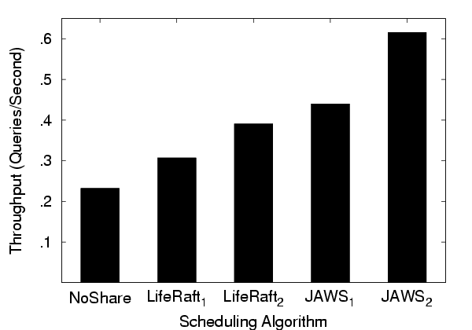
Query Throughput
3x improvement
22% from qry reordering
30% from job-awareness
12% from 2-level sched.
Notes:
Job-awareness exploits data sharing between jobs
Jaws1 to LifeRaft2 is less pronounced because most benefit is derived from contention-based batch scheduling
Reordering and scheduling queries out of arrival order improves cache reuse

Slide 22
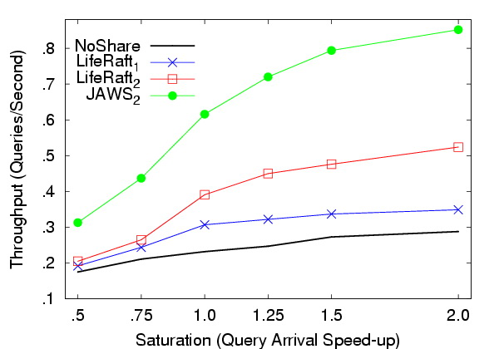
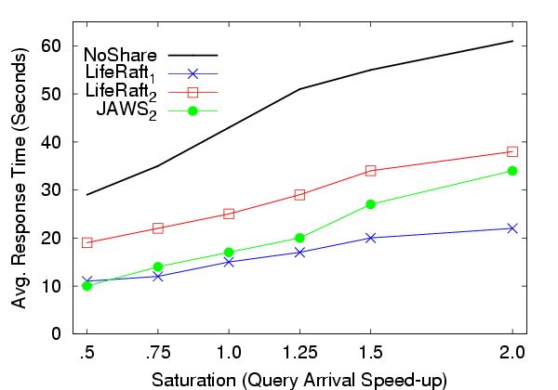
Sensitivity to Workload Saturation
JAWS₂ scales with workload
NoShare and LifeRaft₁ plateau @ 0.3
Gap insensitive to saturation changes
JAWS₂ keeps response time low and adapts to workload saturation
Notes:
Speed-up computed by varying arrival rates between consecutive queries in the workload, speed-up of 1.0 is the original workload, speed up 2.0 means consecutive queries are replayed twice as fast
JAWS2 scales with increased concurrency in the workload with more data sharing
JAWS2 maintains low response time until saturation of 1.5 or higher

Slide 23
Future Directions
Quality of service guarantees
  Supporting interactive queries
  Bounded completion time in proportion to query size
Declarative style interfaces for job optimizations
  Explicitly link related queries
  Pre-declare time and space of interest
  Pre-packaged op. that iterate over space/time inside DB
Job-awareness crucial for Scientific workloads
  Alleviates I/O contention across jobs
  Up to 4x increase in throughput
  Scales with workload
Notes:
Beyond loose completion order guarantees based on arrival order, we want short queries delayed less than longer queries and exploit elasticity to reorder queries for data sharing
Allow scientists to provide hints about data requirements of experiments (pre-fetching data based on extrapolating trajectory of jobs)
Our findings is that more concurrency yields more I/O savings, JAWS scales with workload as saturation increases
Pre-fetch and predict atoms accessed by subsequent queries
Allowing scientists Jobs provide valuable information about future access patterns over days for scheduling
Batch scheduling in a Grid computing environment for clustering or webmap workloads in MapReduce, data intensive apps with reuse that benefit from batch scheduling. Deal with elasticity of Grid resources.
Removed batch scheduling in Grid computing environ.

Slide 24

Questions?

Slide 25
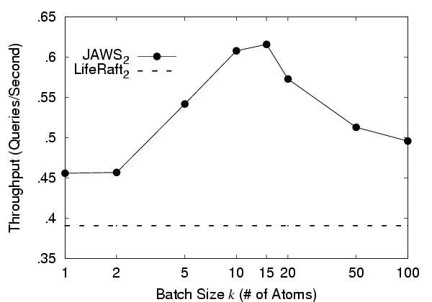
Sensitivity to Batch Size k
Small k fails to exploit locality
of reference in the computation
Large k impacts cache reuse and
conforms less to workload throughput
Notes:
Vary batch size k from two-level scheduling, depends on workload and amount of memory
Small k accesses the same atom multiple times on different passes
Large k evicts useful contents from cache and conforms less to the aged workload throughput metric

Slide 26
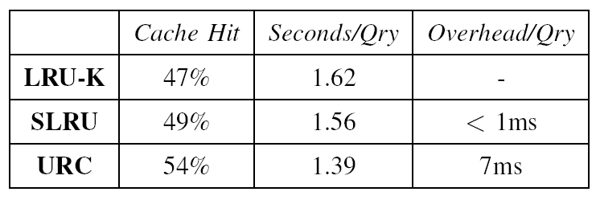
Sensitivity to Cache Replacement
Compare w/ SQL Server’s LRU-K based replacement
  Workload knowledge improves cache hit modestly
  URC and SLRU improves performance by 16% and 4%
  Low overhead optimizations for data intensive queries
Notes:
Cache managed externally by retrieving atoms from the DB and then flushing SQL Server’s buffer
Computation simulated in the database on a static set of atoms pinned in memory

