Slide 1
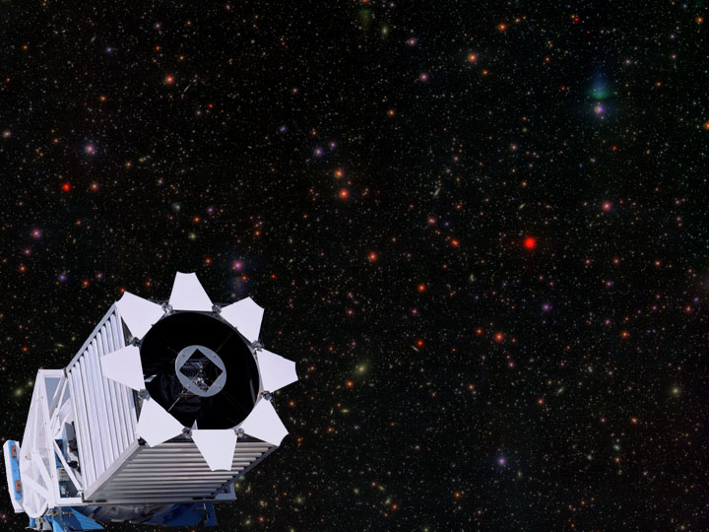
The Sloan Digital Sky Survey:
A Resource for College and High School Astronomy Courses
Julie Lutz and Kristine Washburn
University of Washington

Slide 2
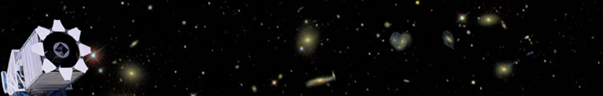

SDSS: a brief intro
Goals:
  To survey 10,000 sq. degrees of sky
  To construct a 3D map of our local universe
SDSS Education Resources:
  SkyServer
  sdss.org
    Education Page
    Image of the Week
  American Museum of Natural History

Slide 3
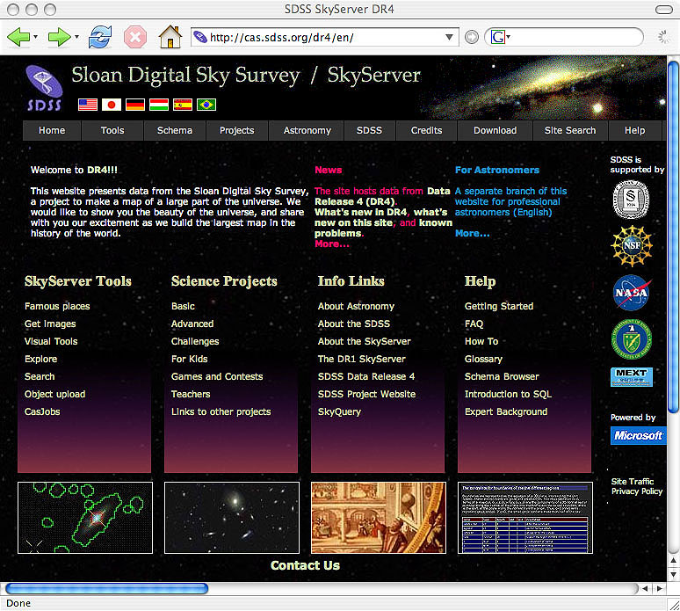
SkyServer
Visualization tools
Science projects

Slide 4
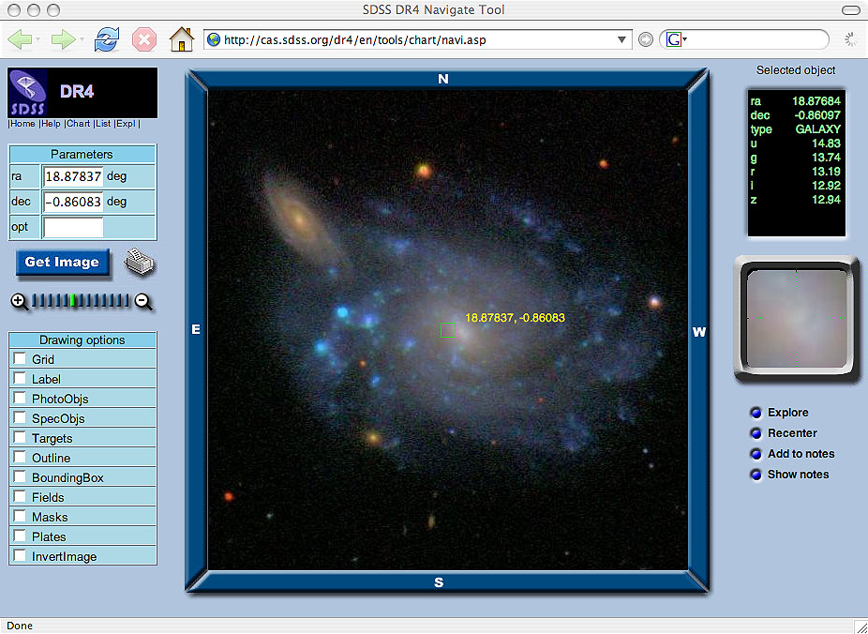
SkyServer

Slide 5
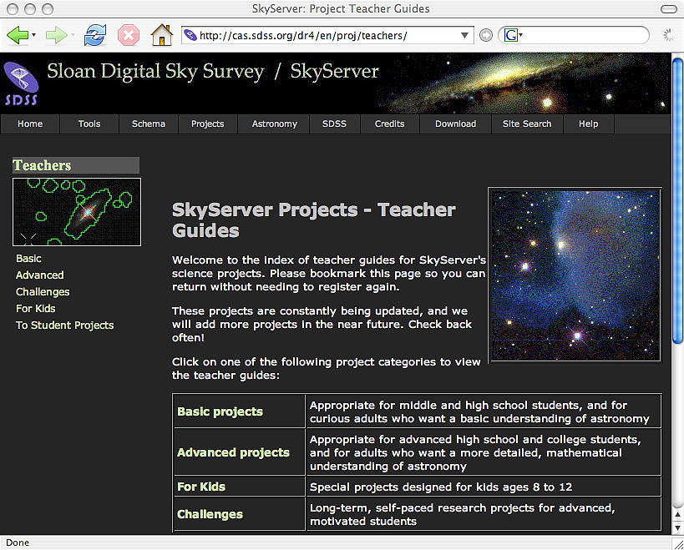
SkyServer
Parallel set of pages for educators
  Background
  Lesson plans
  Teaching tips
  Assessments
  Standards

Slide 6
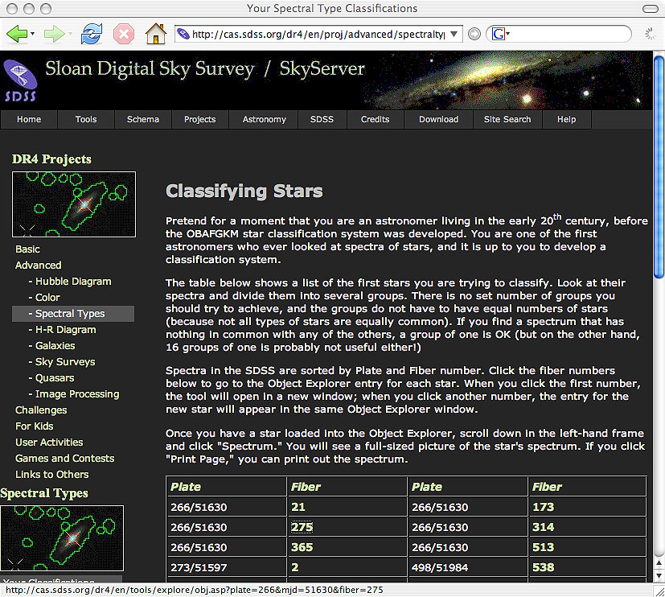
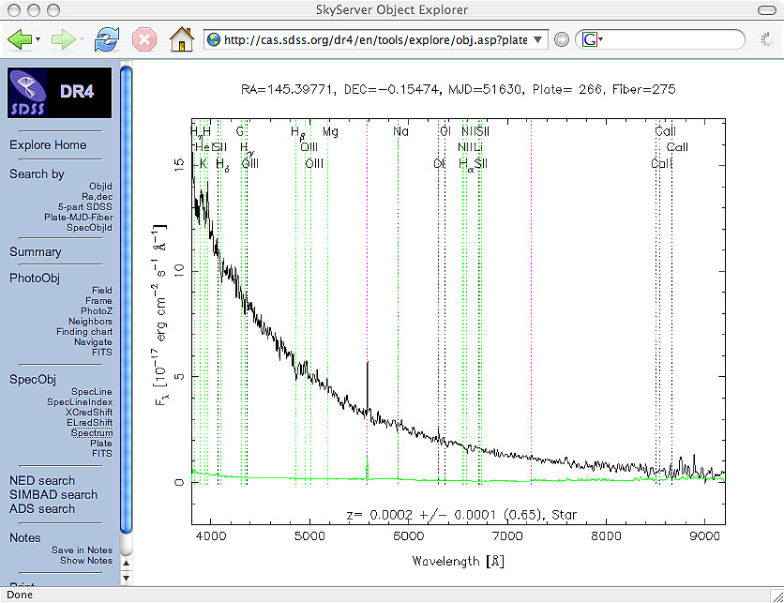
SkyServer
Sample Project: Classifying Stars

Slide 7
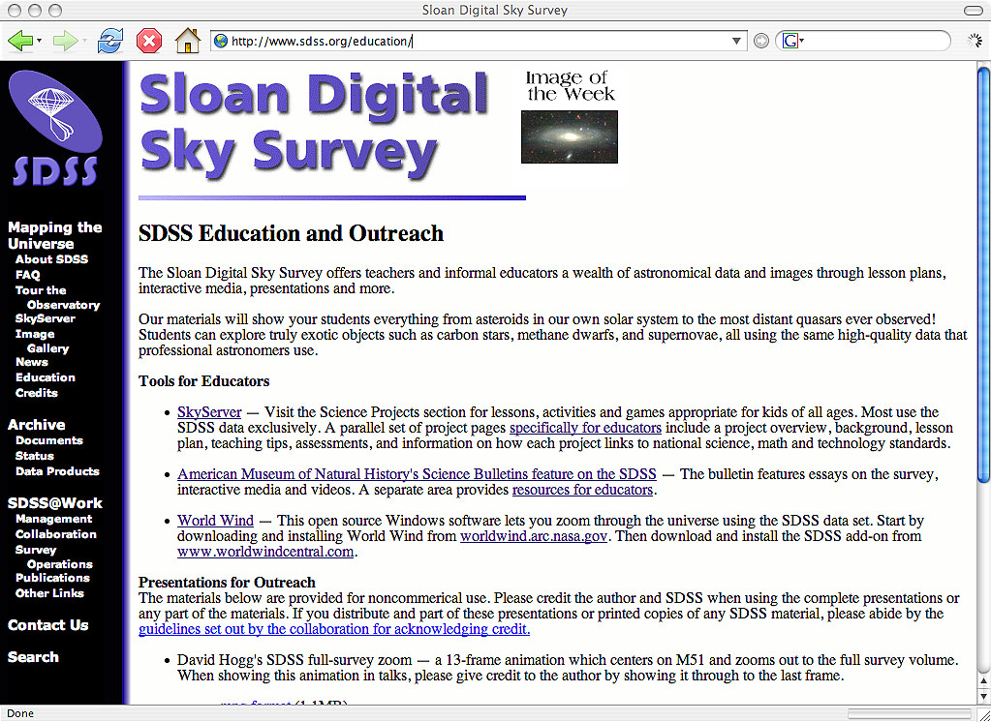
SDSS Education Page

Slide 8
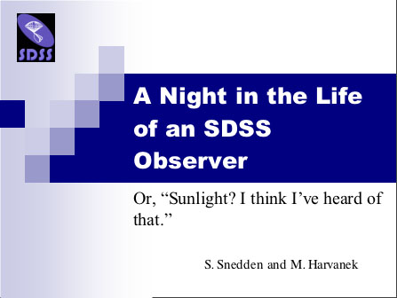
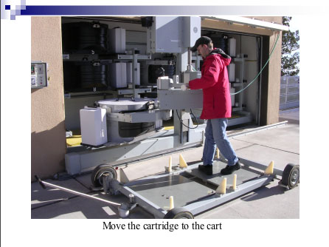
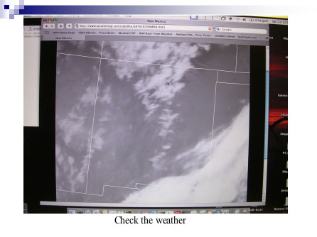
SDSS Education Page
Files from outreach talks given by SDSS collaborators

Slide 9
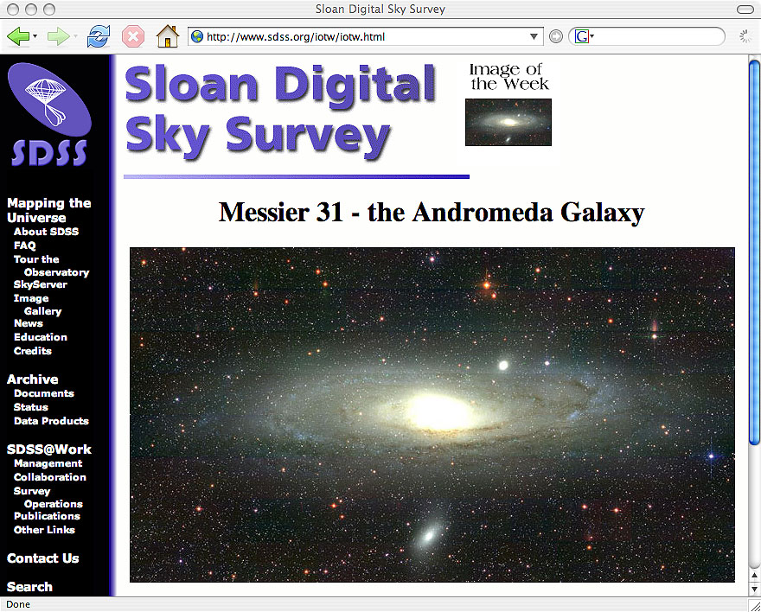
SDSS Image of the Week

Slide 10
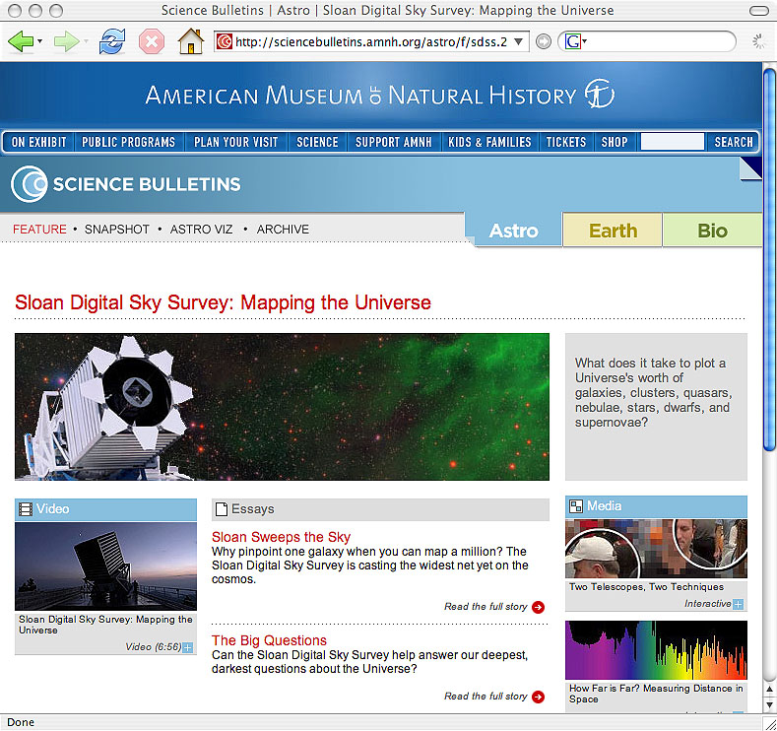
American Museum of Natural History
Essays on SDSS
Interactive media
Video
Resources for educators

Slide 11
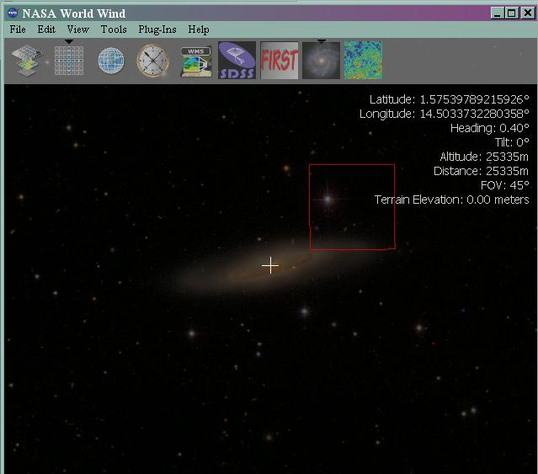
World Wind
“Google Earth” like program
Let’s you zoom around different data sets
  SDSS
  WMAP
  Mars
  Venus
  Earth
Look for link & info on sdss education page
Only works on pcs :-(

Slide 12
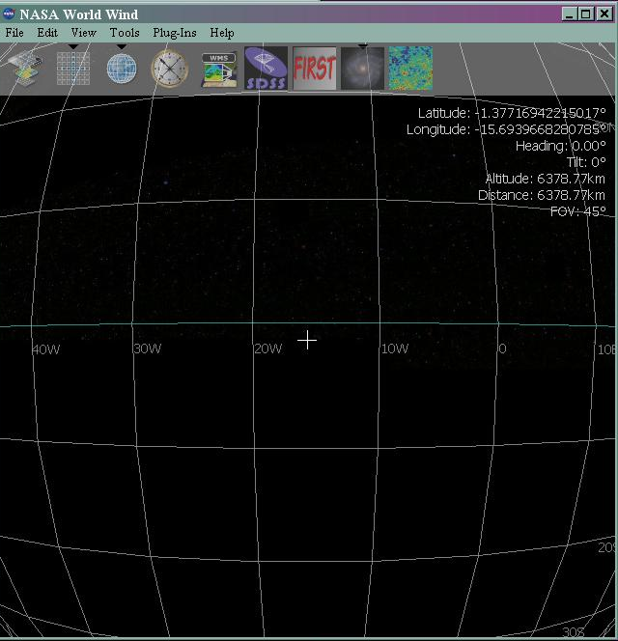
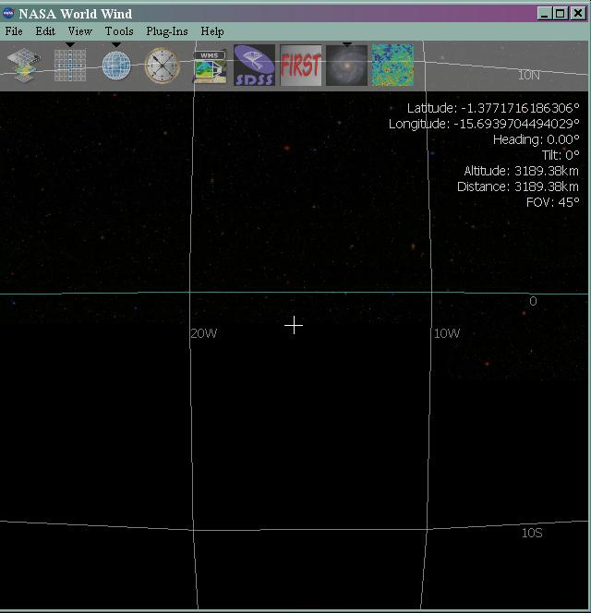
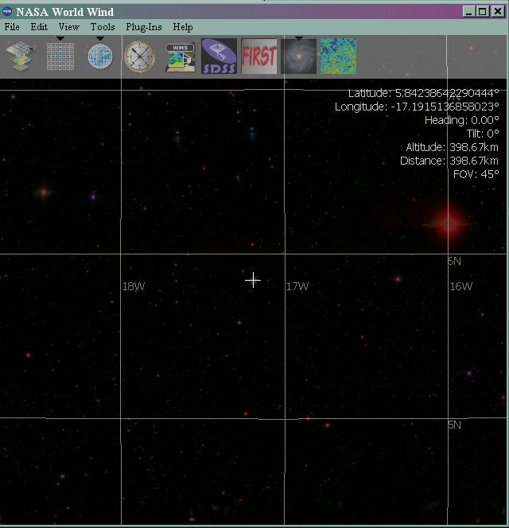
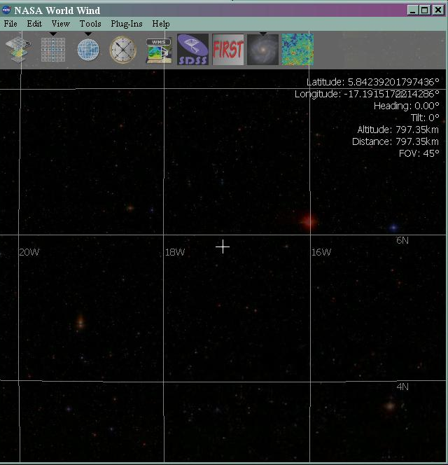


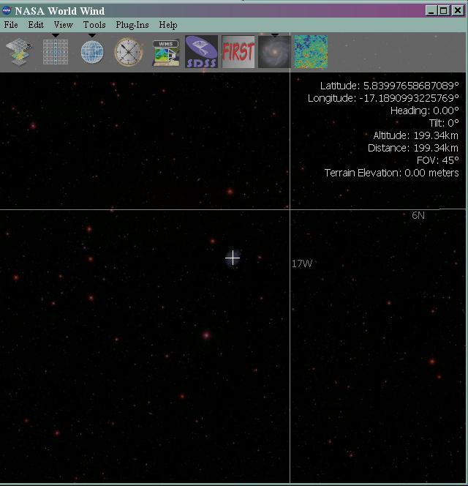
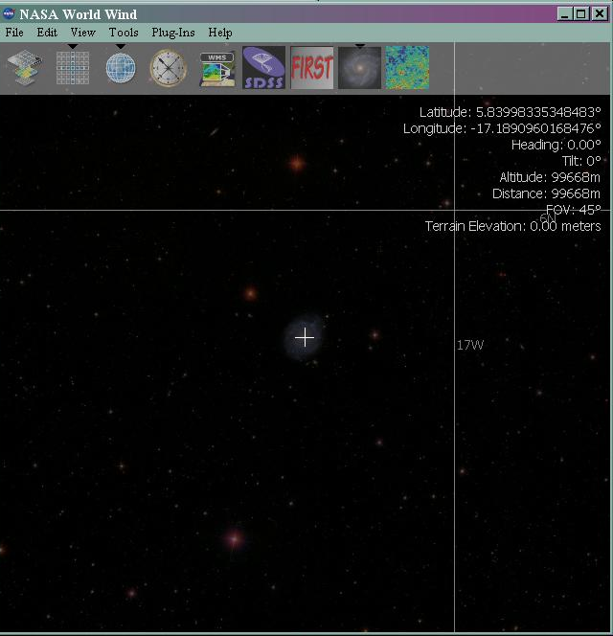


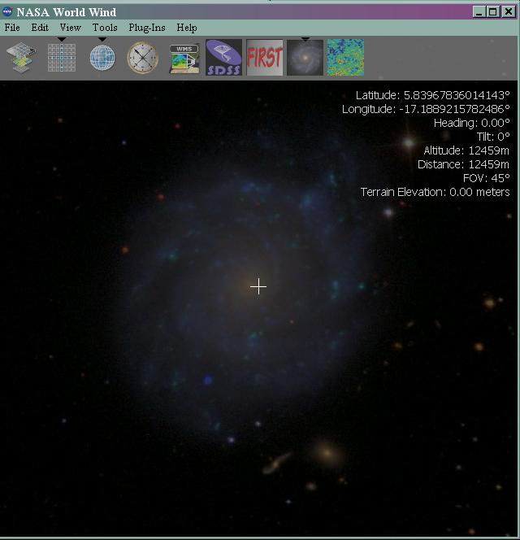
World Wind

Slide 13
SDSS EPO Workshop
Stay tuned for news on a possible SDSS resource workshop this summer!
Sign up for the SDSS EPO email list!

