Slide 1









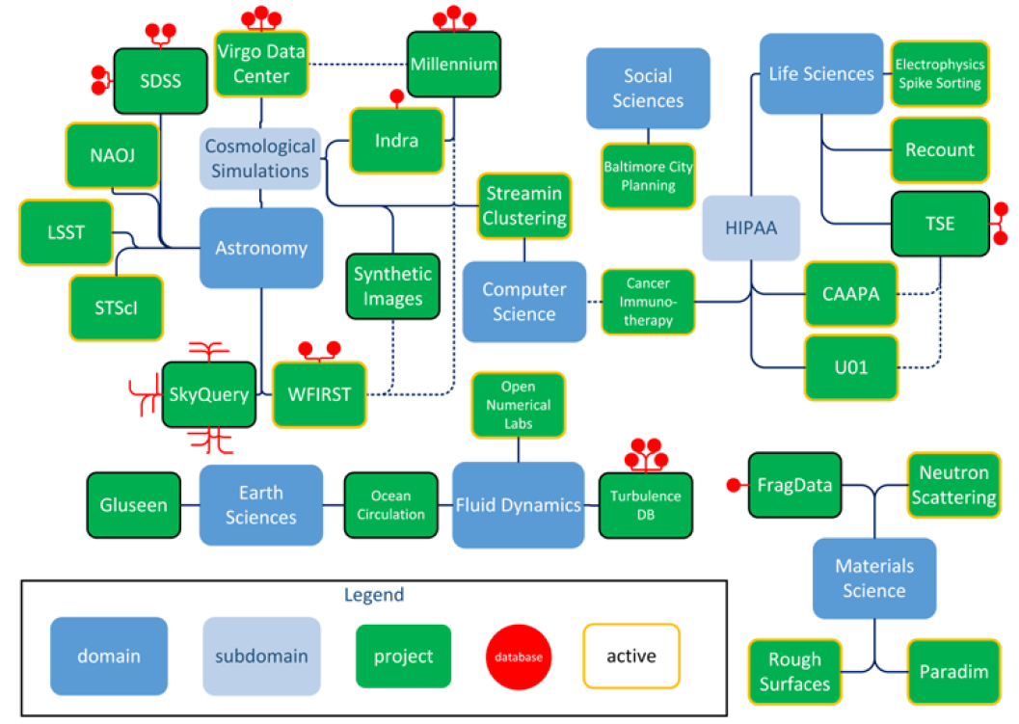






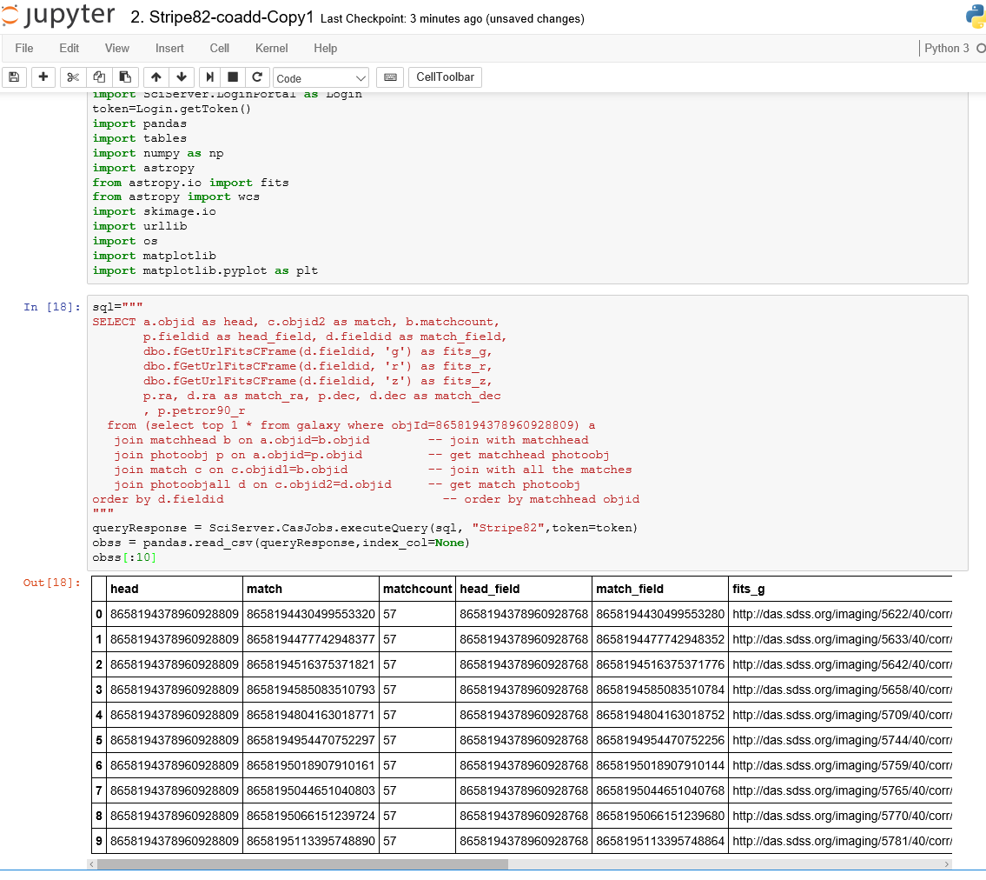
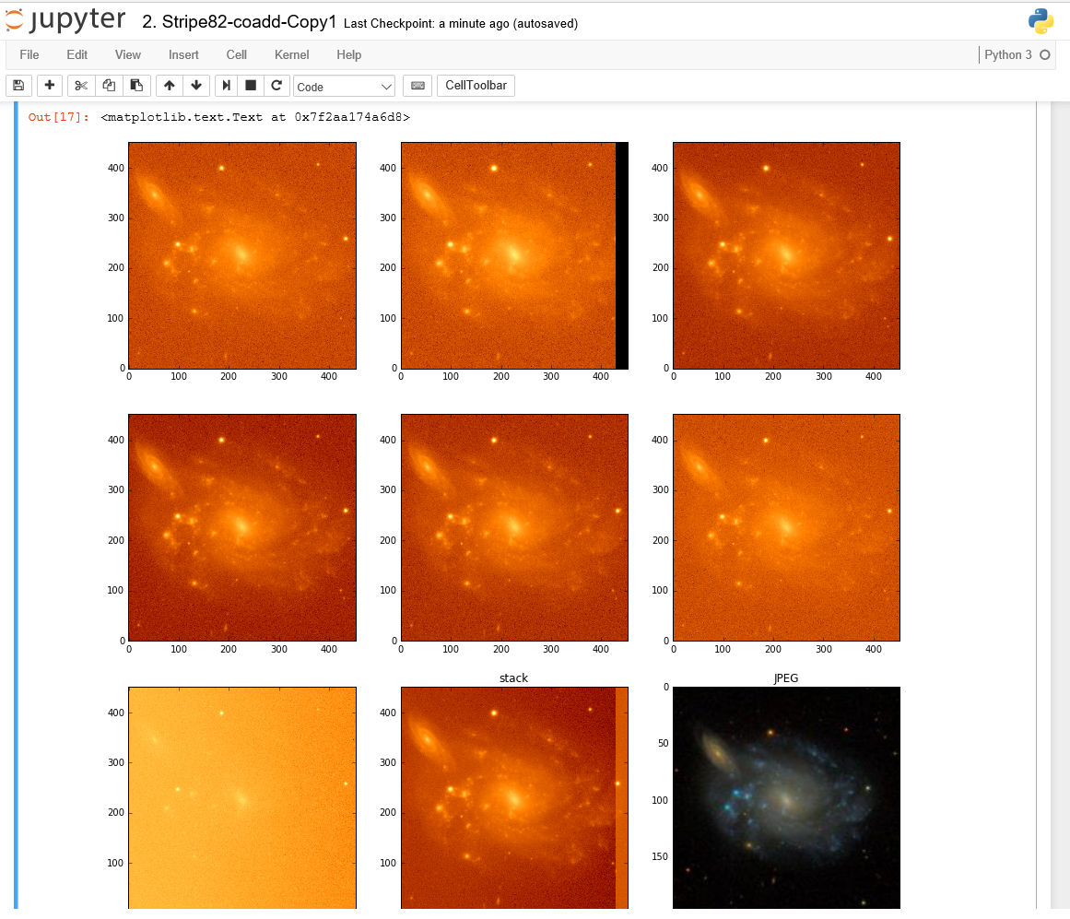
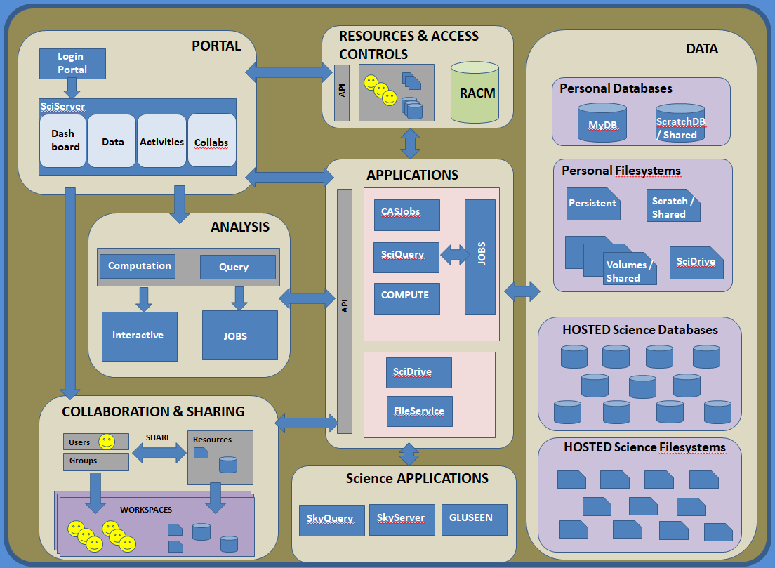
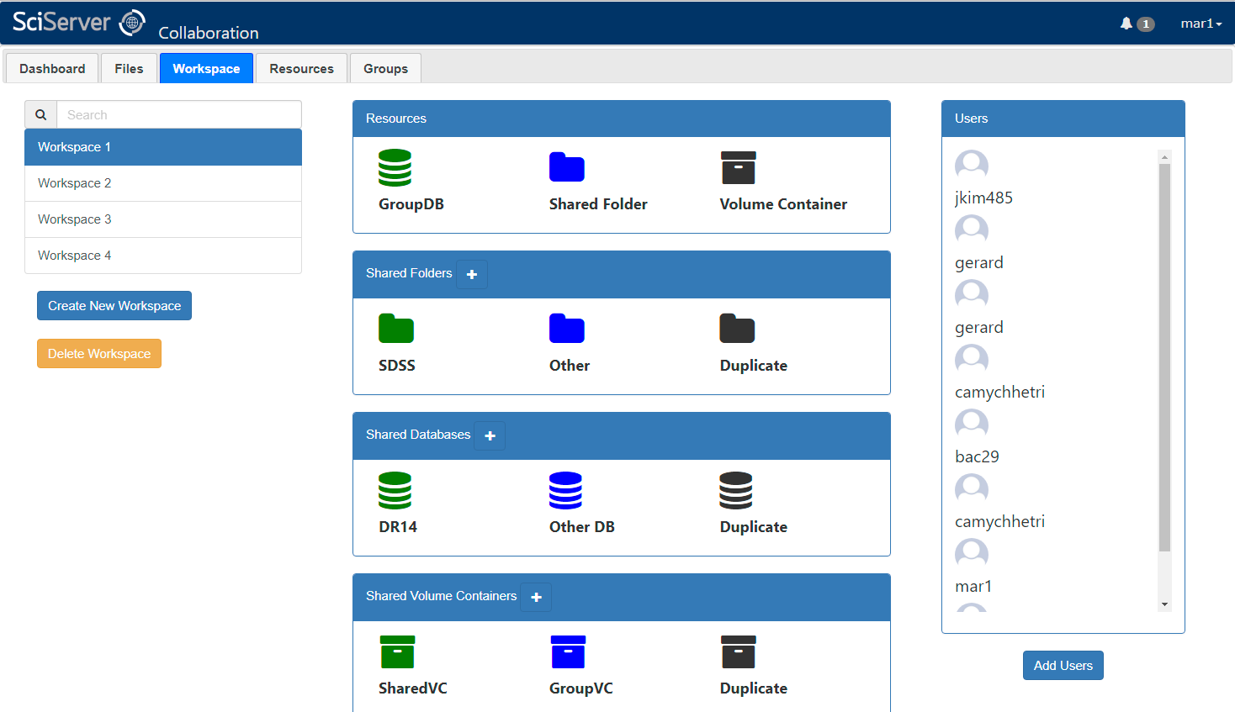
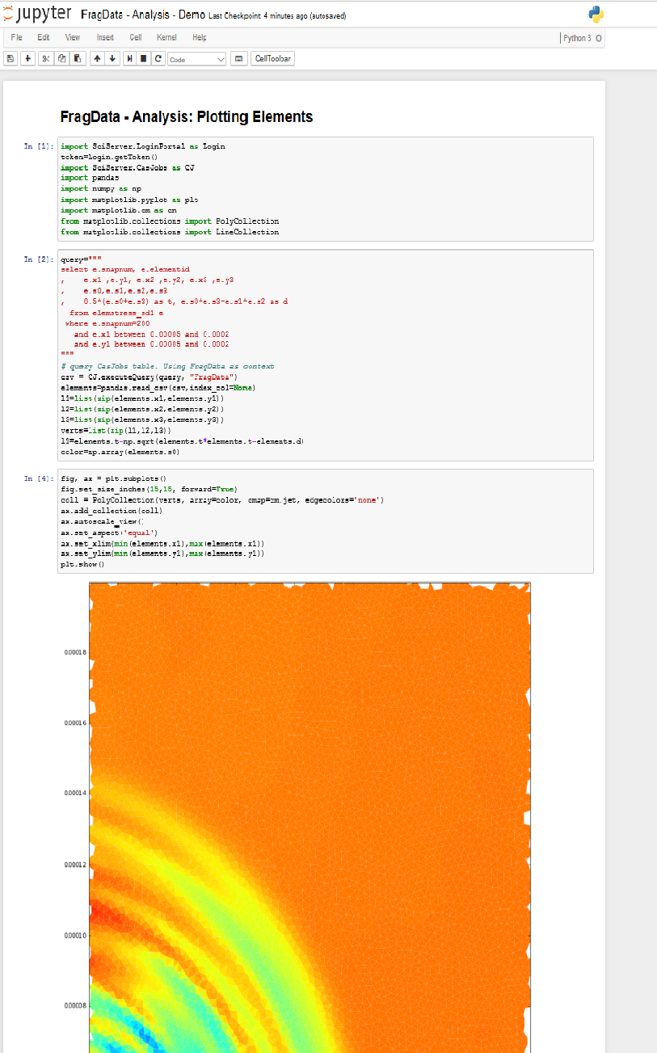
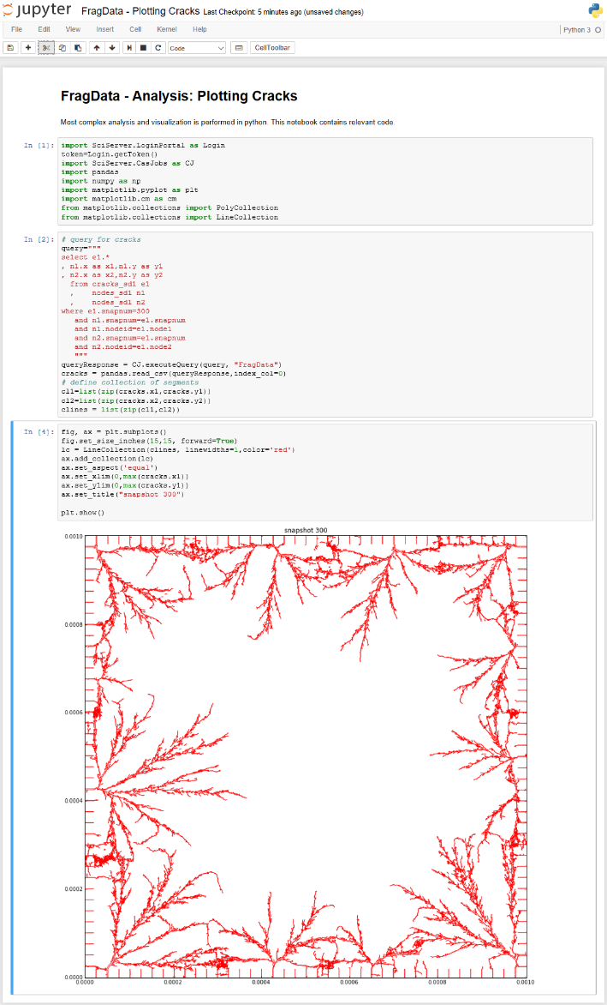
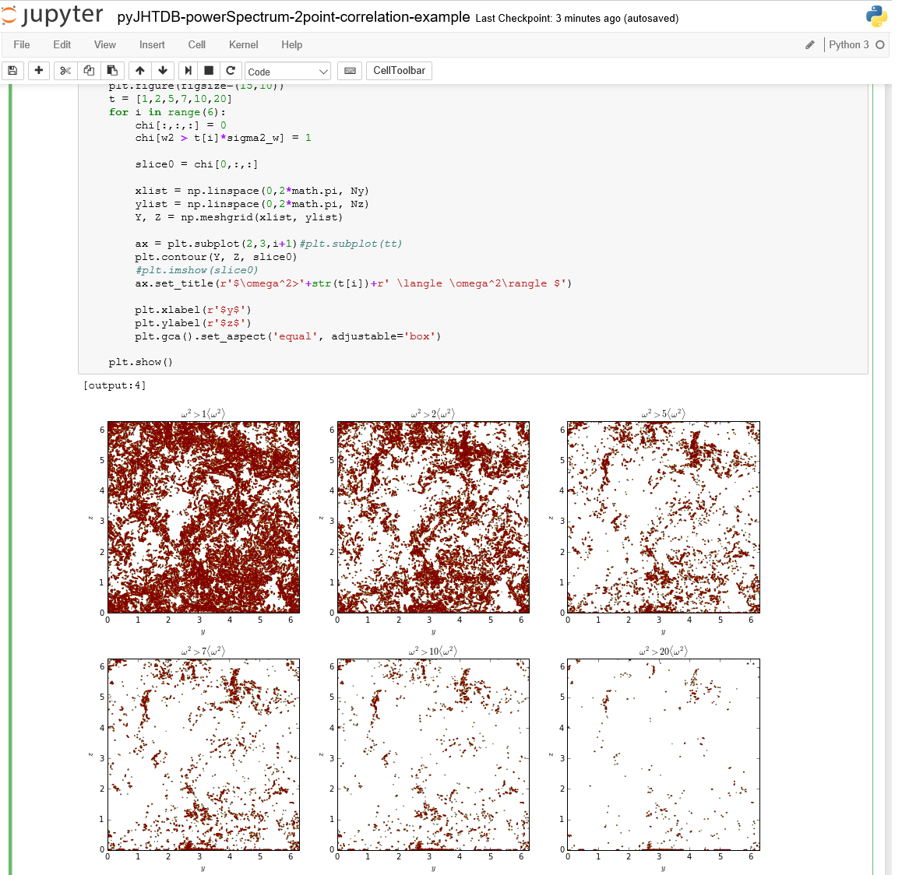
SciServer: Bringing Analysis Close to the Data
PI: Alex Szalay, JHU NSF AWARD No.: 1261715
TEAM
System and Services:
Technology & Features:
Science:
PI – Alex Szalay; PM – Mike Rippin
Team Leads – Ani Thakar, Gerard Lemson, Jordan Raddick, Bonnie Souter
Technical: Dmitry Medvedev, Manu Popp, Jai Won Kim, Sue Werner, Victor Paul, Jan Vandenberg, Lance Joseph, Alainna White, Laszlo Dobos, Camy Chhetri, Joseph Booker
What is SciServer?
SciServer is a system for Science Researchers across multiple domains to host and share their datasets, and provide query and analysis tools for collaborative research.
Core Services:
Science Data Hosting (Files and Databases)
Query and Data Integration
Compute Analysis
Collaboration and Sharing
Personal Storage (Files and Database)
API Integration
Single Sign-On
Collaborations
History & Motivation
Compute & Query Job Scheduling
Started with the SDSS SkyServer
Goal: instant access to rich content
Idea: bring the analysis to the data
Interactive access at the core
Compute Manager
D
D
D
D
D
Jupyter
Dashboard UI
PUSH
D
D
Script Job
Server Cluster
PULL
Async
SciDrive Plugins
PUSH
Script Job
Job Manager
Resource and Access Control Manager
Job List
Meta Data
ACLs
Resources
Applications (Examples)
Where are we Going
Interactive science on petascale data
Create scalable open numerical laboratories
Large footprint across many disciplines
Use commonly shared building blocks
Major national and international impact
PUSH
Script Job
PULL
Async
Astronomy
CASJobs
Compute Manager
D
D
D
D
D
D
D
Server Cluster
Collaborative Workspaces
User created and managed
Easily add Resources and Users
Shared Workspace folder and database
Configurable permissions
How to get Involved
Materials Science
Turbulence
Use our toolkit (www.sciserver.org)
Volunteer to be an Early Adopter by emailing sciserver-help@jhu.edu
Find bugs in our alpha system
Suggest new features
Let us help you share your data
Introduce us to other teams with data to share

Slide 2
PORTAL
RESOURCES & ACCESS CONTROLS
Login Portal
DATA
API
RACM
Personal Databases
SciServer UI
MyDB
ScratchDB / Shared
Dash board
Data
Activities
Collabs
APPLICATIONS
Personal Filesystems
CASJobs
Persistent
Scratch / Shared
ANALYSIS
JOBS
Computation
SciQuery
Volumes / Shared
SciDrive
Query
API
COMPUTE
Interactive
JOBS
HOSTED Science Databases
SciDrive
COLLABORATION & SHARING
FileService
Users
SHARE
Resources
HOSTED Science Filesystems
Groups
Science APPLICATIONS
WORKSPACES
WORKSPACES
SkyQuery
SkyServer
GLUSEEN

