Slide 1




Collaborative Data-Driven Science
sciserver.org

Slide 2
Bringing data-driven science to the cloud!
Providing WEB APPS for:
-Seamless data storage, sharing and transfer.
-Data analysis with Python, R and MATLAB,
with fast data access and loading.
-Easy access of very large scientific datasets.

Slide 3

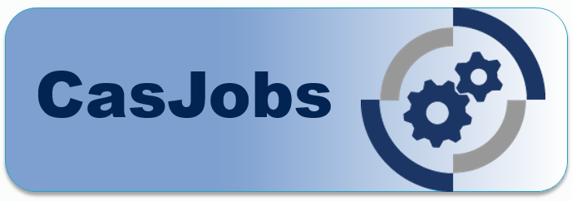



Main components:

Slide 4

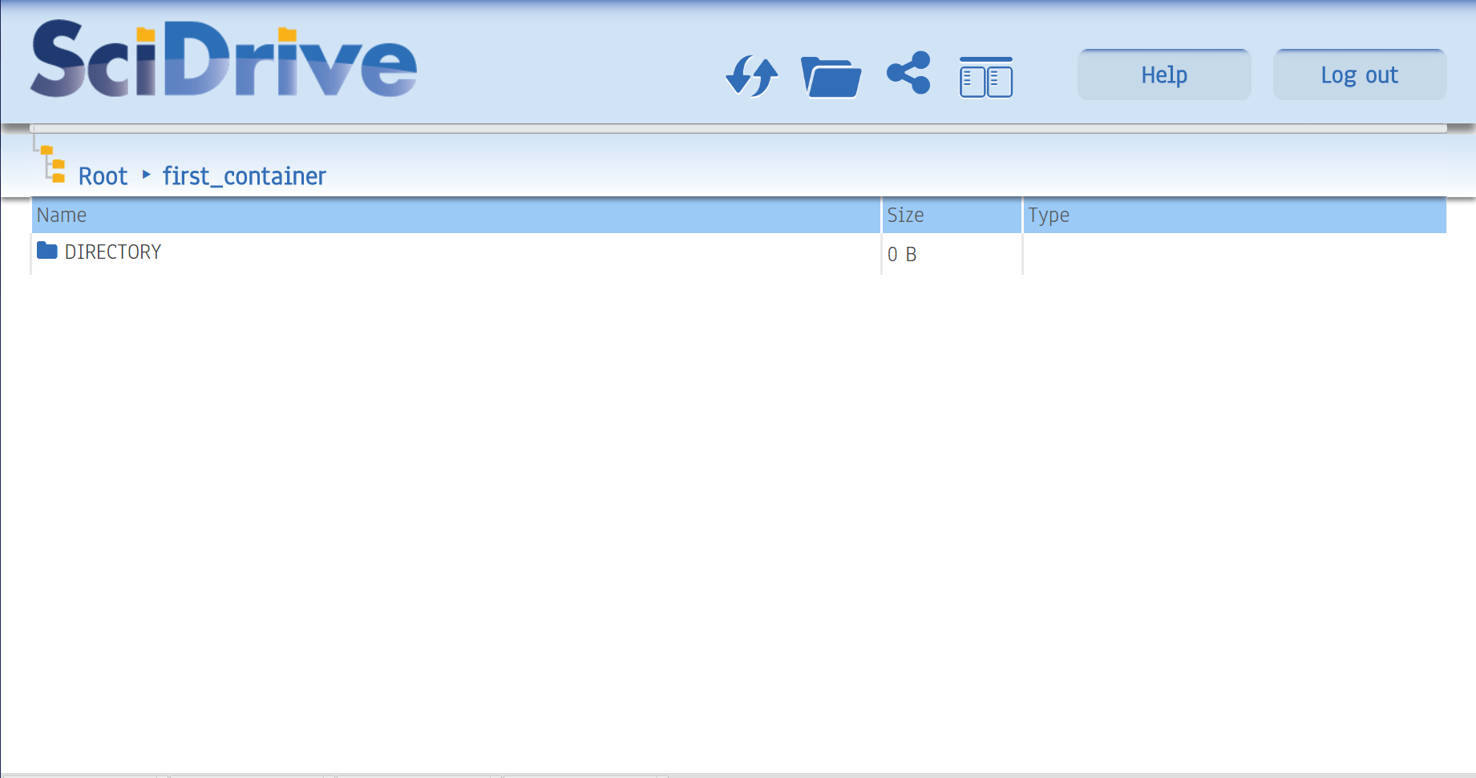
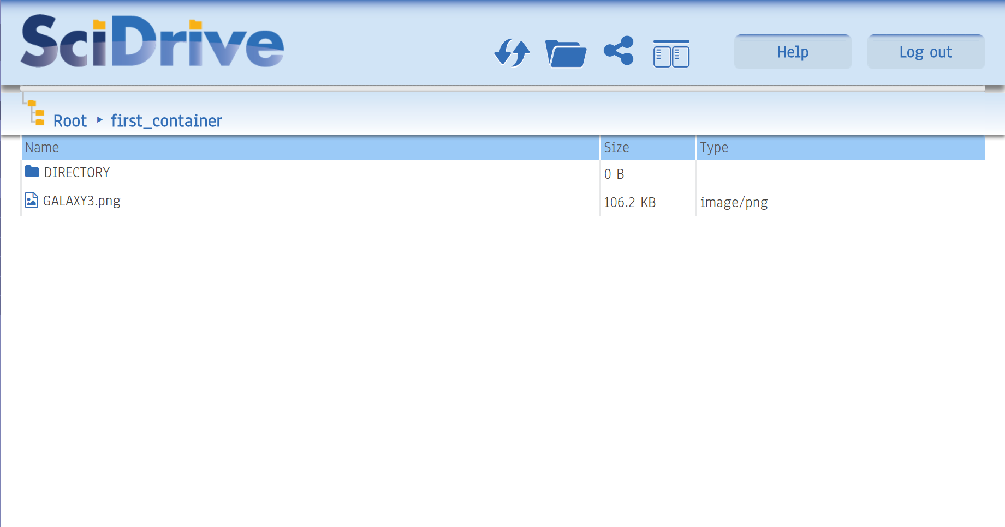
FILE STORAGE & SHARING

Slide 5
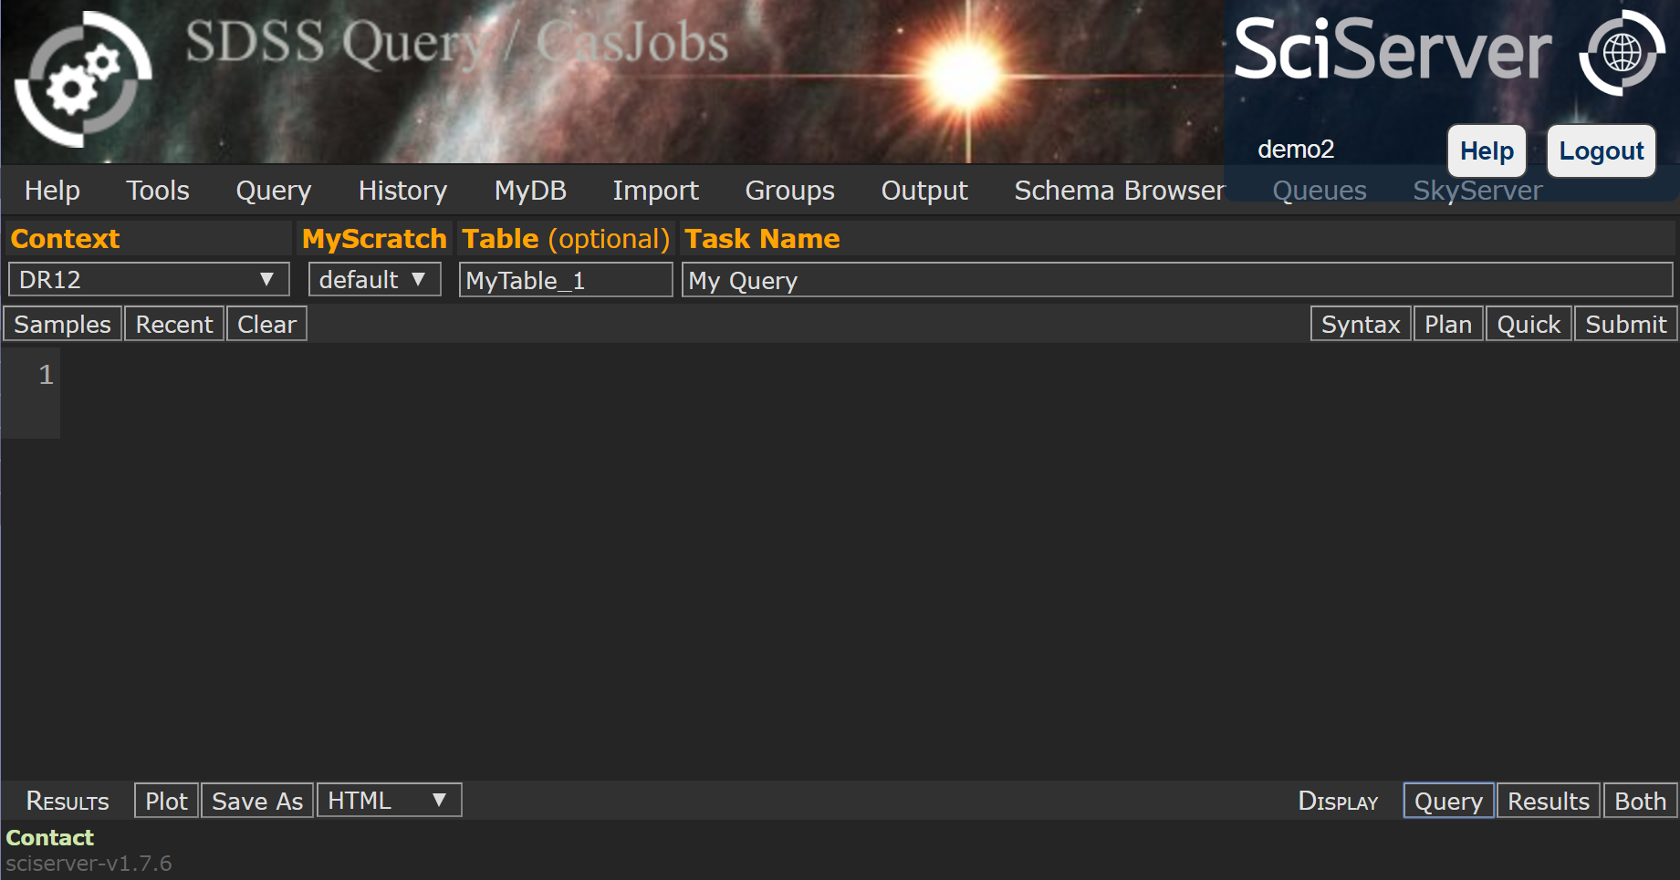
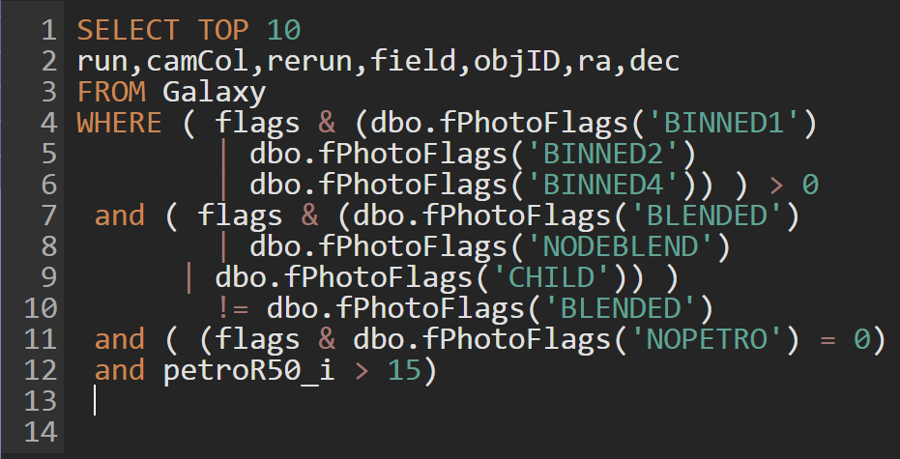
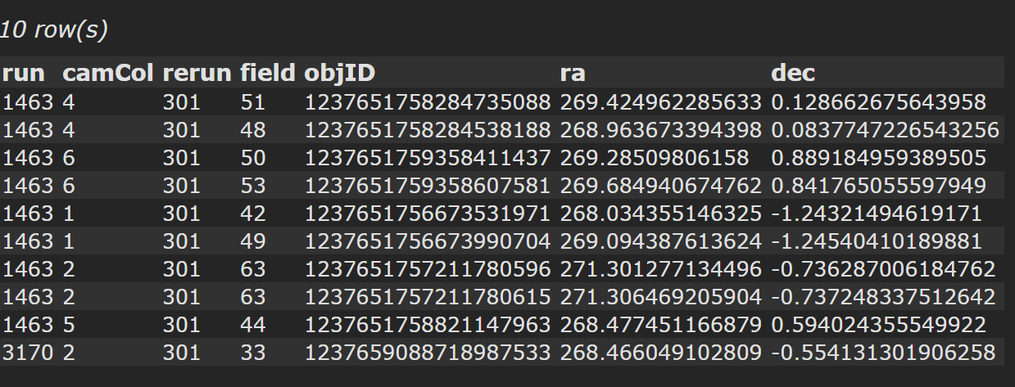
Access huge data-sets.
Get your own database.
Explore table results.
Write SQL queries

Slide 6

Send your tables to SciDrive.

Slide 7
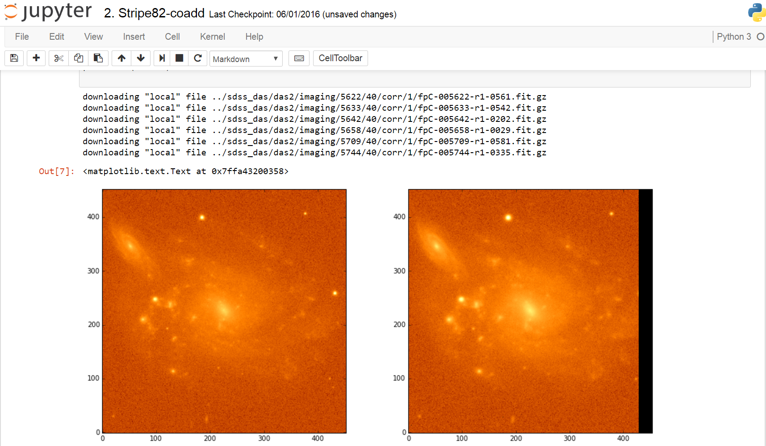
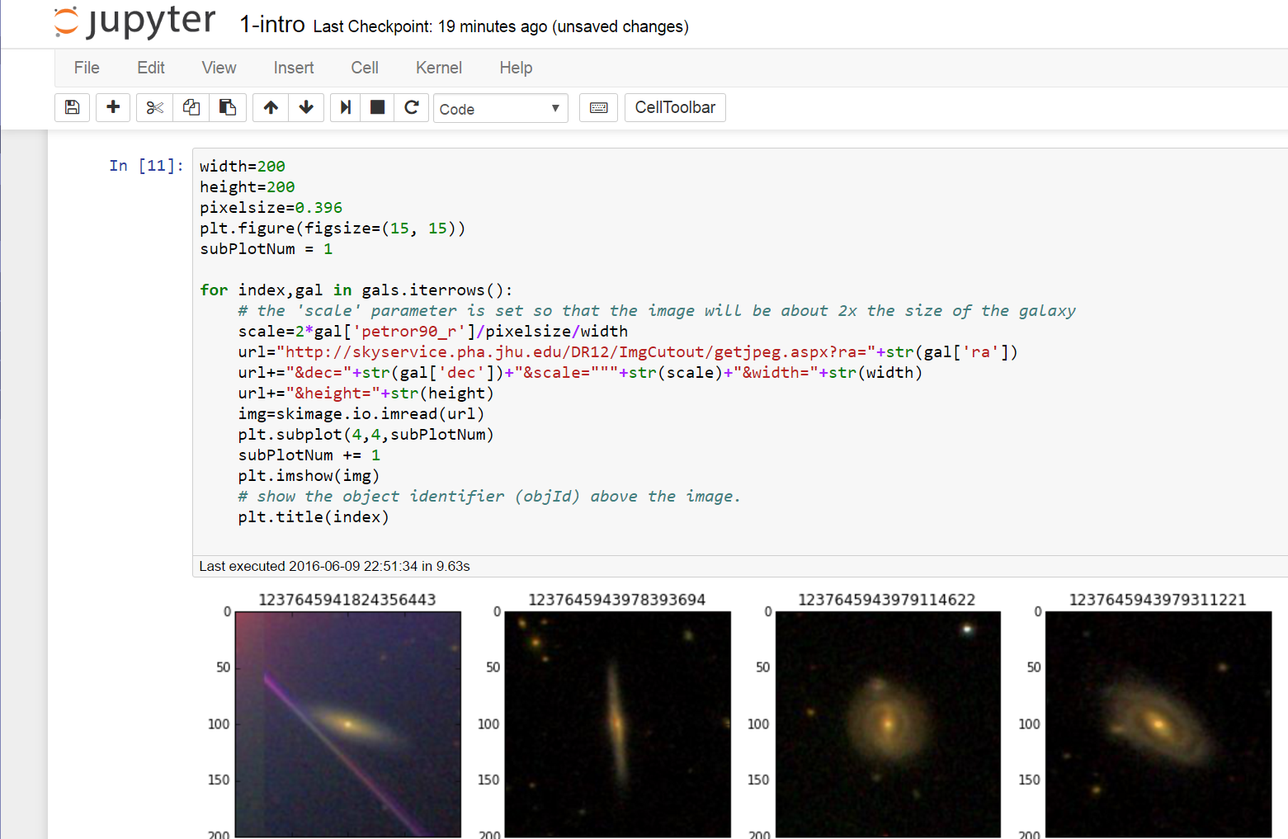
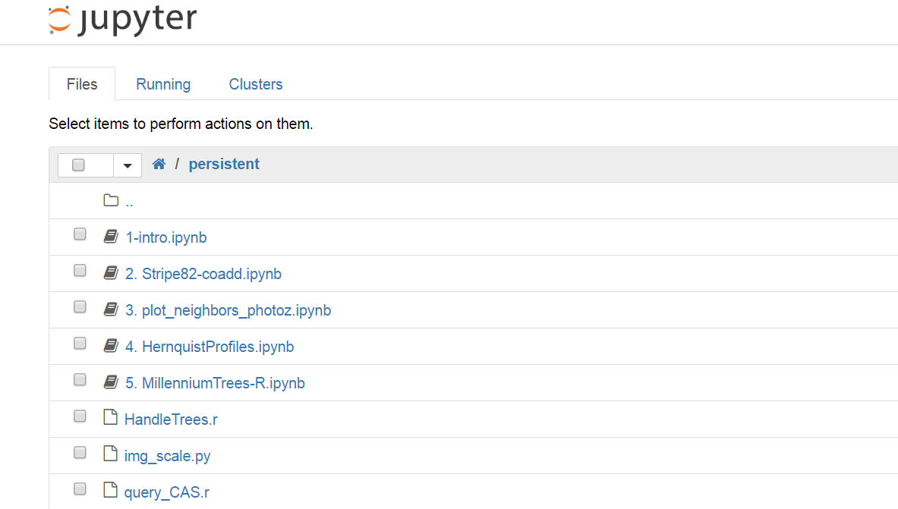

Analyze data using Python, R, Matlab
inside Jupyter Notebooks
Run scripts
Create graphics
Access local
directories
Store your scripts in a persistent folder

Slide 8



Seamless file transfer to and from CasJobs and SciDrive.

Slide 9
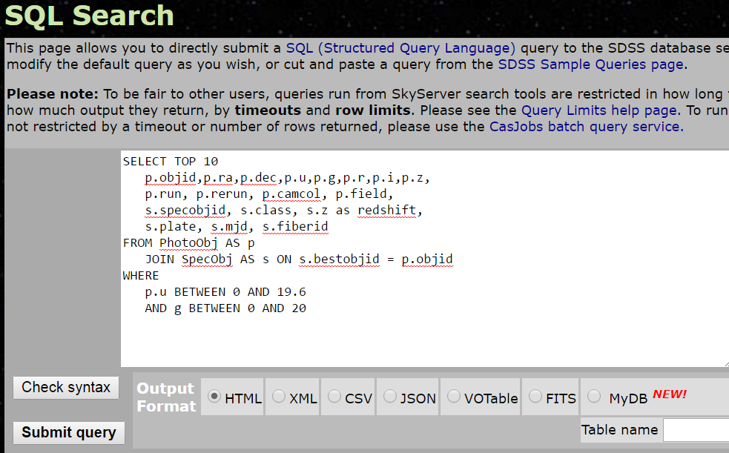
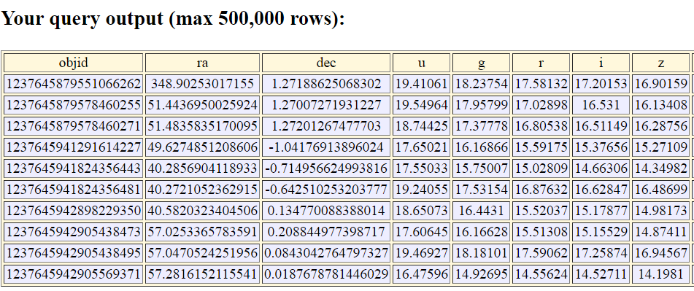
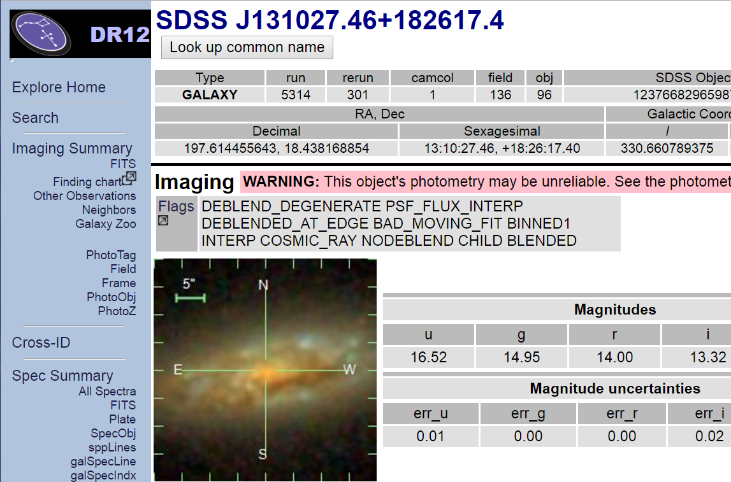
Access SDSS astronomical dataset.
Explore astronomical objects
Run SQL queries
against SDSS data

Slide 10
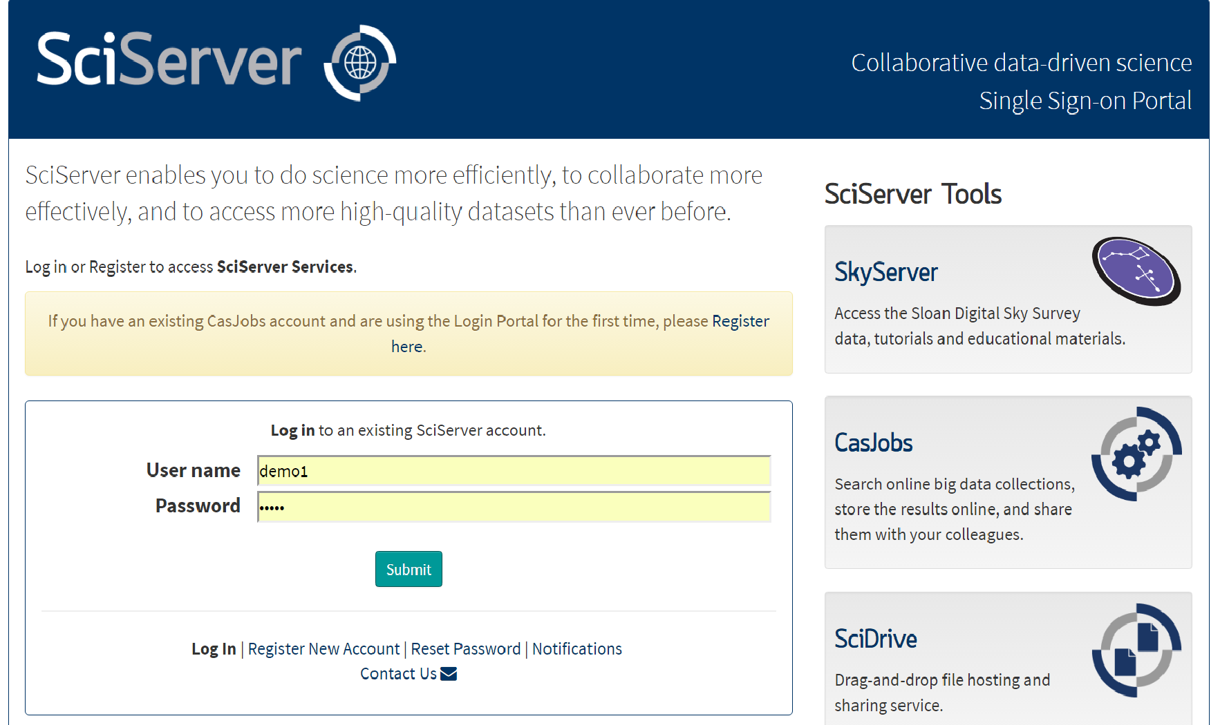
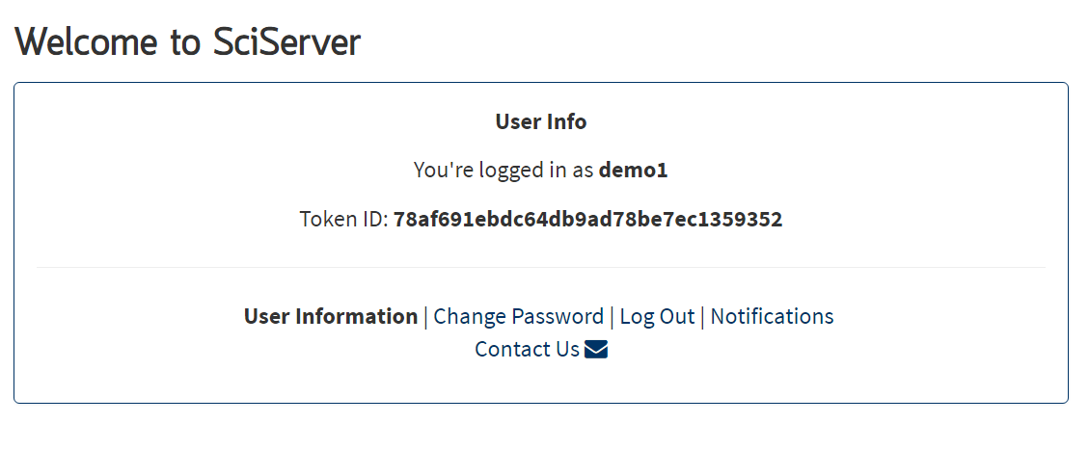
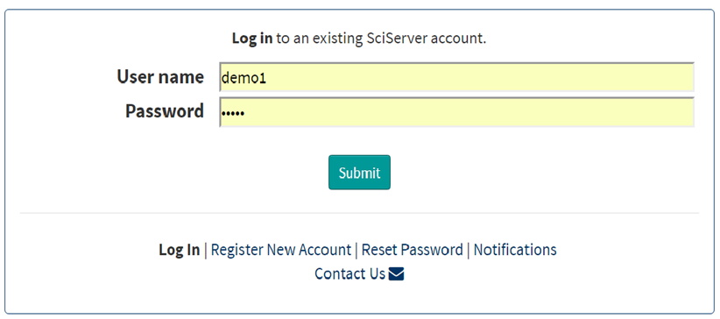

Single sign on
across all components

Slide 11
More Information:
www.sciserver.org
Sciserver-webmaster@jhu.edu
SciServer is funded by
the National Science Foundation through its
Data Infrastructure Building Blocks (DIBBs) Program,
Award ACI-1261715

