Slide 1









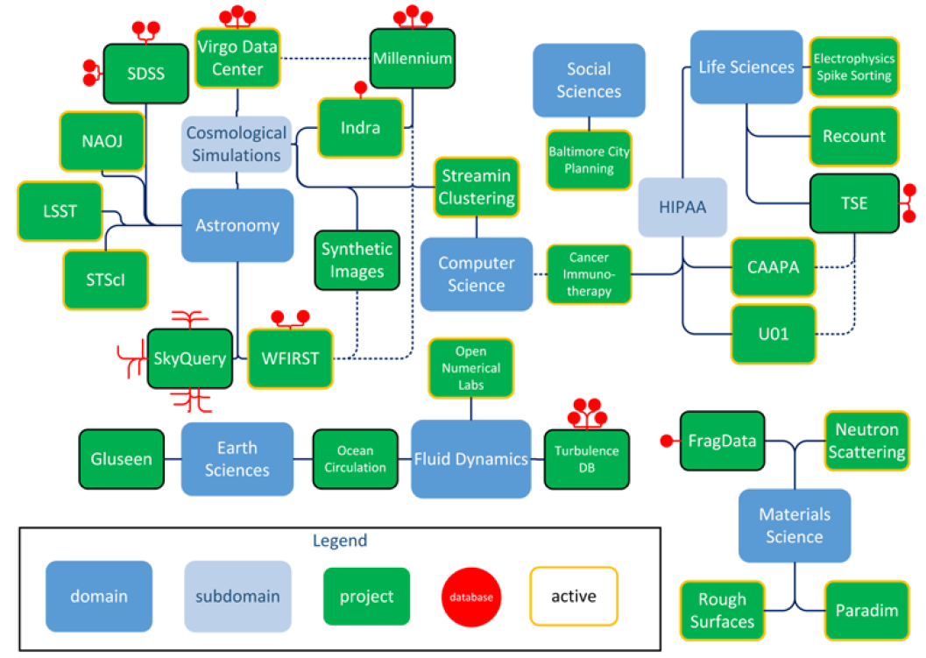






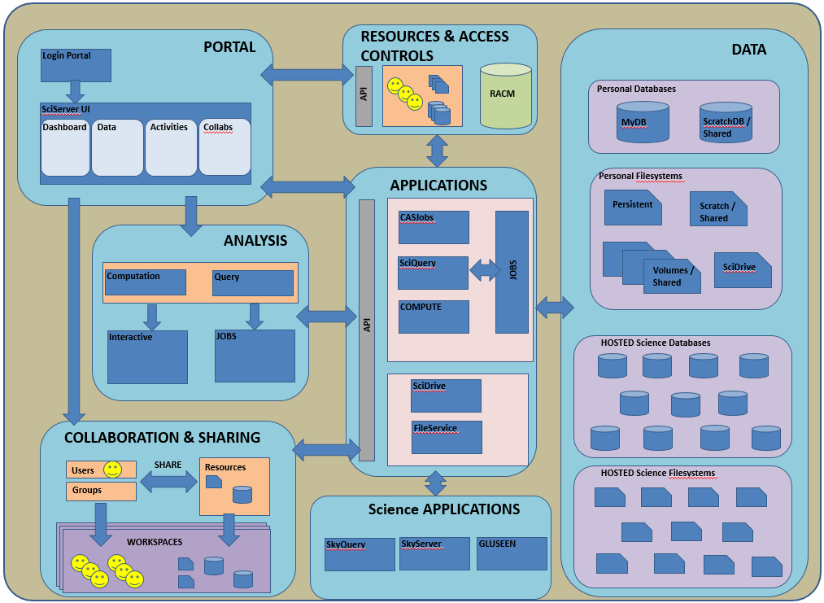
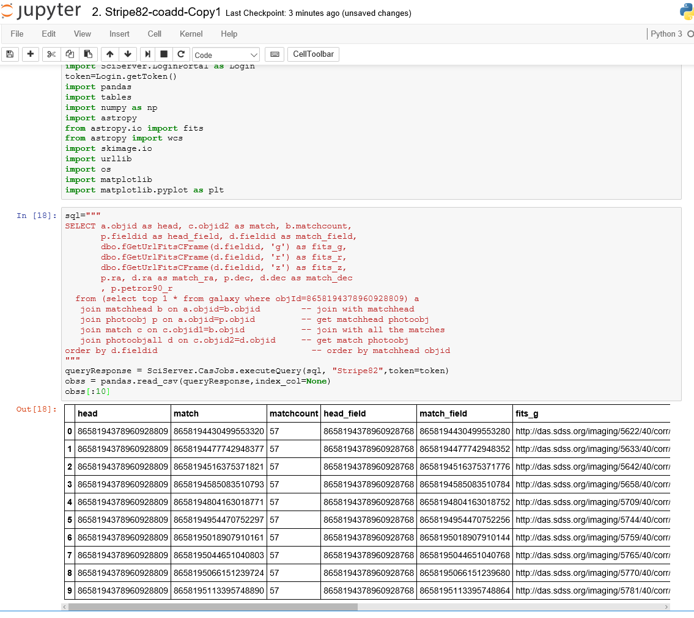
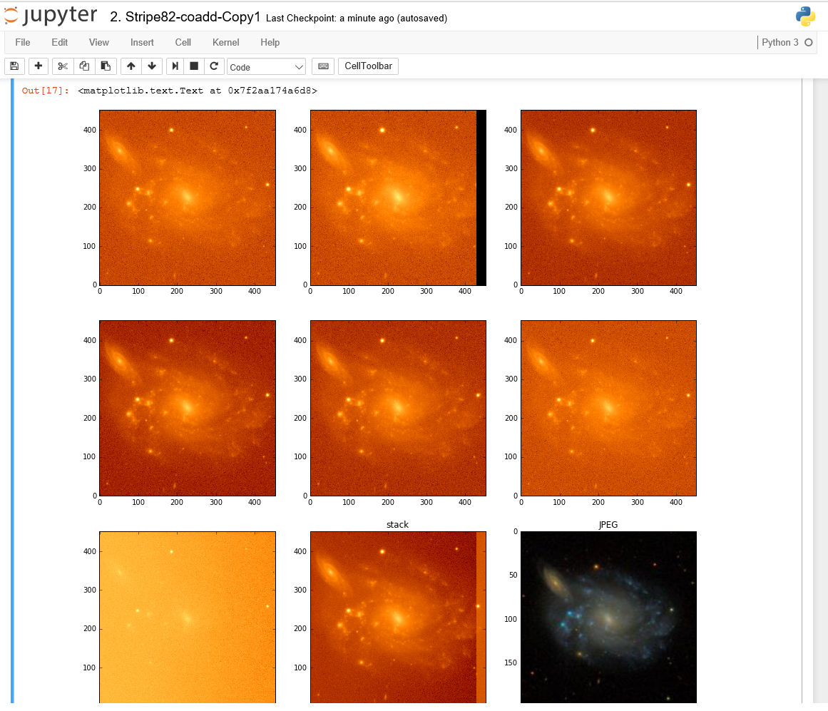
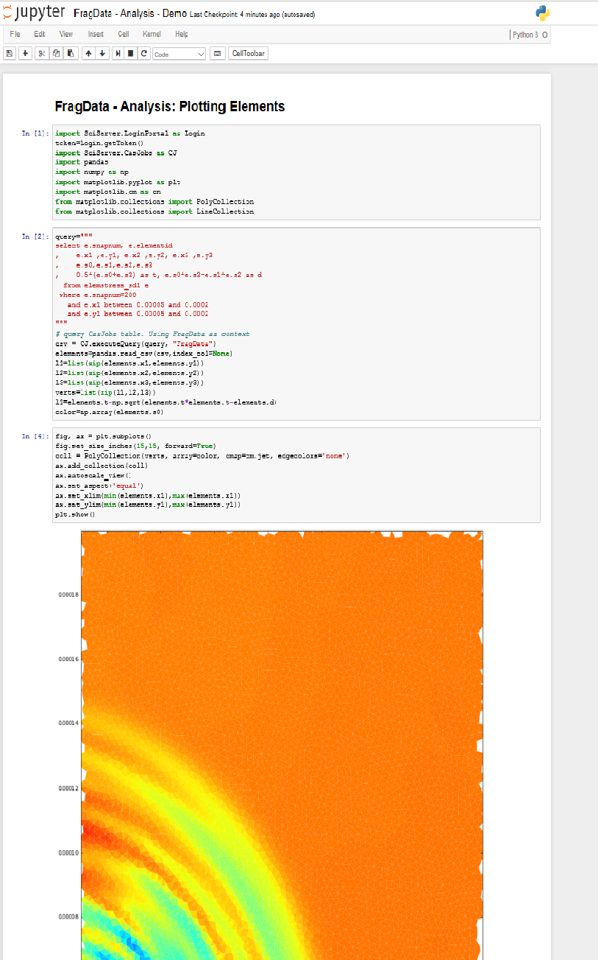
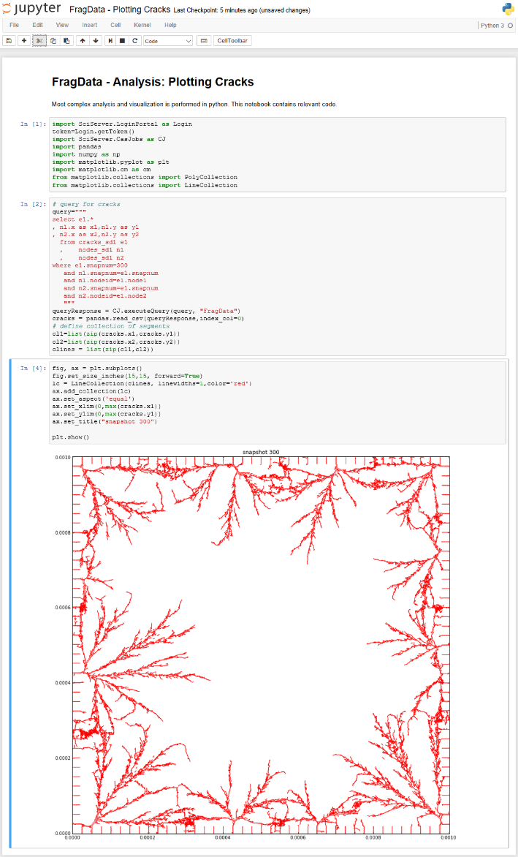
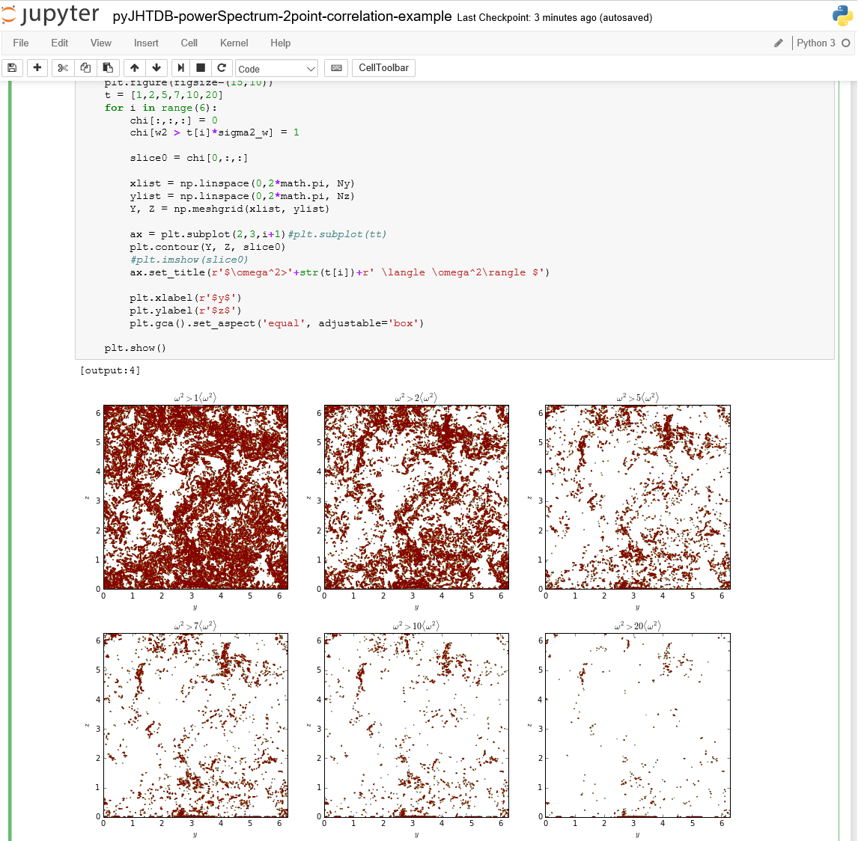
SciServer: Bringing Analysis Close to the Data
PI: Alex Szalay, JHU NSF AWARD No.: 1261715
TEAM
System and Capabilities:
Technology & Features:
Science:
PI – Alex Szalay; PM – Mike Rippin
Team Leads – Ani Thakar, Gerard Lemson, Jordan Raddick, Bonnie Souter
Technical: Dmitry Medvedev, Manu Popp, Jai Won Kim, Sue Werner, Victor Paul, Jan Vandenberg, Lance Joseph, Alainna White, Laszlo Dobos
What is SciServer?
Collaborations
SciServer is a system for Scinece Researchesr to hoset and share their datasets etc etc. The key features are:
1. Dsds 2. dsdsdsd 3. dssdsdsd
History & Motivation
Collaborative Workspaces
Started with the SDSS SkyServer
Goal: instant access to rich content
Idea: bring the analysis to the data
Interactive access at the core
Users
Groups
Workspaces – Simple Collaborative Environment for Projects and Teams. Provides shared folder and database space. Can share personal and science domain data.
[Domains]
[Regions]
FileSharing
FolderSharing
Database sharing
Readonly /Writeable Permissions
Where are we Going
Applications (add genomics & GLUSEEN examples if space permits)
Interactive science on petascale data
Create scalable open numerical laboratories
Large footprint across many disciplines
Use commonly shared building blocks
Major national and international impact
Astronomy
Compute & Query Job Scheduling
Compute Manager
D
D
D
D
D
Jupyter
Dashboard UI
PUSH
D
D
How to get Involved
Script Job
Server Cluster
Materials Science
Turbulence
Use our toolkit (www.sciserver.org)
Volunteer to be an Early Adopter by emailing sciserver-help@jhu.edu
Find bugs in our alpha system
Suggest new features
Let us help you share your data
Introduce us to other teams with data to share
PULL
Async
SciDrive Plugins
PUSH
Script Job
Job Manager
Resource and Access Control Manager
Job List
Meta Data
ACLs
Resources
PUSH
Script Job
PULL
Async
CASJobs
Compute Manager
D
D
D
D
D
D
D
Server Cluster

Slide 2
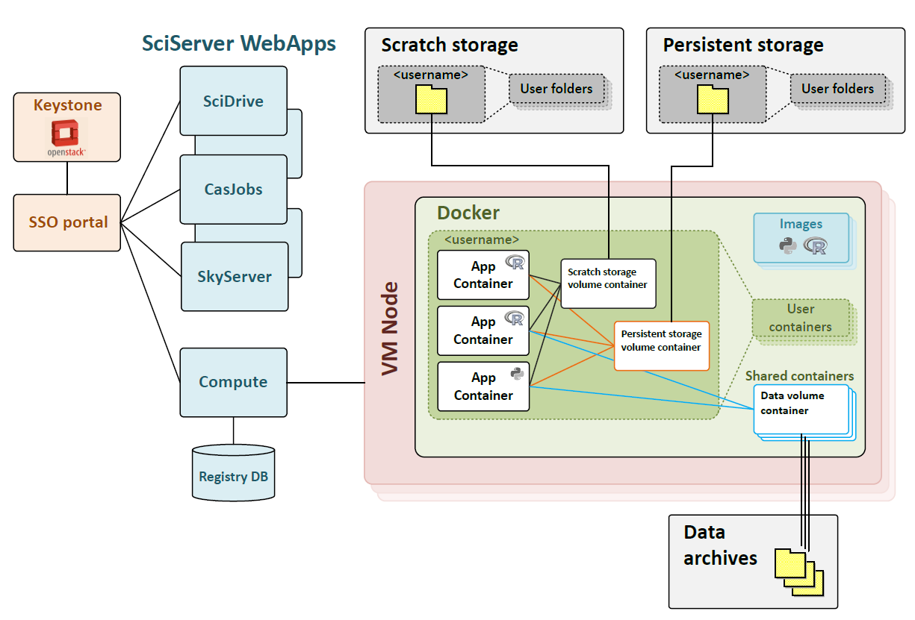
SciServer: Bringing Analysis Close to the Data
PI: Alex Szalay, JHU NSF AWARD No.: 1261715
TEAM
System:
Technology:
Science:
PI – Alex Szalay; PM – Mike Rippin
Team Leads – Ani Thakar, Gerard Lemson, Jordan Raddick, Bonnie Souter
Technical: Dmitry Medvedev, Manu Popp, Jai Won Kim, Sue Werner, Victor Paul, Jan Vandenberg, Lance Joseph, Alainna White, Laszlo Dobos
Collaborations
History & Motivation
Compute
Compute
Started with the SDSS SkyServer
Goal: instant access to rich content
Idea: bring the analysis to the data
Interactive access at the core
Where are we Going
Applications
Interactive science on petascale data
Create scalable open numerical laboratories
Large footprint across many disciplines
Use commonly shared building blocks
Major national and international impact
Astronomy
Compute Job Scheduling
Compute Job Scheduling
Compute Manager
D
D
D
D
D
Jupyter
Dashboard UI
PUSH
D
D
Script Job
Server Cluster
Materials Science
Turbulence
PULL
Async
SciDrive Plugins
PUSH
Script Job
Job Manager
Resource and Access Control Manager
Job List
Meta Data
ACLs
Resources
PUSH
Script Job
PULL
Async
CASJobs
Compute Manager
D
D
D
D
D
D
D
Server Cluster

Slide 3
PORTAL
RESOURCES & ACCESS CONTROLS
Login Portal
DATA
API
RACM
Personal Databases
SciServer UI
ScratchDB / Shared
Dashboard
Data
Activities
Collabs
MyDB
APPLICATIONS
Personal Filesystems
Persistent
Scratch / Shared
CASJobs
ANALYSIS
SciQuery
JOBS
Computation
Query
Volumes / Shared
SciDrive
API
COMPUTE
Interactive
JOBS
HOSTED Science Databases
SciDrive
COLLABORATION & SHARING
FileService
Users
SHARE
Resources
HOSTED Science Filesystems
Groups
Science APPLICATIONS
WORKSPACES
SkyQuery
SkyServer
GLUSEEN
WORKSPACES

Slide 4
PORTAL
RESOURCES & ACCESS CONTROLS
Login Portal
DATA
API
RACM
Personal Databases
SciServer UI
ScratchDB / Shared
Dashboard
Data
Activities
Collabs
MyDB
Personal Filesystems
ANALYSIS
Persistent
Scratch / Shared
Computation
Query
APPLICATIONS
Volumes / Shared
SciDrive
CASJobs
Interactive
JOBS
JOBS
SciQuery
HOSTED Science Databases
COLLABORATION & SHARING
API
COMPUTE
Users
SHARE
Resources
Groups
SciDrive
WORKSPACES
FileService
HOSTED Science Filesystems
WORKSPACES
Science APPLICATIONS
SkyQuery
SkyServer
GLUSEEN

Slide 5





SciServer: Bringing Analysis Close to the Data
PI: Alex Szalay, JHU NSF AWARD No.: 1261715
TEAM
System:
Technology:
Science:
PI – Alex Szalay; PM – Mike Rippin
Team Leads – Ani Thakar, Gerard Lemson, Jordan Raddick, Bonnie Souter
Technical: Dmitry Medvedev, Manu Popp, Jai Won Kim, Sue Werner, Victor Paul, Jan Vandenberg, Lance Joseph, Alainna White, Laszlo Dobos
Database storage & Query:
Database storage & Query:
Collaborations
Data analysis:
Data analysis:
File storage:
File storage:
Data exploration:
Data exploration:
User sign-on:
User sign-on:
History & Motivation
Compute
Compute
Started with the SDSS SkyServer
Goal: instant access to rich content
Idea: bring the analysis to the data
Interactive access at the core
Where are we Going
Applications
Interactive science on petascale data
Create scalable open numerical laboratories
Large footprint across many disciplines
Use commonly shared building blocks
Major national and international impact
Astronomy
Compute Job Scheduling
Compute Job Scheduling
Compute Manager
D
D
D
D
D
Compute Manager
D
D
D
D
D
Jupyter
Dashboard UI
PUSH
D
D
Jupyter
Dashboard UI
PUSH
D
D
Script Job
Server Cluster
Script Job
Server Cluster
PULL
Async
PULL
Async
Materials Science
Turbulence
SciDrive Plugins
PUSH
Script Job
Job Manager
Resource and Access Control Manager
SciDrive Plugins
PUSH
Script Job
Job Manager
Resource and Access Control Manager
Job List
Meta Data
ACLs
Resources
Job List
Meta Data
ACLs
Resources
PUSH
Script Job
PULL
Async
PUSH
Script Job
PULL
Async
CASJobs
Compute Manager
D
D
D
D
D
CASJobs
Compute Manager
D
D
D
D
D
D
D
Server Cluster
D
D
Server Cluster

Slide 6
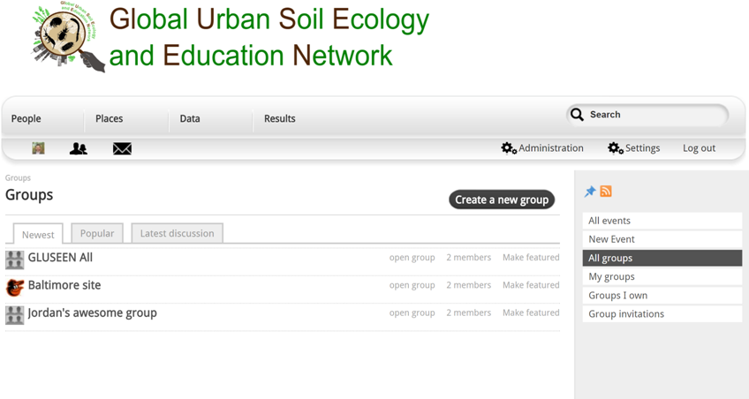
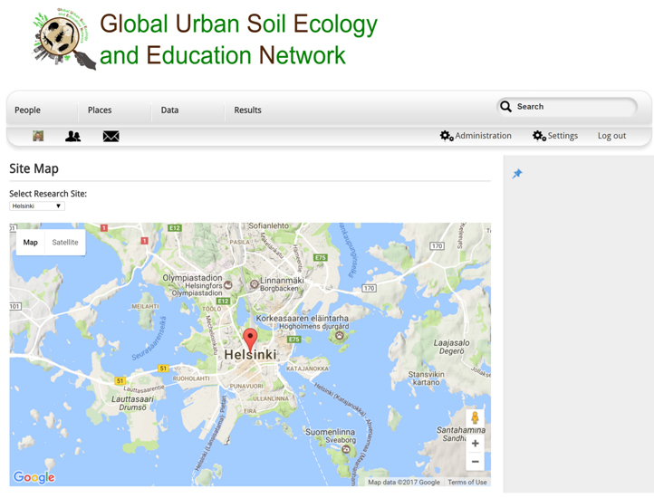
SciServer: Bringing Analysis Close to the Data
PI: Alex Szalay, JHU NSF AWARD No.: 1261715
TEAM
System:
Technology:
Science:
PI – Alex Szalay; PM – Mike Rippin
Team Leads – Ani Thakar, Gerard Lemson, Jordan Raddick, Bonnie Souter
Technical: Dmitry Medvedev, Manu Popp, Jai Won Kim, Sue Werner, Victor Paul, Jan Vandenberg, Lance Joseph, Alainna White, Laszlo Dobos
Database storage & Query:
Database storage & Query:
Collaborations
Astronomy
Turbulence
Data analysis:
Data analysis:
File storage:
File storage:
Oceanography
Materials Science
Earth Science
Data exploration:
Data exploration:
User sign-on:
User sign-on:
Genomics
Cosmology
New Science
History & Motivation
Compute
Compute
Applications
Started with the SDSS SkyServer
Goal: instant access to rich content
Idea: bring the analysis to the data
Interactive access at the core
Astronomy
Where are we Going
Interactive science on petascale data
Create scalable open numerical laboratories
Large footprint across many disciplines
Use commonly shared building blocks
Major national and international impact
Materials Science
Turbulence
Compute Job Scheduling
Compute Job Scheduling
Compute Manager
D
D
D
D
D
Compute Manager
D
D
D
D
D
System Balance
Jupyter
Dashboard UI
PUSH
D
D
Jupyter
Dashboard UI
PUSH
D
D
Script Job
Server Cluster
Script Job
Server Cluster
HPC
PULL
Async
PULL
Async
SciDrive Plugins
PUSH
Script Job
Job Manager
Resource and Access Control Manager
SciDrive Plugins
PUSH
Script Job
Job Manager
Resource and Access Control Manager
Earth Science
Job List
Meta Data
ACLs
Resources
Job List
Meta Data
ACLs
Resources
Compute
cycles/ byte
SciServer
PUSH
Script Job
PULL
Async
PUSH
Script Job
PULL
Async
DB
SkyServer
SciDrive
Cloud Store
CASJobs
Compute Manager
D
D
D
D
D
CASJobs
Compute Manager
D
D
D
D
D
indexing
D
D
Server Cluster
D
D
Server Cluster

Slide 7
SciServer: Bringing Analysis Close to the Data
PI: Alex Szalay, JHU NSF AWARD No.: 1261715
TEAM
System:
Technology:
Science:
PI – Alex Szalay; PM – Mike Rippin
Team Leads – Ani Thakar, Gerard Lemson, Jordan Raddick, Bonnie Souter
Technical: Dmitry Medvedev, Manu Popp, Jai Won Kim, Sue Werner, Victor Paul, Jan Vandenberg, Lance Joseph, Alainna White, Laszlo Dobos
Database storage & Query:
Database storage & Query:
Collaborations
Astronomy
Turbulence
Data analysis:
Data analysis:
File storage:
File storage:
Oceanography
Materials Science
Earth Science
Data exploration:
Data exploration:
User sign-on:
User sign-on:
Genomics
Cosmology
New Science
History & Motivation
Compute
Compute
Applications
Started with the SDSS SkyServer
Goal: instant access to rich content
Idea: bring the analysis to the data
Interactive access at the core
Astronomy
Where are we Going
Interactive science on petascale data
Create scalable open numerical laboratories
Large footprint across many disciplines
Use commonly shared building blocks
Major national and international impact
Materials Science
Turbulence
Compute Job Scheduling
Compute Job Scheduling
Compute Manager
D
D
D
D
D
Compute Manager
D
D
D
D
D
System Balance
Jupyter
Dashboard UI
PUSH
D
D
Jupyter
Dashboard UI
PUSH
D
D
Script Job
Server Cluster
Script Job
Server Cluster
HPC
PULL
Async
PULL
Async
SciDrive Plugins
PUSH
Script Job
Job Manager
Resource and Access Control Manager
SciDrive Plugins
PUSH
Script Job
Job Manager
Resource and Access Control Manager
Earth Science
Job List
Meta Data
ACLs
Resources
Job List
Meta Data
ACLs
Resources
Compute
cycles/ byte
SciServer
PUSH
Script Job
PULL
Async
PUSH
Script Job
PULL
Async
DB
SkyServer
SciDrive
Cloud Store
CASJobs
Compute Manager
D
D
D
D
D
CASJobs
Compute Manager
D
D
D
D
D
indexing
D
D
Server Cluster
D
D
Server Cluster

