Slide 1














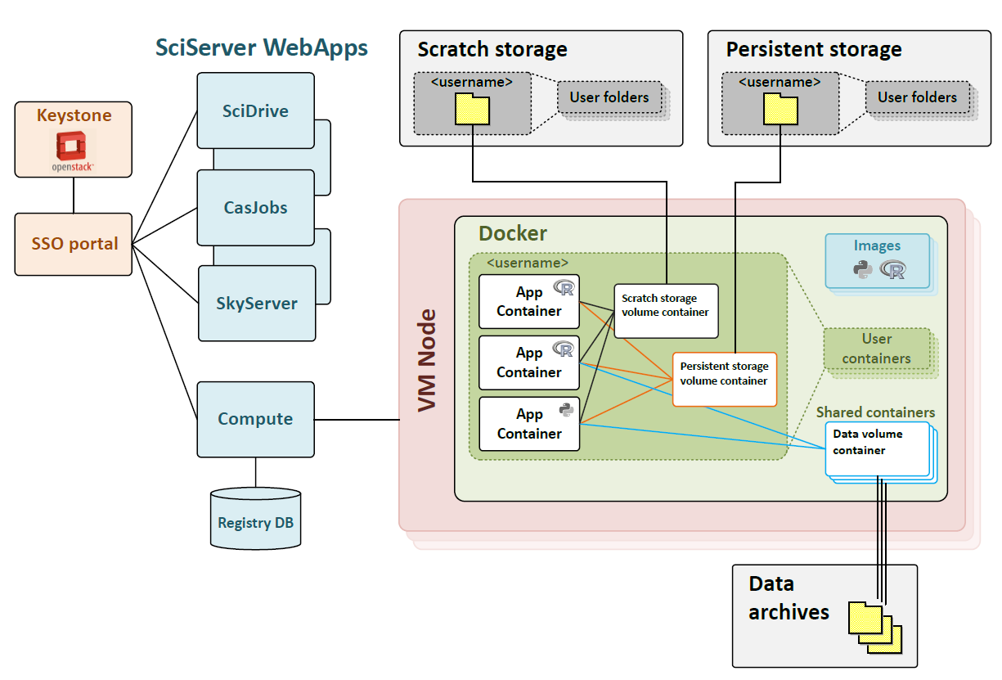
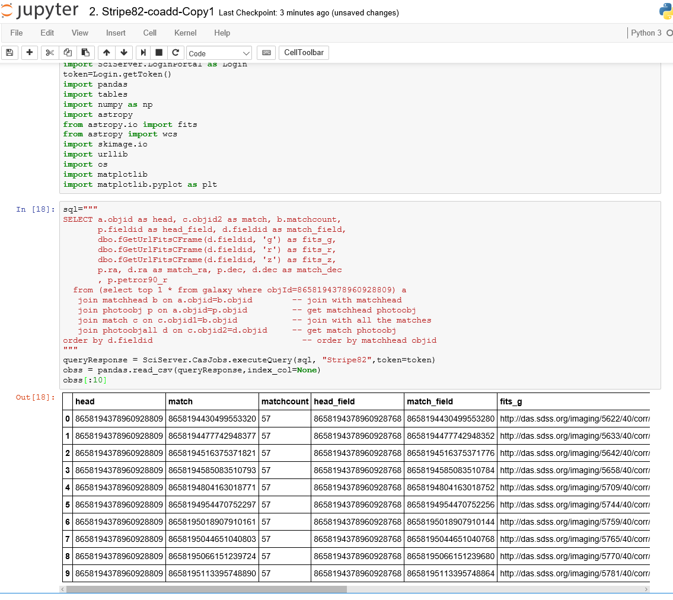
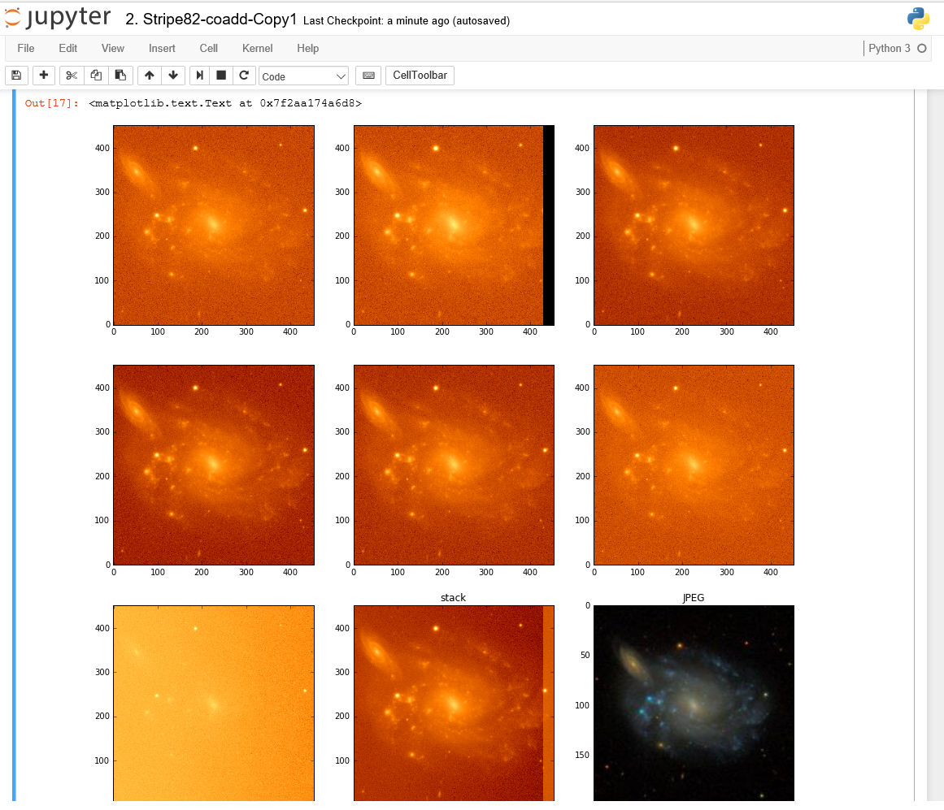
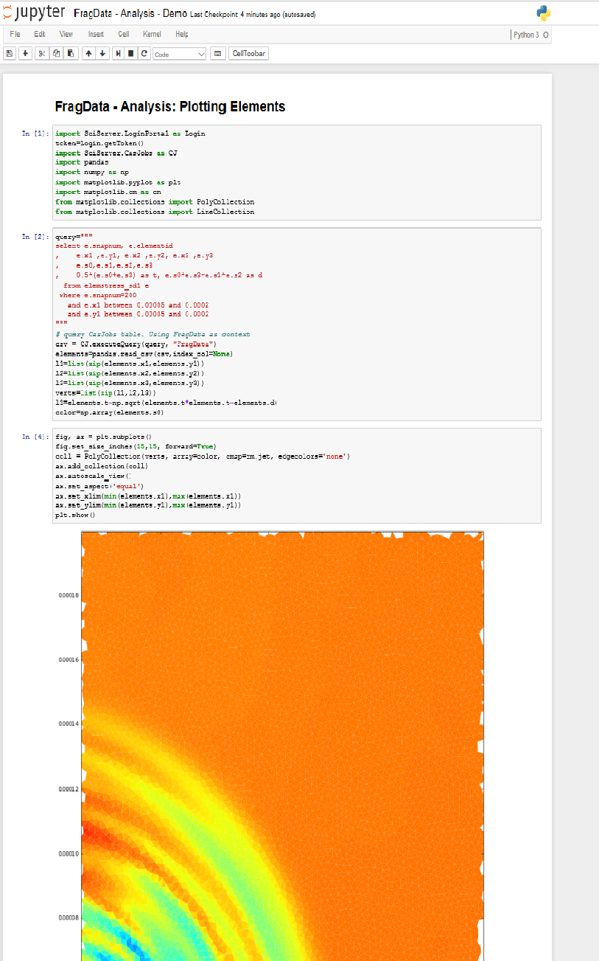
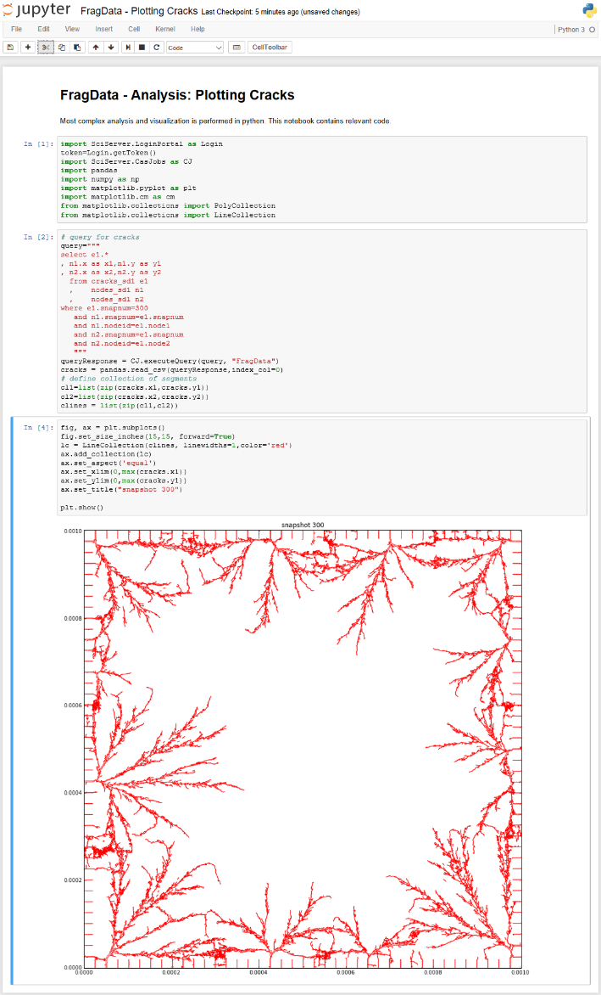
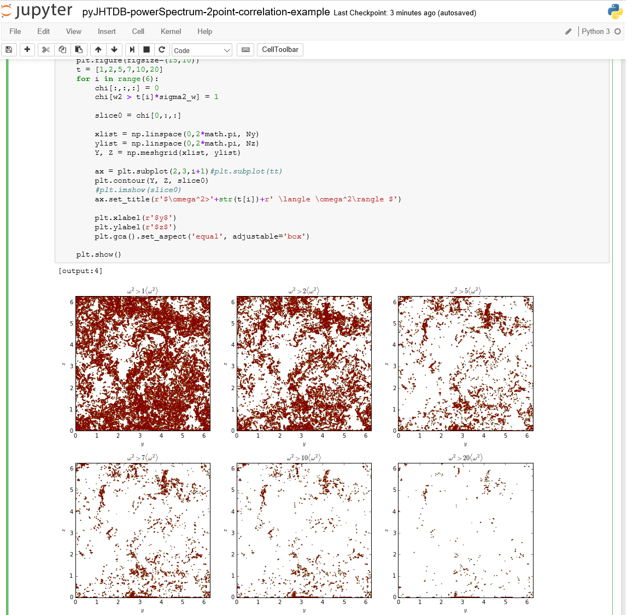
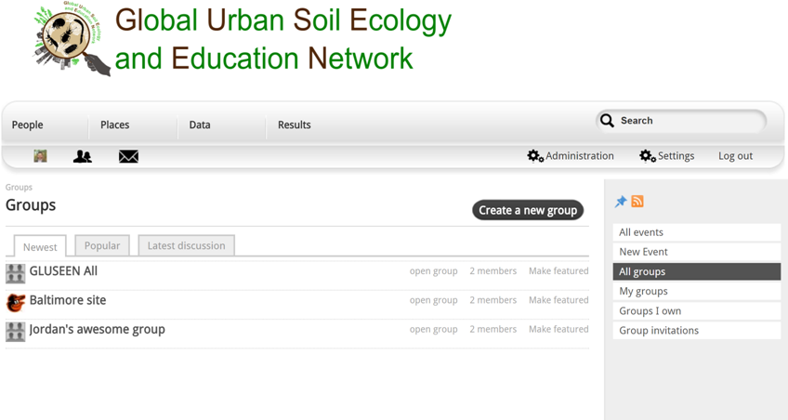
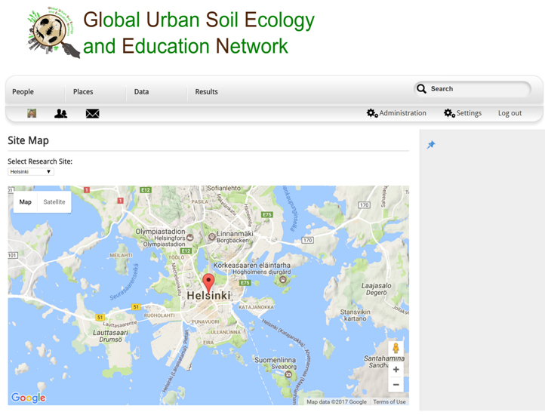
SciServer: Bringing Analysis Close to the Data
PI: Alex Szalay, JHU NSF AWARD No.: 1261715
TEAM
Technology:
Science:
PI – Alex Szalay; PM – Mike Rippin
Team Leads – Ani Thakar, Gerard Lemson, Jordan Raddick, Bonnie Souter
Technical: Dmitry Medvedev, Manu Popp, Jai Won Kim, Sue Werner, Victor Paul, Jan Vandenberg, Lance Joseph, Alainna White, Laszlo Dobos
Database storage & Query:
Current System
Collaborations
Astronomy
Turbulence
Data analysis:
File storage:
Oceanography
Materials Science
Earth Science
Data exploration:
User sign-on:
Genomics
Cosmology
New Science
History & Motivation
Compute
Applications
Started with the SDSS SkyServer
Goal: instant access to rich content
Idea: bring the analysis to the data
Interactive access at the core
Astronomy
Where are we Going
Interactive science on petascale data
Create scalable open numerical laboratories
Large footprint across many disciplines
Use commonly shared building blocks
Major national and international impact
Materials Science
Turbulence
Compute Job Scheduling
Compute Manager
D
D
D
D
D
Jupyter
Dashboard UI
PUSH
D
D
System Balance
Script Job
Server Cluster
HPC
PULL
Async
SciDrive Plugins
PUSH
Script Job
Job Manager
Resource and Access Control Manager
Earth Science
Job List
Meta Data
ACLs
Resources
Compute
cycles/ byte
SciServer
PUSH
Script Job
PULL
Async
DB
SkyServer
SciDrive
Cloud Store
CASJobs
Compute Manager
D
D
D
D
D
indexing
D
D
Server Cluster

