Slide 1
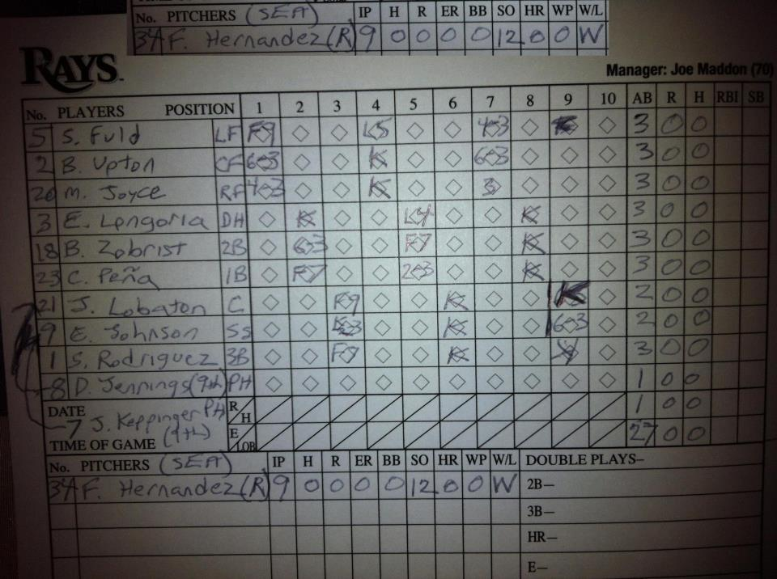
Baseball data online with SciServer

