Slide 1
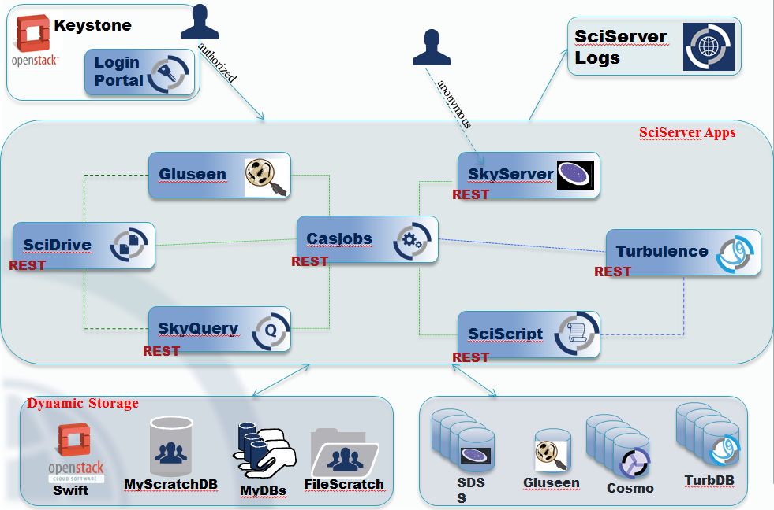
How they Fit Together : Now

