Slide 1
SciServer Compute Workshop

Slide 2
Bring Your Code to the Data
Alex Szalay

Slide 3
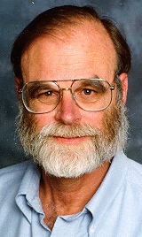
Motivation and History
Started with the SDSS SkyServer
Built very quickly in 2001
Goal: instant access to rich content
Idea: bring the analysis to the data
Interactive access at the core
Much of the scientific process is about data
Data collection, data cleaning, data archiving, data organization, data publishing, mirroring, data distribution, data analytics, data curation…
2012: NSF DIBBS to extend/reengineer SkyServer
Jim Gray

Slide 4
Where Are We Going?
Interactive science on petascale data
Sustain and enhance our astronomy effort
Grow a footprint into new disciplines
Build scalable open numerical laboratories
Scale system to several petabytes
Deep integration with the “Long Tail”
Use sharable, well-defined building blocks

Slide 5
Data in HPC Simulations
HPC is an instrument in its own right
Largest simulations approach/exceed petabytes
Need public access to the best and latest
Also need ensembles of simulations for UQ
Creates new challenges
How to access the data?
What is the data lifecycle?
What are the analysis patterns?
What architectures can support these?
On Exascale everything is a Big Data problem

Slide 6
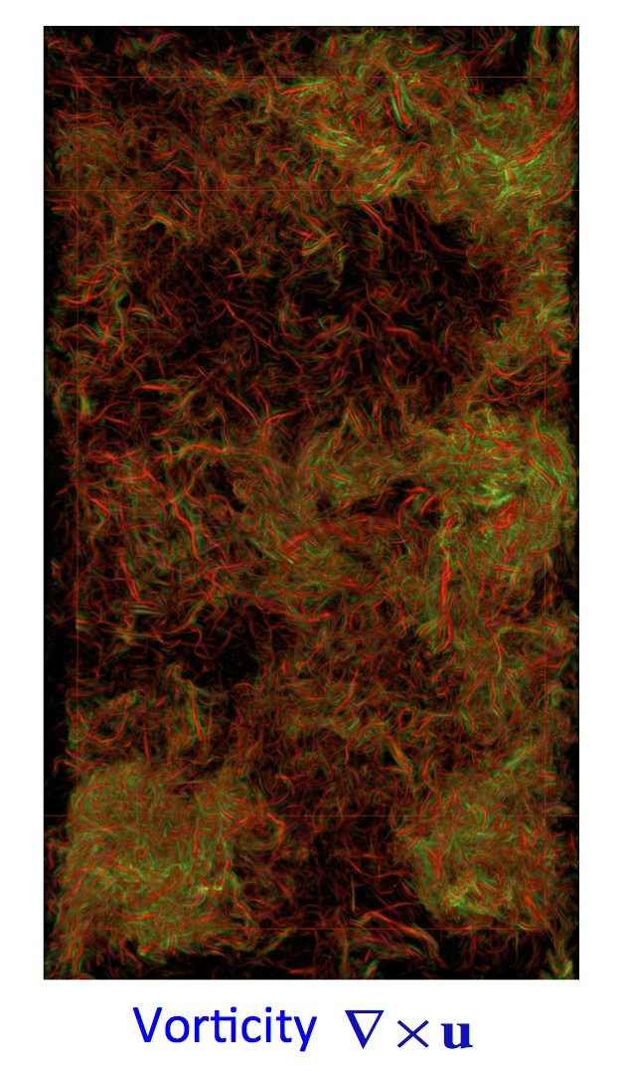
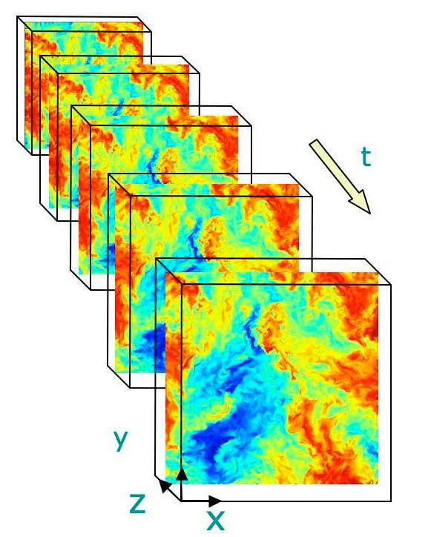
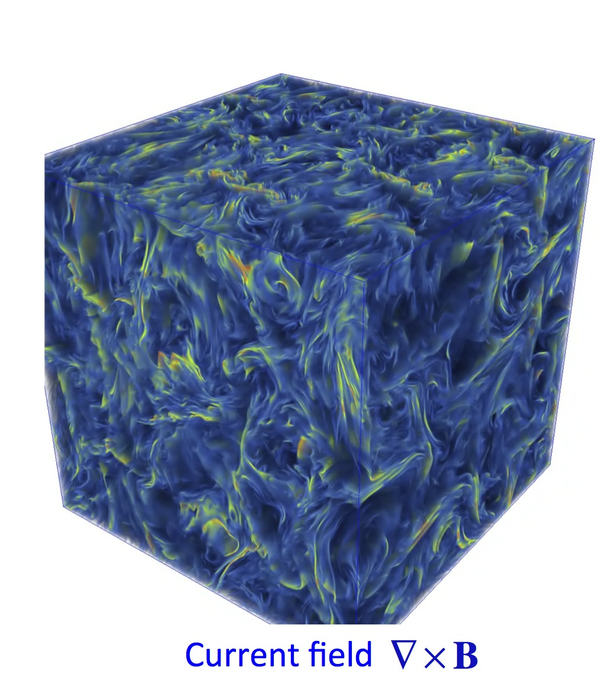
Turbulence databases (JHUTB)
http://turbulence.pha.jhu.edu/

Slide 7
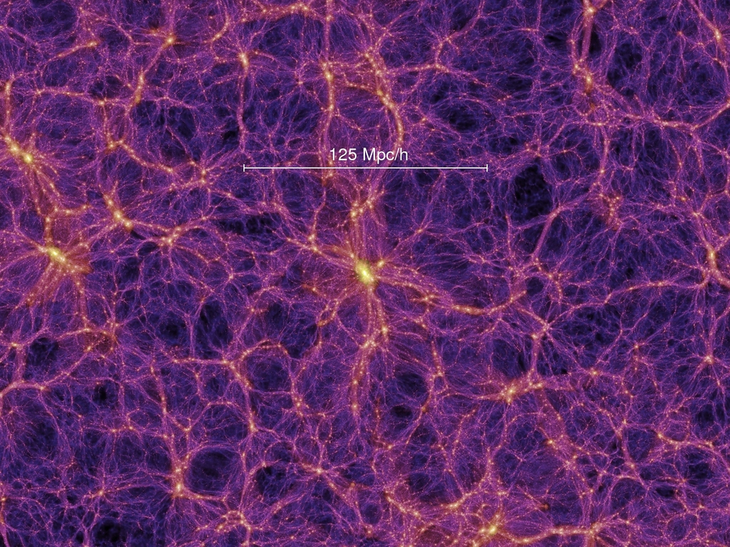

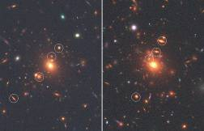
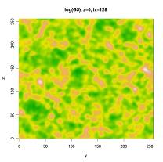
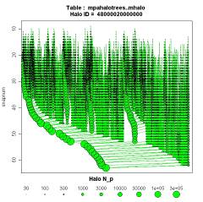
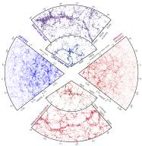
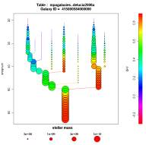
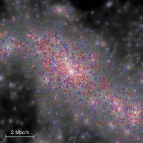
Cosmological Simulations
Mirror of Millennium Database
Raw data:
Particles
FOF groups
Subhalos
Mock images
Halo merger trees
Density fields
Synthetic galaxies
Mock catalogues

Slide 8
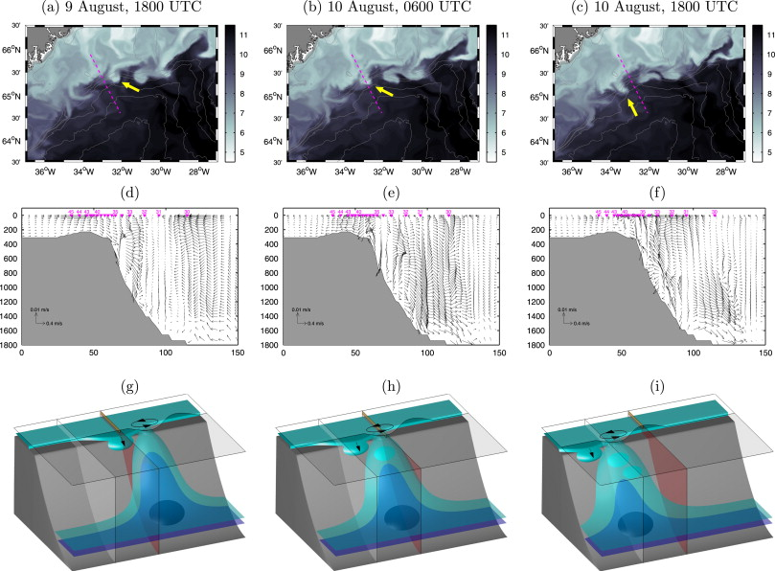
Oceanography
Hydrostatic and non-hydrostatic simulations of dense waters cascading off a shelf: The East Greenland case Marcello G. Magaldi, Thomas W.N. Haine

Slide 9
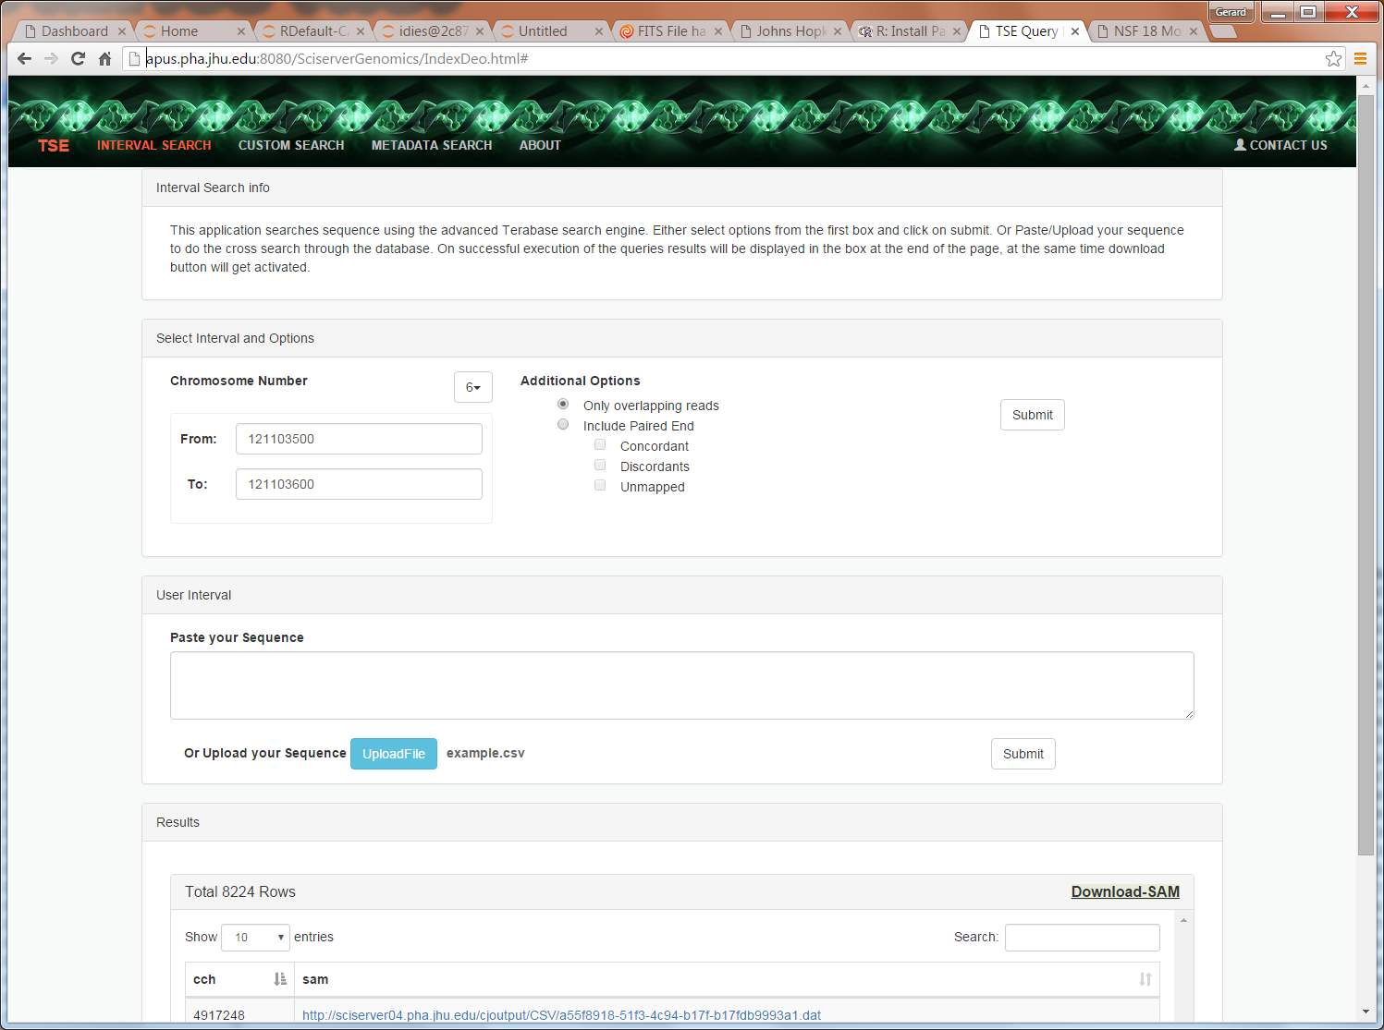
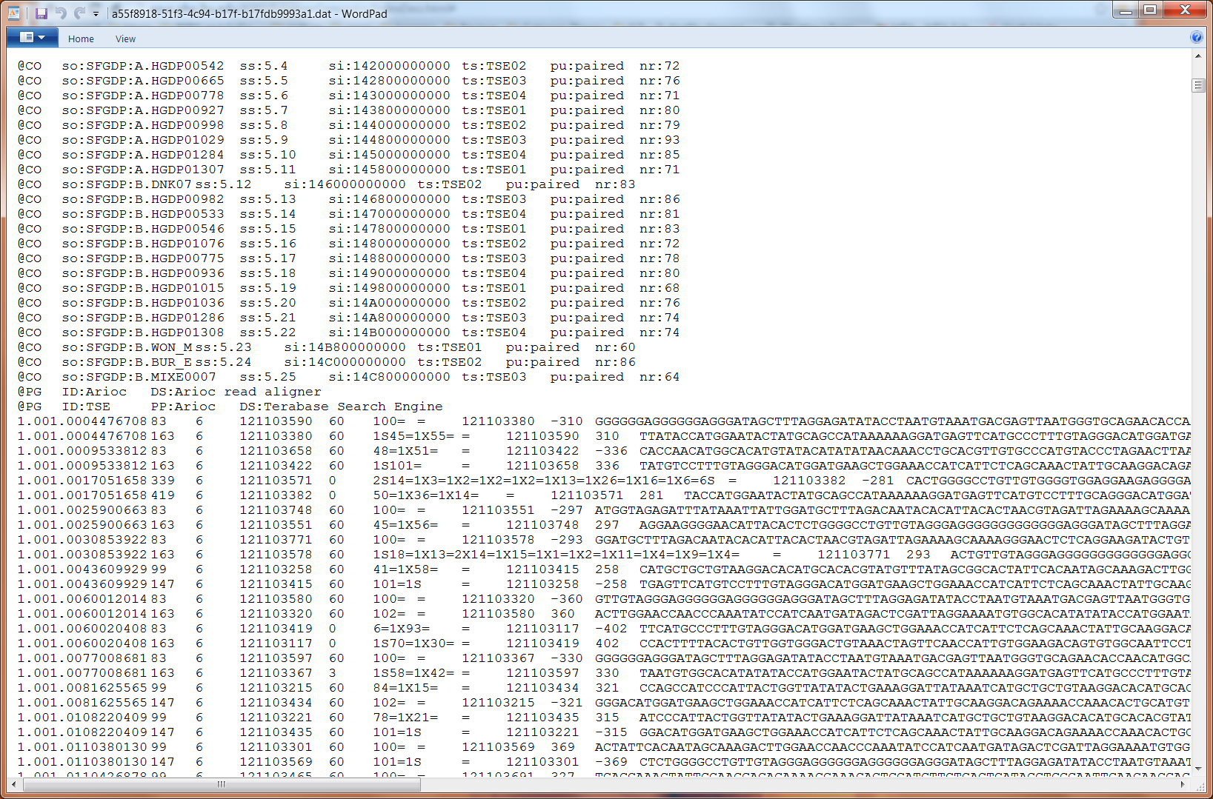
Genomics
Building a DB of a trillion short reads from Next Gen Sequencing

Slide 10

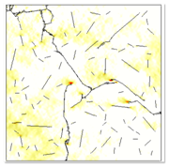
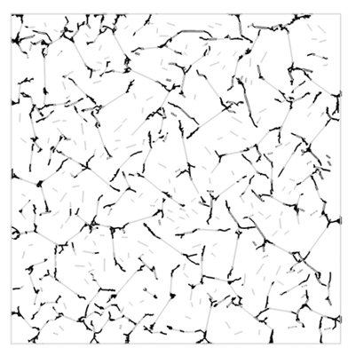

Materials Science
Daphalapurkar, Brady, Ramesh, Molinari. JMPS (2011)

Slide 11
Open Numerical Laboratories
Create interactive Numerical Laboratories
Analysis server-side through web service
Use virtual sensor metaphor
Many access patterns are local
No need to download whole data sets
Concept very successful in turbulence and cosmological N-body
turbulence.pha.jhu.edu: 19 trillion points delivered!
Total science data in SciServer currently ~2.5PB

Slide 12
New Analysis Patterns Emerging
User written crawlers, inefficient
Cutouts delivered to users, slow
Scalability challenge (over 100TB scales)
Requests for scripting access
Need for easy joins with long-tail data
Still expecting interactive response

Slide 13
Architectural Challenges
Need to define sharp tradeoffs
Data Analytics system is different from supercomputer
What is the right balance between I/O and compute?
Need high bandwidth to large data
Computations/visualizations must be on top of the data
Must support at least few 100TB per server
Petascale: 3 copies for production (or erasure code?)
Wide area data movement/backbone is hard
Lessons from the database world:
It is nontrivial to schedule complex I/O patterns
For subsets we must use indexing, cache resilient storage

Slide 14
Directions
Offer more computing resources server side
Enhanced visualization tools (ParaView)
Augment and combine SQL queries with easy-to-use scripting tools
Heavy use of virtual machines/ Docker
Interactive portal via iPython/Matlab/R

Slide 15
Workshop Overview
Mike Rippin
April 27, 2016

Slide 16
Introductions and Logistics

Slide 17
The Team
Alex Szalay (PI)
Mike Rippin (PM)
Ani Thakar
Jordan Raddick
Bonnie Souter
Gerard Lemson
Jaiwon Kim
Dmitry Medvedev
Deoyani Heinis
Manu Popp
Victor Paul
Sue Werner
Jan Vandenberg

Slide 18
Agenda
8:30 AM | Continental Breakfast & Coffee
9:00 AM | Welcome | Alex Szalay
9:05 AM | SciServer Overview | Mike Rippin
9:25 AM | Getting Started with SciServer | Jordan Raddick
9:40 AM | Technical Overview | Dmitry Medvedev
10:30 AM | Coffee
10:45 AM | Demo Notebook #1 | Gerard Lemson
12:00 PM | Lunch
1:00 PM | Astronomy & Cosmology Examples | Gerard Lemson
2:30 PM | Break
2:45 PM | Explore & Customize | Participants
3:30 PM | Q&A
3:50 PM | Closing Remarks | Mike Rippin
4:00 PM | Adjourn

Slide 19
Logistics
Stay in this room all day
Restrooms
Coffee and Breaks – morning and afternoon
Lunch – ‘Working Lunch’ if preferred
Wrap up – 4pm

Slide 20
Structure of the Day

Slide 21
Test Environment
Technology
Everyone should be able to connect to WIFI
Everyone will create an account
Everyone will create a Docker Container
Workshop running in TEST Environment
MyDB etc is temporary
Jupyter Notebooks can be saved and taken away

Slide 22
Objectives of the Workshop
Participants | SciServer Team
Set up a SciServer Notebook Authenticate with the SciServer Login Portal Import and query SDSS with CasJobs Save your data and graphics locally Save your data and graphics on SciDrive Save & Retrieve your data in MyDB Learn the SciServer API | Test the Compute feature set Test out the Architecture Gain early feedback from participants Implement this feedback before live release
We want this to be Interactive…

Slide 23
Structure of the Workshop
Agenda sets the scene
To start: Structured
First example workbooks cover the ‘building blocks’ and will be done in a structured way
Subsequently: Flexible
Notebooks delve deeper into specifics
Timing and deviations are fine, Q&A, examples etc
Tune to the experiences and needs of participants
Emphasis on PRACTICAL exercises…

Slide 24
SciServer Project Background

Slide 25
SciServer Project Award
Award
NSF DIBBs (Data Infrastructure Building Blocks)
5 years: 2013 – 2018
Approx $10M
Cooperative Agreement

Slide 26
SciServer Project Objectives
Objectives
Extend infrastructure for SDSS to support additional Science Domains
Host and serve petabyte datasets
Support custom user datasets
Provide access and query services
Provide scalable compute services
Support analyses and data sets too large to handle locally
Provide collaborative tools for shared analysis
Computations stay CLOSE to the DATA…

Slide 27
SciServer Project Components
Major Components | Supporting Technologies
Core | Microsoft SQL Server
Login Portal | Open Stack
CASJobs | Docker
SciServer Compute | Jupyter
SciDrive
Applications
SkyQuery
SkyServer
GLUSEEN
Turbulence

Slide 28
SciServer Project Timeline
Timelines
Year 1 (2013-2014) | Project Setup, Scoping, Planning, Begin Refactoring, SDSS Unification
Year 2 (2013-2014) | Architectural Refactoring – API, Single Sign-on, prototype Compute
Year 3 (2013-2014) | SciServer System Release, Interactive Compute, Scalable Job Management, Basic Dashboard, Initial Collaborative capabilities
Year 4 (2013-2014) | Implementation in Science Domains, Educational workbooks
Year 5 (2013-2014) | System Scale out, Data Analytics, Advanced Deployment Scenarios
NOW

Slide 29
SciServer Project Current Plans
Timelines – Year 3
Apr 2016 | SciServer System Release
May 2016 | Interactive Compute SkyQuery Gluseen
August 2016 | Prototype Scalable Job Management Basic Dashboard Initial Collaborative capabilities
October 2016 | Scalable Job Management Turbulence Cosmology
November 2016 | Project 3 year Review

Slide 30
Getting Started with SciServer
Jordan Raddick
April 27, 2016

Slide 31
Resources
Agenda:
www.sciserver.org/outreach/spring-workshop/detailed-agenda
Documentation and Support (go here now!):
www.sciserver.org/outreach/spring-workshop/documentation

