Slide 1
Bring Your Code to the Data
Alex Szalay

Slide 2
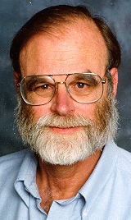
Motivation and History
Started with the SDSS SkyServer
Built very quickly in 2001
Goal: instant access to rich content
Idea: bring the analysis to the data
Interactive access at the core
Much of the scientific process is about data
Data collection, data cleaning, data archiving, data organization, data publishing, mirroring, data distribution, data analytics, data curation…
2012: NSF DIBBS to extend/reengineer SkyServer
Jim Gray

Slide 3
Where Are We Going?
Interactive science on petascale data
Sustain and enhance our astronomy effort
Grow a footprint into new disciplines
Build scalable open numerical laboratories
Scale system to several petabytes
Deep integration with the “Long Tail”
Use sharable, well-defined building blocks

Slide 4
Data in HPC Simulations
HPC is an instrument in its own right
Largest simulations approach/exceed petabytes
Need public access to the best and latest
Also need ensembles of simulations for UQ
Creates new challenges
How to access the data?
What is the data lifecycle?
What are the analysis patterns?
What architectures can support these?
On Exascale everything is a Big Data problem

Slide 5
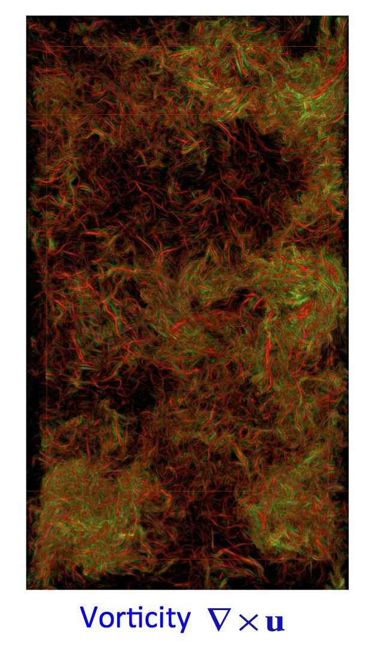
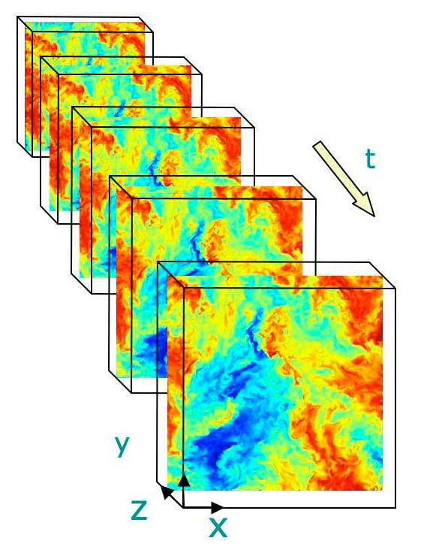
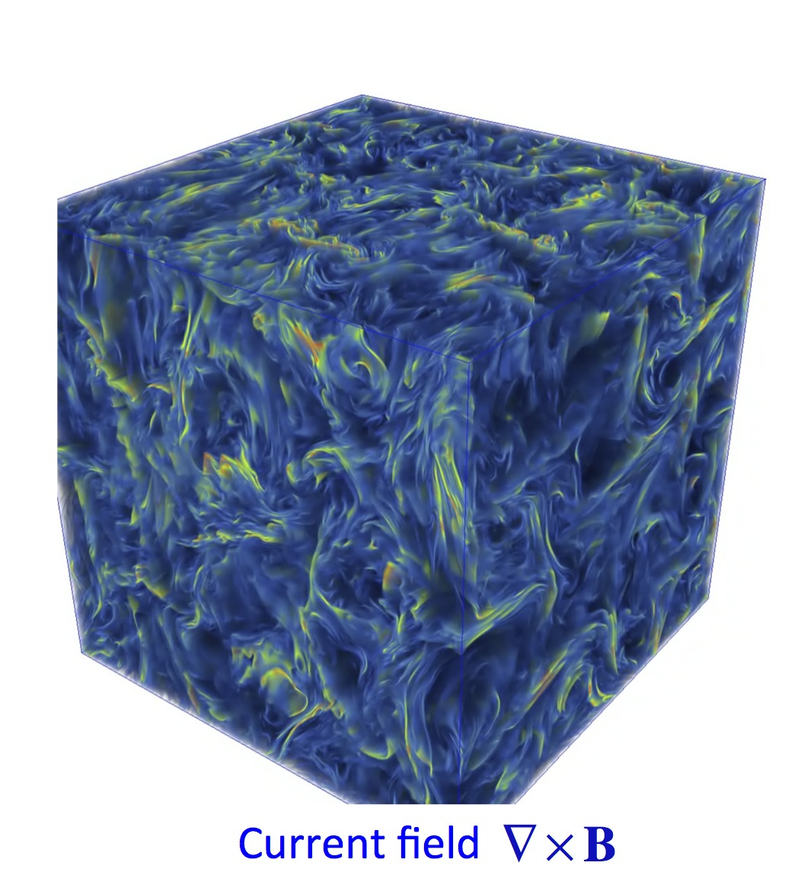
Turbulence databases (JHUTB)
http://turbulence.pha.jhu.edu/

Slide 6
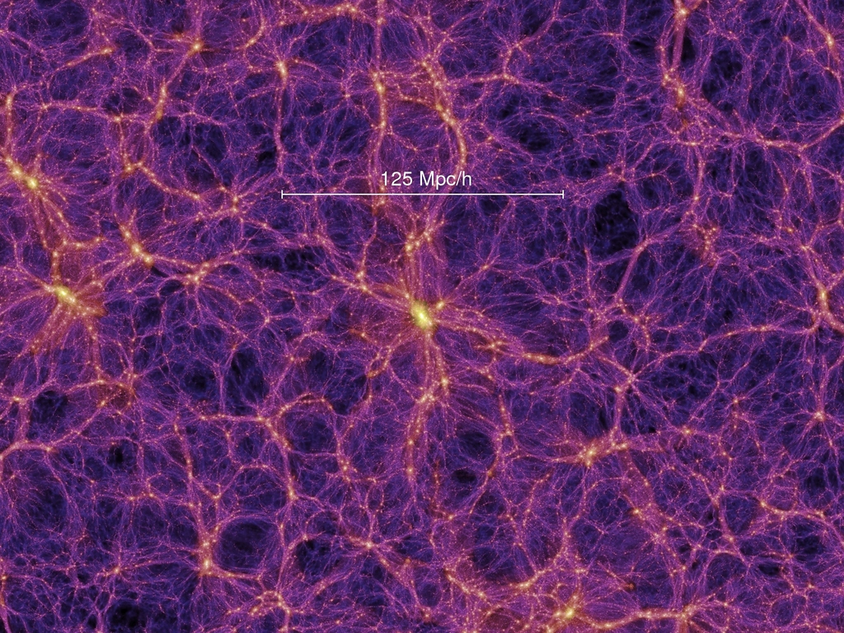
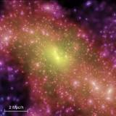
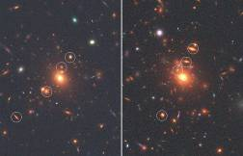
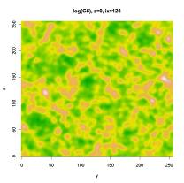
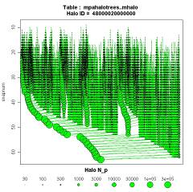
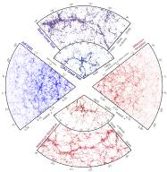
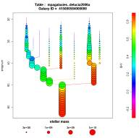
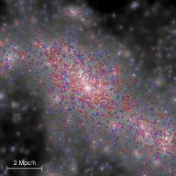
Cosmological Simulations
Mirror of Millennium Database
Raw data:
Particles
FOF groups
Subhalos
Mock images
Halo merger trees
Density fields
Synthetic galaxies
Mock catalogues

Slide 7
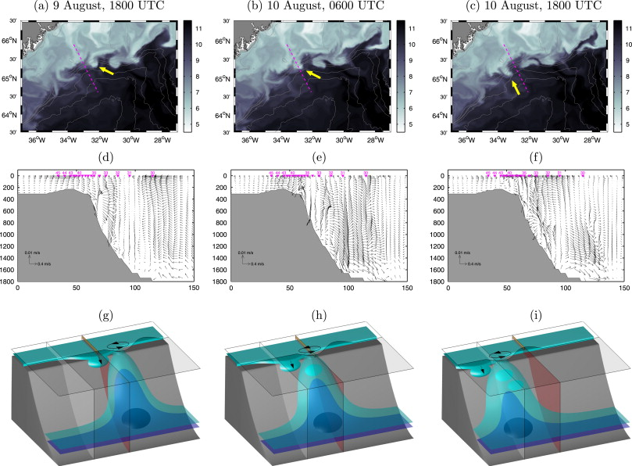
Oceanography
Hydrostatic and non-hydrostatic simulations of dense waters cascading off a shelf: The East Greenland case Marcello G. Magaldi, Thomas W.N. Haine

Slide 8
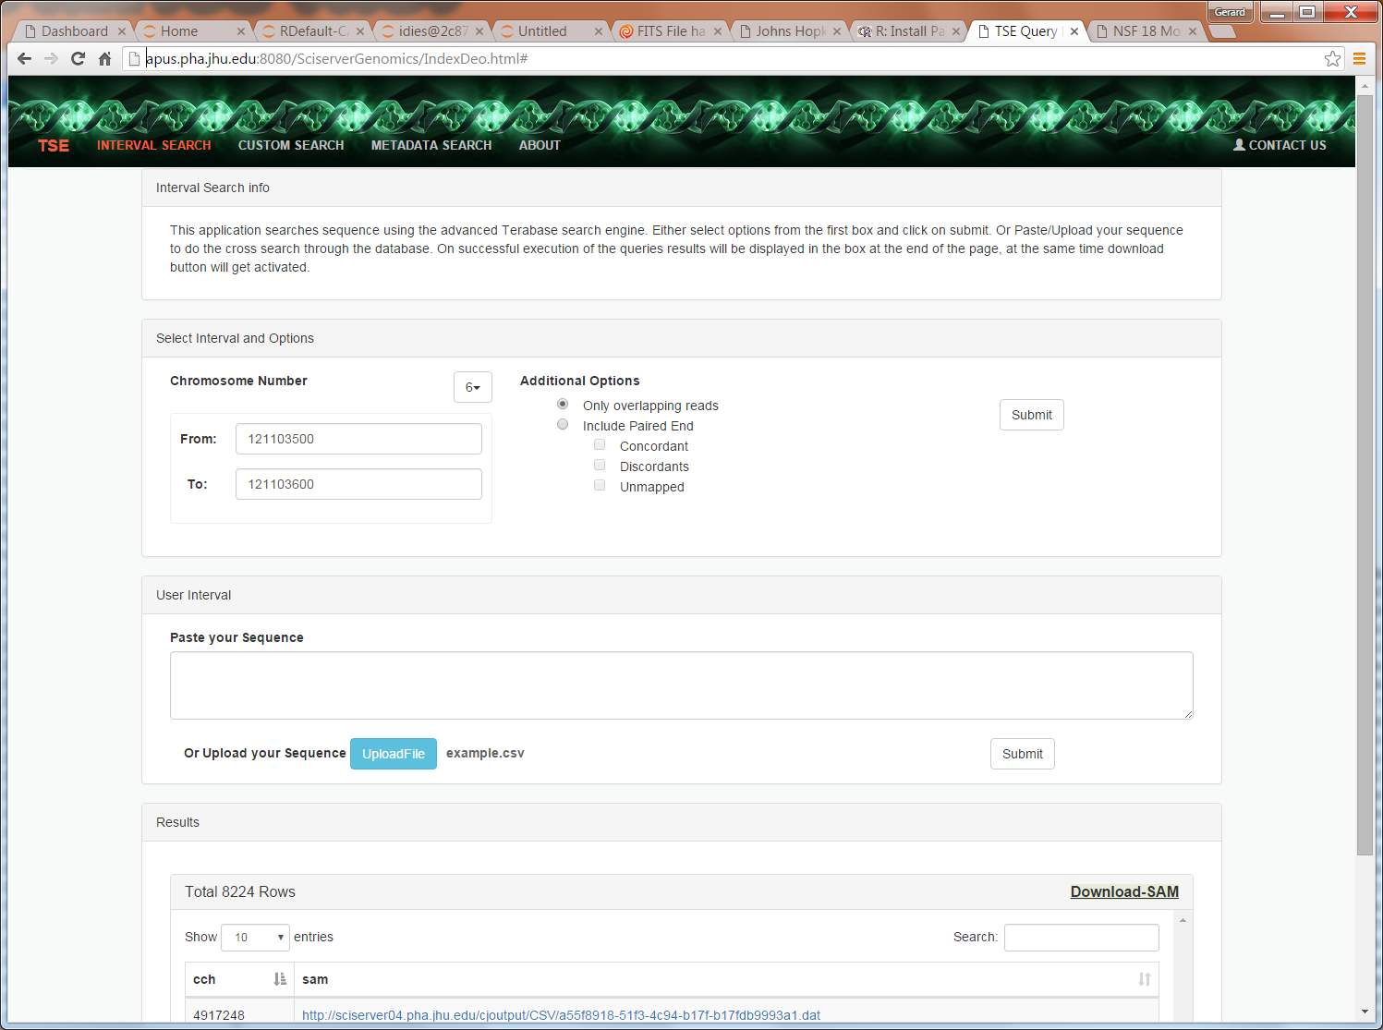
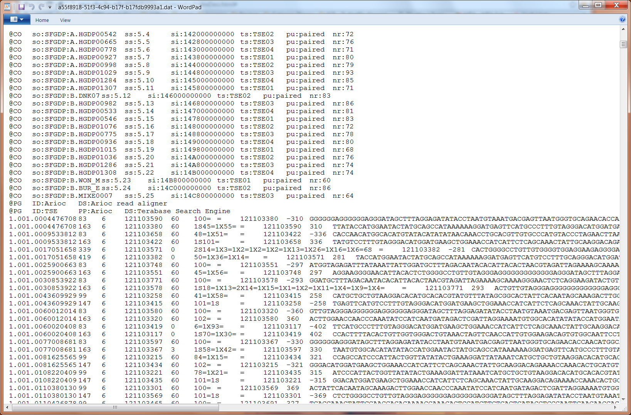
Genomics
Building a DB of a trillion short reads from Next Gen Sequencing

Slide 9
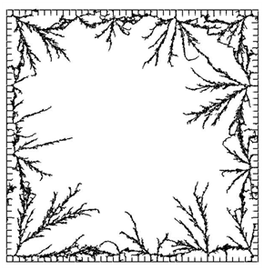
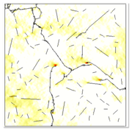
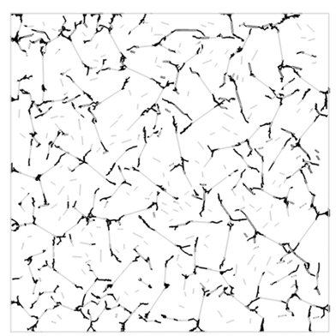
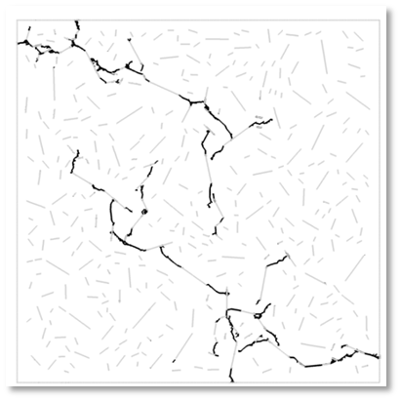
Materials Science
Daphalapurkar, Brady, Ramesh, Molinari. JMPS (2011)

Slide 10
Open Numerical Laboratories
Create interactive Numerical Laboratories
Analysis server-side through web service
Use virtual sensor metaphor
Many access patterns are local
No need to download whole data sets
Concept very successful in turbulence and cosmological N-body
turbulence.pha.jhu.edu: 19 trillion points delivered!
Total science data in SciServer currently ~2.5PB

Slide 11
New Analysis Patterns Emerging
User written crawlers, inefficient
Cutouts delivered to users, slow
Scalability challenge (over 100TB scales)
Requests for scripting access
Need for easy joins with long-tail data
Still expecting interactive response

Slide 12
Architectural Challenges
Need to define sharp tradeoffs
Data Analytics system is different from supercomputer
What is the right balance between I/O and compute?
Need high bandwidth to large data
Computations/visualizations must be on top of the data
Must support at least few 100TB per server
Petascale: 3 copies for production (or erasure code?)
Wide area data movement/backbone is hard
Lessons from the database world:
It is nontrivial to schedule complex I/O patterns
For subsets we must use indexing, cache resilient storage

Slide 13
Directions
Offer more computing resources server side
Enhanced visualization tools (ParaView)
Augment and combine SQL queries with easy-to-use scripting tools
Heavy use of virtual machines/ Docker
Interactive portal via iPython/Matlab/R

