Slide 1



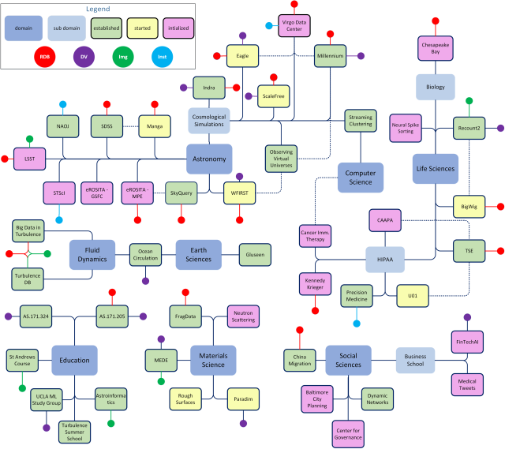
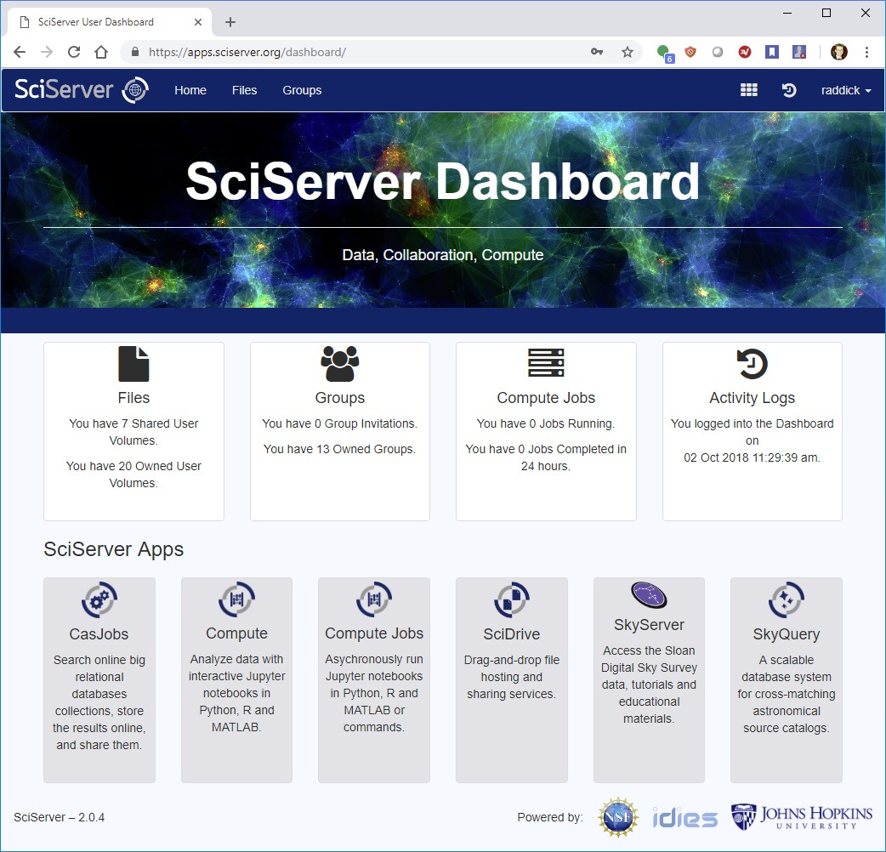
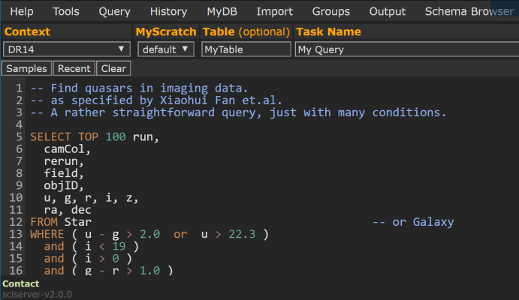
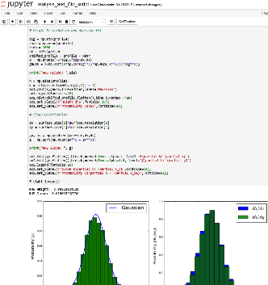
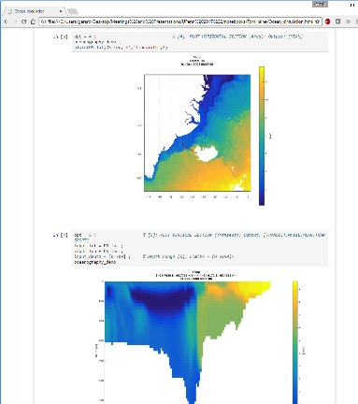
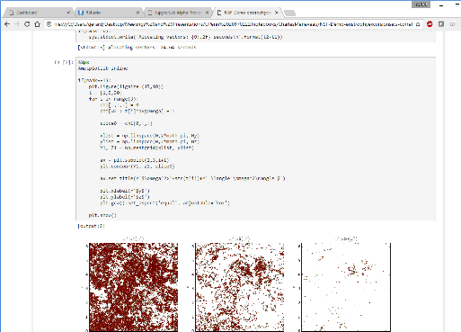
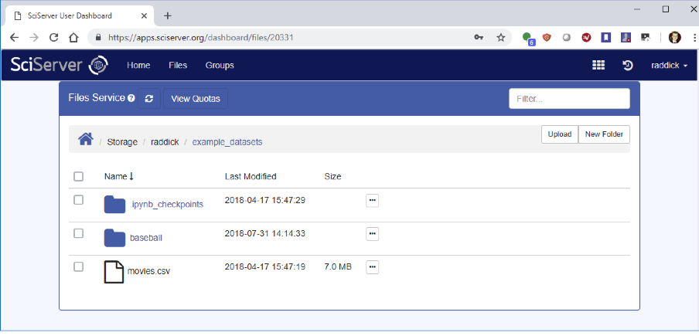
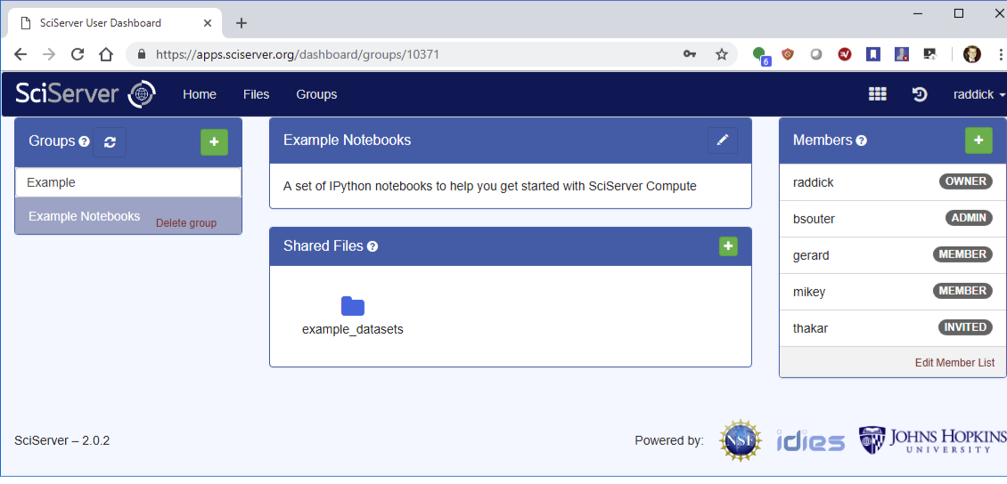
SciServer: Collaborative Tools for Data-Driven Engineering and Science
PI: Alex Szalay
NSF AWARD No.: 1261715
What is SciServer?
A system for researchers across multiple domains to host and share datasets, featuring query and analysis tools for collaborative research.
1
SciServer HOSTS datasets for Research Science Groups
2
Users Register and Login
7
External API Access
DATA PROVIDERS
USERS
EXTERNAL APPS
5
1.1 Provide and Register the Data
SkyServer
SkyQuery
SCISERVER
3
API
Marvin
Gluseen
Dashboard & Collaboration
6
Query, Compute, Analysis
1.2 SciServer Hosts the Data
Paradim
MEDE
Turbulence
Millenium
1.3 Setup Access Controls for Team
Astronomy
Sloan Digital Sky Survey
Millennium Simulations
Fluid mechanics
JHU Turbulence DBs
Genomics
Recount (RNA seqs)
JHSPH UKBiobank
Materials Science
MEDE
Paradim
8
Educational Support
COURSEWARE
1.4 Data Available for Use
API
CLASSROOM
CONFERENCE
4
Manage Your Data
5
Share Your Data
How to Get Started
User Account: Register an account at https://apps.sciserver.org
Data Provider: Contact helpdesk@sciserver.org
Tell us your Use Cases for Team collaboration
Provide feedback on your experiences
Let us help you share data
Introduce SciServer to other users
DATA
HOSTED
USER
RESOURCES
Docker Images
Example Jupyter Notebooks
API Reference

