Slide 1



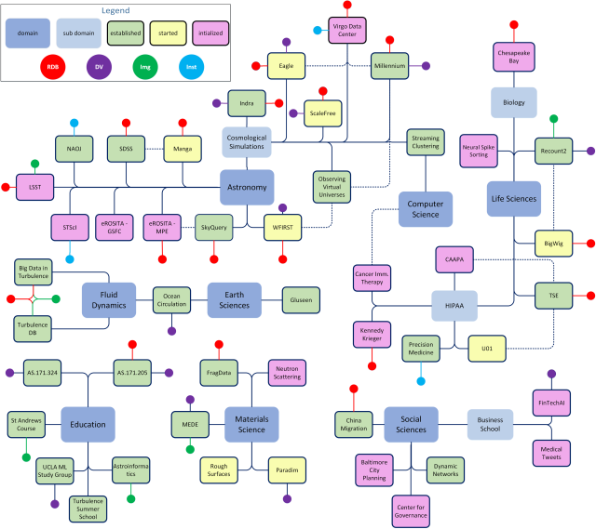
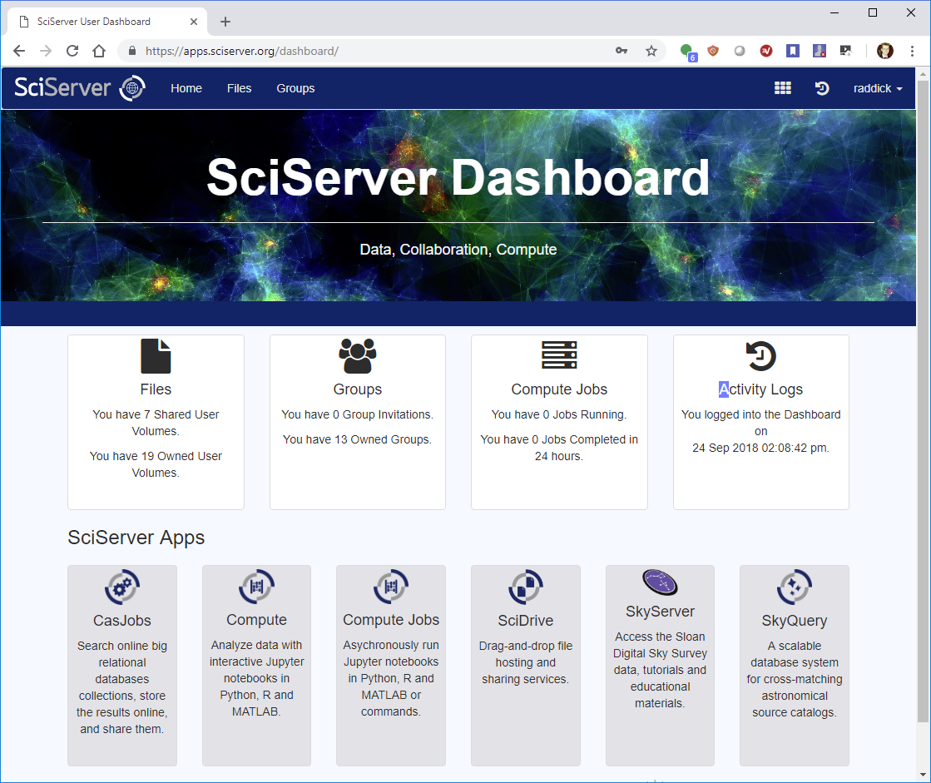
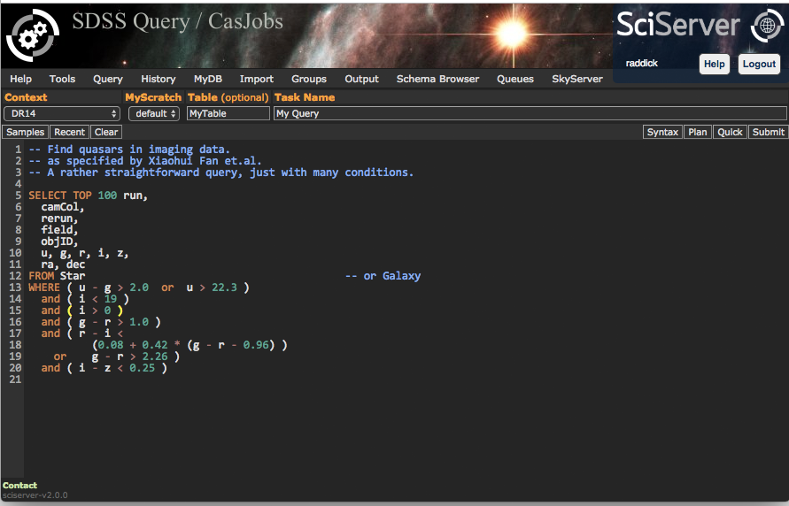
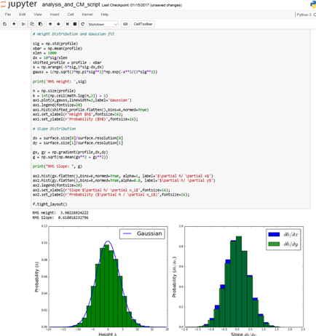
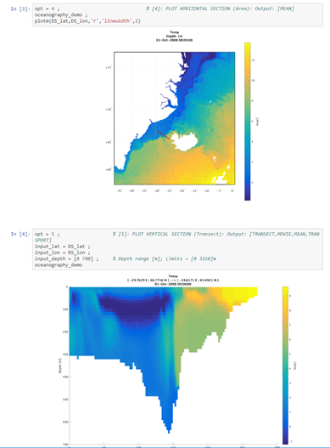
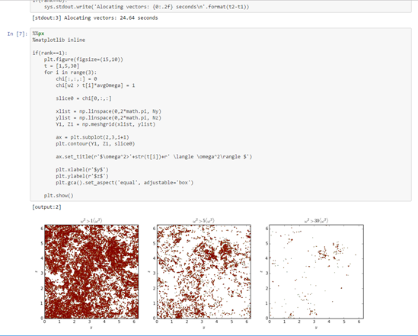
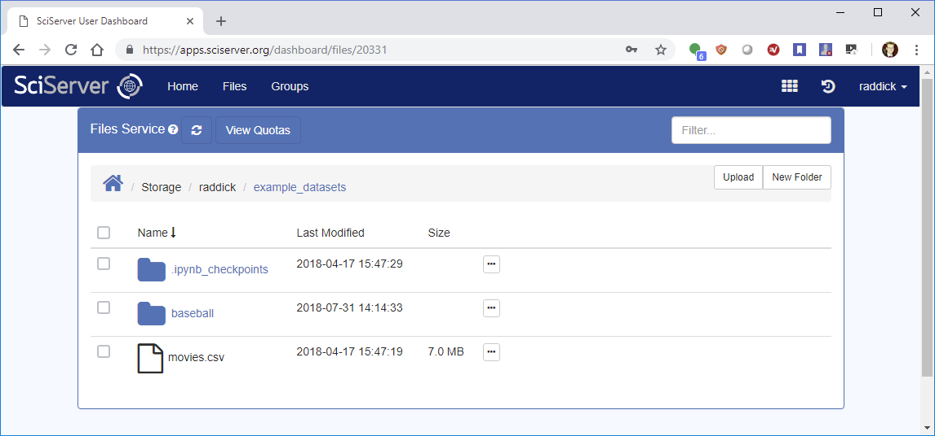
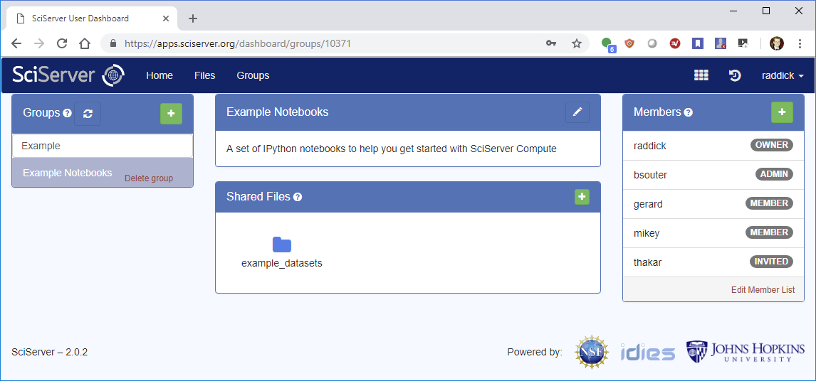
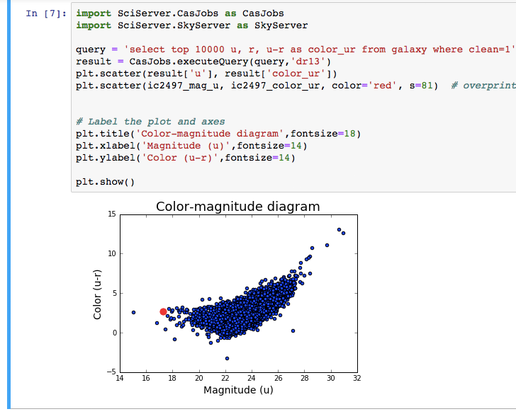
SciServer: Collaborative Tools for Data-Driven Engineering and Science
PI: Alex Szalay
NSF AWARD No.: 1261715
What is SciServer?
A system for researchers across multiple domains to host and share datasets, featuring query and analysis tools for collaborative research.
1
SciServer hosts datasets for Research Science Groups
2
Users Register and Log in
7
External API Access
DATA PROVIDERS
USERS
EXTERNAL APPS
5
1.1 Provide and Register the Data
SkyServer
SCISERVER
SkyQuery
API
Marvin
3
Dashboard & Collaboration
6
Query, Compute, Analysis
PARADIM
GLUSEEN
1.2 SciServer Hosts the Data
Turbulence
MEDE
Millennium
1.3 Setup Access Controls for Team
Astronomy
Sloan Digital Sky Survey (SDSS)
Millennium Simulations (cosmology)
Fluid mechanics
JHU Turbulence DBs (direct numerical simulation)
Genomics
Recount (RNA sequencing)
JHU Bloomberg / UKBiobank
Materials Science
JHU MEDE
JHU Paradim
8
Educational Support
COURSEWARE
1.4 Data Available for Use
API
Create student groups
Manage assignments
Give feedback to individual students
4
Manage Your Data
5
Share Your Data
DATA
How to Get Started
User Account: Register an account at https://apps.sciserver.org
Data Provider: Contact helpdesk@sciserver.org
Tell us your Use Cases for team collaboration
Provide feedback on your experiences
Let us help you share data
Introduce SciServer to other users
HOSTED DATASETS
EXAMPLES / DOCS
Mat sci
Turbu
YOUR DATA
SDSS
Gene
Soil
Millen

