Slide 1



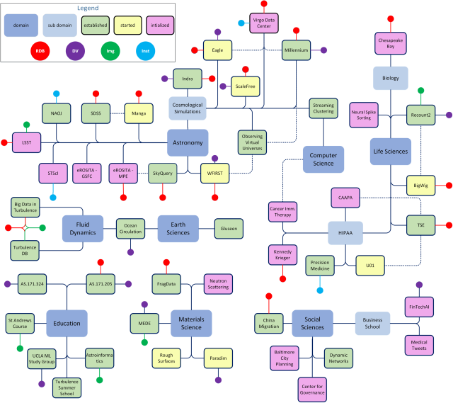
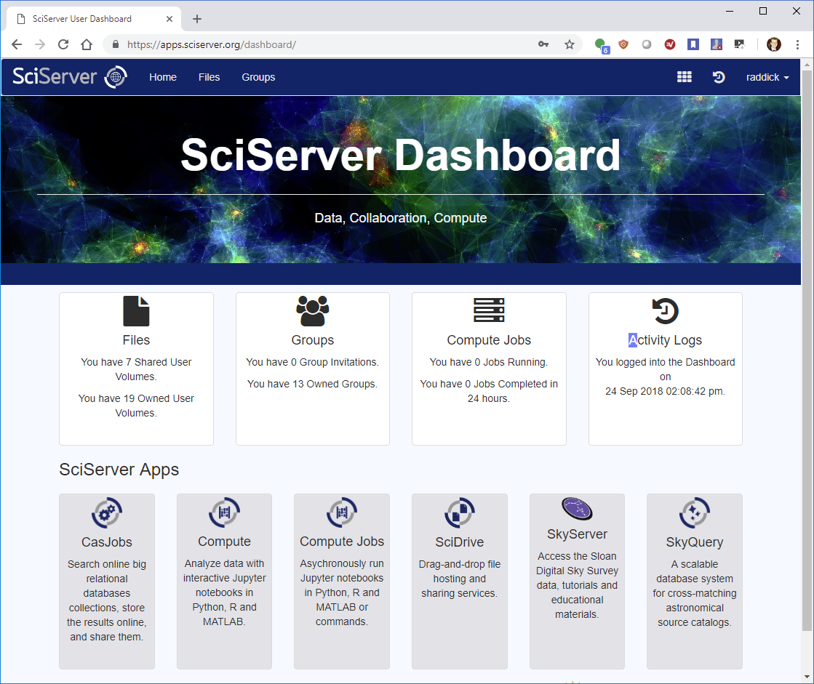
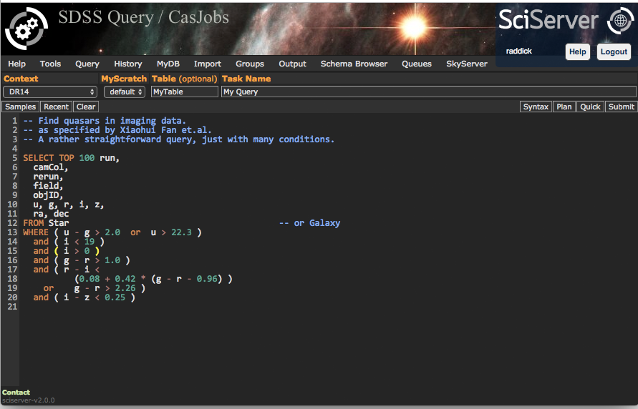
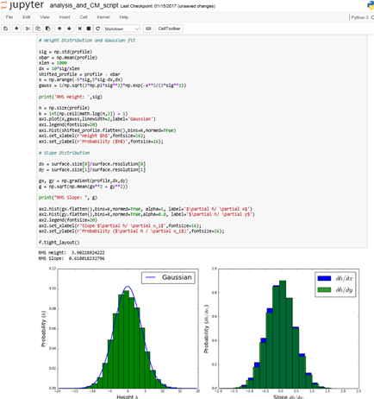
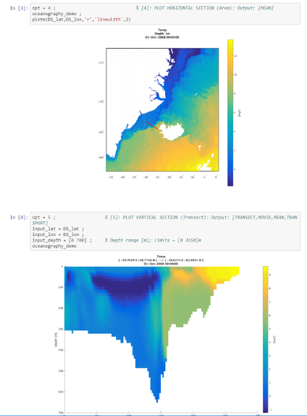
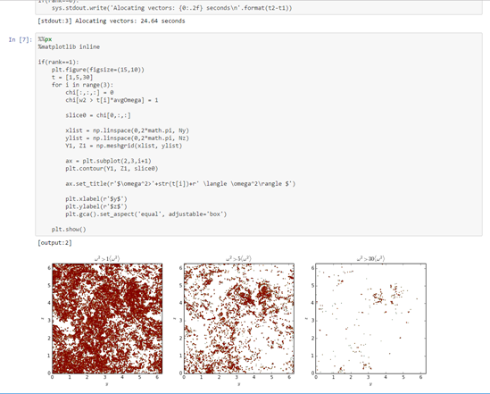
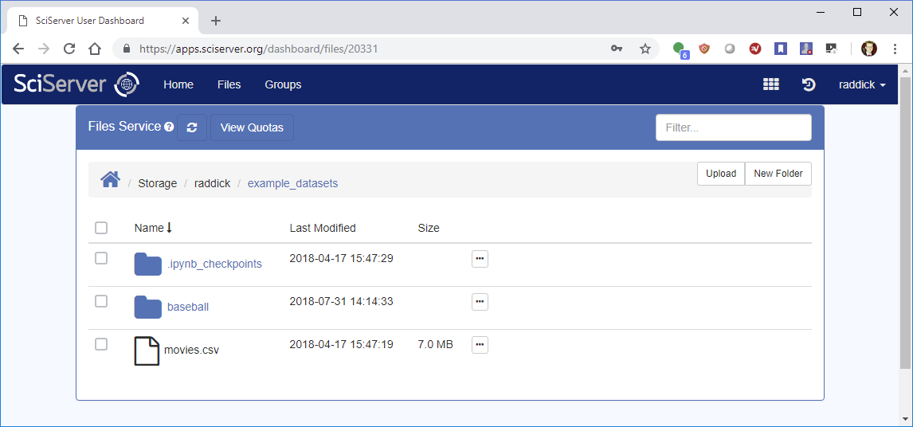
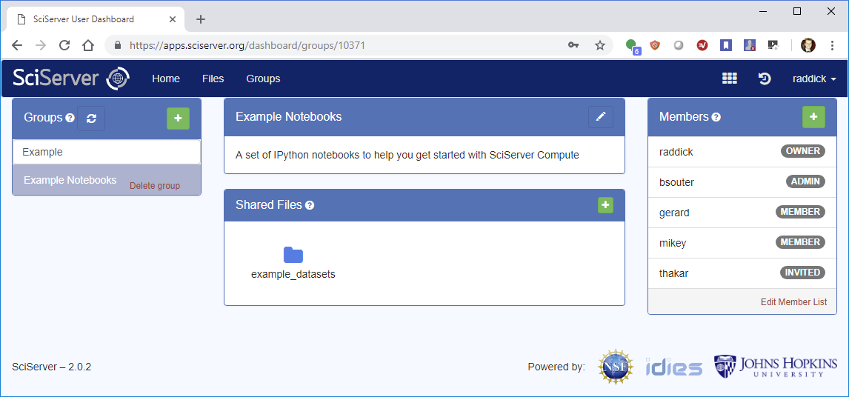
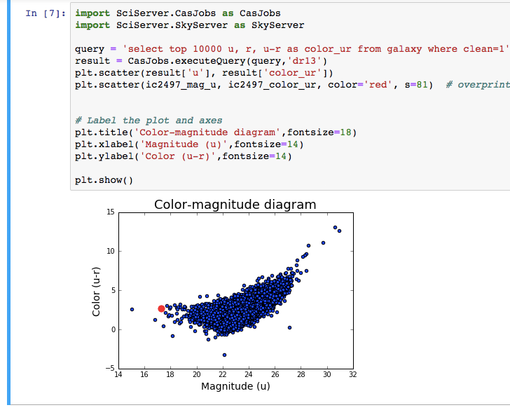
SciServer: Collaborative Tools for Data-Driven Engineering and Science
PI: Alex Szalay
NSF AWARD No.: 1261715
SciServer hosts datasets for Research Science Groups
Users register and log in
What is SciServer?
A system for researchers across multiple domains to host and share datasets, featuring query and analysis tools for collaborative research.
7
External API Access
1
2
DATA PROVIDERS
USERS
EXTERNAL APPS
5
1.1 Provide and Register the Data
SkyServer
SCISERVER
SkyQuery
Dashboard & Collaboration
API
Marvin
3
6
Query, Compute, Analysis
GLUSEEN
PARADIM
1.2 SciServer Hosts the Data
MEDE
Turbulence
Millennium
1.3 Setup Access Controls for Team
8
Educational Support
Astronomy
Sloan Digital Sky Survey (SDSS)
Millennium Simulations (cosmology)
Fluid mechanics
JHU Turbulence DBs (direct numerical simulation)
Genomics
Recount (RNA sequencing)
JHU Bloomberg / UKBiobank
Materials Science
JHU MEDE
JHU Paradim
COURSEWARE
1.4 Data Available for Use
API
Create student groups
Manage assignments
Give feedback to individual students
4
Manage Your Data
5
Share Your Data
DATA
How to Get Started
User Account: Register an account at https://apps.sciserver.org
Data Provider: Contact helpdesk@sciserver.org
Tell us your Use Cases for team collaboration
Provide feedback on your experiences
Let us help you share data
Introduce SciServer to other users
HOSTED DATASETS
EXAMPLES / DOCS
Mat sci
Turbu
YOUR DATA
SDSS
Gene
Soil
Millen

