Slide 1




Collaborative Data-Driven Science
sciserver.org

Slide 2
Bringing data-driven science to the cloud!
Providing WEB APPS for:
-Seamless data storage, querying, sharing and transfer.
-Data analysis with Python, R and MATLAB,
with fast data access and loading.
-Easy access of very large scientific datasets.

Slide 3
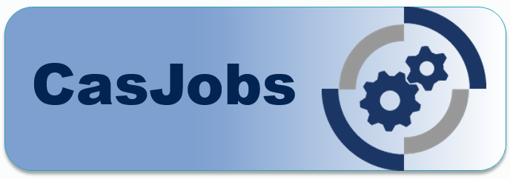
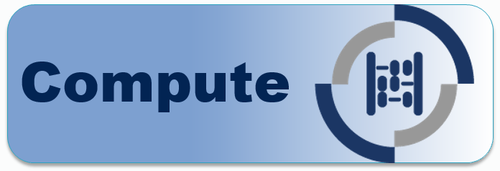




Main components:
Database storage:
Data analysis:
File storage:
Data exploration:
Data CrossMatch:
User sign-on:

Slide 4
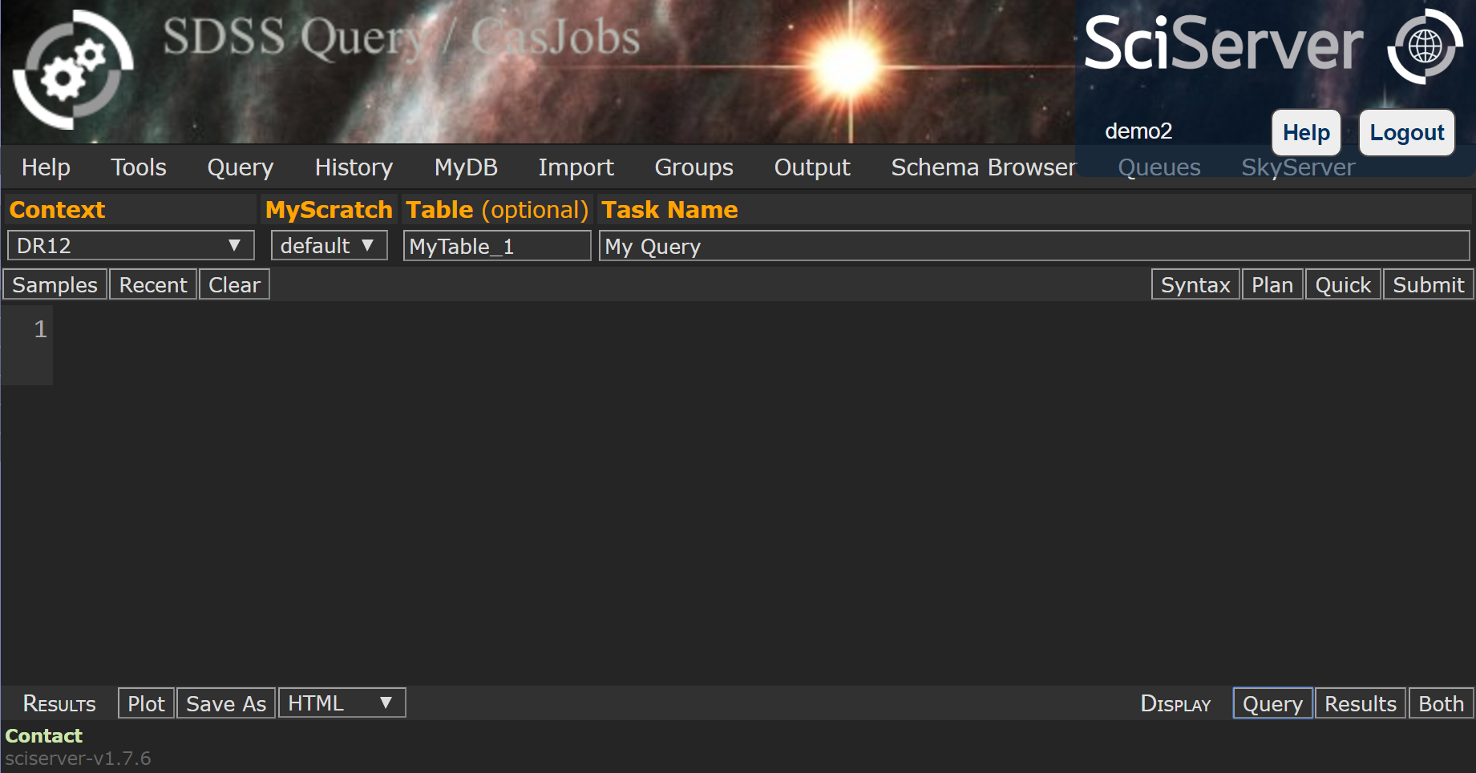
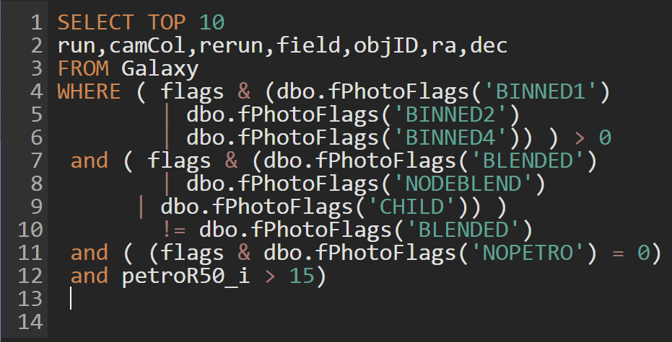
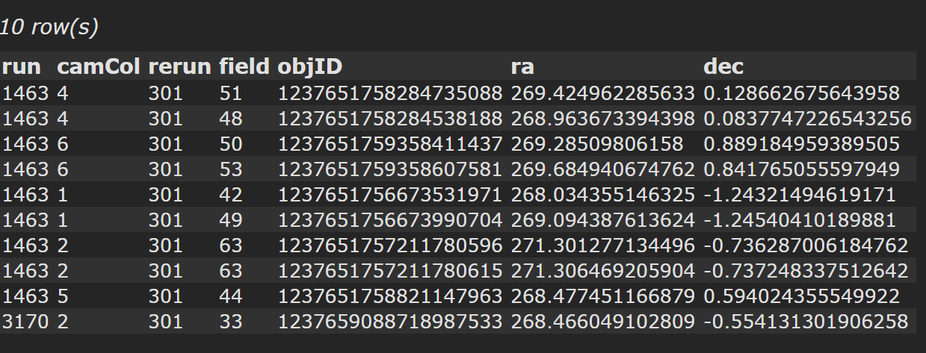
Access to huge databases.
Explore table results.
Write SQL queries

Slide 5
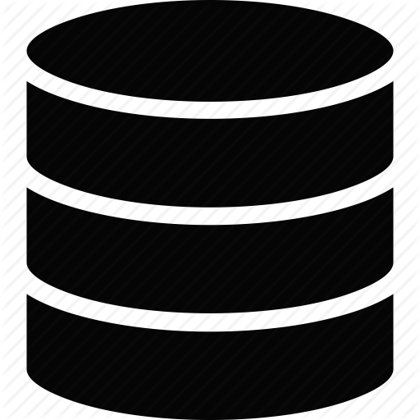

Get MyDB:
your own persistent database
MyDB

Slide 6
Get MyScratch: temporary database for your largest tables
MyScratch

Slide 7
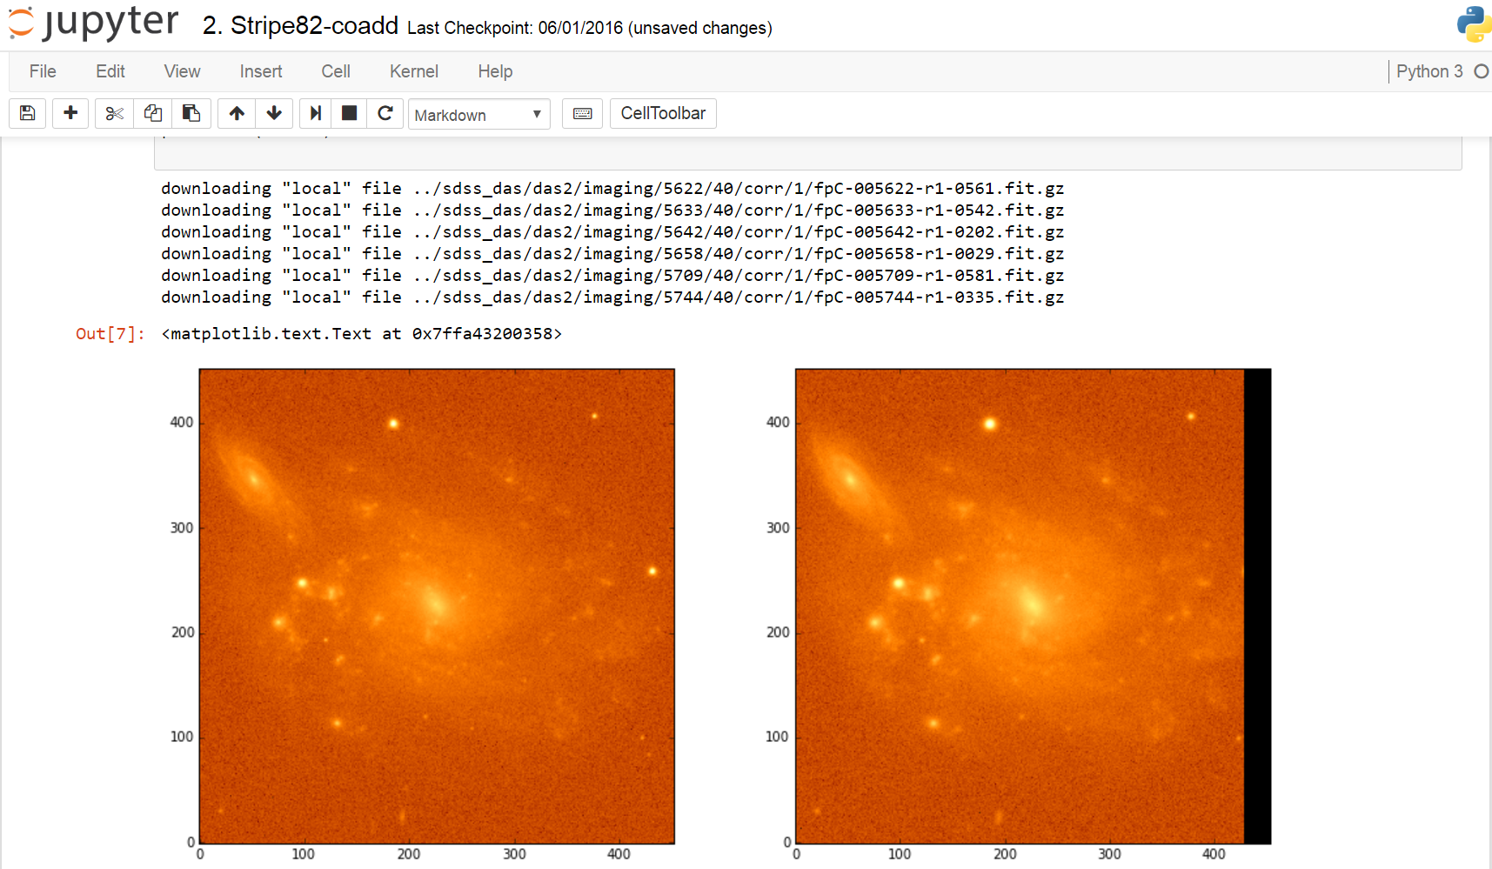
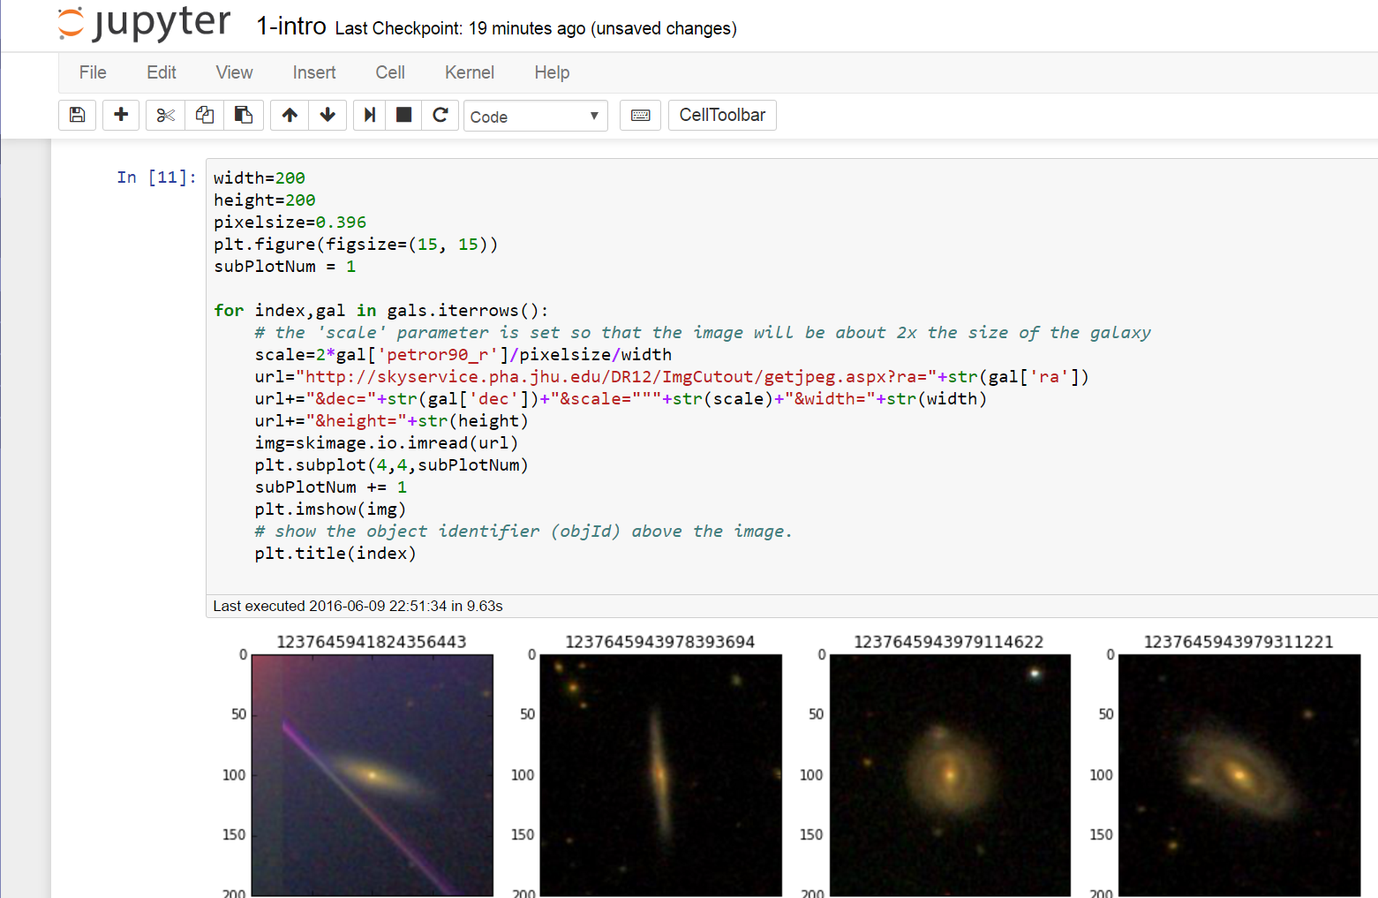
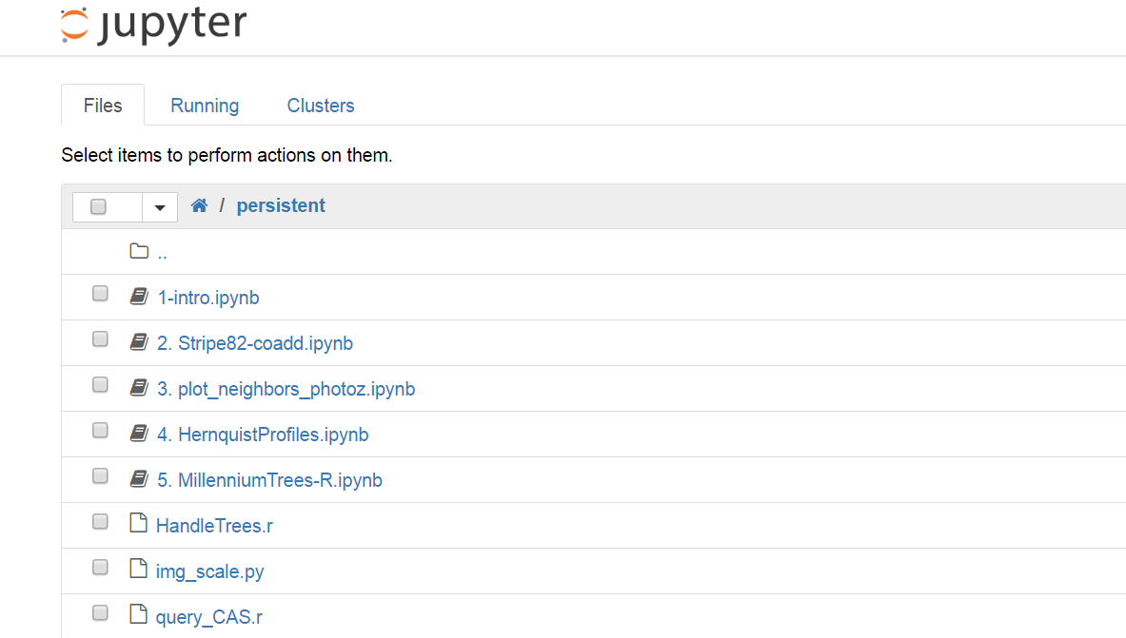

Analyze data using Python, R, Matlab
in Jupyter Notebooks
Run scripts,
Create graphics
Access local
data directories
Store your scripts in a persistent folder

Slide 8


Seamless data transfer between Compute and CasJobs/SciDrive.

Slide 9

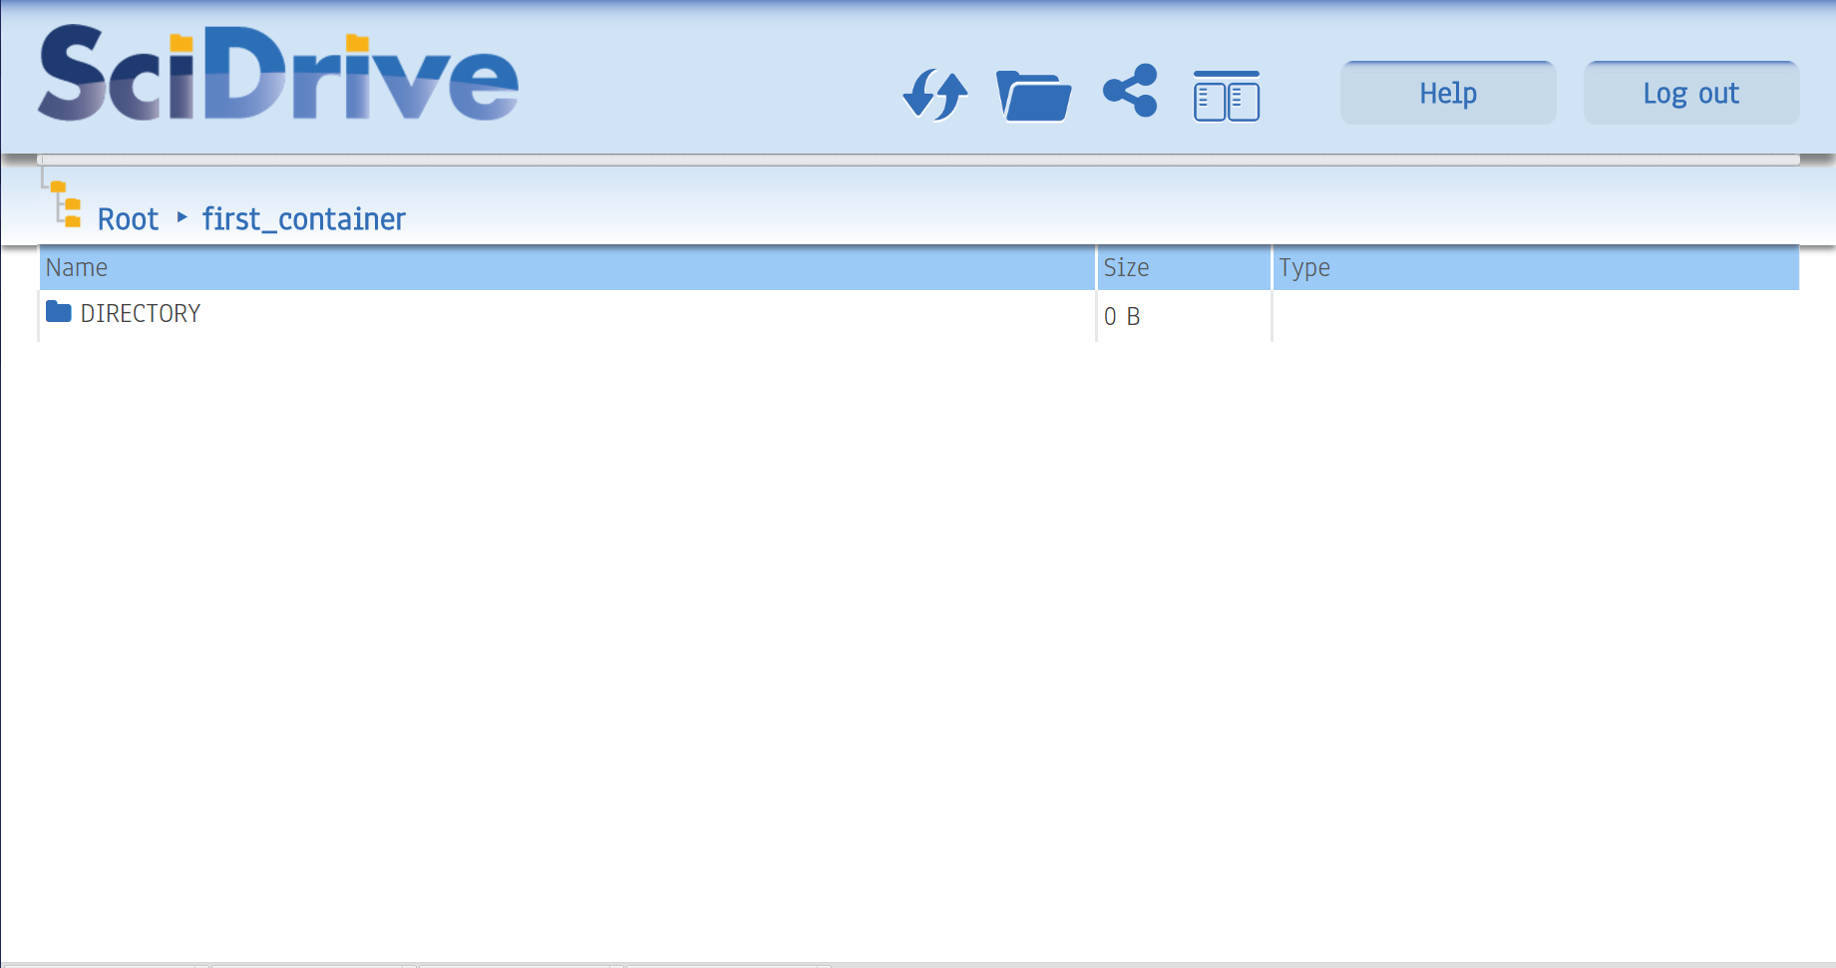
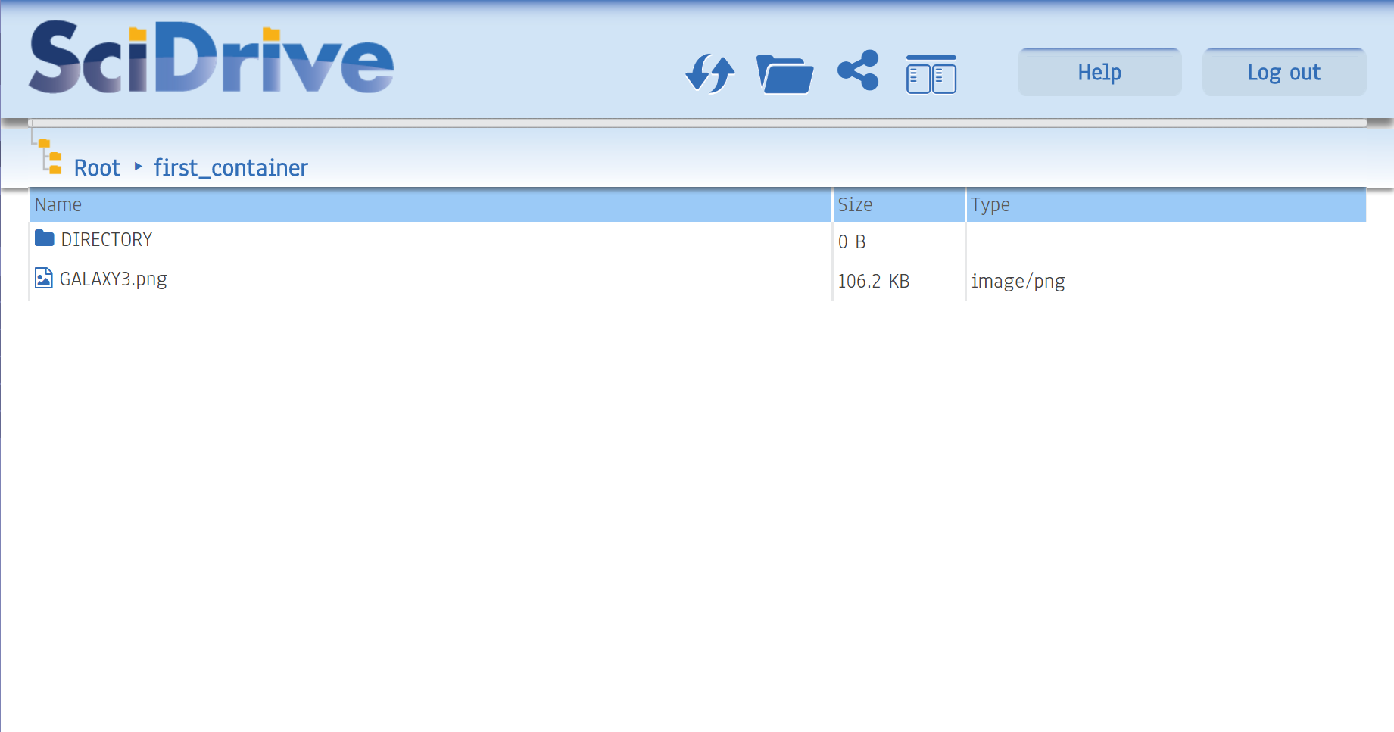
File storage & sharing

Slide 10

Send tables from your
MyDB database to SciDrive
MyDB

Slide 11
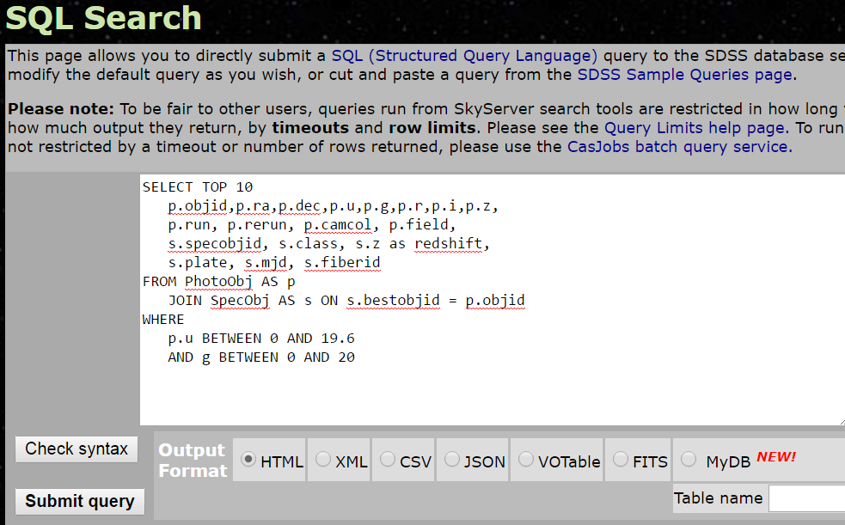
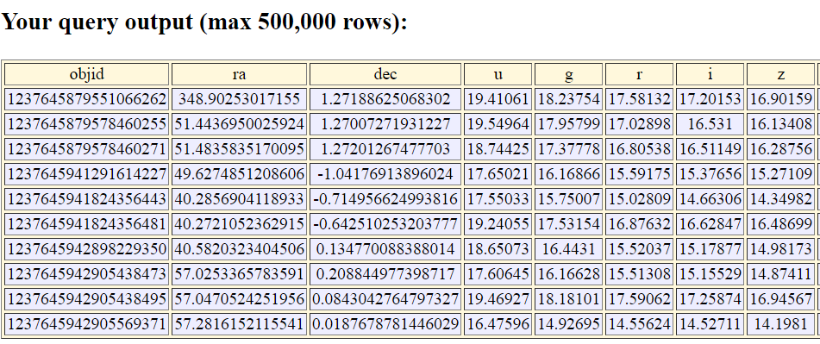
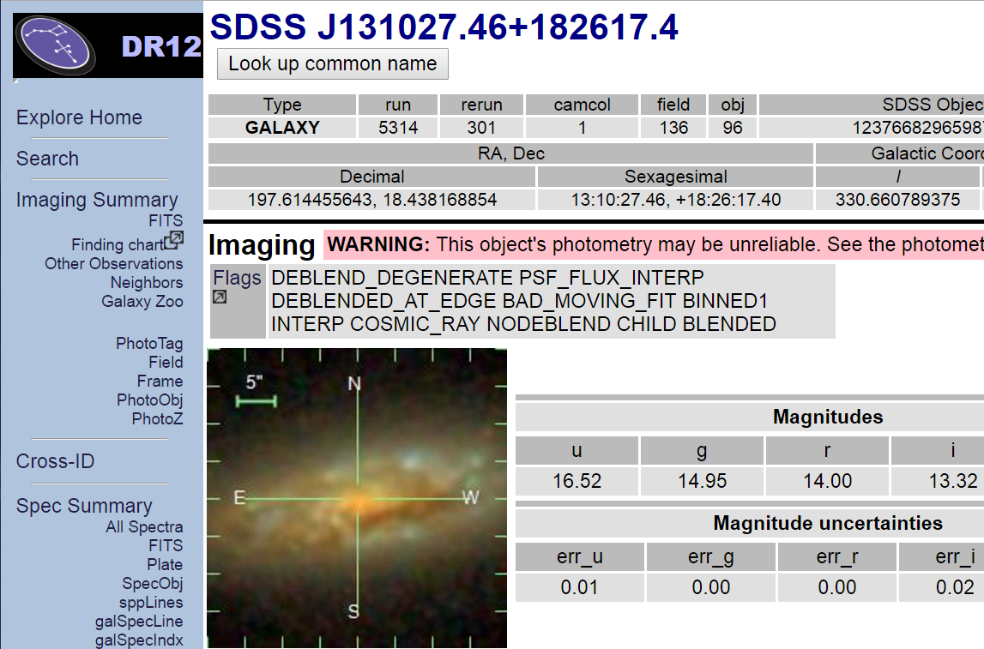
Explore SDSS astronomical datasets.
Find astronomical objects
Run SQL queries
against SDSS data

Slide 12
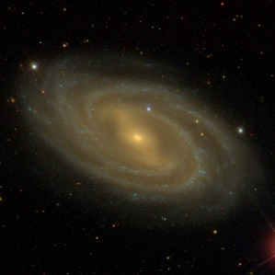
Send objects and tables
to your MyDB CasJobs database
MyDB

Slide 13

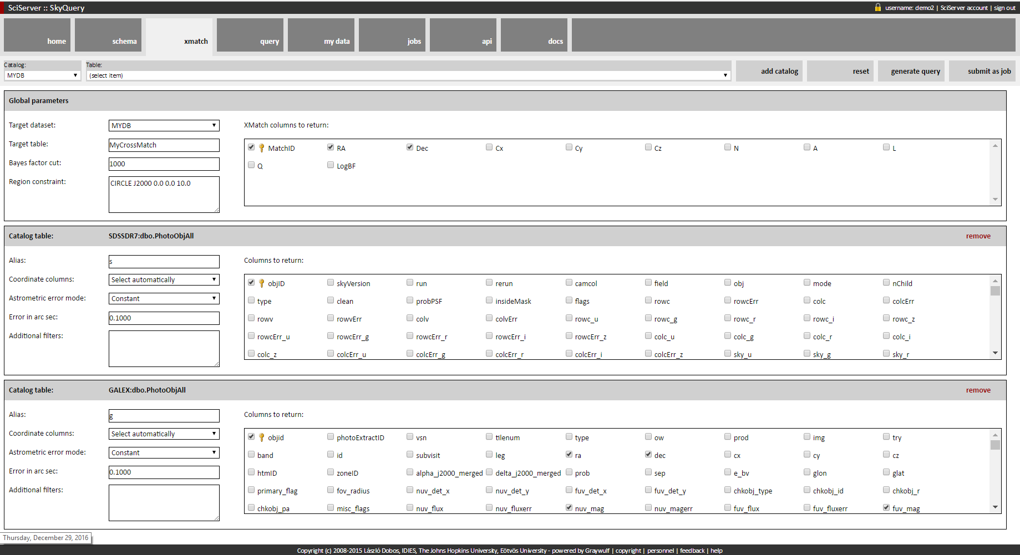
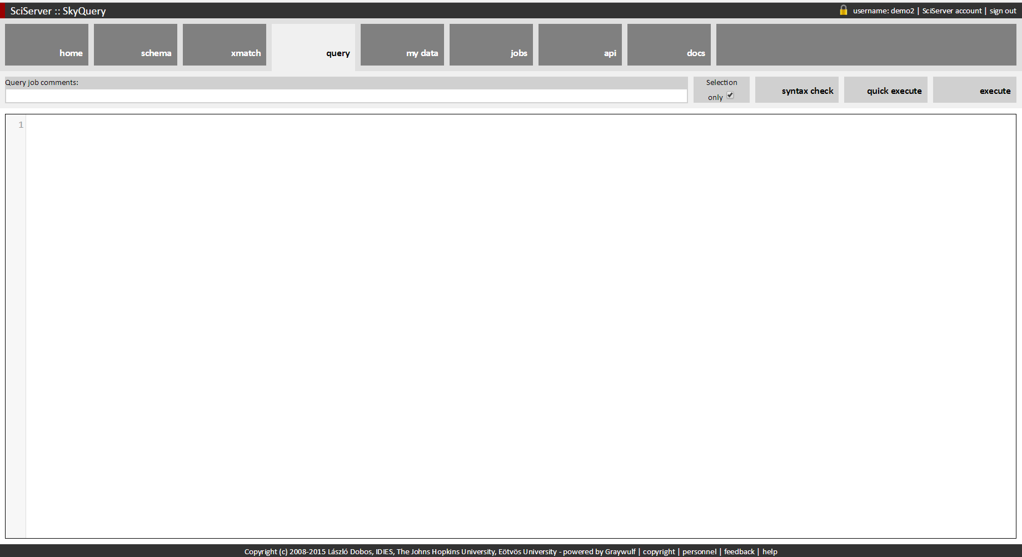
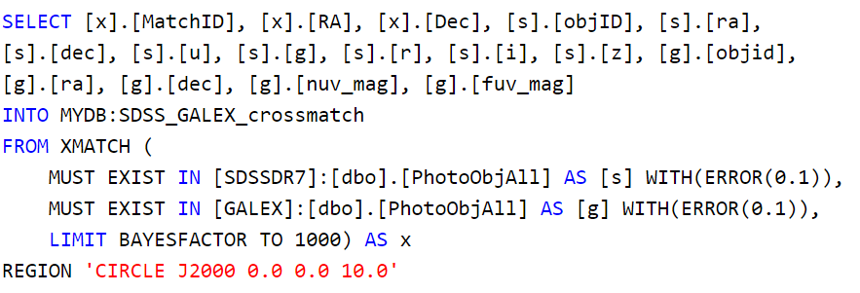
Database system for cross-matching astronomical source catalogs.
Add cross-match region
and Bayesian constraints.
Select source catalogs
and output columns.
Automatic creation of cross-match SQL query

Slide 14
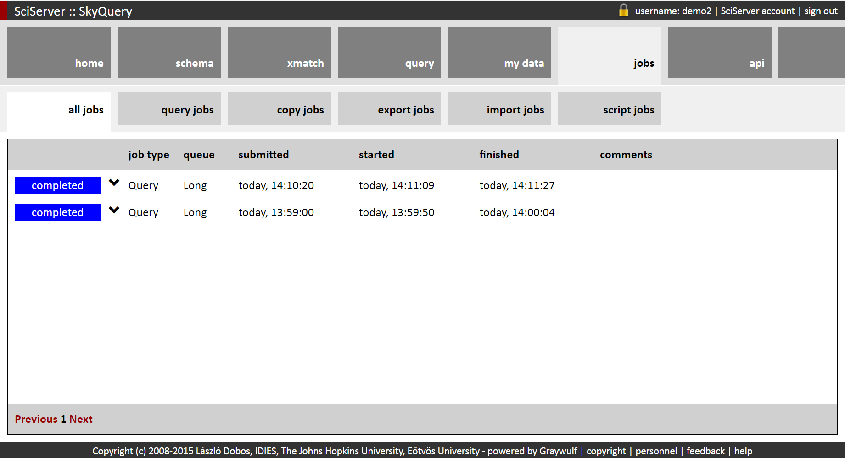
Database system for cross-matching astronomical source catalogs.
Schedule cross-match jobs,
save results in MyDB.

Slide 15
Send cross-match tables from MyDB database to SciDrive.
MyDB

Slide 16
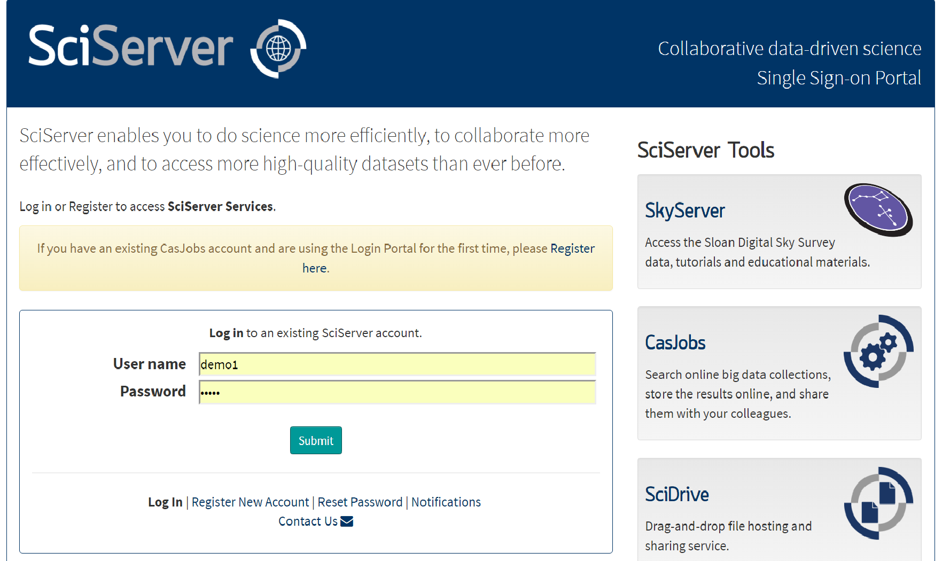
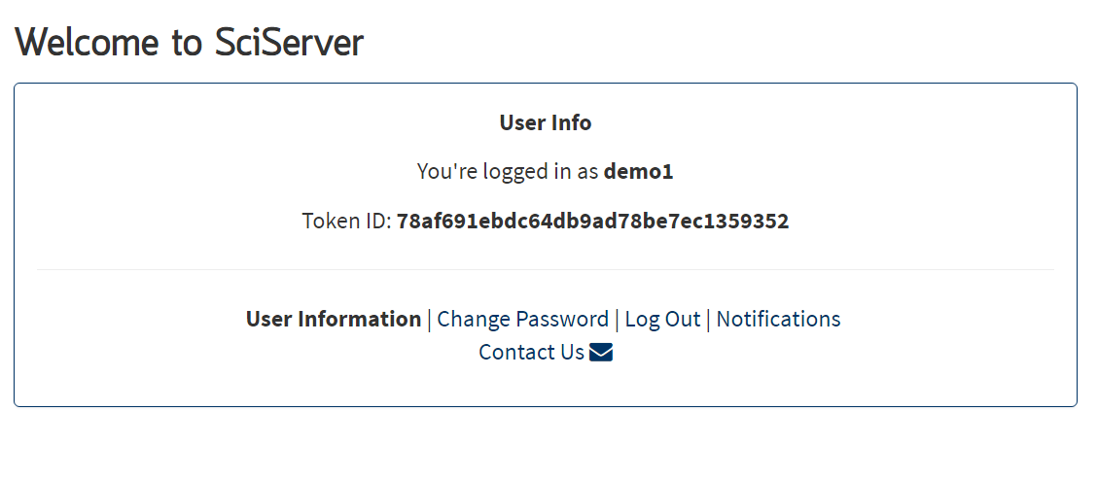
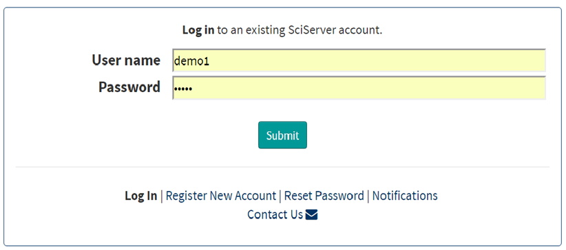

Single sign-on
across all components

Slide 17
More Information:
www.sciserver.org
Sciserver-webmaster@jhu.edu
SciServer is funded by the National Science Foundation through its Data Infrastructure Building Blocks (DIBBs) Program, Award ACI-1261715

