Slide 1



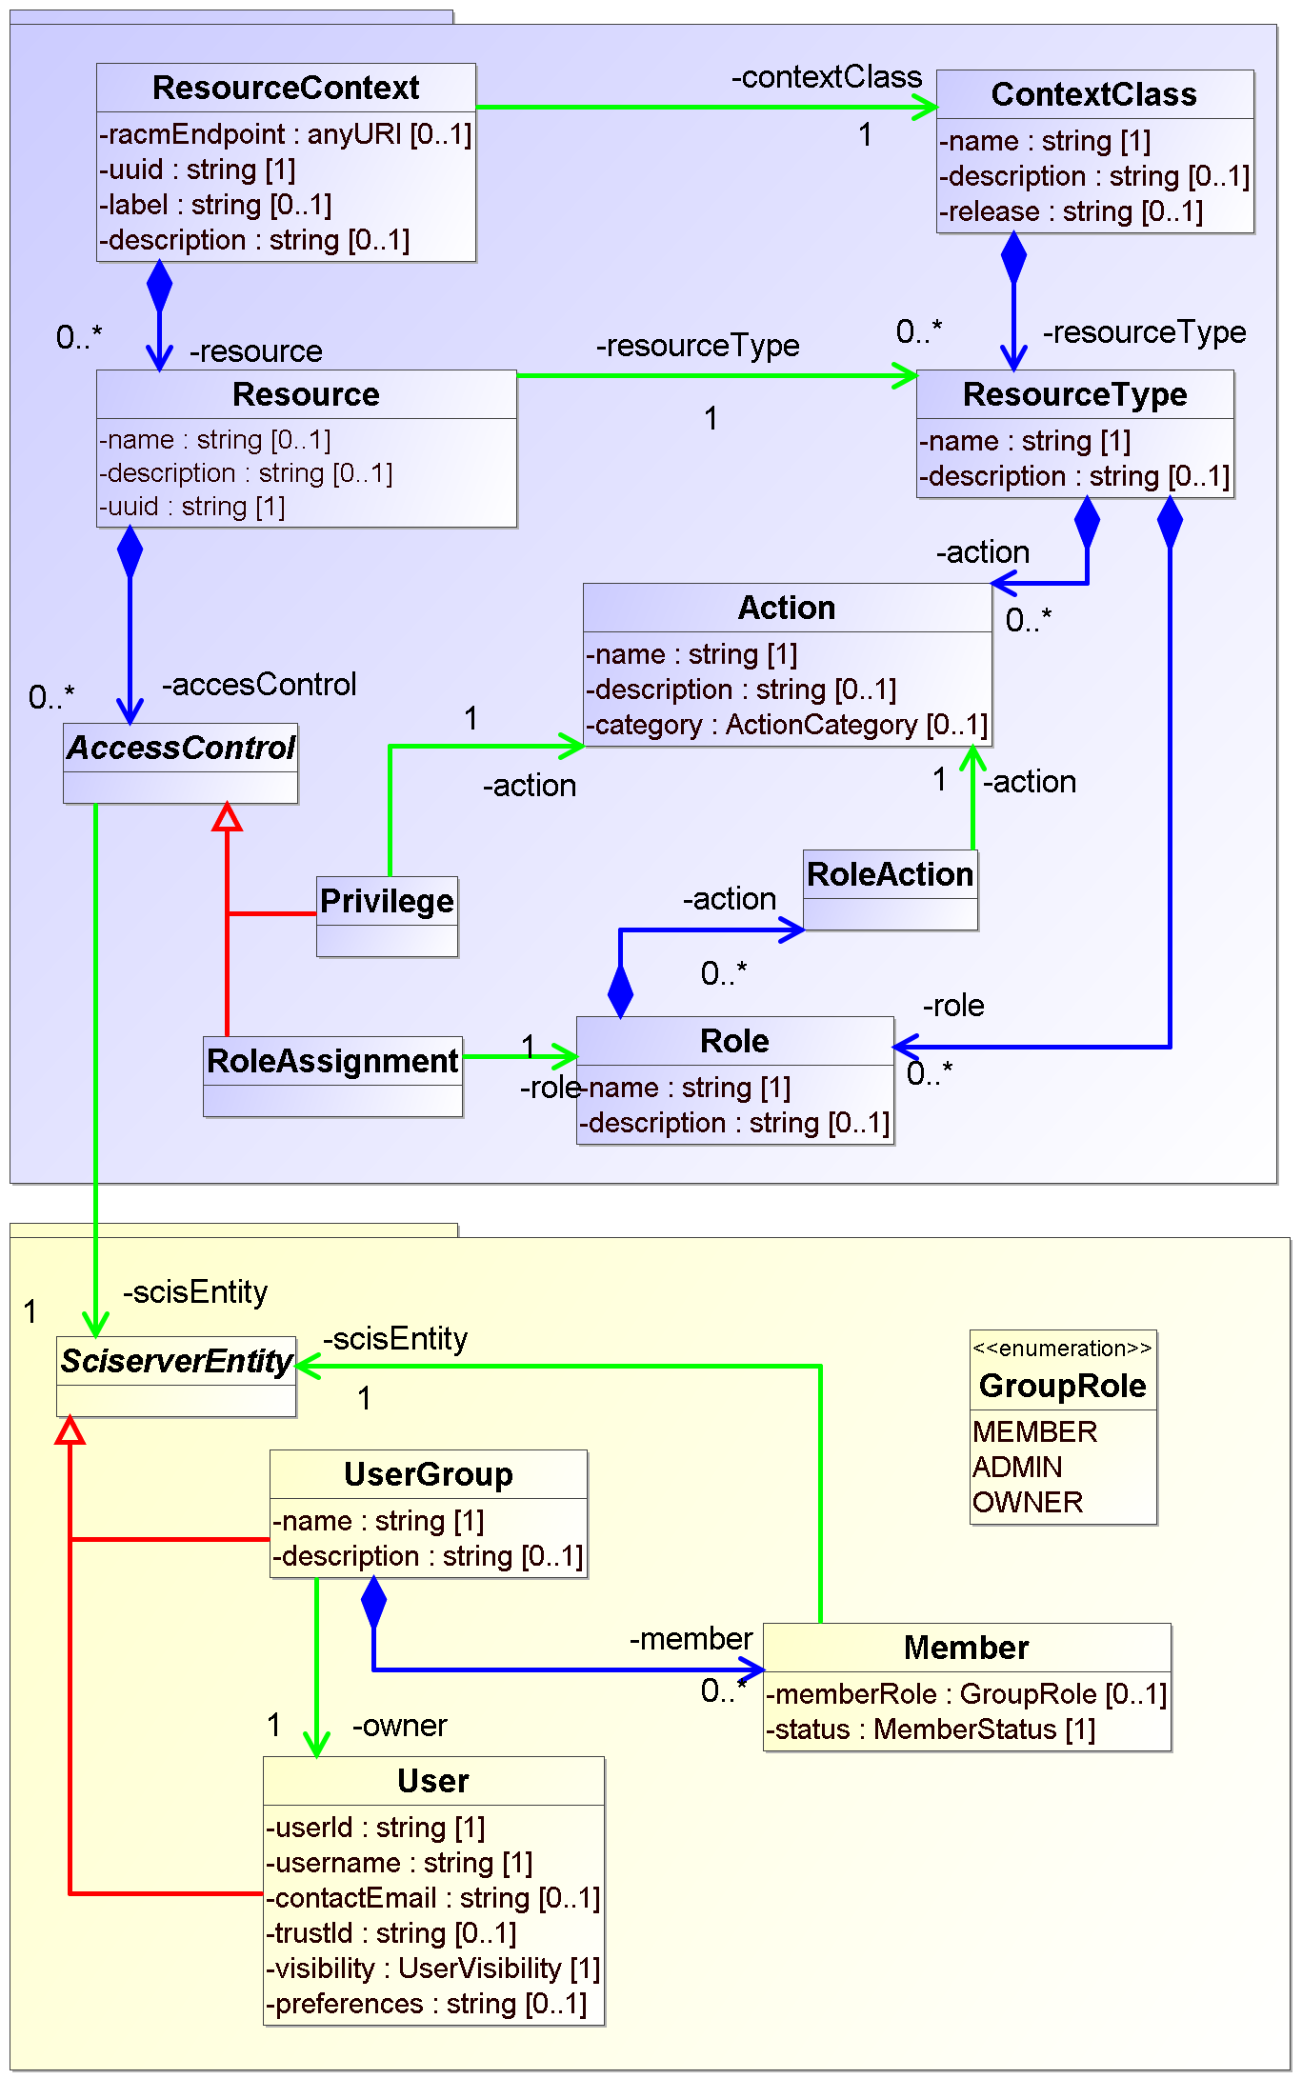
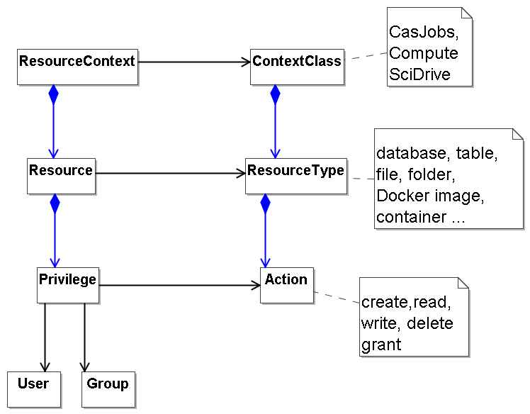
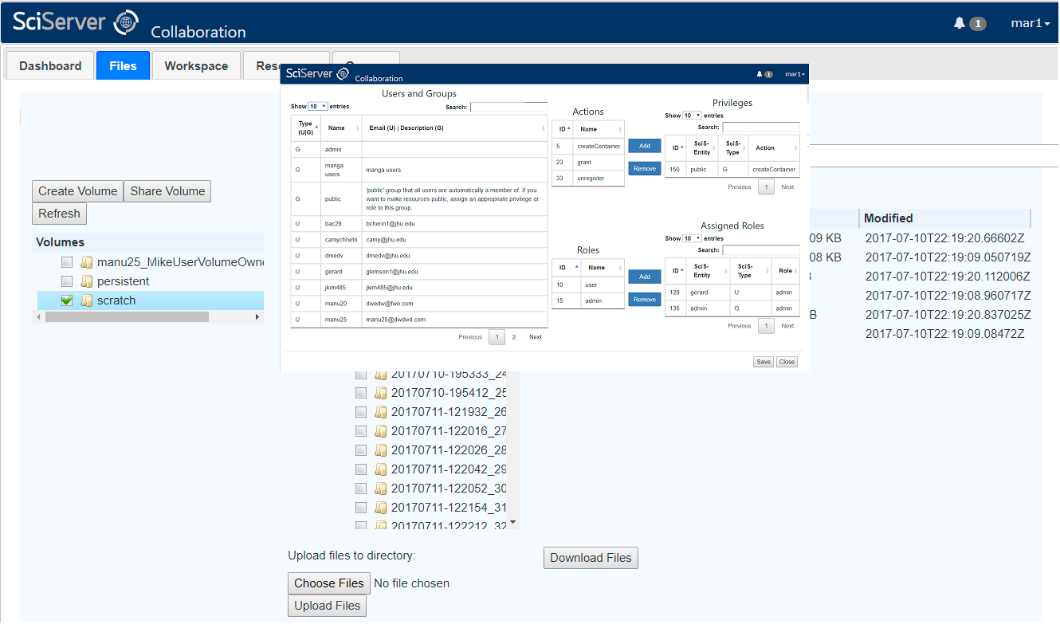
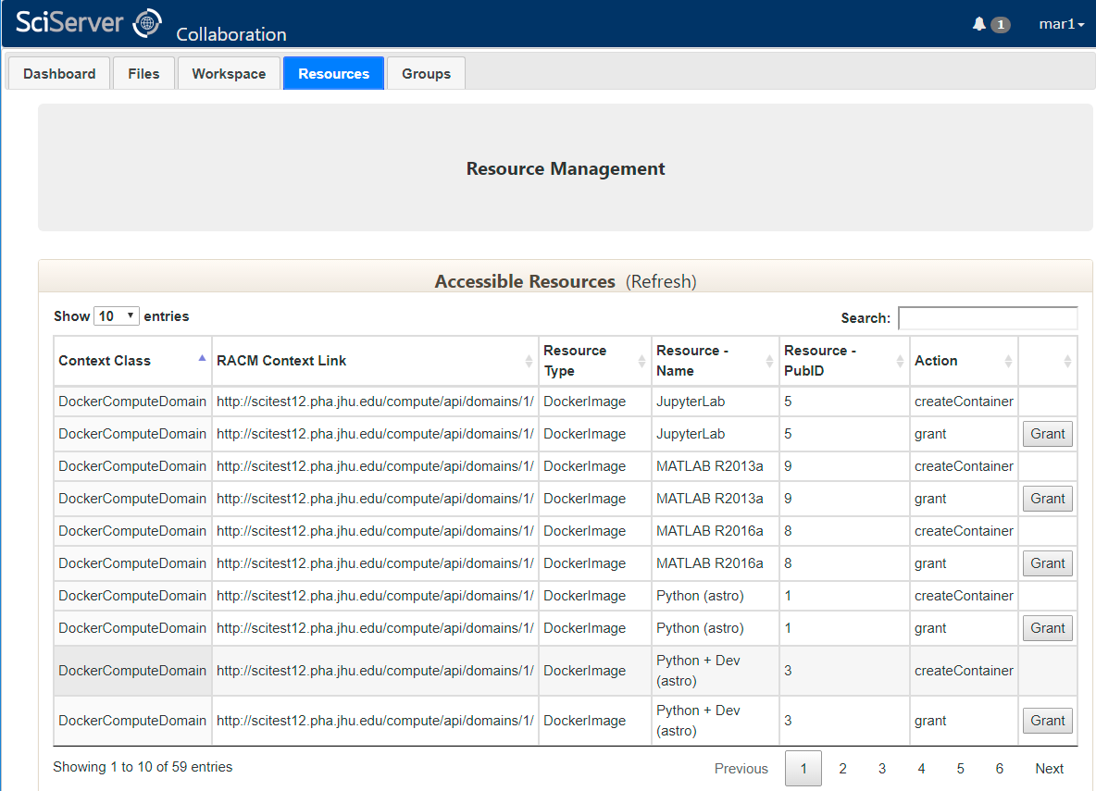
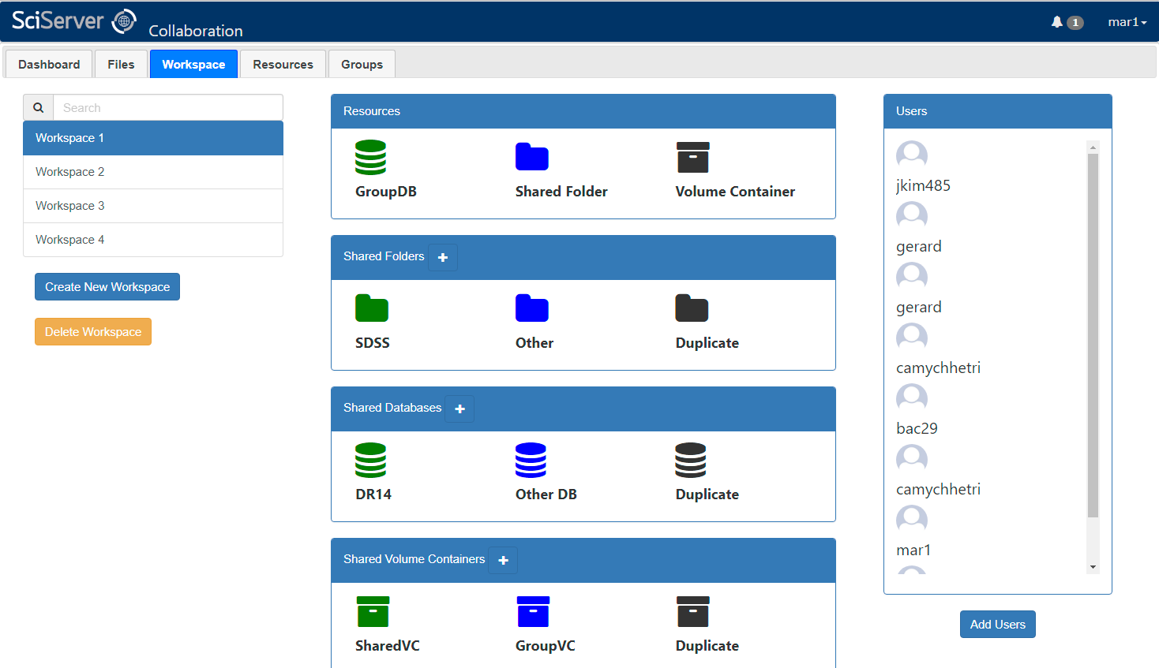
Resources Supported:
Files and Folders
Databases
Docker Images
Docker Volume Containers
Resource Access Control in SciServer
Data Model and Implementation
Gerard Lemson, Jai Won Kim, Manuchehr Taghizadeh Popp and the SciServer team
Institute for Data Intensive Engineering and Science (IDIES), Johns Hopkins University
NSF AWARD No.: 1261715
OVERVIEW
UML MODEL REPRESENTATION
RACM is the Resource Access Control Management component of SciServer (http://www.sciserver.org), a system for providing advanced analysis capabilities to large astronomical and other scientific data sets.
RACM uses a flexible data model for representing who is allowed to do which actions on a particular resource.
Major Features
Folder, file and database sharing (readonly and readwrite)
Administrative tools
Workspaces for intuitive user implementation
Core Concepts:
Define and manage Users and Groups
Define and manage system Resources
Define and manage access controls between Users and Resources
Define and manage relationships between resources
Support nested Groups
Soon: Regions and Domains
Flexibility and Application:
REST API for all major features
Abstract model allows new Resource types to be defined
Can be used by external applications as an Access Control Framework in itself
Resource | Type | Actions
CASJobs | ResourceContext
Folder | Resource
DockerCOMPM | ResourceContext
DockerImage | Resource
Implementation uses customized vo-urp framework, originally developed for IVOA/Simulation DM effort.
https://github.com/glemson/vo-urp
IMPLEMENTATION
Data Sharing
Administration
User Workspaces
Folders
Files
Databases
Docker images
Volume containers
Resource definition
Resource registration
Relationships
Actions, roles
User created and managed Easily add Resources and Users
Shared workspace folder and database
Configurable permissions

