Slide 1



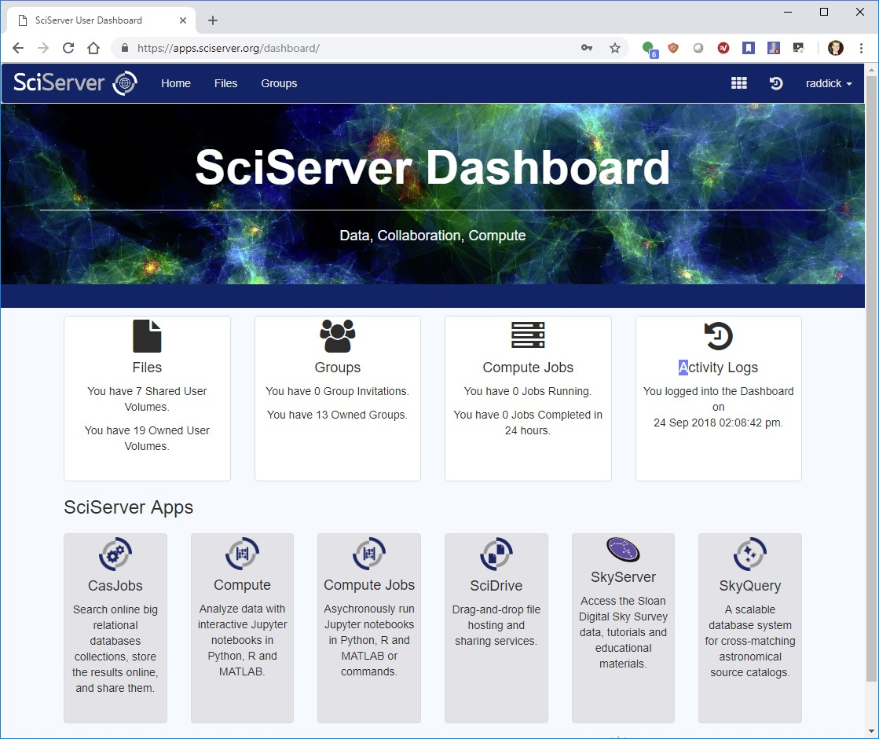

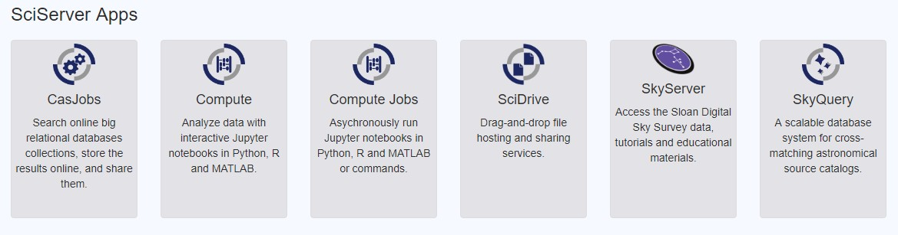
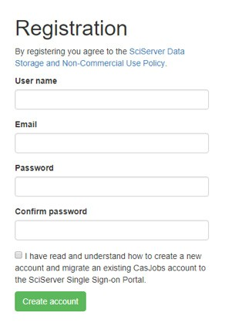
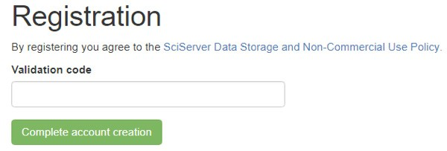
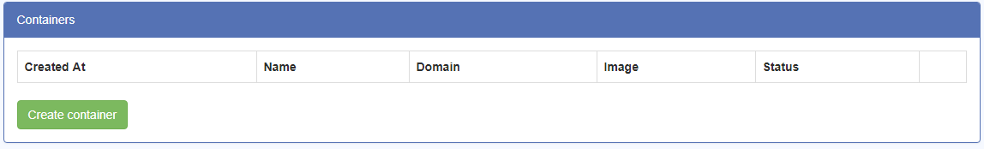
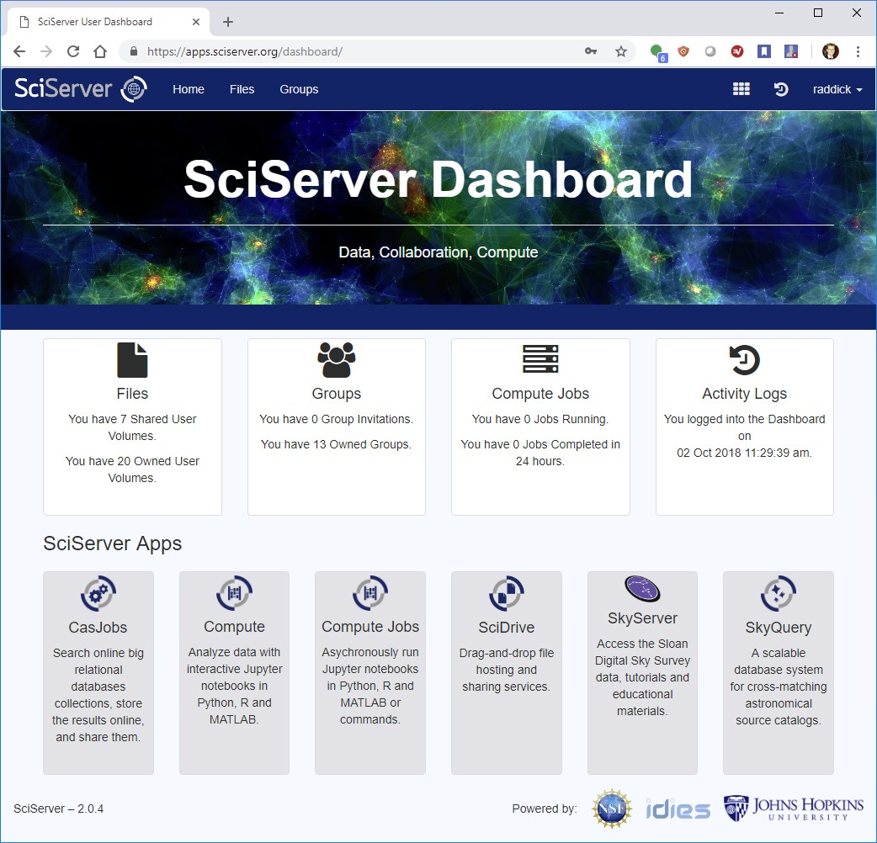
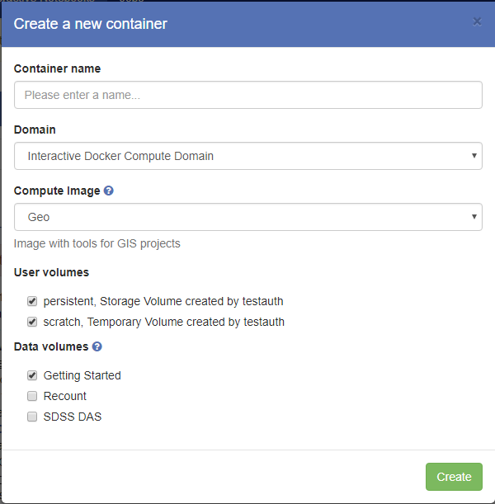
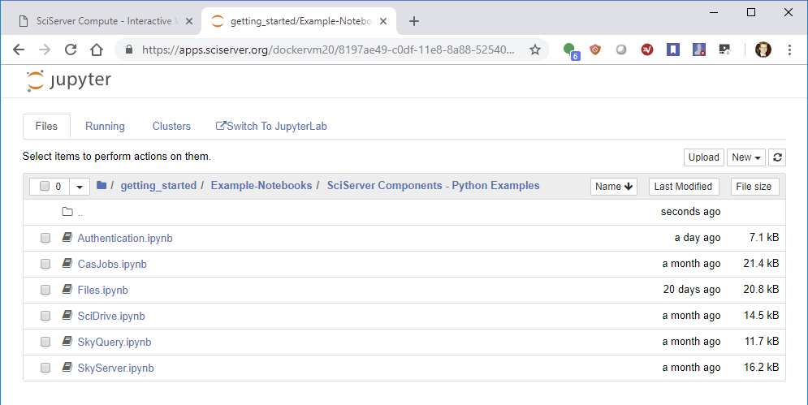
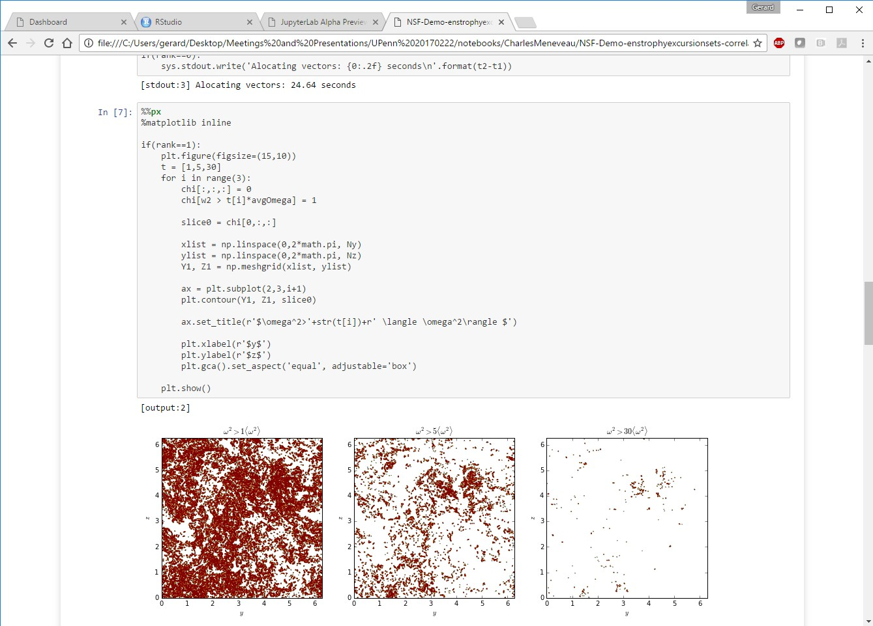
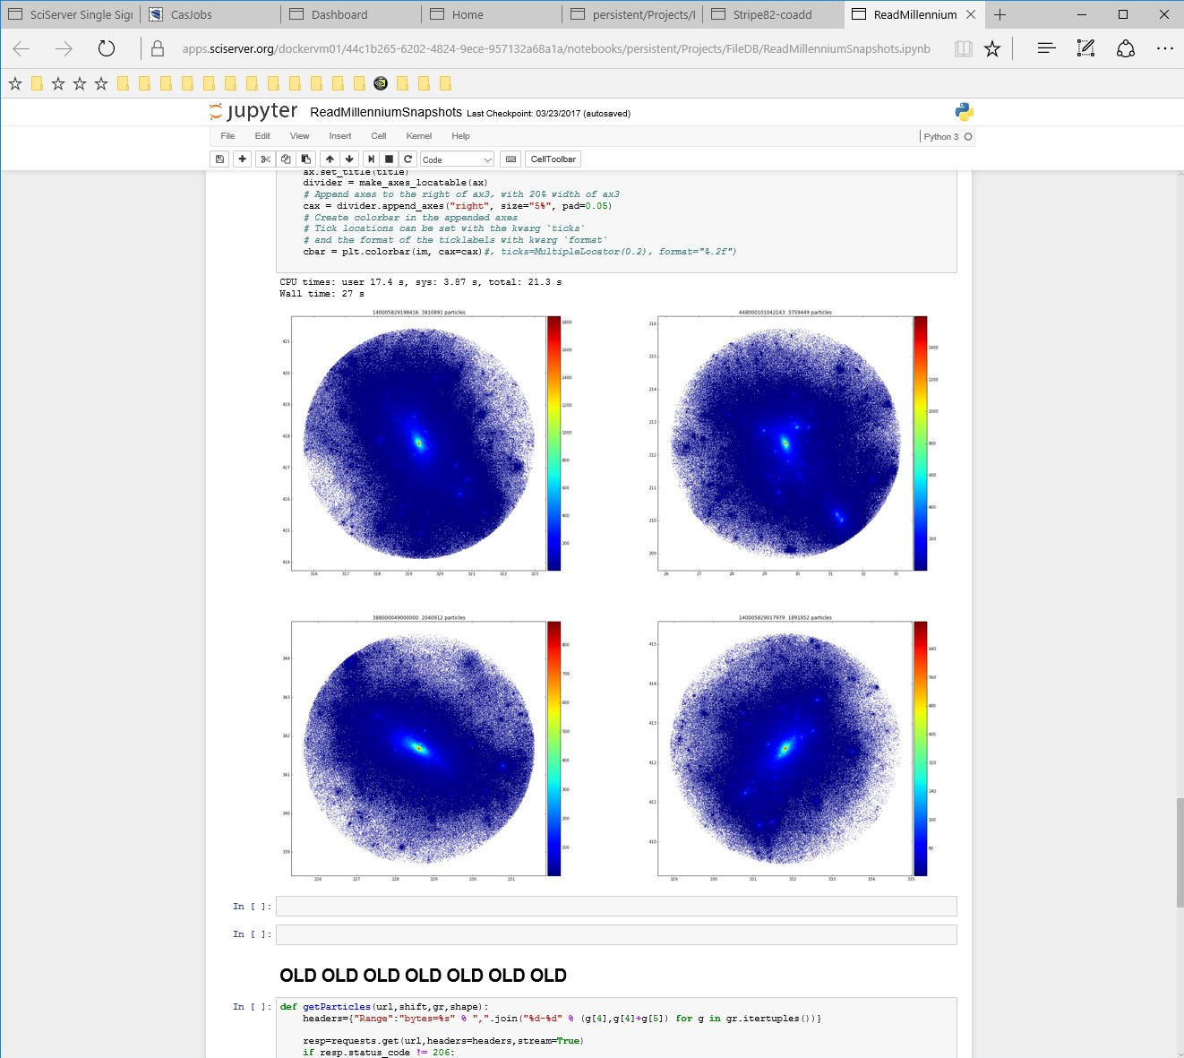
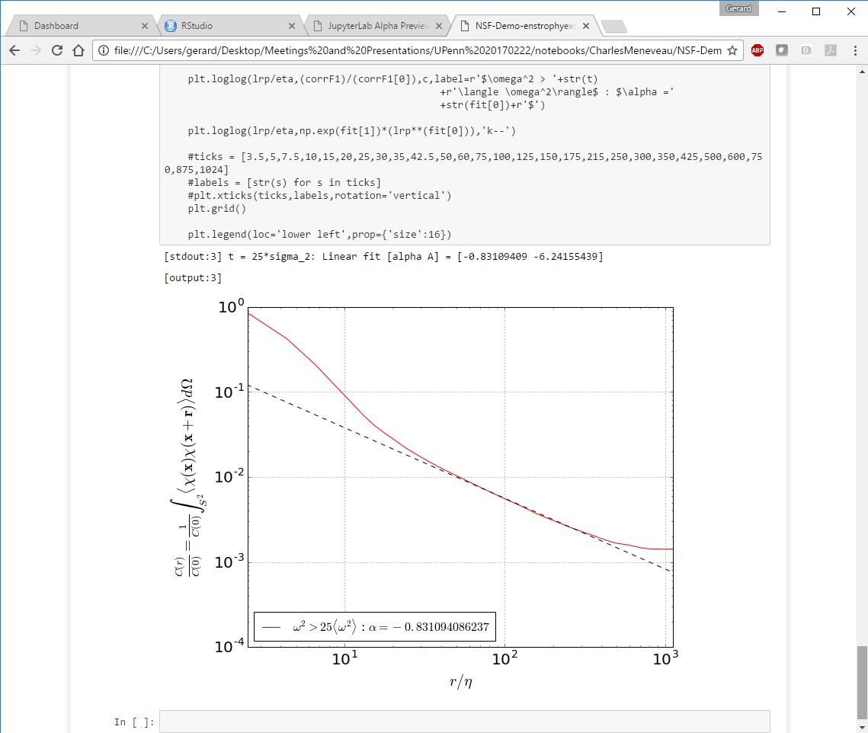
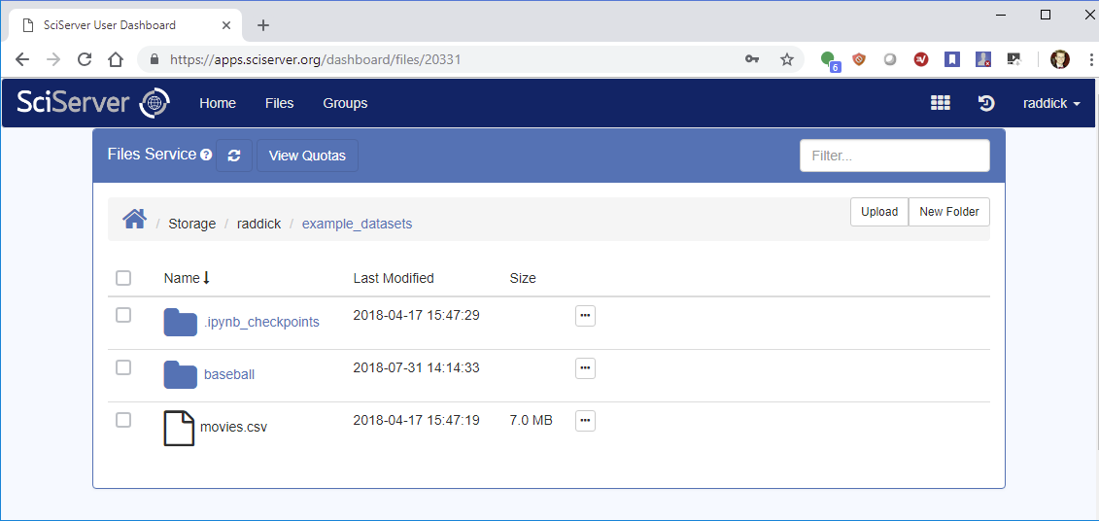
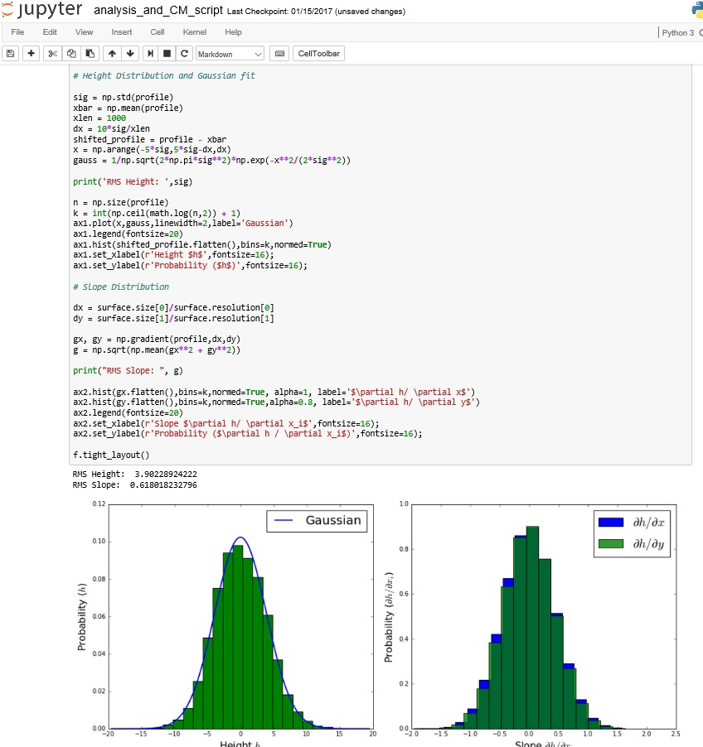
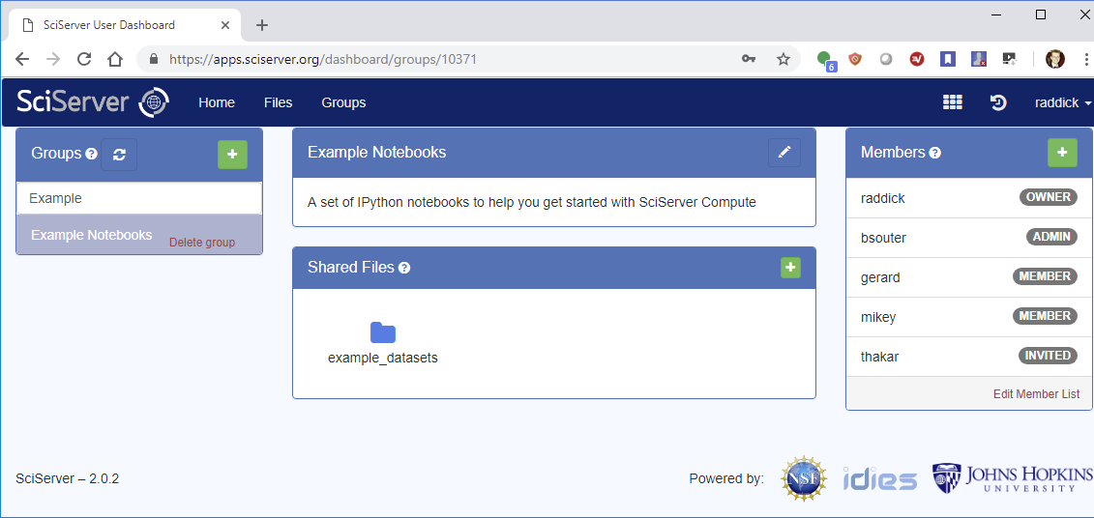
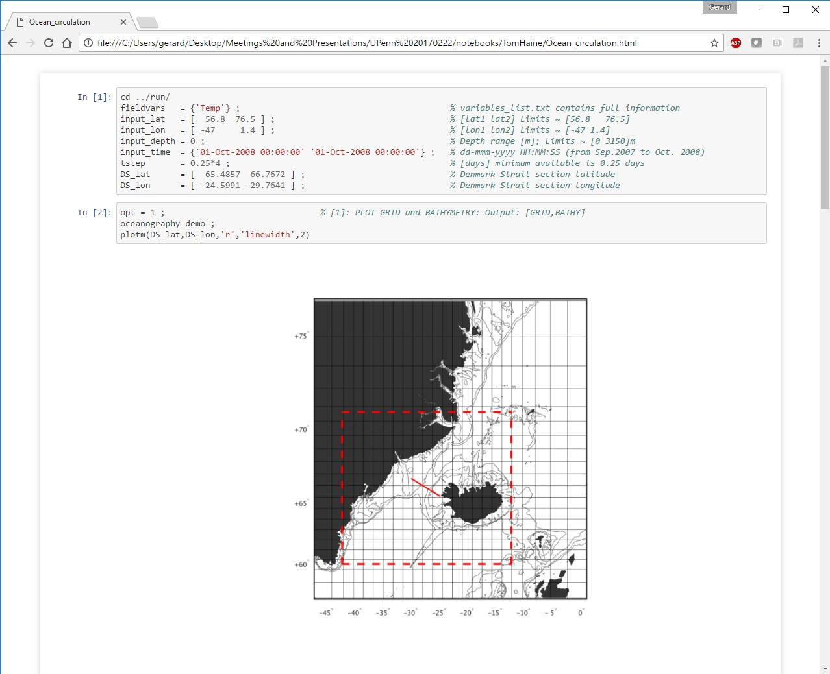
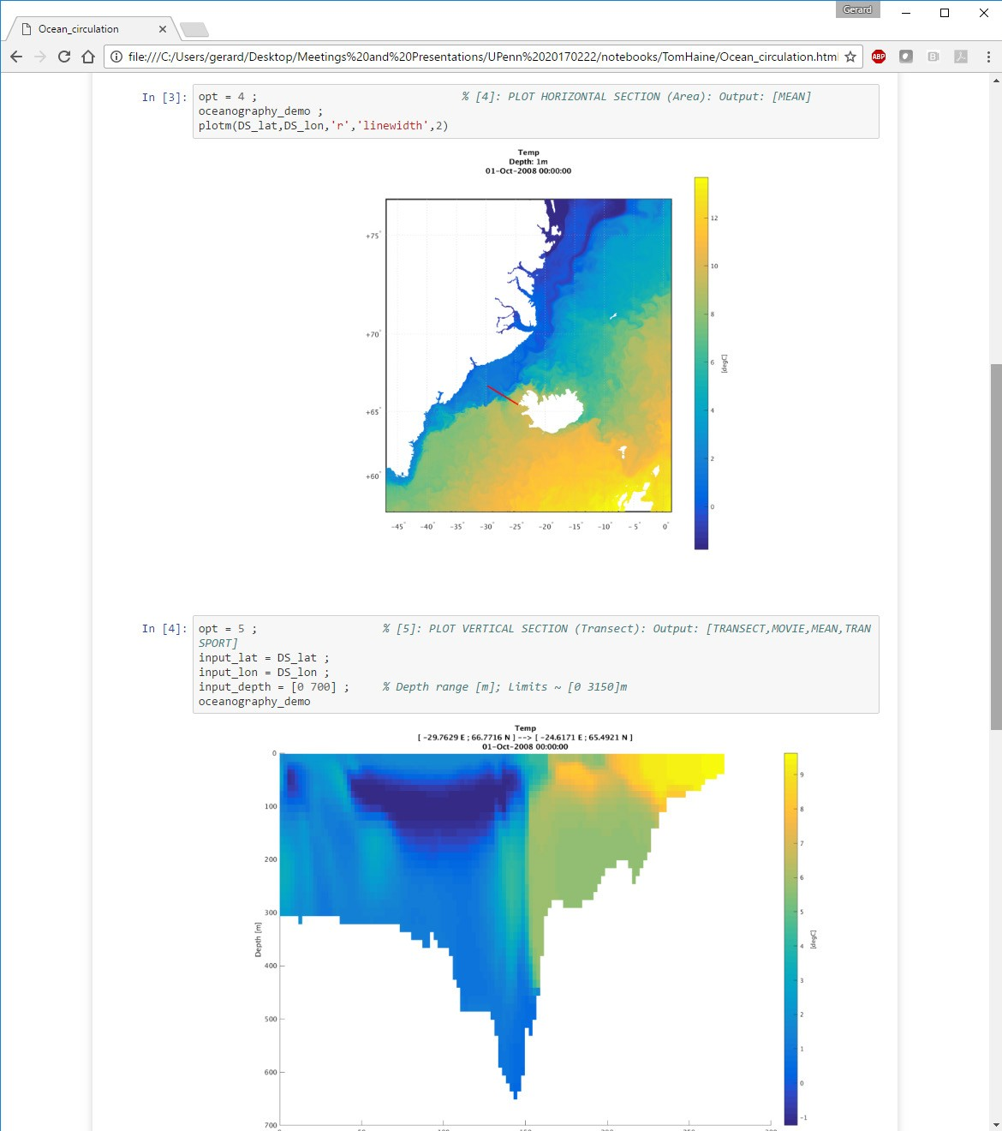
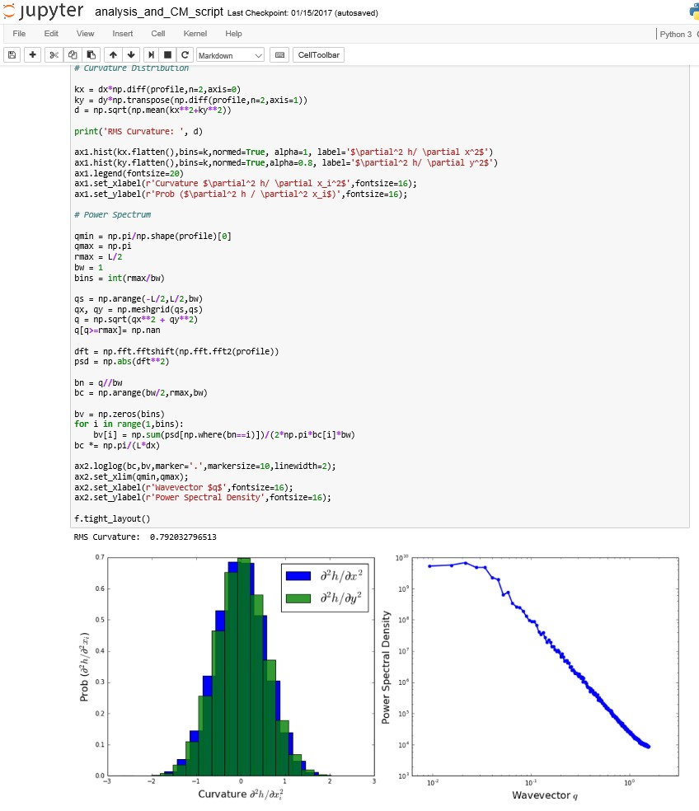
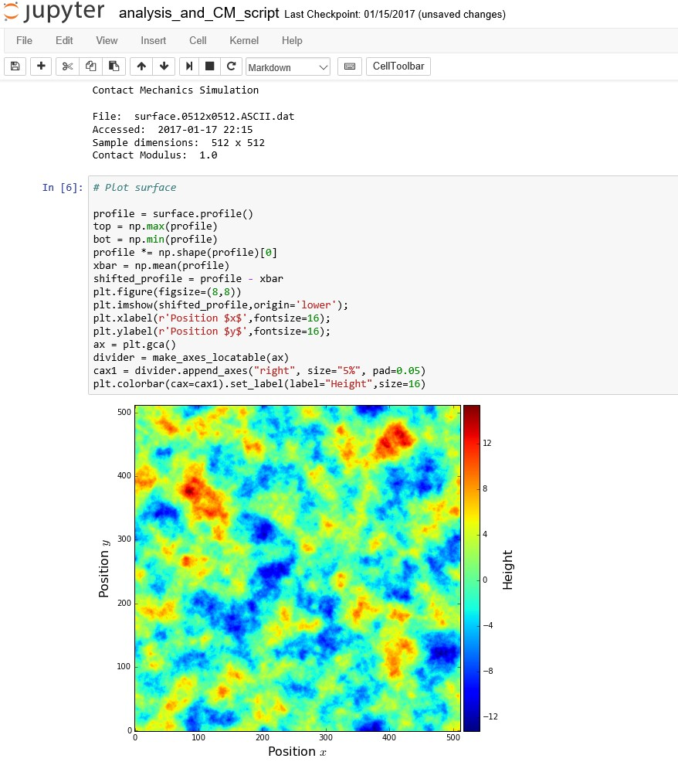




















The New SciServer: Collaborative Tools for Data-Driven Engineering and Science
SciServer Courseware
1. Create account
What is SciServer?
A system for researchers across multiple domains to host and share datasets, featuring query and analysis tools for collaborative research.
5. Compute
Connecting with APIs
2. Access Data
Astronomy
Sloan Digital Sky Survey Catalog Data (DR1 - DR14)
Raw image (FITS) data (DR1 - DR7) Fluid mechanics
Johns Hopkins Turbulence Databases
Full data for 8 DNS simulations (> 1 PB) Genomics
Recount
Human RNA sequencing samples (> 70,000) Cosmological simulations
Millenium / INDRA / Illustris / EAGLE Or upload your own data
6. Analyze
Cosmological Simulations
Turbulence
3. Manage Your Data
How to Get Involved
Use our toolkit (www.sciserver.org)
Volunteer to be an Early Adopter by emailing sciserver-help@jhu.edu
Find bugs in our alpha system
Suggest new features
Let us help share your data
Introduce us to other teams with data to share
Materials Science
4. Share
Ocean Circulation

