Slide 1
Improving OCR Inputs
from OCR Outputs?
iDigBio Augmenting OCR Hackathon
Preliminary Results
Ben Brumfield
FromThePage.com

Slide 2
Handwriting Detection
“Remember, son – if you don't try, you can't fail.”
Homer Simpson

Slide 3
Handwriting Detection
Problem 1: You can't OCR handwriting
  OCR produces gibberish
  Handwriting requires human interpretation
Problem 2: How do you detect handwriting?
  Route handwritten images to humans
  Route typed/printed images to OCR.

Slide 4
Handwriting Detection
Approach:
  Use OCR gibberish to detect handwriting
Step One: Classify OCR output visually
Step Two: Automate Classifications

Slide 5
Handwriting Detection
 | ABBY | Tesseract
Handwriting Detected | 41 | 61
No Handwriting Detected | 34 | 21
False Positives | 5 | 20
False Negatives | 16 | 1

Slide 6
Handwriting Detection
'Four Dots' => /\.\.\.\./, 'Five Non-Alphanumerics' => /\W\W\W\W\W/, 'Isolated Euro Sign' => /\S€\D/, 'Double "Low-Nine" Quotes' => /„/, 'Anomalous Pound Sign' => /£\D/, 'Caret' => /\^/, 'Guillemets' => /[«»]/, 'Double Slashes and Pipes' => /(\\\/)|(\/\\)|([\/\\]\||\|[\/\\])/, 'Bizarre Capitalization' => /([A-Z][A-Z][a-z][a-z])|([a-z][a-z][A-Z][A-Z])|([A-Z][a-z][A-Z])/, 'Mixed Alphanumerics' => /(\w[^\s\w]\w).*(\w[^\s\w]\w)/

Slide 7
Handwriting Detection
What's Next?
Combine best aspects from two systems

Slide 8
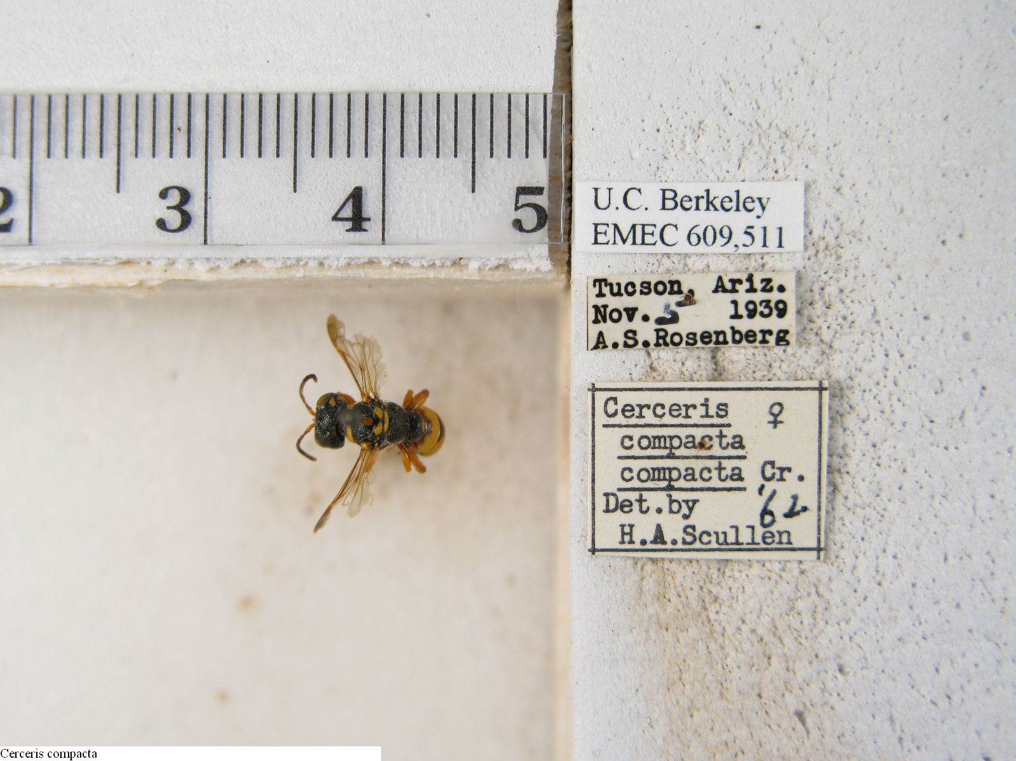
Label Extraction

Slide 9
Label Extraction
HUI]! I Cerceris compacta ~'lllljl U.C.Berké1’e§ ’_ A EMEg_6()9,§ 1 1 »_, A .1“; , 9 3.3..‘ 4 nov...~.'5‘ 19a9?;._i;_,;; 1 A-ET’-‘.139-"°‘F.*¥‘-°}.~7‘:‘$' . | Cerceris cﬂasta, cgggacta ' Det.by 12 pr. 51» .~; 9-: “ ‘J. 5 » \ I H .A. Scullen

Slide 10
Label Extraction
How to sort labels from rulers, holes in styrofoam, and bugs?
False start: direct image processing to find edges of labels
Second try: Use OCR to find words; use words to find labels

Slide 11
Label Extraction
HOCR output:
<span class='ocr_word'
id='word_7'
title="bbox 75 1182 152 1199">
Compacta
</span>

Slide 12
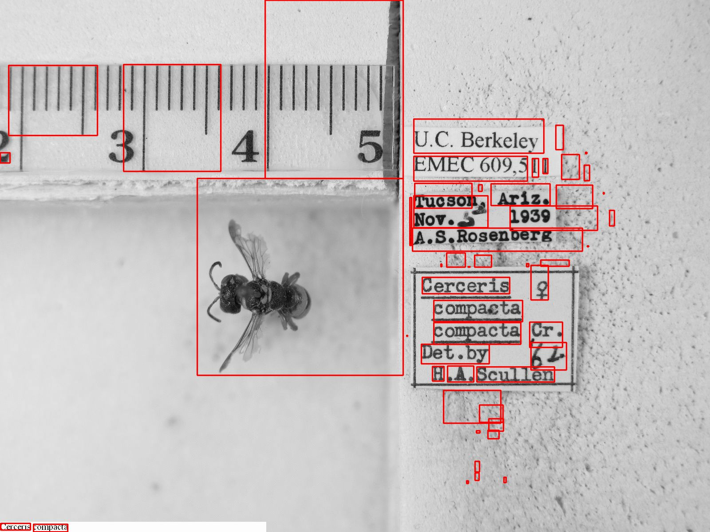

Slide 13
Label Extraction
Filter rectangles by OCR text
  /\w\w\w/
  /\w\.$/
  /^\w$/
Filter rectangles by size
  Rectangle area must be > 0.00015 of total

Slide 14
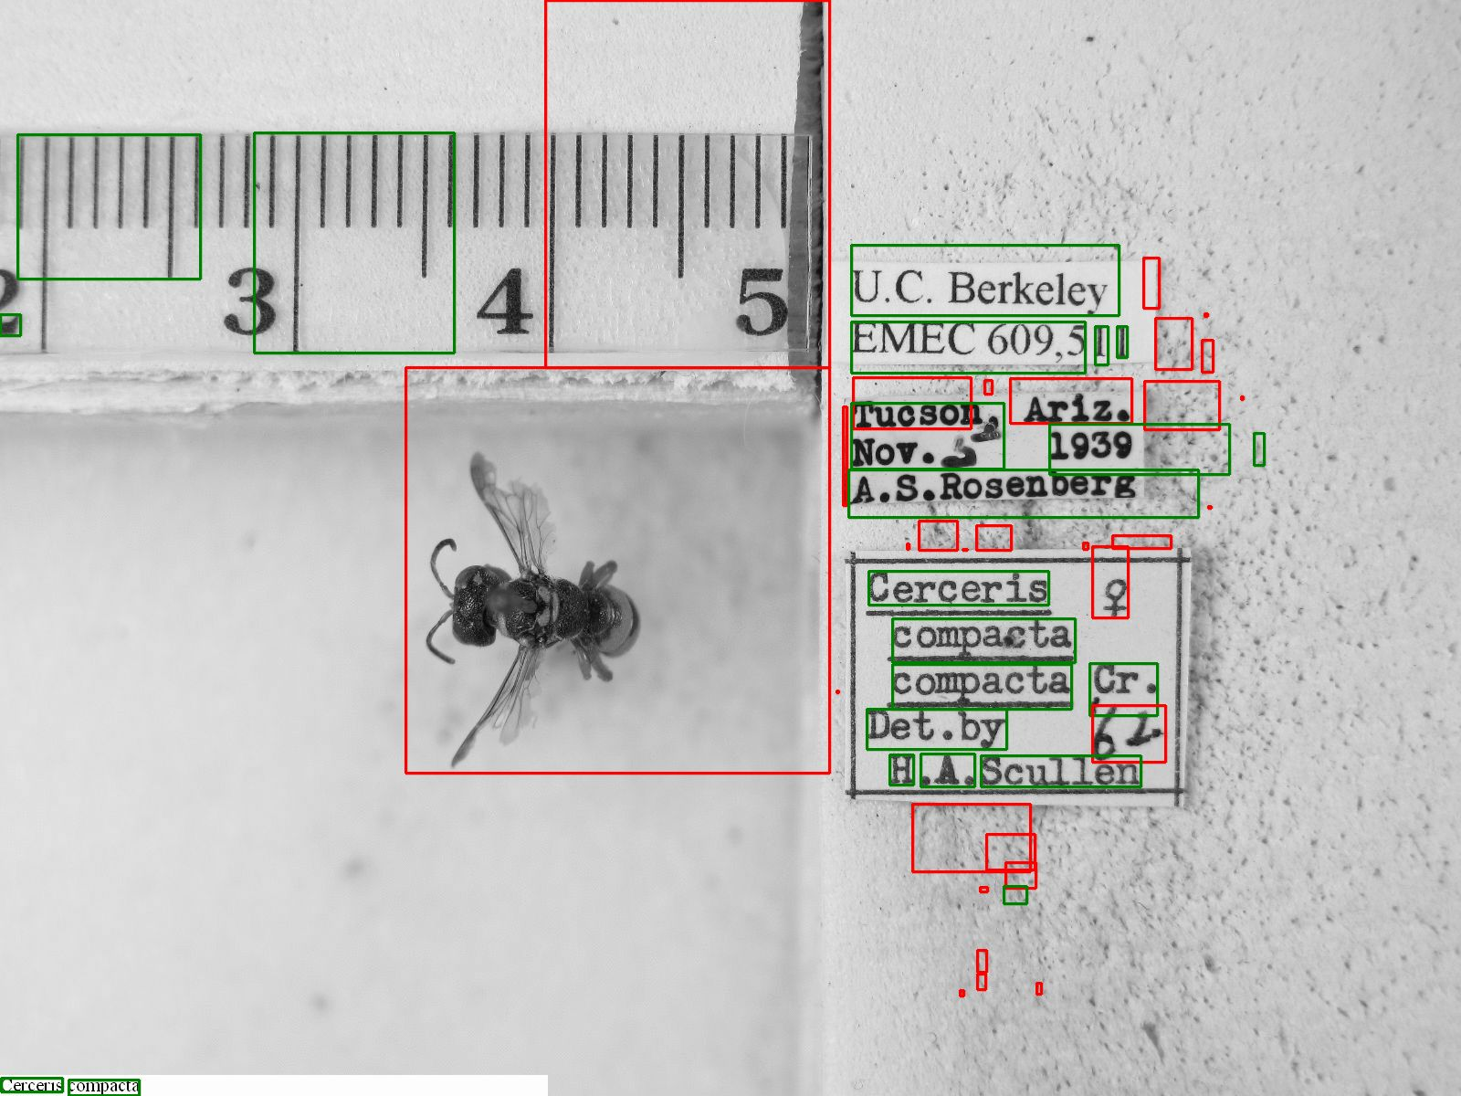

Slide 15
Label Extraction
Aggregating words into labels
For each permutation of two rectangles,
  Expand them both.
  Do they overlap?
  Replace with a new containing rectangle
  Start over

Slide 16
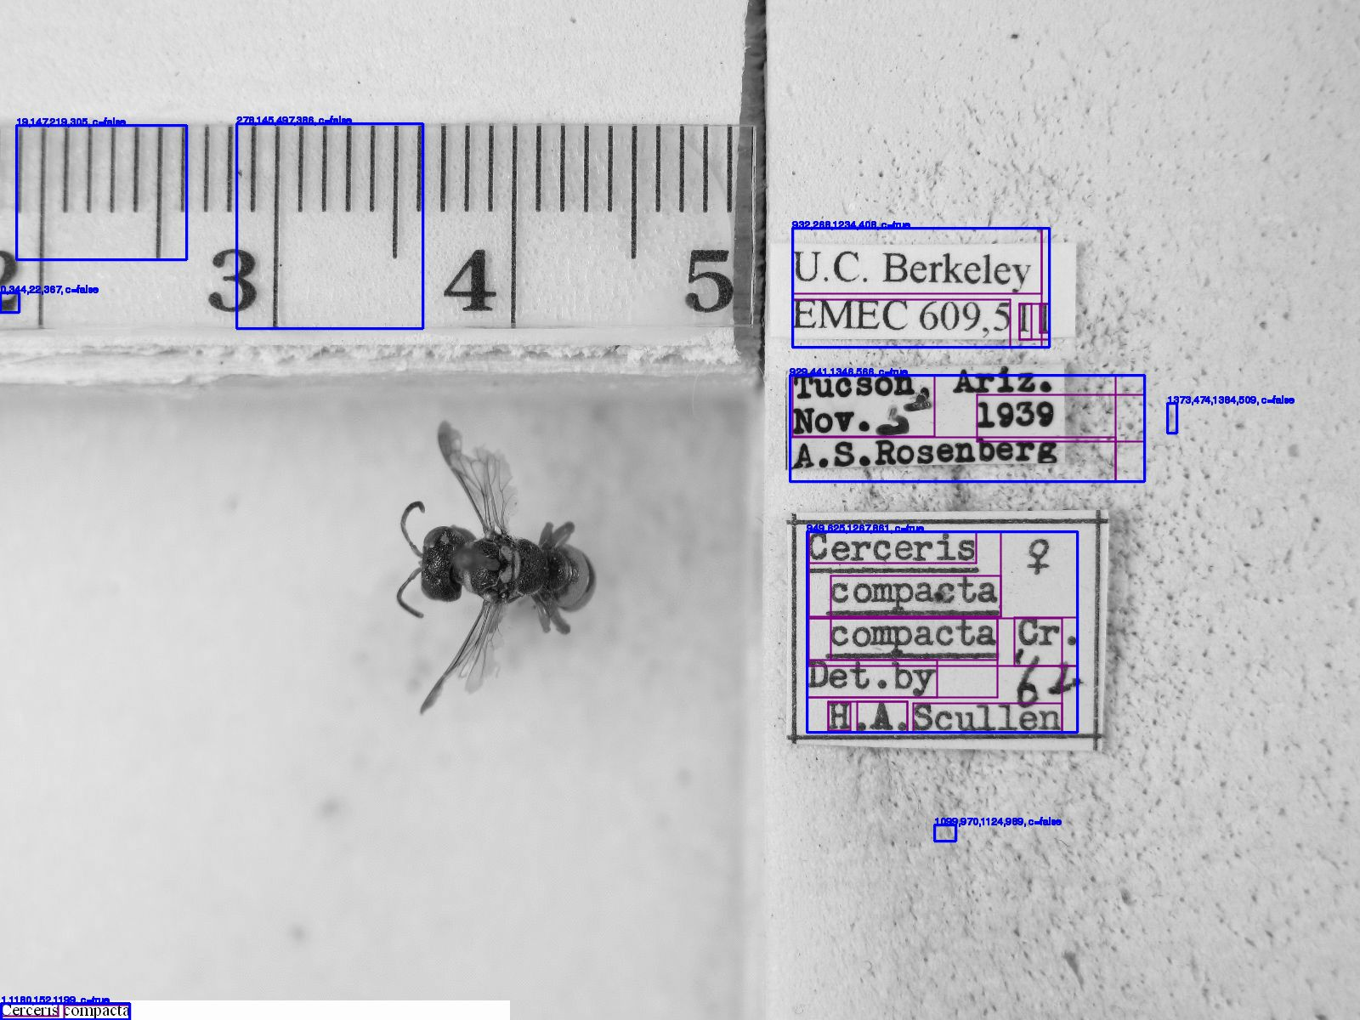

Slide 17
Label Extraction
Labels contain words
Reject any rectangles not created through consolidation
Crop resulting rectangles

Slide 18
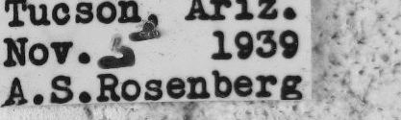
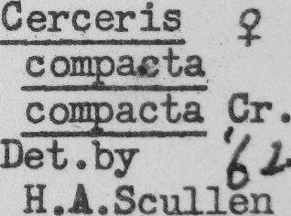
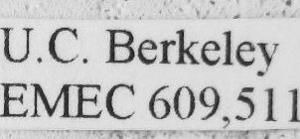
Label Extraction

Slide 19
Label Extraction
Feed the resulting label files back into Tesseract
Combine the text files in Y-axis order
How'd we do?

Slide 20
Label Extraction
Arzz. cs .- . Nov..”;“’ 1939 , A.s,aos.e,;:be.rg U.C. Berké1'e{ EMEQ 609,5 1 1 | Cerceris g cgggacta, cggacta (G1-. Det.by 61.. H.A.Scul1en

Slide 21
Label Extraction
Raw Results | Cropped Results
Cerceris compacta | [blank!]
nov...~.'5‘ 19a9?;._i;_,;; 1 | Nov..”;“’ 1939 ,
U.C.Berké1’e§ ’_ A | U.C. Berké1'e{
EMEg_6()9,§ 1 1 »_ | EMEQ 609,5 1 1
Cerceris cﬂasta, cgggacta | Cerceris g cgggacta, cggacta (G1-.
' Det.by [9 lines of gibberish] H .A. Scullen | Det.by 61.. H.A.Scul1en

Slide 22
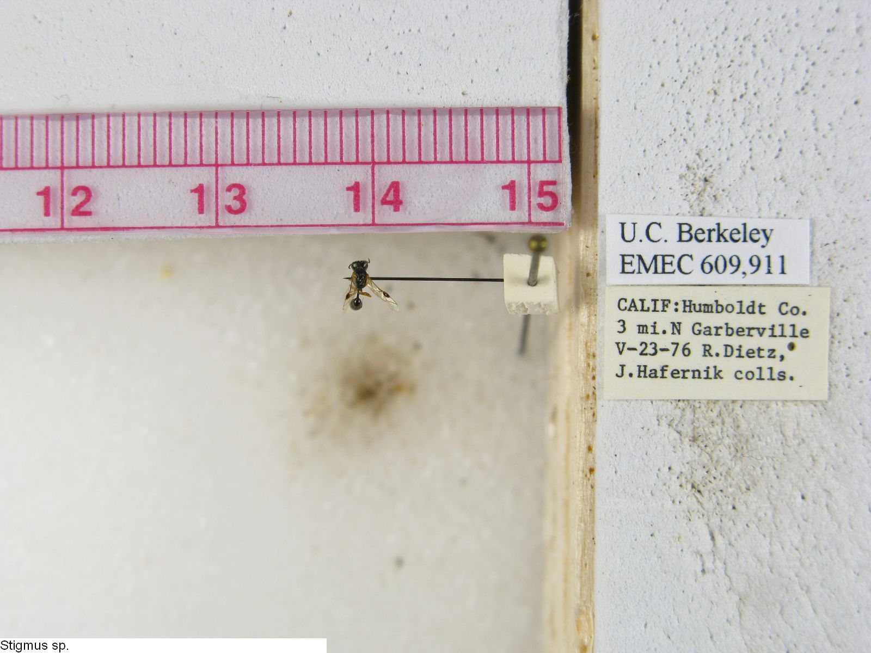
Label Extraction

Slide 23
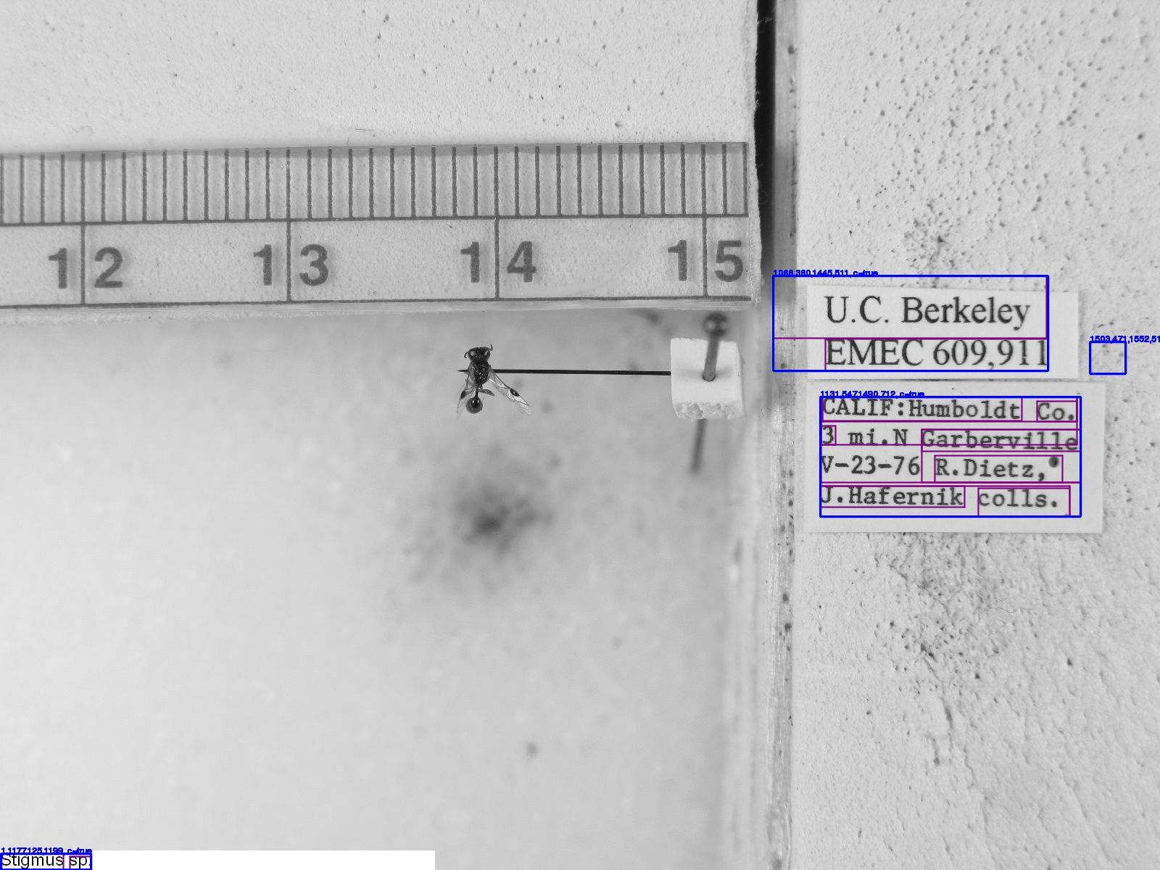
Label Extraction

Slide 24
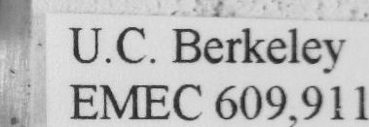
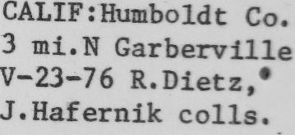
Label Extraction

Slide 25
Label Extraction

Slide 26
Label Extraction
-U.c.BEik¢1ey“ 1 ,_ EMEC609,91l CAI.IP:'Hllbb1dC C0. ~. 3 mm Garhetville . - ‘I-23-76 n.nuu,' " J-Haferuik co11s._ ‘_ "- [8 lines of gibberish] Stigmus sp. | _'* U.C. Béfkeley H ,5 EIVHEC 609,911 Stigmus sp. CALIF:Humbo1dt Co. 3 mi.N Garberville V-23-76 R.Dietz,' J.Hafe1-nik co1ls._

Slide 27
Label Extraction
Original | Autocropped
-U.c.BEik¢1ey“ 1 ,_ EMEC609,91l | _'* U.C. Béfkeley H ,5 EIVHEC 609,911
CAI.IP:'Hllbb1dC C0. ~. 3 mm Garhetville . - ‘I-23-76 n.nuu,' " J-Haferuik co11s._ ‘_ "- | CALIF:Humbo1dt Co. 3 mi.N Garberville V-23-76 R.Dietz,'
Stigmus sp. | Stigmus sp.

Slide 28
Label Extraction
Conclusion:
  OCR-fed image cropping approaches—but does not attain--the quality of manual cropping
  OCR from cropped images is less horrible than OCR on raw specimen images.

Slide 29
All code at http://github.com/idigbio-aocr
Ben Brumfield
benwbrum@gmail.com
Transcript will be posted at
http://manuscripttranscription.blogspot.com/

