Slide 1
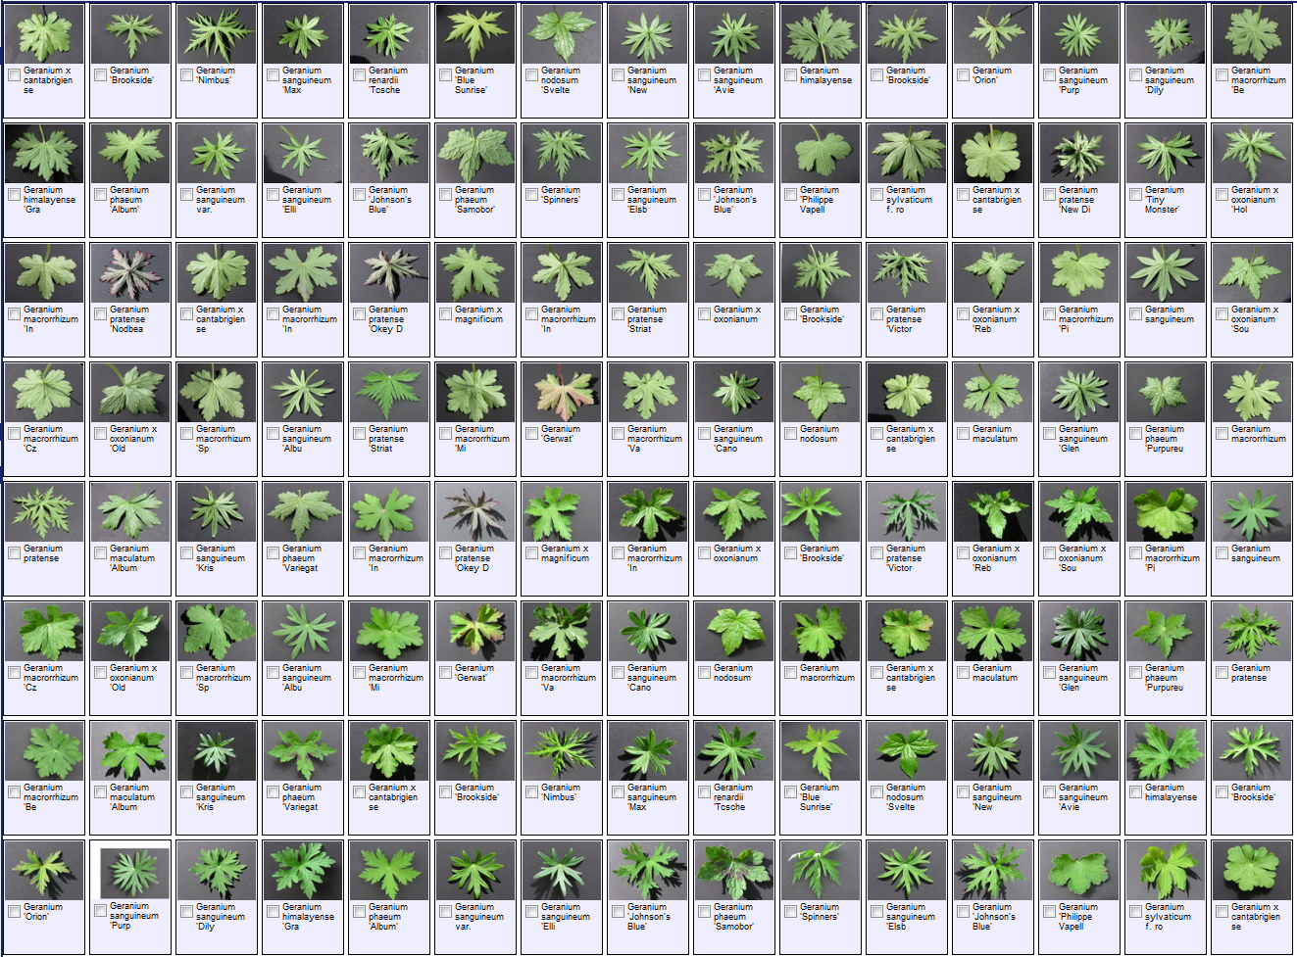

Notes:
Presentation January 20th, 2009 for the

Slide 2
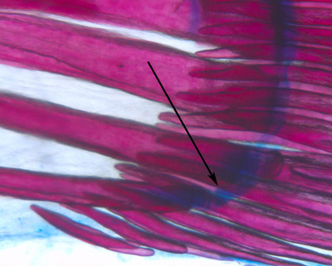
Topics
Morphbank history
An image repository – morphbank.net
Collections – an exponential function
Annotations – value added
Summing up
Notes:
Topics, the current state of Morphbank and plans for the future. An overview (review for some) of the website user-interface. Encouraging the use of uids to facilitate data-sharing between systems (Morphbank GBIF provider).
Morphbank coming to the end of a 3 year grant. High probabilty to get a new grant to further develop interoperability. Dedication from the Dept of Scientific Computing to support the project (admin staff). Greg & Austin are dedicated PIs to the Morphbank project. Moving in the excel workbook direction to allow future uploads via services which also helps b/c their will likely be a smaller staff. Moving overall towards services – and thinking about interoperability.
Changes in progress: Fewer required fields , Display restricted to group items by default
New features: new workbook enabling User-defined fields, Unique identification from provider, Morphbank as an Image provider through services.

Slide 3
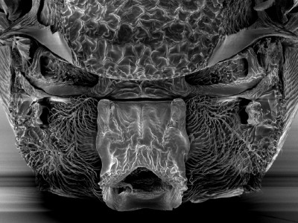
Morphbank history
Morphbank is an open web repository of biological images serving the research community. Any research biologist may use the Morphbank tools.
First developed in 1998 by a Swedish-American-Spanish group of entomologists as an ftp site
Now centered at the Department of Scientific Computing (SC), Florida State University

Slide 4
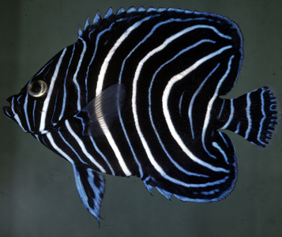
An image repository
Images stored permanently
  Metadata optional
Backup-second server + tape backup
Morphbank Identifiers & GUIDs maintained
  MorphbankId (mbId) but searchable by the original file name for that image.
Access requires only a Web browser
Edit/upload from the Web, Excel, XML upload
User branding

Slide 5
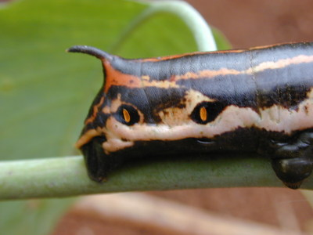
An image repository plus…
Browse and search based on objects in Morphbank
Published vs. unpublished data
Group access/security
Reviewer Accounts
Darwin Core standard for data definitions
Online user’s manual and FAQ

Slide 6
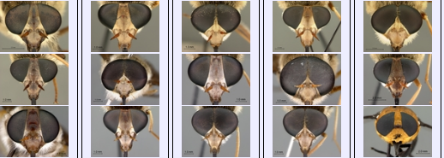
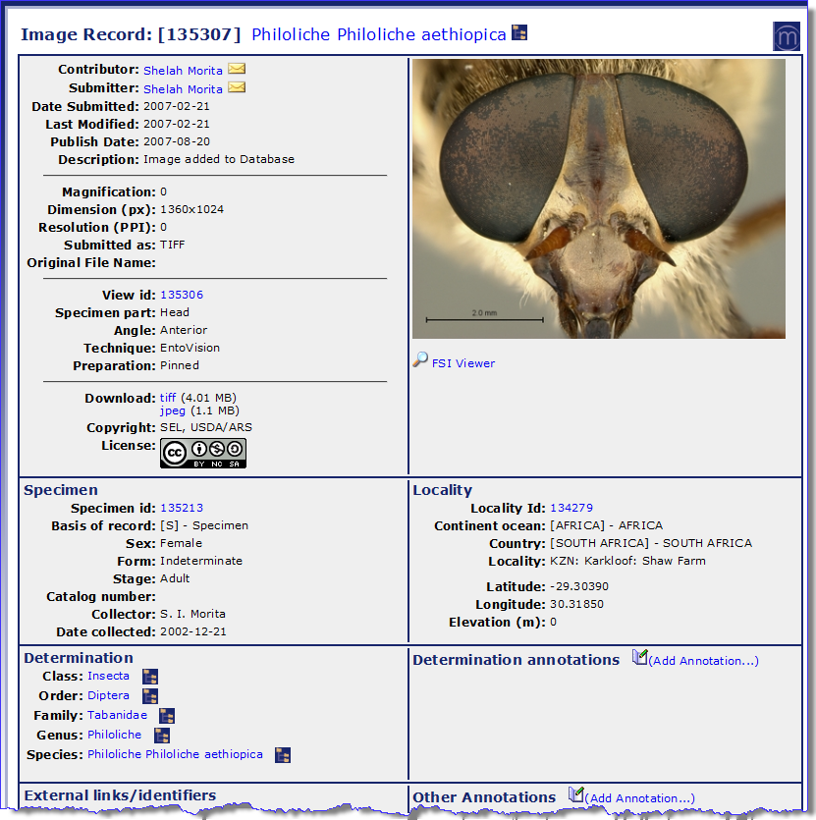
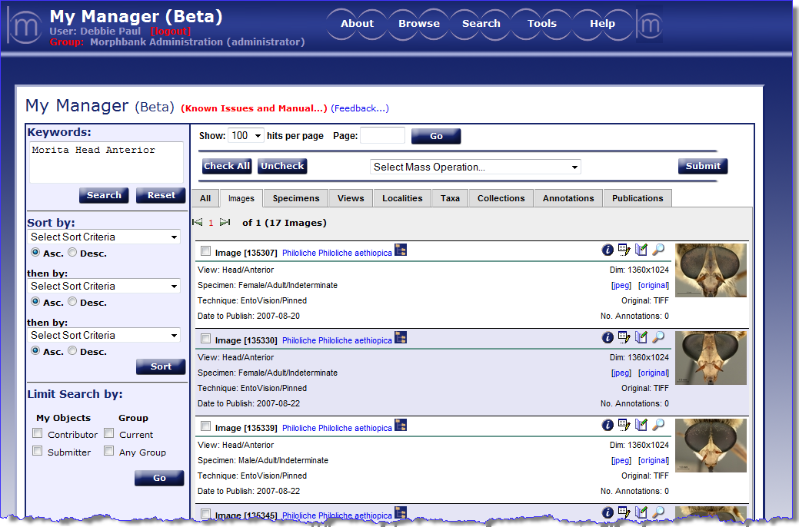
morphbank.net
Notes:
Once logged on to Morphbank – note Keyword searching, and the limit search features. Select Mass Operation is used to create collections and as one way to manipulate the date to reveal images to the public. In this slide, the search is: Morita Head Anterior. Morita is a Morphbank contributor’s last name, body part = head and the view angle = anterior. This results in 17 images of which one can see 3 in this screen shot. The cropped image in the top right-hand corner gives an idea of the variation of these 17 male and female heads of the genus Philoliche (horseflies).
Use the info (eye) icon to reveal metadata about any object in Morphbank.

Slide 7
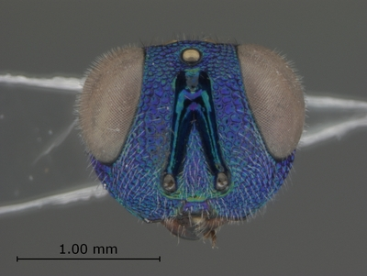
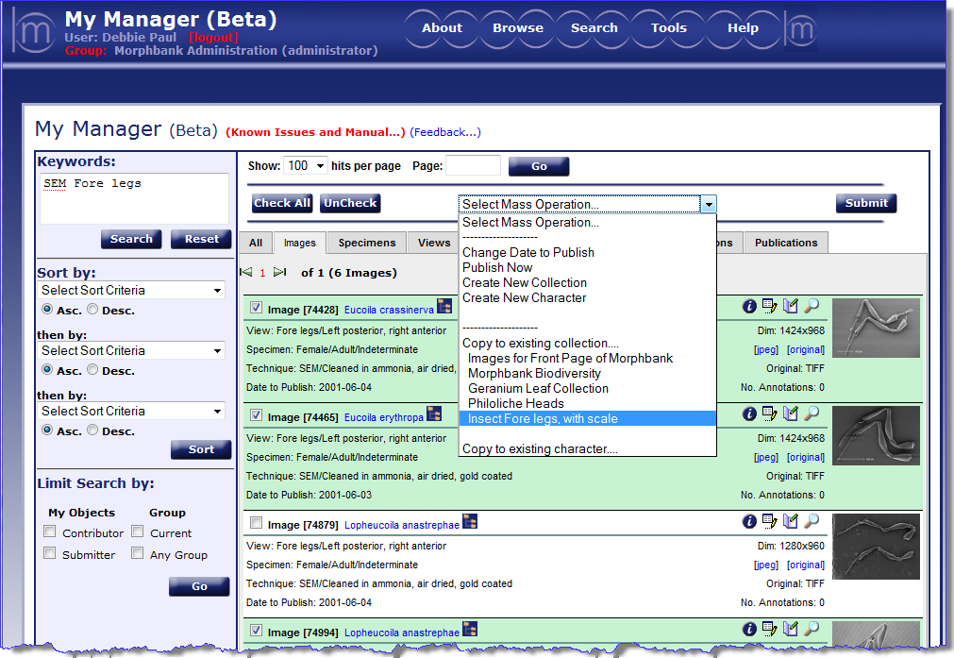
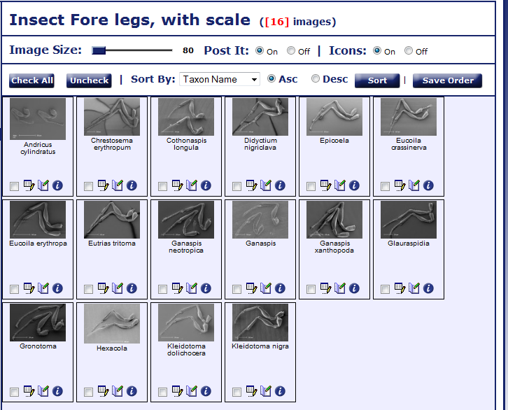
morphbank.net
Create a collection

Slide 8
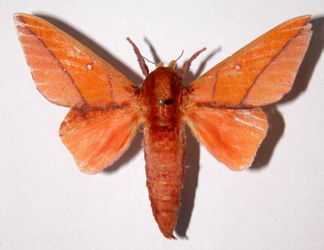
Collections in action
NC State University Insect Museum Blog
  A fully web-illustrated morphological phylogenetic study of relationships among oak gall wasps and their closest relatives, Liljeblad J. Ronquist F. et al. Zootaxa 1796: 1-73
  Characters and Collections in Morphbank
Five new species of the damselfish genus Chromis (Perciformes: Labroidei: Pomacentridae) from deep coral reefs in the tropical western Pacific, by R.L. Pyle, et al.(2008, Zootaxa 1671:3-31).
Revision of world species of the genus Heptascelio Kieffer, Johnson NF et al. Zootaxa 1776: 1-51
http://www.tolweb.org/Alobevania/120177
http://codex.begoniasociety.org/chalcidkey/ and mbId=111285

Slide 9
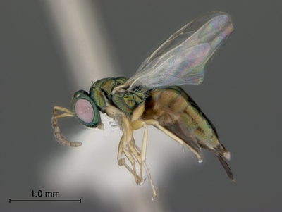
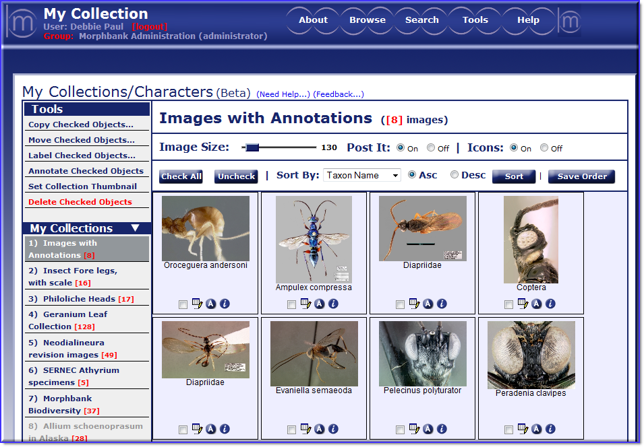
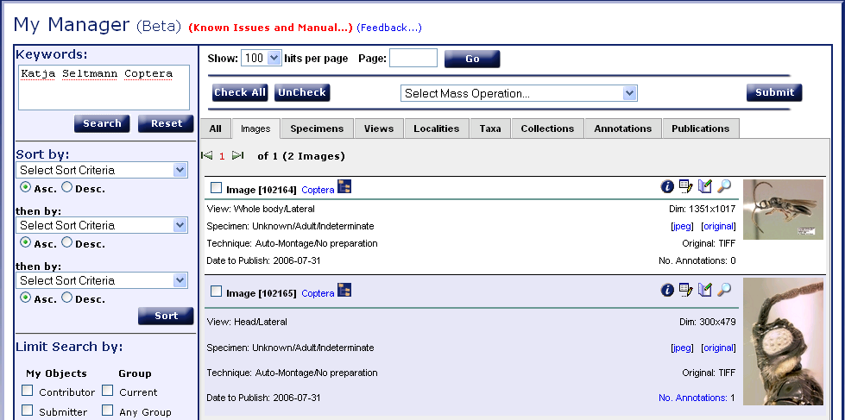
Annotations

Slide 10
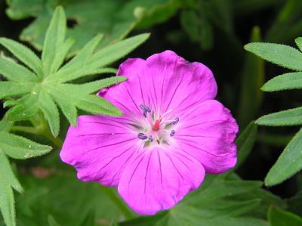
More about Morphbank
How to add / edit / link images & data
http://services.morphbank.net
  Google Maps
  Rss feeds
  XML
CToL, Ontologies, GBIF, …

