Slide 1
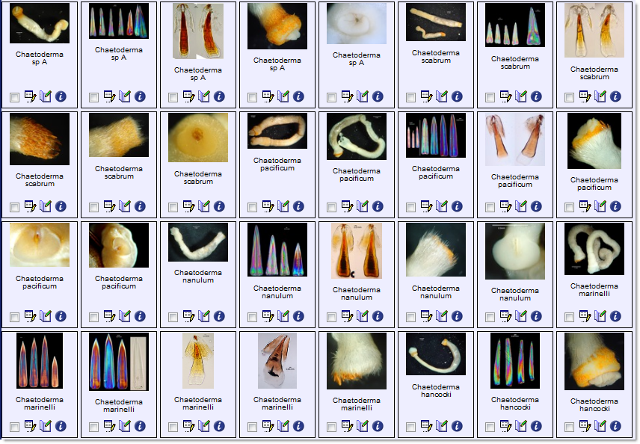
SCAMIT-Morphbank Workshop Custom Workbook Submission Monday 8 August 2011 SCCWRP, Costa Mesa, CA
Notes:
Purposes of this workshop, 1) to review how to upload and edit records via the Morphbank website at http://www.morphbank.net, 2) learn how to populate the SCAMIT-Morphbank custom workbook for bulk upload of data, 3) share bits about what’s new at Morphbank, 4) other issues: FTP of images (or DVD / CD), sending records to BOLD, standardizing naming of workbooks, storing workbooks.

Slide 2
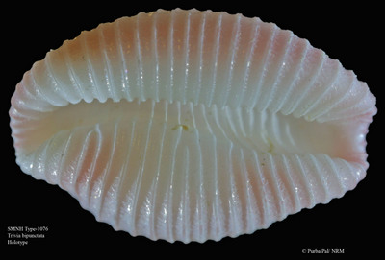
Topics
Morphbank News & New Features
Morphbank Objects
image, specimen, view, locality
identification (morphbank identifier and uids)
Best Practices
Metadata Organization and Management
Adding Objects at http://www.morphbank.net
web-interface workflow options
Finding Objects in Morphbank
SCAMIT – Morphbank workbook
workflow discussion
populating the workbook
SCAMIT workbook validation & upload
Images by FTP, DVD / CD
Notes:
Topics covered in this presentation include 1) overview of how to upload objects via the morphbank.net, 2) how to populate the Morphbank Excel Workbook, 3) using Morphbank Collections, Annotations, web services, linking, rss, Google Maps after upload, 4) ontologies linked to images in Morphbank (using images in Morphbank to illustrate an ontology).

Slide 3
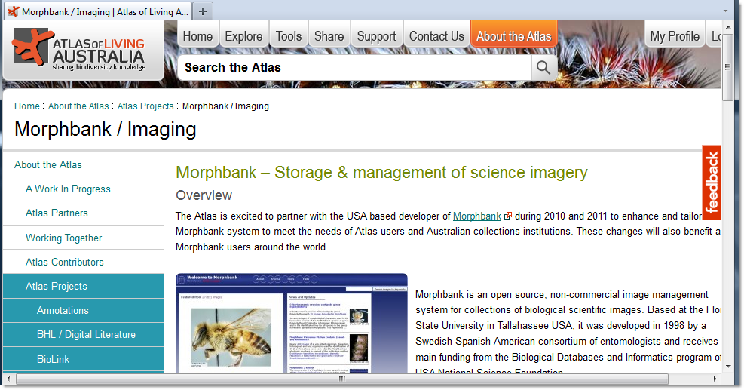
Morphbank News I
Atlas of Living Australia (ALA) – building a customized version of Morphbank to support an online atlas for all known species in Australia.
Notes:
Morphbank is currently working on a version specifically designed for the Atlas of Living Australia. http://www.ala.org.au/about/program-of-projects/morphbank/
The iDigBio project is a new NSF-funded long-term project at $100 million dollars over 10 years. Morphbank’s role involves facilitating digitization of other collections (TCNs) and helping to create a clearinghouse of best practices and workshops to demonstrate available software / hardware options. The goal of the HUB part of the grant is to insure all the digitized collections are interoperable (data can be and is shared between them).

Slide 4
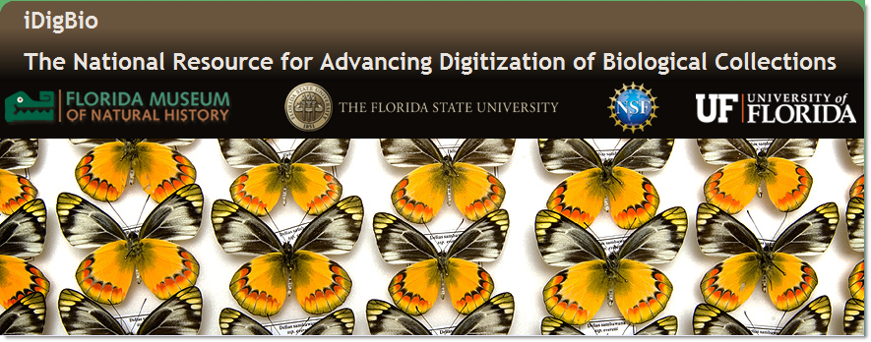
Morphbank News II
iDigBio - the HUB for Advancing Digitization of Biological Collections
http://www.flmnh.ufl.edu/idigbio & http://idigbio.wordpress.com/
Thematic Collection Networks (TCNs) at:
Illinois Natural History Survey at University of Illinois Champaign-Urbana, InvertNet
University of Wisconsin at Madison: North American Lichens and Bryophytes
American Museum of Natural History: Collaborative Research: Plants, Herbivores, and Parasitoids
Notes:
Morphbank is currently working on a version specifically designed for the Atlas of Living Australia. http://www.ala.org.au/about/program-of-projects/morphbank/
The iDigBio project is a new NSF-funded long-term project at $100 million dollars over 10 years. Morphbank’s role involves facilitating digitization of other collections (TCNs) and helping to create a clearinghouse of best practices and workshops to demonstrate available software / hardware options. The goal of the HUB part of the grant is to insure all the digitized collections are interoperable (data can be and is shared between them).

Slide 5
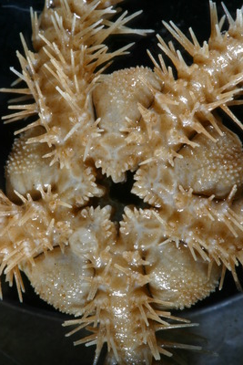
Morphbank v3 New Features
Three mirrored sites
ALA http://morphbank.ala.org.au
NRM http://morphbank.nrm.se/
Finland http://morphbank.digitarium.fi
Fewer required fields
Fewer required objects
Name Query improvements
Coming soon:
Workbook validation service
User conversion of Workbook to XML format
…open source…

Slide 6
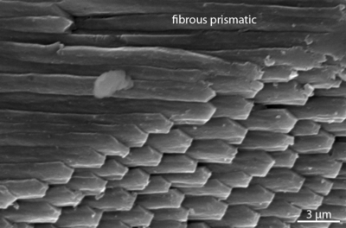
Morphbank Objects
What’s an object? Think of each of them as a record with a Morphbank unique id. There are 4 main objects in Morphbank:
Image
View
Specimen
Locality
Other objects: User, Group, TaxonConcept, Collection,…
Notes:
Grasping what Morphbank means by an “Image record” (or View, Specimen or Locality record) helps the user better understand the bulk-upload process.
We have found, in general, that a user familiar with the online interface fills out the bulk-upload forms faster and with greater accuracy.

Slide 7
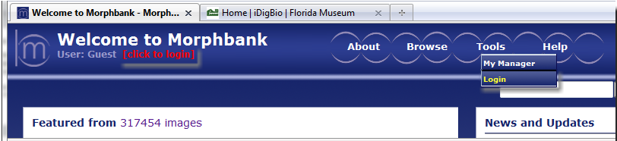
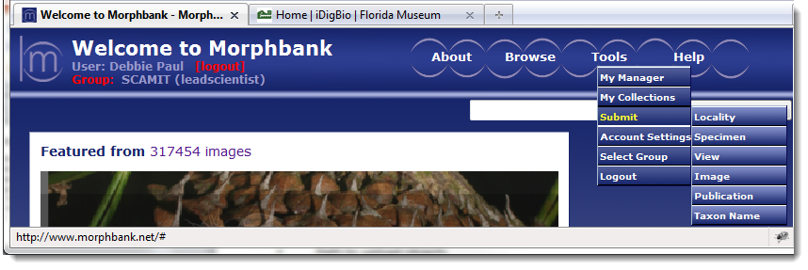
Add Objects to Morphbank
Path to upload objects
log in [two places] > note Group [left header menu]
header menu > tools > submit > object of choice
Notes:
To begin adding (or editing) objects via the web, log in, then the path is: header menu > tools > submit > [choose object]
Note the Group (top left of header). All Morphbank users have their own Group. (It’s a Morphbank object). All SCAMIT members
are part of the Morphbank SCAMIT group. So, all SCAMIT members belong to at least 2 Morphbank groups. The default group
displays in the top left of the header menu. You can click there, to change to the other group. You may also change your default group.
For choosing a different default group: path is: tools > account settings.

Slide 8
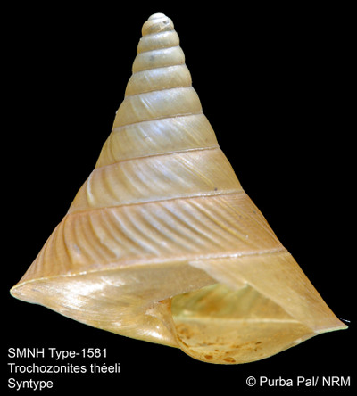
Best Practices
Save time, insure accuracy
Gather Data before upload
Contributor, Submitter, Group name, date to publish
Images and metadata including unique id (uid) information
View metadata
Specimen metadata including unique id (uid) information
Locality metadata: see Bight Station list
Avoid spaces in image file names
Are the Unique Ids unique?
Are Taxon Names needed for upload, in Morphbank?
Path – header menu > help > Name Query: http://www.morphbank.net/Help/nameMatch/
Path – header menu > tools > my manager > taxa
Path – header menu > browse > taxon search
Path – header menu > tools > submit > taxon name
Upload exemplar images first if > 1 image for a specimen
Encyclopedia of Life
BOLD
Standard Image
Where is Help?
see: http://www.morphbank.net/About/Manual
email: mbadmin@scs.fsu.edu

Slide 9
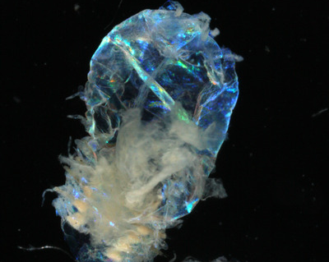
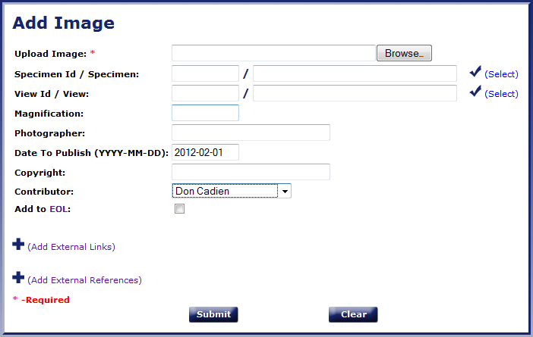
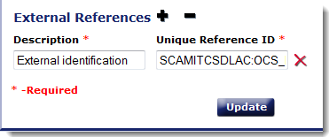
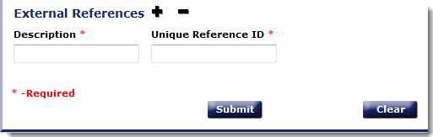
Add Image
Path: log in > header menu > tools > submit > image
one required field
add external links
add external ids
Notes:
Image record: data stored in the Image table in the Morphbank database includes: original file name of image, photographer, copyright holder information, Encyclopedia of Life flag, magnification, Morphbank userid of the contributor of the image and its metadata). Note that an image can now be uploaded with no other metadata. This is a new feature to allow as much flexibility to the user as possible.

Slide 10
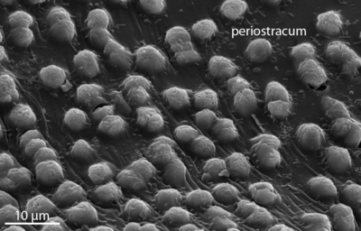
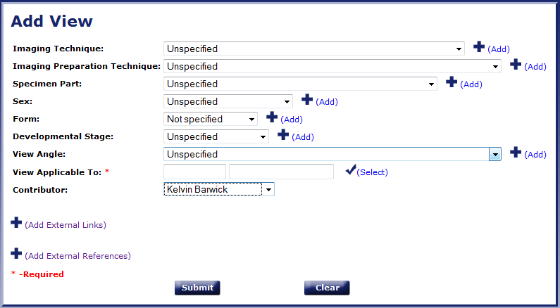
Add View
Path: log in > header menu > tools > submit > view
one required field
add choices
Notes:
View record: data stored in the View table in the Morphbank database includes specific, detailed information about what is seen in an image like view angle, specimen part, imaging technique, sex, form, developmental stage and imaging preparation technique. In the above form, options can be added to any drop-down as needed, simply by clicking on the Add link.

Slide 11
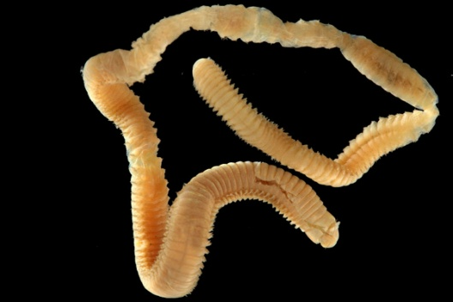
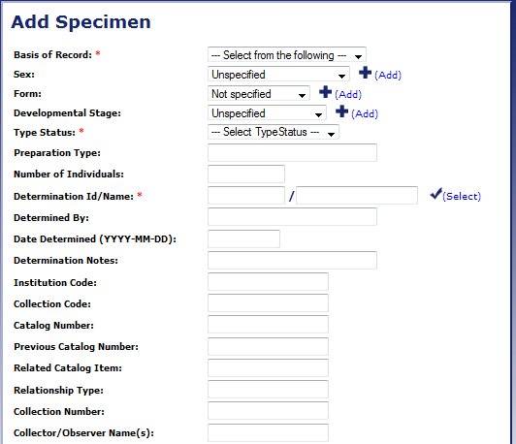
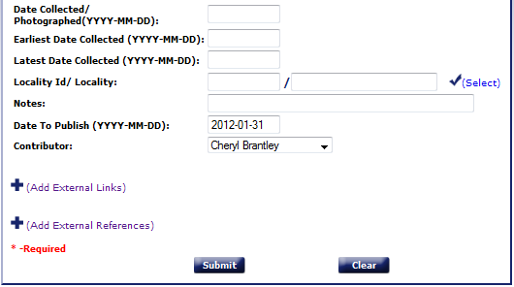
Add Specimen
Path: log in > header menu > tools > submit > specimen
three required fields
locality not required
Notes:
Specimen record: data stored in the Specimen table in the Morphbank database includes fields like collector name, date collected, date identified, catalog number, sex, form, developmental stage and tsn id of the specimen.

Slide 12
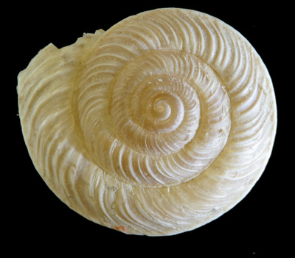
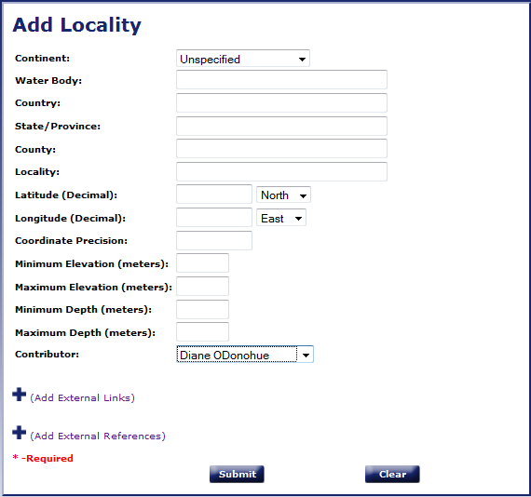
Add Locality
Path: log in > header menu > tools > submit > locality
no required fields
Notes:
Locality record: data stored in the Locality table in the Morphbank database includes details about the locality where the specimen was collected like country, water body, state, county, minimum depth and maximum depth.

Slide 13
Work Flow - www.morphbank.net
Two options via the web
Upload related objects first, image records last
locality
view
specimen
image
Upload all records at one time through the
Add Image form
use the select check to Add Specimen (Locality) and View records from inside the Add Image form.
Notes:
The 2nd method may be more intuitive. It depends a lot on the individual user and how they understand these various objects and how to find them
once they are uploaded to Morphbank. …

Slide 14
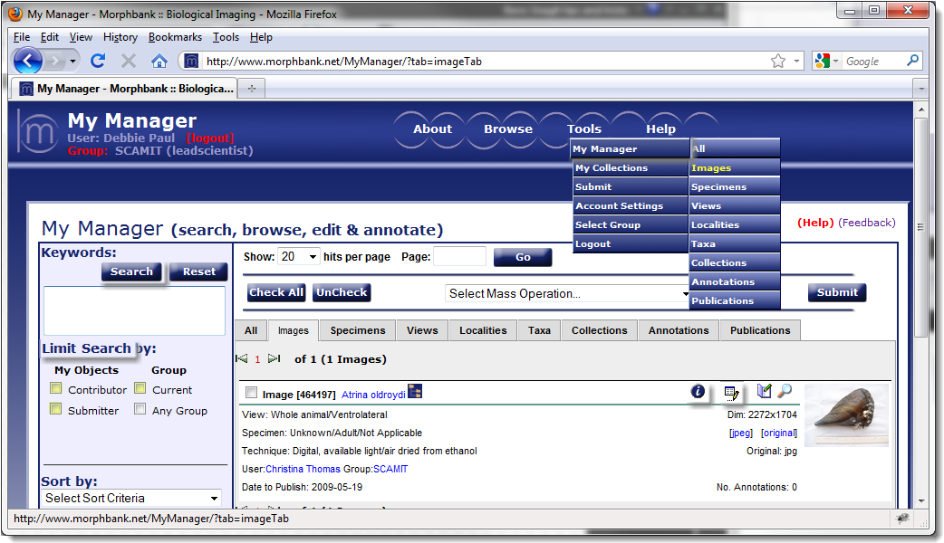
Finding Objects in Morphbank
Use My Manager
Search by keyword
Limit search to objects contributed or …
Click i to open the single show (metadata)
Click Edit icon to open Edit form.
Notes:
Several options exist to help a user find their objects in Morphbank. After logging in, and perhaps after uploading various objects a user would like to see just their image records (or specimens, views or locality objects). From path: header menu > tools > My Manager > Images, a user can search in the keywords search box by values like: user name, taxon name, group name, original name of the image file or unique identifier for the image. Hovering over the keywords search box reveals a post-it note showing what fields are searchable in the My Manager > Images tab.
It is also easy to Limit the Search by Contributor, Submitter and / or Group. The check boxes are boolean and so the user can combine these delimiters. To show only objects where you are the Morphbank Contributor, click the Contributor box > click Search. If you’d like to see only SCAMIT images, check Group current > click Search. This works because the user (see example in screen shot) is logged in and currently in the SCAMIT group.
Perhaps you are the Morphbank Submitter of images (not the Contributor). In that case, to see your images, Limit the Search by Submitter. To do so, click the Submitter box > click Search.
To see all the metadata for a particular Image record, click on the i icon (information) near the thumbnail on the right. Clicking the i icon opens the Morphbank single show window revealing the metadata in Morphbank for this image.
You may have privileges to Edit the metadata for this Image record. If you are the Contributor, Submitter OR you are a member of the SCAMIT Morphbank group, you can click the Edit icon to open the Edit form to supply additional data or update current data. The Edit icon is just to the right of the i icon.
The same guidelines apply to finding / limiting / viewing metadata / and editing other objects in Morphbank (Specimen, View, Locality). Just click on the My Manager tab of interest to see those objects. The same features are available in most tabs.

Slide 15
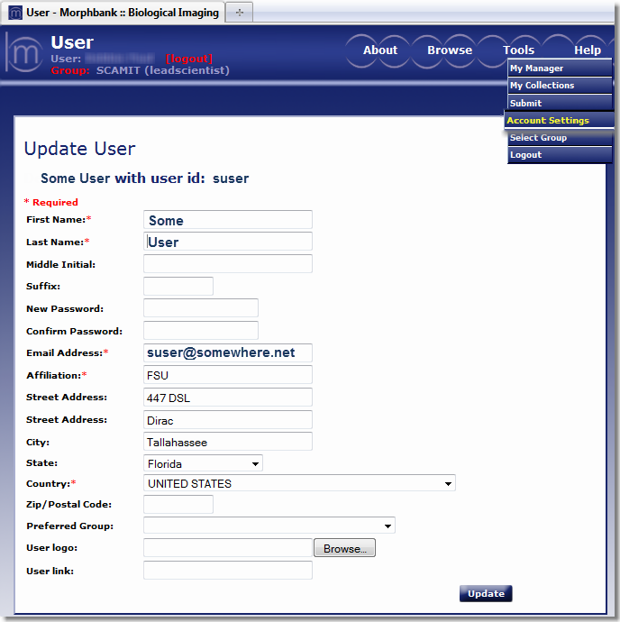
Your Morphbank Account
Need to update your account information?
Path: login > header menu > tools > account settings

Slide 16
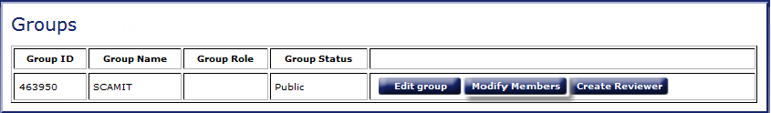
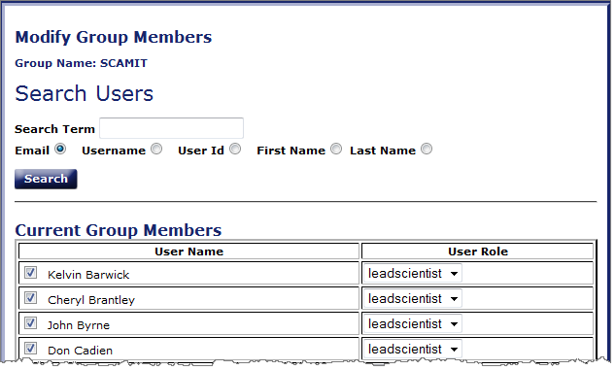
SCAMIT Morphbank Group
Need to add someone to the SCAMIT group in Morphbank?
Only the Morphbank Group Coordinator can do this (currently, Larry Lovell).
Path: login > header menu > tools > group settings

Slide 17
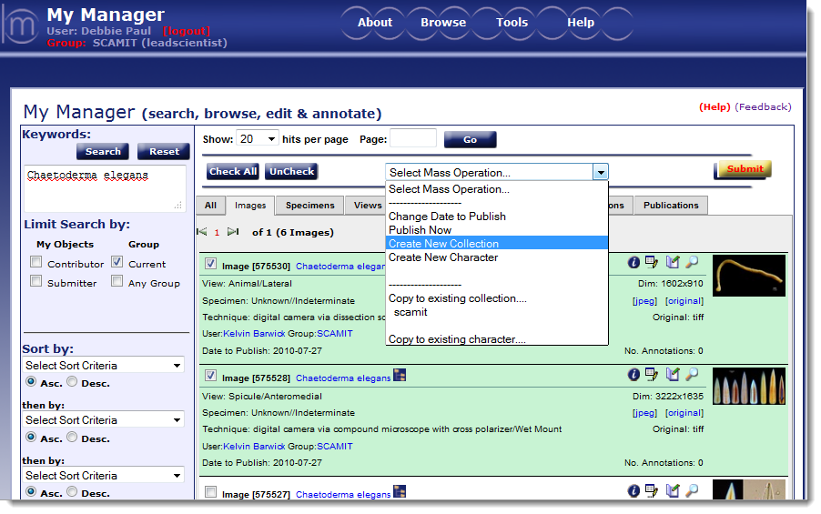
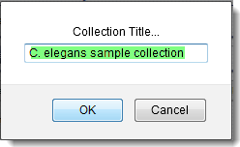
Create a Collection object
Path – log in > group=SCAMIT > tools > my manager > images
Limit Search > check current group > only SCAMIT images show
check box for any image to be in a collection
Select Mass Operation > Submit > name the Collection > click OK
Notes:
After creating a collection, it is found in the My Manager > Collection tab. A collection is an object in Morphbank. So, it has a unique identifier and it also has a date-to-publish. Users may create and also delete collections they have made. Note a collection cannot be deleted if the date-to-publish is passed.

Slide 18
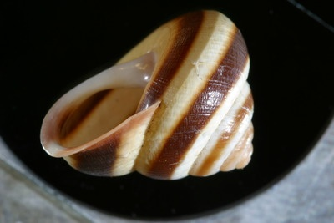
www.morphbank.net
Notes:
Go to www.morphbank.net and upload some images and related objects.

Slide 19
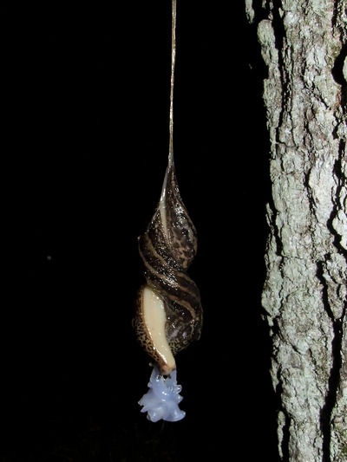
SCAMIT Custom Workbook: Workflow
Gather & organize data
image & specimen unique ids (uid)
image file names
exemplar images
locality data
taxon names
SCAMIT unique identifiers for Specimens:
SCAMIT + Affliation + Lab identifier + Taxonomist Initials + SCAMIT speciesID + SpecimenCode##
SCAMITCSD:OCS_KLB_0263_S01
SCAMIT unique identifiers for Images:
SCAMIT + Affliation + Lab identifier + Taxonomist Initials + SCAMIT speciesID + SpecimenCode## + ImageCode##
SCAMITCSD: OCS_KLB_0263_S01_01
ContributorInfo sheet
Check the DropDowns sheet: Add terms as needed
Data sheet
User-enabled automated verification
Send data to Morphbank
Send images to Morphbank: FTP or DVD/CD
always keep originals somewhere

Slide 20
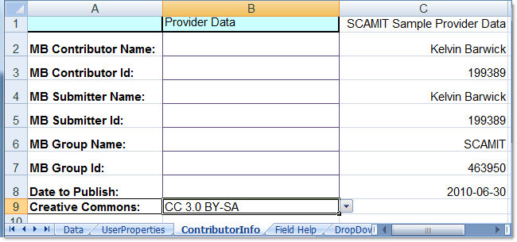
SCAMIT Custom Workbook: ContributorInfo Sheet
Notes:
The Contributor and Submitter may both be the same person, they do not have to be the same. The id of a Morphbank user is much easier to locate after this user has uploaded images to Morphbank. Log in, path: tools > my manager > images tab > search by keyword=name of user > click search. If a user’s name returns a record, the person’s name is hot-link to their User record (an object in Morphbank). Click on the link and the User’s id is displayed with other metadata about the User. Contact mbadmin@scs.fsu.edu for help with this, if needed. For Contributing Images and other records to the SCAMIT group, the Group Name and Group Id do not change from the above example. Date to publish is up to the Contributor. Morphbank suggests several weeks to a month after upload for images to become public. This is usually enough time for any issues discovered to be resolved. The Creative Commons field for each image on the Data sheet, now auto-fills based the choice made on this sheet. Users may choose one of the existing choices, or SCAMIT may decide to go to the Creative Commons web site to design / choose their own version of Creative Commons. SCAMIT may also choose Public Domain.

Slide 21
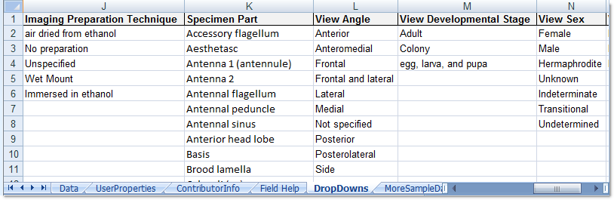
SCAMIT Custom Workbook: DropDowns Sheet
Values for Basis of Record, Type Status and Object Type
may not be modified (Columns B, H and P).
Add values to other drop-down columns
use Excel features: Data Validation and Name Manager
Notes:
Check the values on the DropDowns sheet before upload and try to add any needed values before filling out the Data sheet.
Note that columns B, H and P (Basis of Record, Type Status and Object Type) can not be modified. If your workbook has a drop-down for
continent – please choose from presented options (don’t modify this drop-down either). Probably? most of SCAMIT data is continent=North America.(?)
The Scamit Manual written to explain how to populate this workbook, explains how to add values to this sheet so that the new
entries appear in the drop-down menus on the Data sheet. The steps to do this involve Excel > Data Validation and Excel > Name Manager.

Slide 22
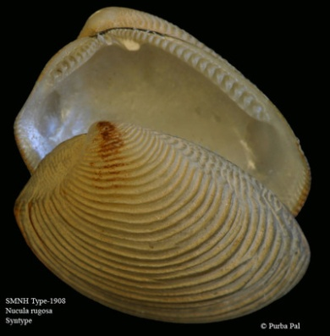
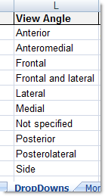
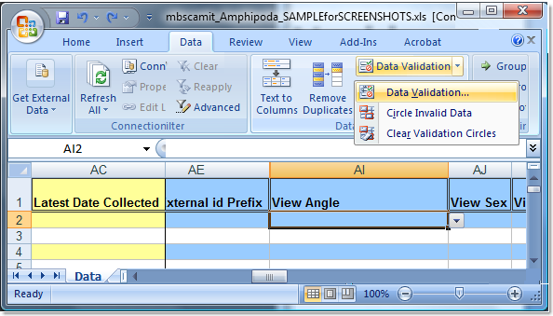
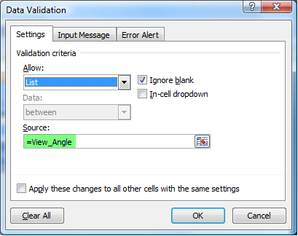
SCAMIT Custom Workbook: Editing drop-down lists
use Excel: Data Validation and Name Manager
Example: 10 more View Angle values needed
First: reveal the Source for the Data Validation (aka where is the drop-down defined).
Source: = View_Angle
Notes:
Check the values on the DropDowns sheet before upload and try to add any needed values before filling out the Data sheet.
Note that columns B, H and P (Basis of Record, Type Status and Object Type) can not be modified.
The Scamit Manual written to explain how to populate this workbook, explains how to add values to this sheet so that the new
entries appear in the drop-down menus on the Data sheet. The steps to do this involve Excel > Data Validation and Excel > Name Manager.
In this slide, Data Validation is explained and note the Source of the Data Validation for the drop-down of the View Angle field is
=View_Angle.

Slide 23
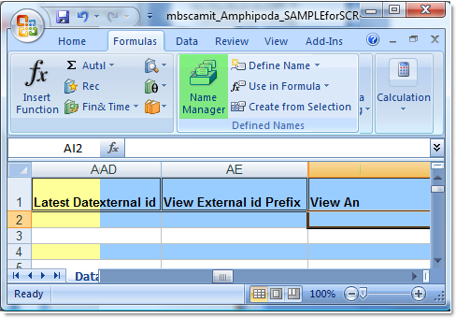
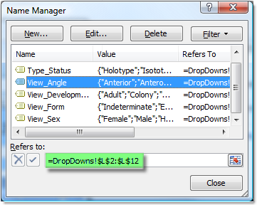
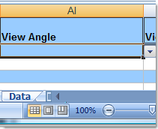
SCAMIT Custom Workbook: Editing drop-down lists
Add values to drop downs
Data Validation to Name Manager
Example: 10 more View Angle values needed
Source for Data Validation = View_Angle
Next, Excel tab Formulas (Defined Names Panel) > click Name Manager > look for View_Angle
change the Refers to from =DropDowns!$L$2:$L$12 to =DropDowns!$L$2:$L$22
click Close button
10 more cells now in this drop-down.
Type desired values in the cells on the DropDowns sheet. They now appear in the View Angle column drop-down on the Data sheet.
Notes:
Check the values on the DropDowns sheet before upload and try to add any needed values before filling out the Data sheet.
Note that columns B, H and P (Basis of Record, Type Status and Object Type) can not be modified.
The Scamit Manual written to explain how to populate this workbook, explains how to add values to this sheet so that the new
entries appear in the drop-down menus on the Data sheet. The steps to do this involve Excel > Data Validation and Excel > Name Manager.
After figuring out the Data Validation for View Angle is View_Angle…
Next, find the Name Manager list and reference for View_Angle.
Adjust the Refers to definition to include extra cells as needed.
In this example, 10 more cells are needed, so the 12 is changed to a 22 in the =DropDowns!$L$2:$L$22
click Close.
Type in the values needed into the cells in the View Angle column on the DropDowns sheet.
The new values now show up in the View Angle drop-down feature in the View Angle column on the Data sheet.

Slide 24
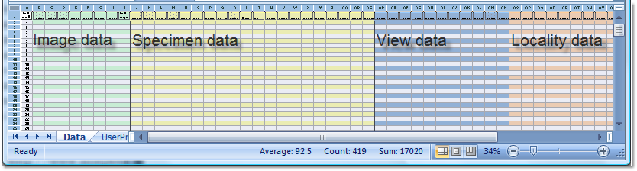
SCAMIT Custom Workbook: Data Sheet
Populate the workbook sections and fields desired
at least two possible work flow suggestions
left-to-right if 1:1 image to specimen
all image data, then other sections if many images : 1 specimen
Note help is available
click on column header for any column
see the Field Help sheet
Notes:
As you begin to fill out fields, note the Creative Commons field auto-fills.

Slide 25
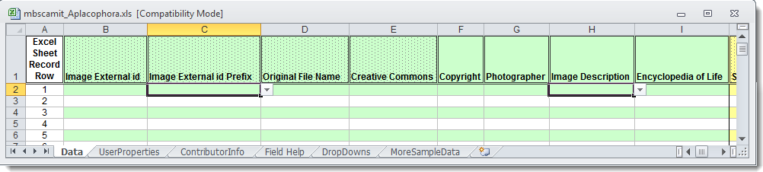
SCAMIT Custom Workbook: Data Sheet – Image data
Required fields have a dotted-fill pattern in the column header.
Note help is available from any column header or see the Field Help sheet
columns:
Image External id: SCAMIT external id for image
Image External id Prefix: choose from drop-down
Original File Name: the exact name of the image, including the image type (.jpg, .tif, etc.) (case matters)
Creative Commons: auto fills from choice on ContributorInfo sheet
Copyright: (text) Expected values are the person/s (and perhaps year) to be attributed if someone uses the image
Image Description: SCAMIT contributors can use this to enter a description of what is seen in the image.
Encyclopedia of Life (EoL): enter yes if image goes to EoL. Otherwise, leave empty
EoL prefers exemplar images.
Notes:
As you begin to fill out fields, not the Creative Commons field auto-fills.

Slide 26
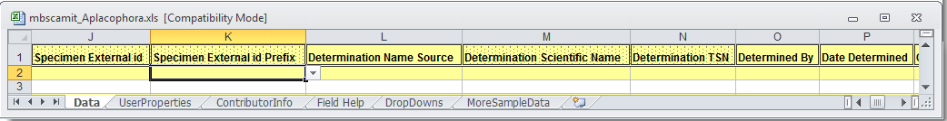
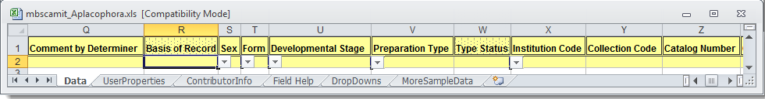
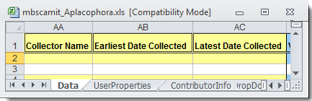
SCAMIT Custom Workbook: Data Sheet – Specimen data
Specimen External id: SCAMIT external id for specimen
Specimen External id Prefix: choose from drop-down
Determination Name Source: enter SCAMIT if name is in Ed 5 list
Determination Scientific Name: must match name on the Ed 5 list exactly
Determination TSN: find this on the Ed 5 list (Morphbank tsn or mtsn), use www.morphbank.net, if needed
Determined By: name of person/s credited with identifying the specimen; separate names with commas
Date Determined: date specimen identified in yyyy-mm-dd format
Comment by Determiner: any remarks made by the person identifying the specimen
Basis of Record: A descriptive term indicating if the record represents an object (in a collection) or observation.
Sex: choose from drop-down
Form: choose from drop-down
Developmental Stage: choose from drop-down
Preparation Type: if something was done to preserve the specimen in a collection, enter preparation information here
Type Status: choose from drop-down
Institution Code: if there is a standard acronym or full name – for the place storing the specimen, enter it here
Collection Code: museums often resolve their various collections with collection codes like: fossil, or seed, for example.
Catalog Number: a barcode or accession id for the specimen in a given collection, if it exists
Collector Name: name of the person/s responsible for collecting the specimen
Earliest Date Collected: date specimen collected in yyyy-mm-dd format
Latest Date Collected: end date specimen collected in yyyy-mm-dd format if collected over a range of days

Slide 27
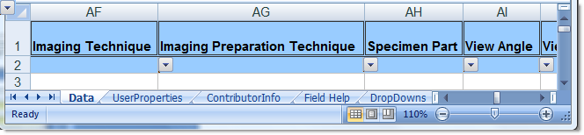
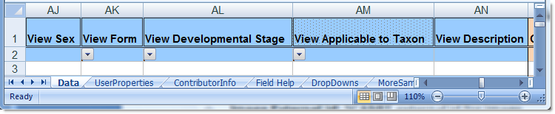
SCAMIT Custom Workbook: Data Sheet – View data
columns:
Imaging Technique: choose from drop-down
Imaging Preparation Technique: choose from drop-down
Specimen Part: choose from drop-down
View Angle: choose from drop-down
View Sex: choose from drop-down
View Form: choose from drop-down
View Developmental Stage: choose from drop-down
View Applicable to Taxon: enter highest taxon for which the view is appropriate
View Description: free text
Notes:
SCAMIT is not using View external ids.

Slide 28
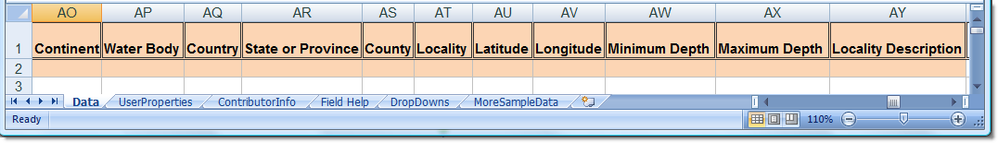
SCAMIT Custom Workbook: Data Sheet – Locality data
columns:
Continent: choose from drop-down or enter North America
discuss if this drop-down needs adding
Water Body: enter name of the body of water from which the specimen was collected, imaged or observed
Country: enter the country
State or Province: enter state or province
County: enter county (or township, for example)
Locality: free text – note how SCAMIT is using this field (see Field Help and Sample Data).
Latitude: in degrees decimalized
Longitude: in degrees decimalized
Minimum Depth: enter value in meters
Maximum Depth: enter value in meters
Locality Description: free text
Notes:
SCAMIT is not using View external ids.

Slide 29
Custom Workbook Validation
Validate the custom workbook
http://www.morphbank.net:8080/mbd/validateXls.jsp
auto validation checks
Image External id
Determination
Determination TSN
Contributor & Submitter Information
Date to Publish

Slide 30
Custom Workbook Upload
Workbooks validated
Send to Morphbank for upload
to FTP site
or mbadmin@scs.fsu.edu
or DVD / CD
Send images to Morphbank
FTP
DVD / CD
Anticipate seeing data / images in Morphbank 24 hours after upload.
overnight processing of keywords and images.
Request reports for ids, or
Use services.morphbank.net for retrieving ids

Slide 31
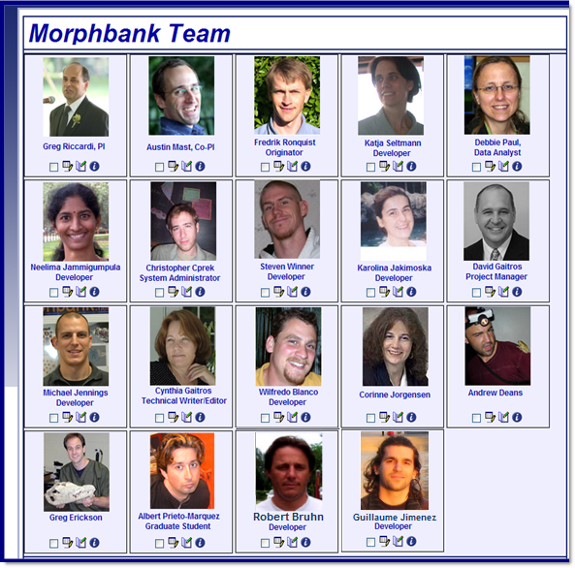
Thanks from the Morphbank Team ~ 2011
Steven Winner
Katja Seltmann
Fred Ronquist
Greg Riccardi
Albert Prieto-Marquez
Debbie Paul
Austin Mast
Corinne Jorgensen
Michael Jennings
Neelima Jammigumpula
Karolina Jakimoska
David Gaitros
Cynthia Gaitros
Greg Erickson
Andrew Deans
Christopher Cprek
Wilfredo Blanco
Robert Bruhn
Guillaume Jimenez
Notes:
Persons highlighted in bold are currently active with Morphbank in 2011.

