Slide 1

Representing and Using Phylogenetic Characters in Morphbank
Greg Riccardi, David Gaitros, Fredrik Ronquist, Austin Mast, Andrew Deans, Neelima Jammingumpula, Wilfredo Blanco, Katja Seltmann, Karolina Maneva-Jakimoska, Steve Winner

Slide 2

Overview
Morphbank goals
Progress update
GUID support
Annotations and Associations

Slide 3
Morphbank Goals
Help biologists capture, organize, and manage phylogenetic information
  Store and publish images
  Provide tools to create and manipulate annotations and associations
  Help move to digital basis of specimen analysis
  Capture peoples’ knowledge of species
Example of Tree of Life process
  Specimens are photographed
  Images and metadata entered into database
  Features (character states) are identified in images
  Character state matrices are created
  Character matrices are processed to produce family trees
    Cipres, TreeBase

Slide 4
What is Morphbank
Curated repository of biological digital media and associated information
  Funded by NSF to develop technology and keep images
  Acquire, Protect, Distribute, Archive
  Add value to images by acquiring and managing annotations and other associations
    Tools to create and record information supported by images
    Seamless integration of research and publication
Not primarily a tool development
  Back end repository for many clients (some examples follow)
  Some client tool development planned for Morphbank

Slide 5
Morphbank Progress
New interfaces
Better search and Filter
Collections
Annotations

Slide 6
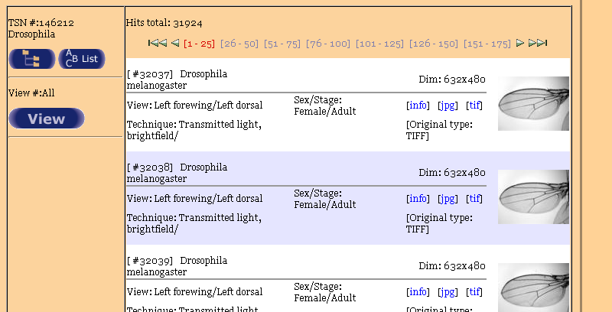
Morphbank Image Display 2005
Some of the fly wings in developmental DB

Slide 7
Conceptual Challenges
Schema for media repository
Relationships between data objects
Acquiring and managing annotations and associations
Searching and browsing information
Managing classifications

Slide 8
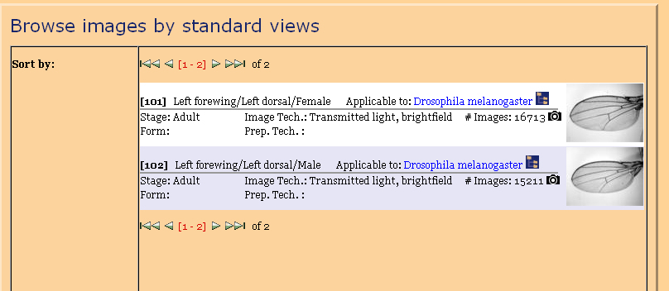
Browse by View
View description is based on morphological classification

Slide 9
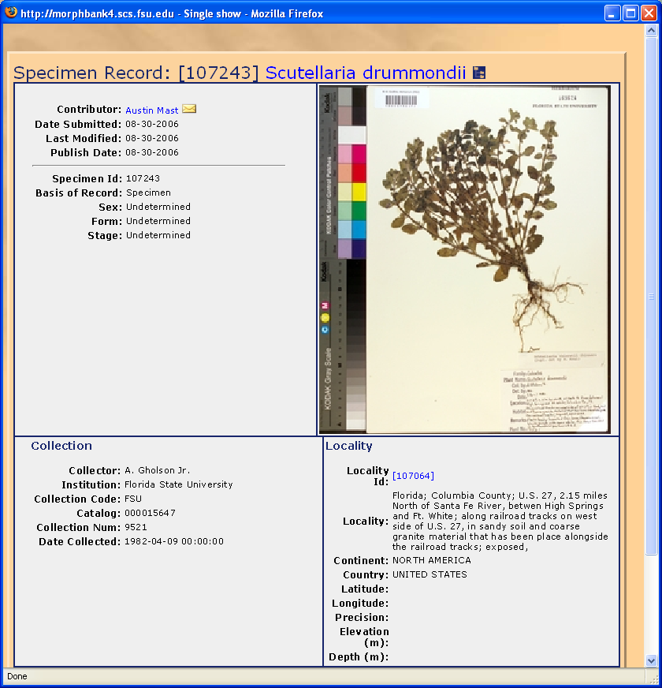
Specimen Display Page

Slide 10
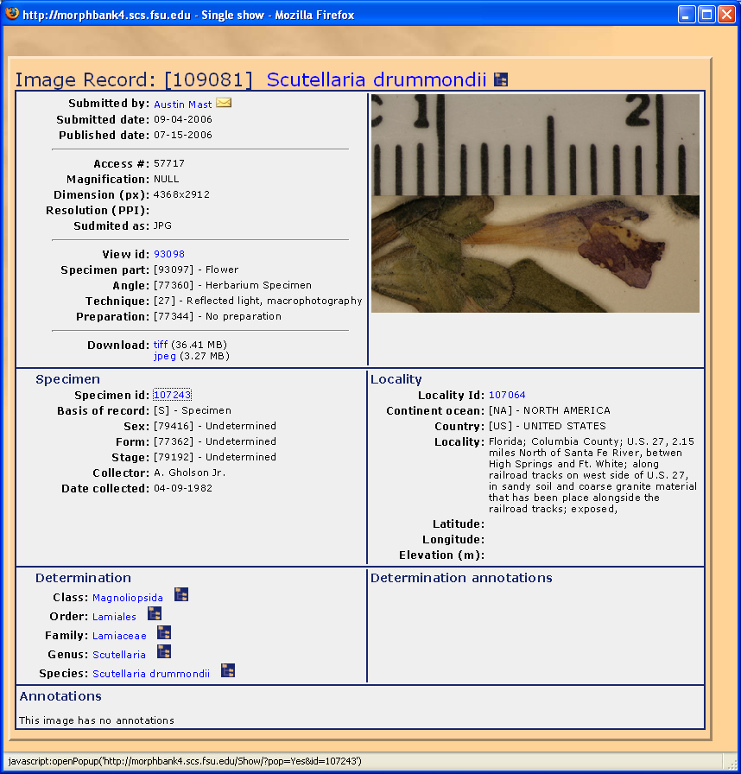
Image Display Page

Slide 11
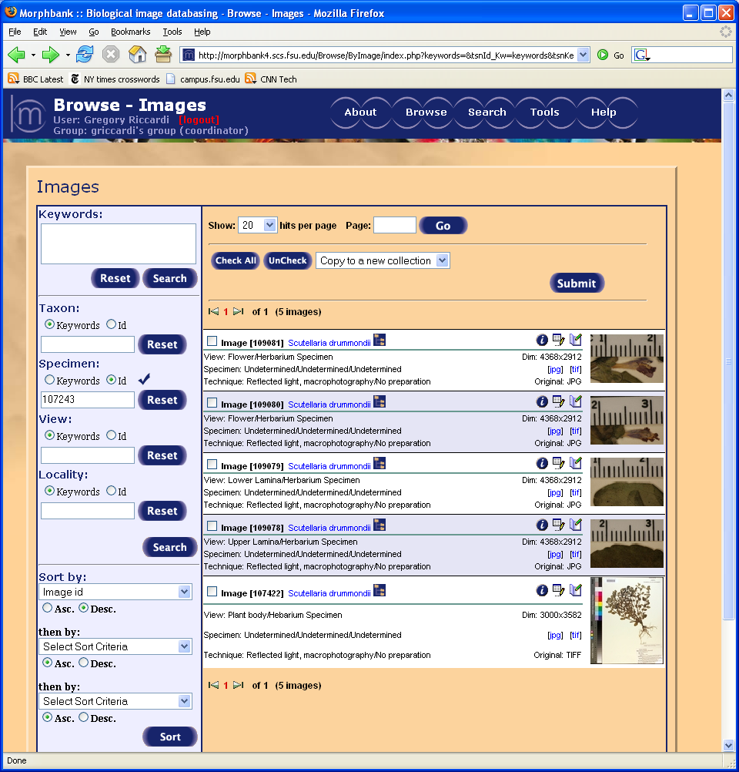
Search for Images of Specimen

Slide 12
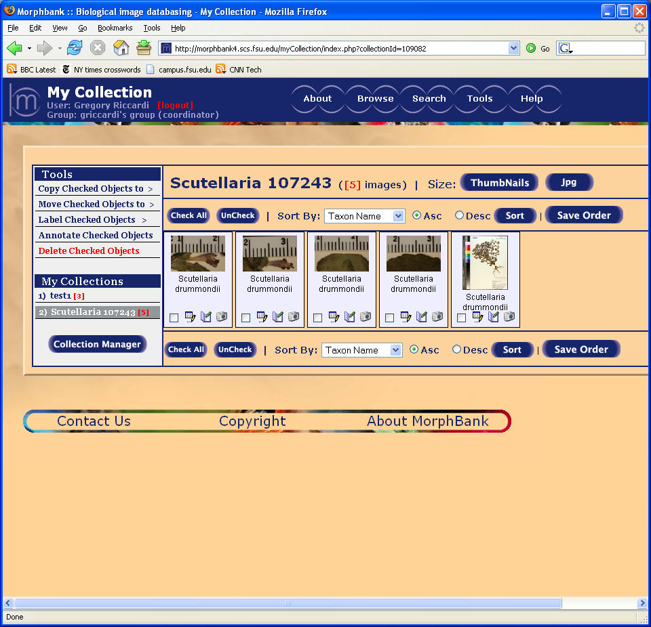
Collection Page

Slide 13
GUIDs at Morphbank
Map relational database to Java object model
Export Java objects as RDF
Develop RDF schema for objects
Use LSID software to publish RDF

Slide 14
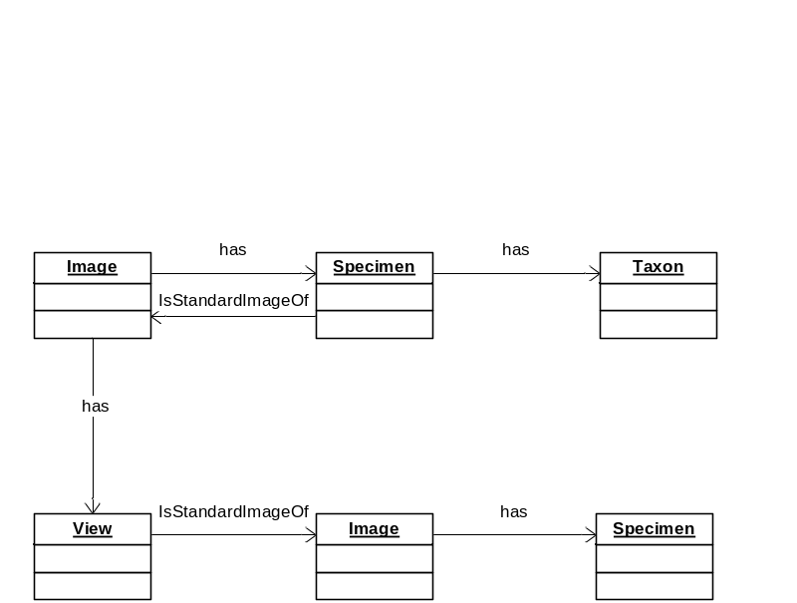
Sample RDF for an Image
<rdf:Description rdf:about="urn:lsid:morphbank.scs.fsu.edu:morphbank:66007">
<mbank:specimen rdf:resource="urn:lsid:morphbank.scs.fsu.edu:morphbank:64282"/>
<mbank:view rdf:resource="urn:lsid:morphbank.scs.fsu.edu:morphbank:63977"/>
<rdf:type rdf:resource="http://morphbank3.scs.fsu.edu:8080/rdf/morphbank#Image"/>
<mbank:description>Width and Height set</mbank:description>
<mbank:imageWidth>829</mbank:imageWidth>
</rdf:Description>
<rdf:Description rdf:about="urn:lsid:morphbank.scs.fsu.edu:morphbank:64282">
<darwin:kingdom>Animalia</darwin:kingdom>
<mbank:images rdf:resource="urn:lsid:morphbank.scs.fsu.edu:morphbank:66007"/>
<rdf:type rdf:resource="http://digir2.ecoforge.net/rdf-schema/darwin/2005/2.0#DarwinCoreSpecimen"/>

Slide 15
What is an Annotation?
An assertion of a relationship among objects
  Someone claims that several objects are associated by a relationship and gives evidence of the connection
  Includes record of author and date of assertion
  Objects are often datasets with provenance
  Annotations often assert quality characteristics of data objects
Crucial social components
  Attribution, confidence, and validity
  Ontologies and compliance with standards
  Establishment of object naming strategy
  Security policies
Feature Annotation
  E.g., shows an area of interest in an image that displays a particular character state

Slide 16
What is a Phylogenetic Character?
A morphological feature
  Relevant to taxa under a taxon
  Value is discrete (set of states) or continuous
A value of a character may represent a characteristic of some anatomical or morphological component of a collection of taxa
The value of the character is selected by sorting specimens
  In the digital world, sorting images

Slide 17
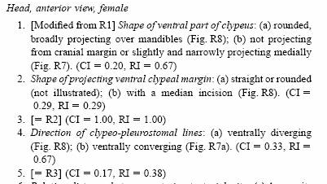
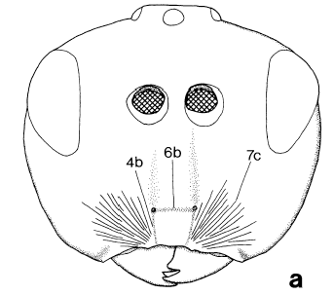
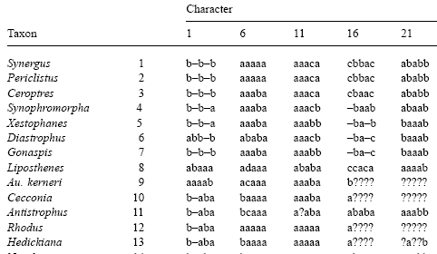
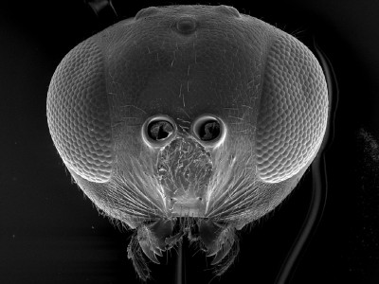
Morphology Publication Example

Slide 18
How to Create Characters and States
Select a collection of taxa and one or more features of interest
Collect images as appropriate
Annotate images to identify location of feature
Sort images into piles according to the character state
Define a state for each pile
  Name and describe the state

Slide 19
Advantages of Collections
Searching in large datasets is hard
  Filtering doesn’t work, ranking is required
Identifying similarity is hard
  Character definitions shared between researchers
Associations between objects
  Google uses associations (links) for ranking
  Collections provide semantically rich associations
    E.g. images that are part of a character state associated with a particular taxon
As amount of annotation grows
  Quality of searching grows

Slide 20
Technical Challenges
User interface quality is crucial
  Users will provide the least amount of data possible
  Good tools make it easy for users to provide more data
Searching the image space
  Searching for characters and states
  Implementing a variety of classifications, including custom and temporary classifications
GUIDs and data handles are crucial
Schemas and performance

Slide 21




Acknowledgements
Thanks to the Morphbank development and research team
  Fredrik Ronquist, Austin Mast, Andrew Deans, David Gaitros, Neelima Jammingumpula, Wilfredo Blanco, Katja Seltmann, Karolina Maneva-Jakimoska, Steve Winner, Debra Paul, Peter Jorgensen
Supporting Organizations
  National Science Foundation, BDI panel
  Florida State University School of Computational Science
  NESCent National Evolutionary Synthesis Center
Morphbank collaborators and contributors
  Angiosperm AToL project, DigiMorph project, Electronic Field Guide project, Hymenoptera AToL project, Lepidoptera AToL project, MorphoBank project., Peabody Museum of Natural History, Robert K. Godfrey Herbarium Online Database Project at Florida State University, Specimen Image Database project, Drosophila morphogenetics project at Florida State University, PEET project Monographic Research in Parasitic Hymenoptera, ZooBank

