Slide 1




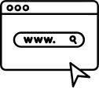
Title Page
nwHacks2025
Lost2Found
Idil Bil - Mehmet Berke Karadayi - Kerem Oktay

Slide 2

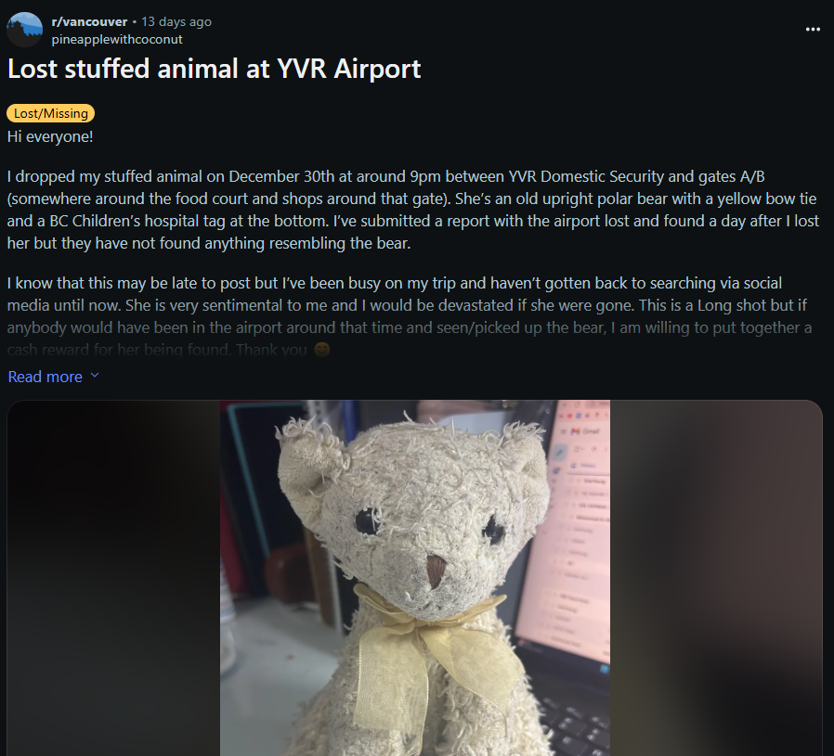
Title Page
Inspiration
nwHacks2025
Inspiration
How many of us still have emotional support stuffed animals and would be devastated if they were lost?
Losing items is frustrating, and finding them can be challenging without a central platform.

Slide 3

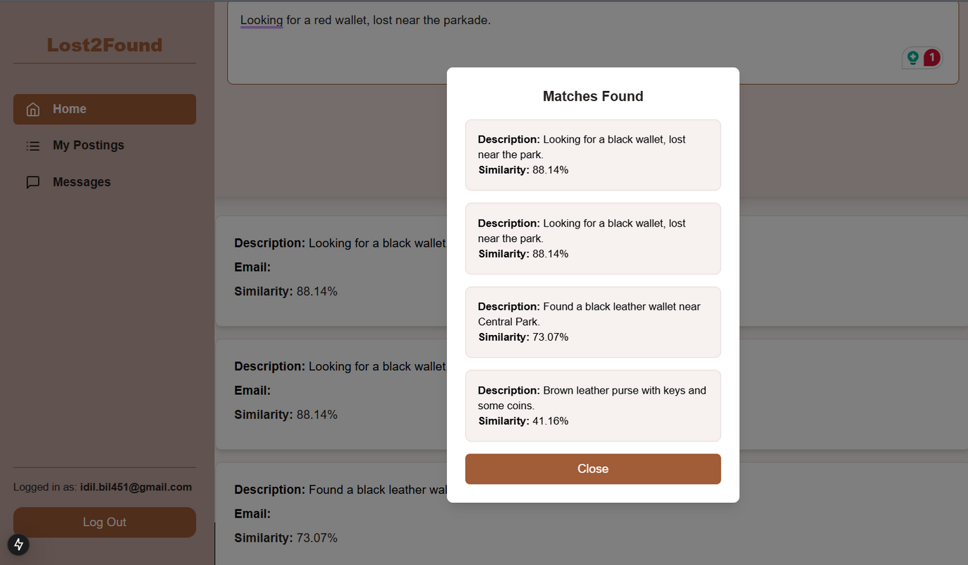
Title Page
Inspiration
What it does?
nwHacks2025
What it does?
Users can post lost or found items with descriptions and images.
AI analyzes and matches lost items with found ones for potential connections.
Streamlines the process of reuniting people with their belongings.

Slide 4


Title Page
Inspiration
What it does?
How we built it?
nwHacks2025
How we built it?
Front -End
Back-End
Database
AI Matching
Designed a responsive and user-friendly interface using Next.js and styled with Tailwind CSS.
Combined Node.js and FastAPI to handle API requests, manage data flow, and integrate AI functionality.
Stored user posts (lost/found items) in a PostgreSQL database for secure and scalable data management.
Integrated the Sentence Transformers (all-MiniLM-L6-v2) model to compare item descriptions and find potential matches.

Slide 5

Title Page
Inpiration
What it does?
How we built it?
What’s next?
nwHacks2025
What’s next?
User Dashboard
Messaging System
Add a dedicated page where users can view and manage all the posts they’ve created (lost or found items).
Implement a built-in messaging feature to allow users to directly communicate with each other on the platform, enabling quicker connections and resolutions.

