Slide 1
DEEP REINFORCEMENT LEARNING FOR STOCHASTIC QUANTUM NETWORKS
Diagnosing a Training-Instability Failure Mode and Proving the Fix
A deep RL scheduler for quantum repeater networks — and the evaluation discipline behind the result
Idil Gozel

Slide 2
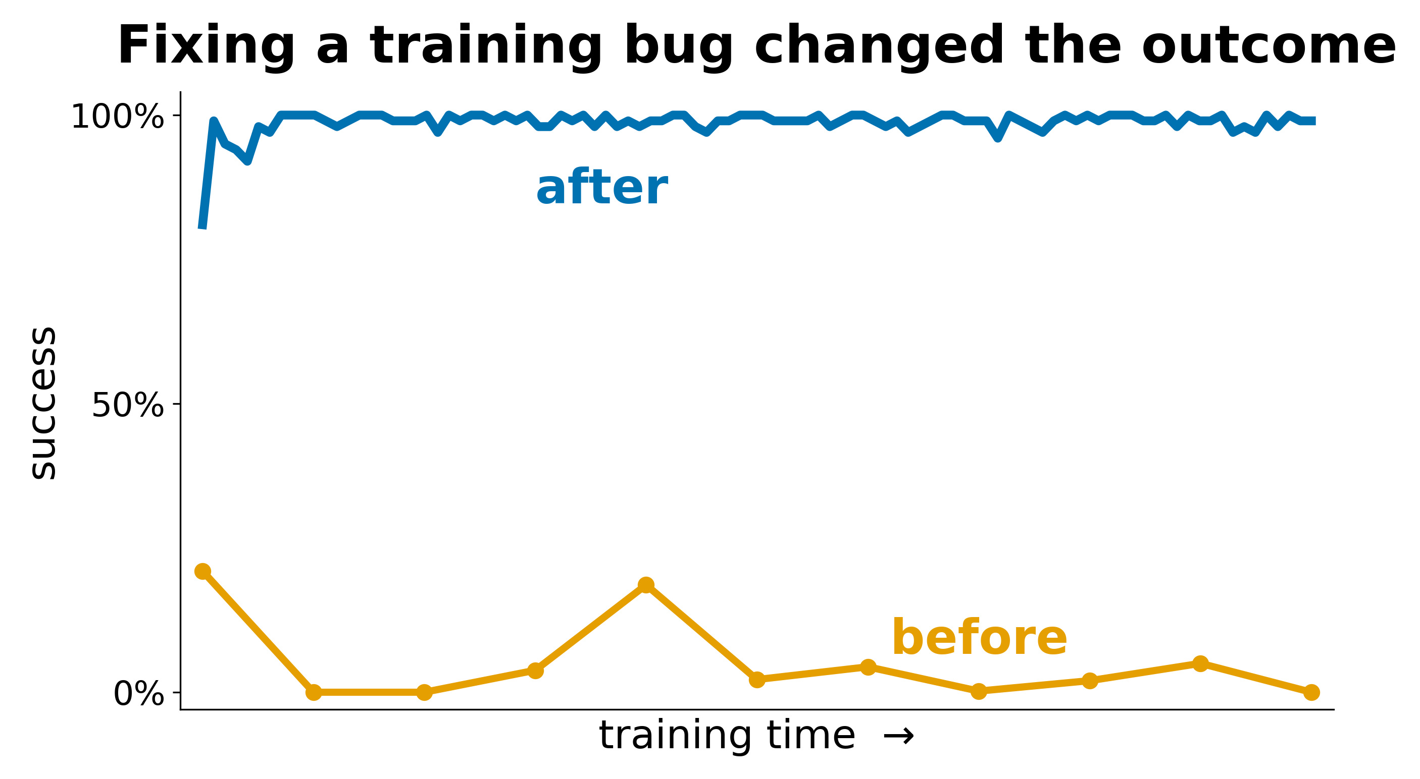
DEBUGGING THE LEARNER
Training looked healthy — the policy was silently collapsing
The task: a deep Q-network schedules probabilistic entanglement-generation and swap operations on an n-node chain to deliver an end-to-end link.
The symptom. Training reward trended up, but the greedy (argmax) policy's success rate decayed toward 0% as training continued — ε-soft evaluation masked it.
The diagnosis. With a 100-step episode cap, most early failures are timeouts. The replay buffer stored truncated (timed-out) transitions as terminal, so the Bellman target zeroed their bootstrap — teaching the network that late-horizon states are terminal-bad.
The fix. Separate terminated (real success/failure) from truncated (time limit); bootstrap from V(s′) on truncation. Plus Double-DQN, a dueling head, and potential-based reward shaping as stabilizers.
Greedy success rate vs training. Orange: before the fix (collapses to 0). Blue: after.

Slide 3
PROVING THE RESULT
A pre-registered, paired protocol — so the win can't be an artifact
Pre-registered metric. Fixed before seeing results: (1) non-inferior success rate, then (2) fewer steps-to-completion, compared only on instances both policies solved. Success can't be traded for speed.
Common random numbers. Each policy faces the identical sequence of generation/swap outcomes per episode — verified byte-identical with a fixed-action probe — so the steps comparison is truly paired.
Attribution. An ablation isolates each component; no single one is catastrophic, confirming the terminated/truncated correctness fix is foundational, not the architecture.
21
fewer steps per problem, paired
Matched reliability
98.7% vs 85.5% success on identical instances.
Consistent
All 5 evaluation seeds positive; ~1-step spread.

Slide 4
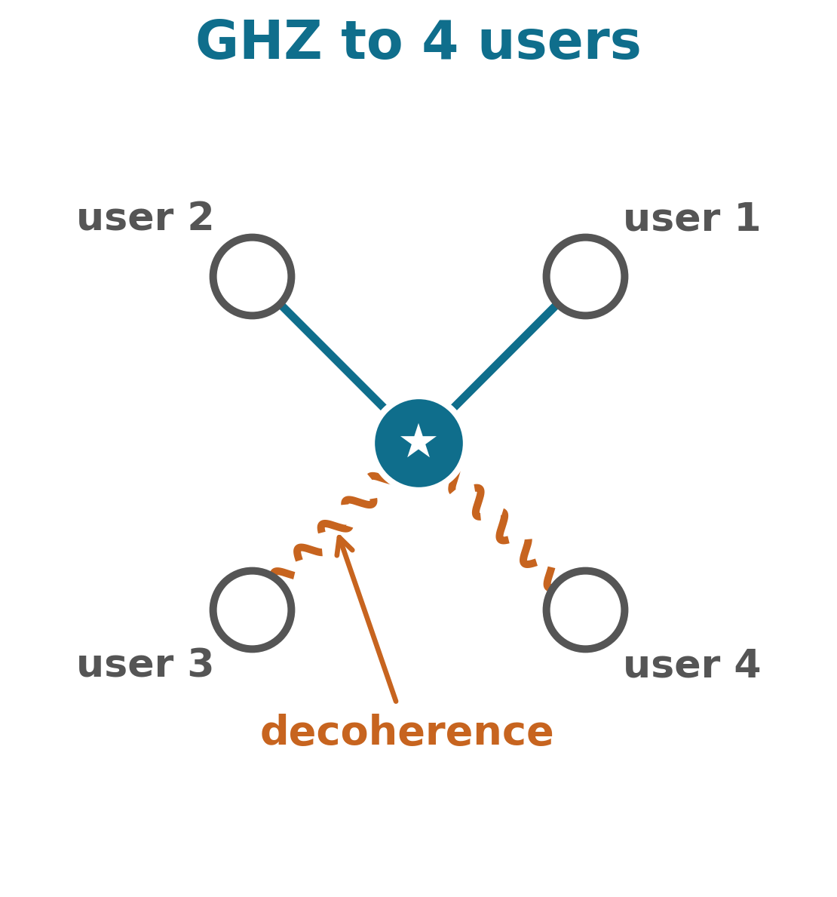
PRACTICE & DIRECTION
Reproducible by construction
■ Pre-registered success criteria before looking at data
■ Paired evaluation with common random numbers
■ Multi-seed runs; ablation-based attribution of each component
■ Deterministic checkpointing and reproducible re-runs
The chain validates the method where an analytical optimum exists. The open problem is multipartite distribution under finite memory coherence — links decay while partial states assemble and fixed heuristics provably fail. That is the next engineering target.
“Same engine, larger problem.”

