Slide 1
AI based Credıt allocatıon Project:
Aylin soykok
Salih Emre Demirkol
İdil güler
Zehra bengü emül

Slide 2
STEPS:
Data Segregation
Definition of Different Column Sets for Transformation
Separation of Test and Train Data
Creation of Pipelines for Numerical and Categorical Features
Application of ColumnTransformer Process for Each Column Set
Addition of Model to the Final Pipeline (XGBoost)
Selection of Top 10 Features from SHAP, Permutation Importance, and Random Forest
Creation of Confusion Matrix
Evaluation of Metrics
Visualization of Data

Slide 3
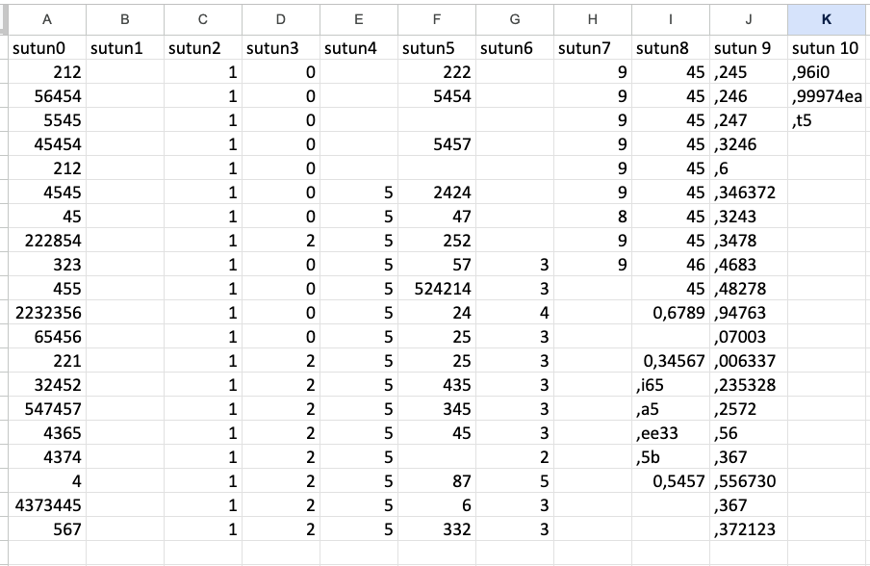

Slide 4
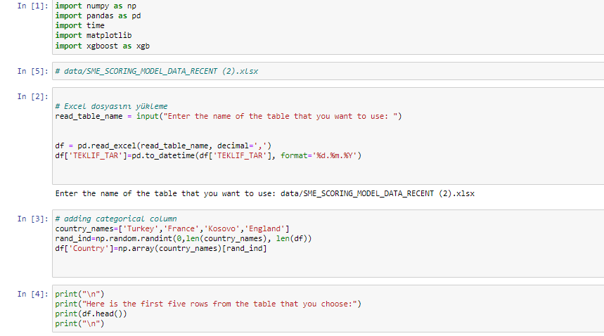

Slide 5
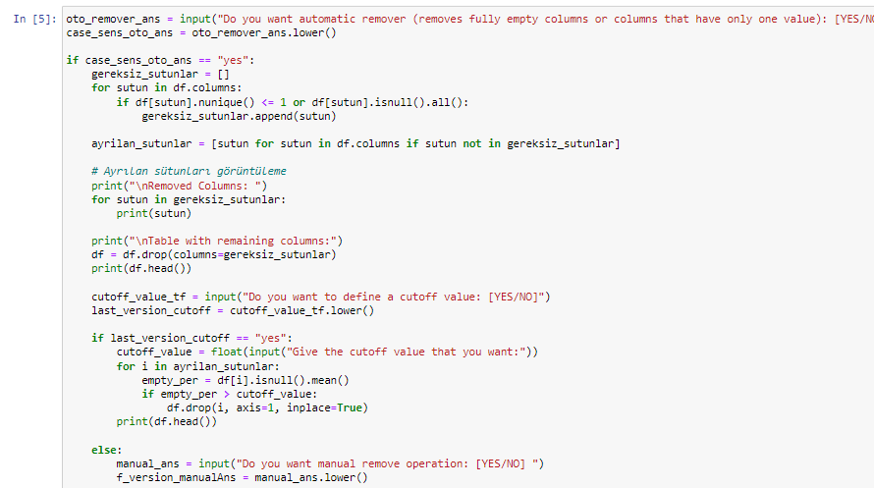

Slide 6
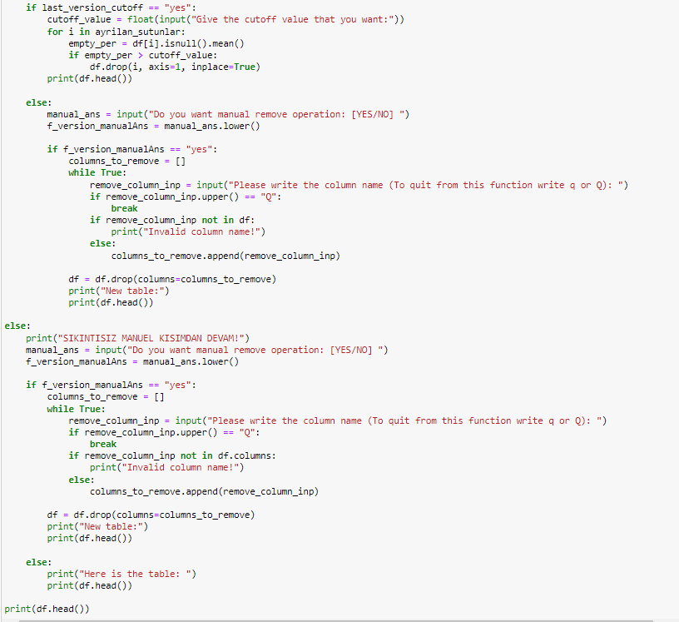

Slide 7
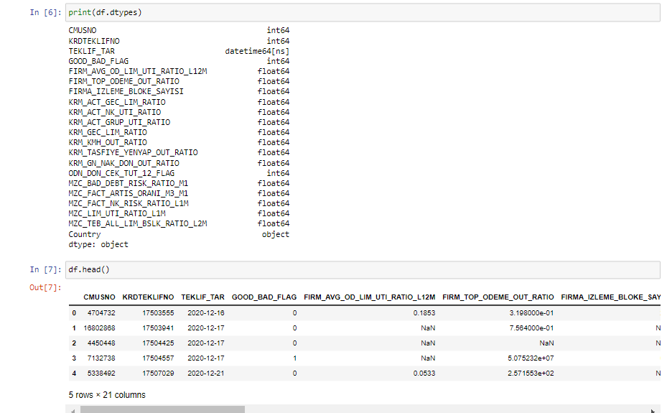

Slide 8
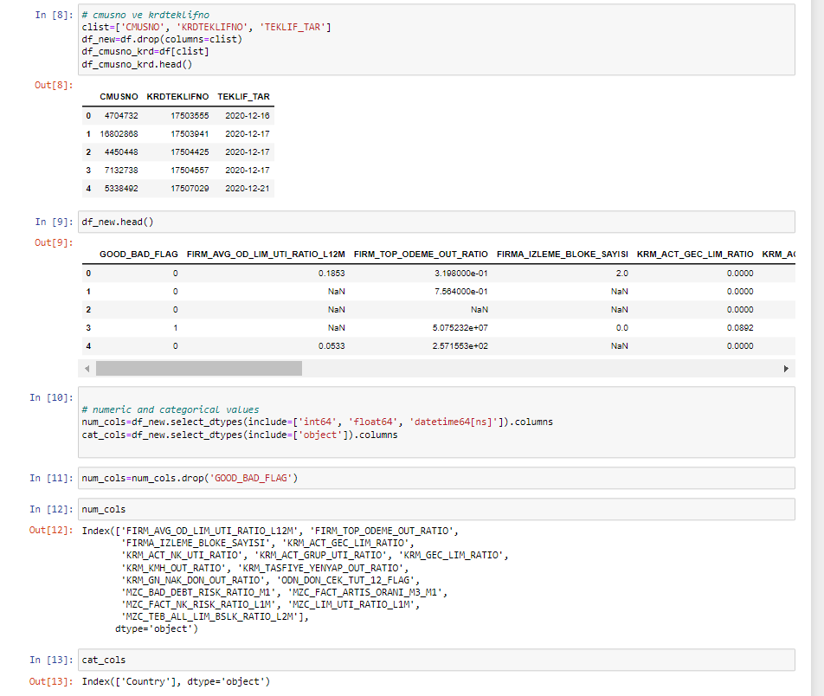

Slide 9
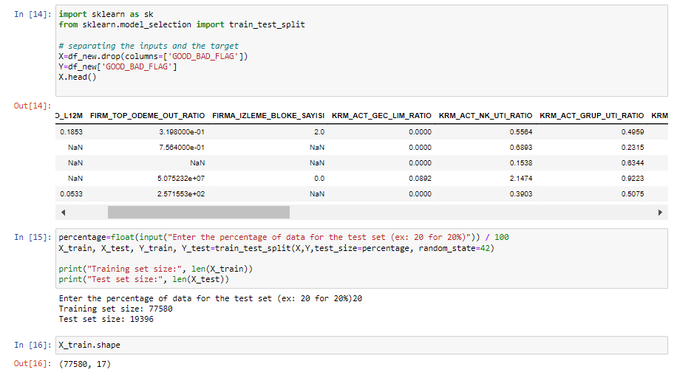

Slide 10
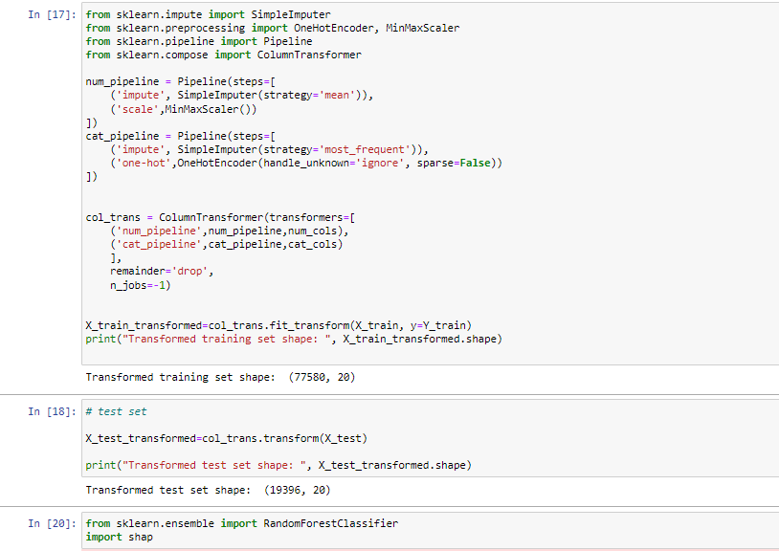
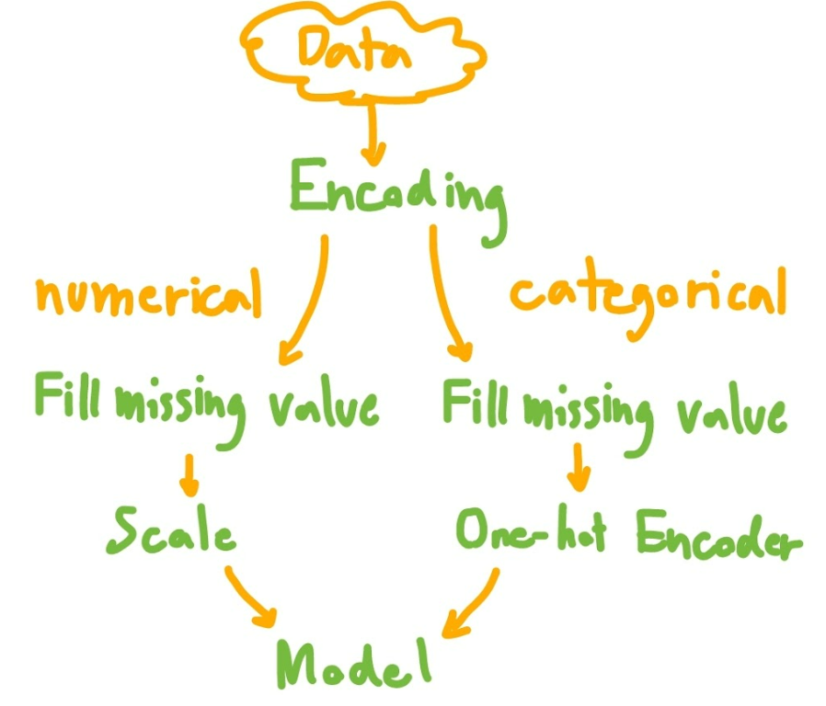

Slide 11
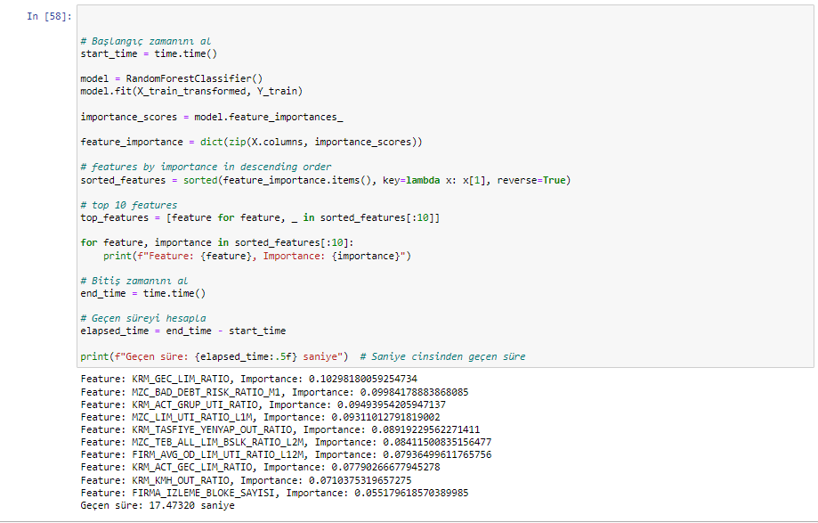

Slide 12
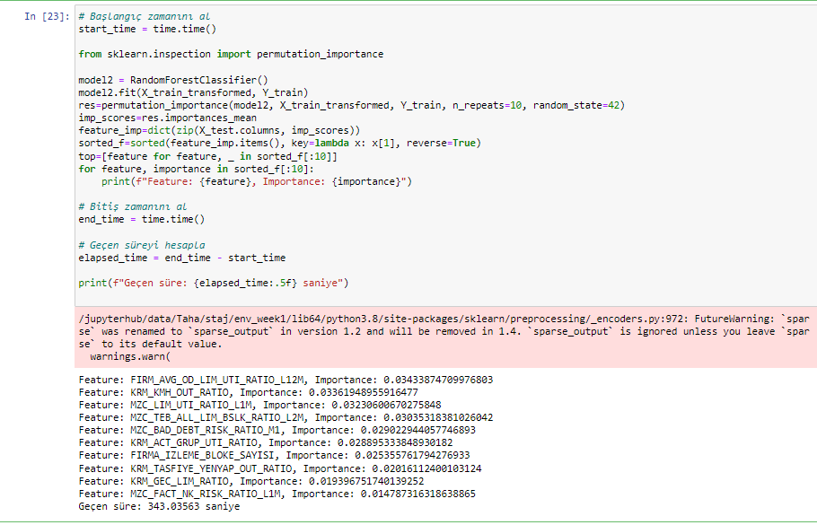

Slide 13
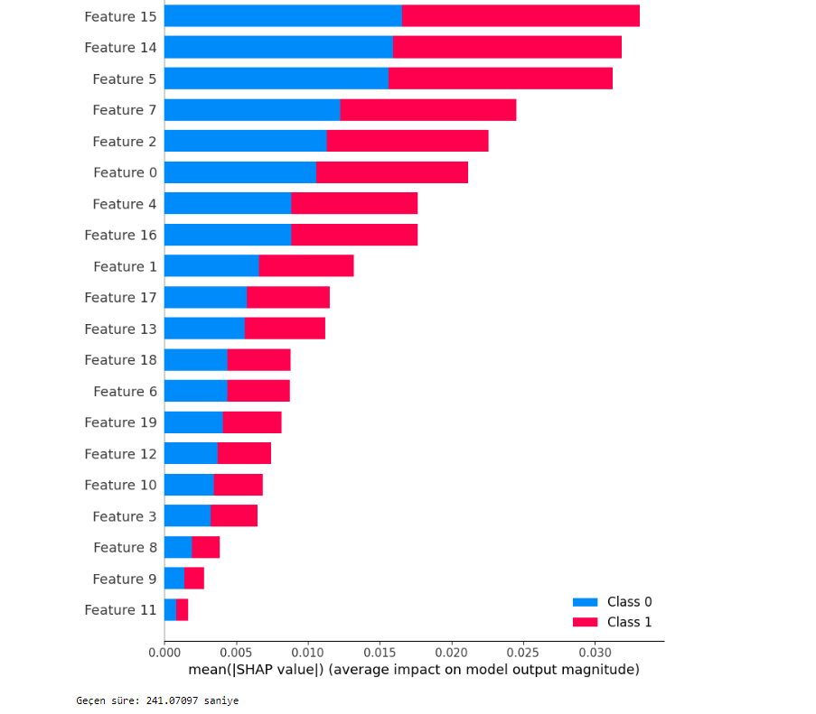

Slide 14
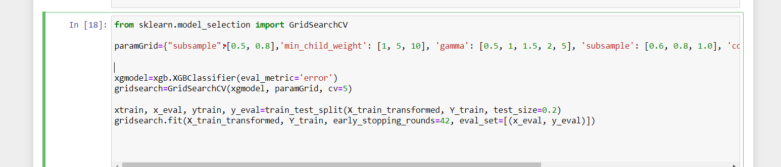
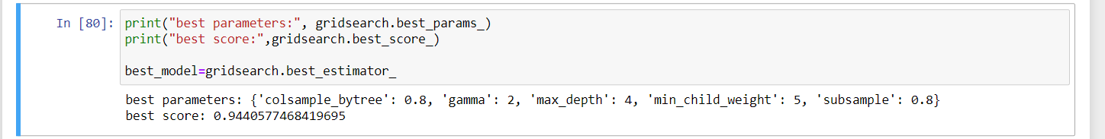
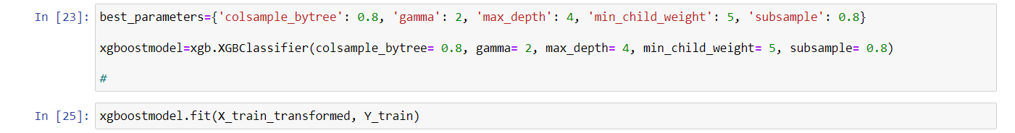

Slide 15
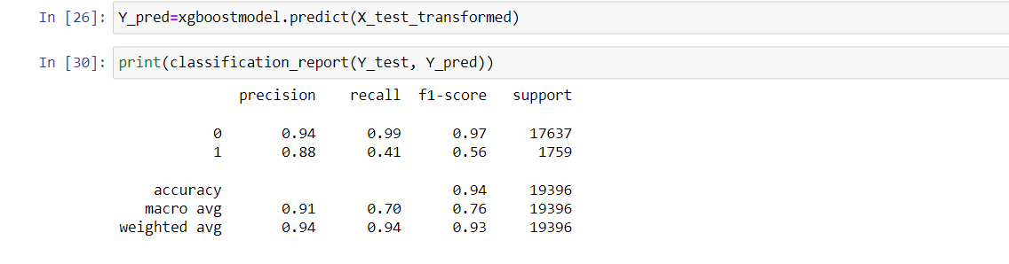

Slide 16
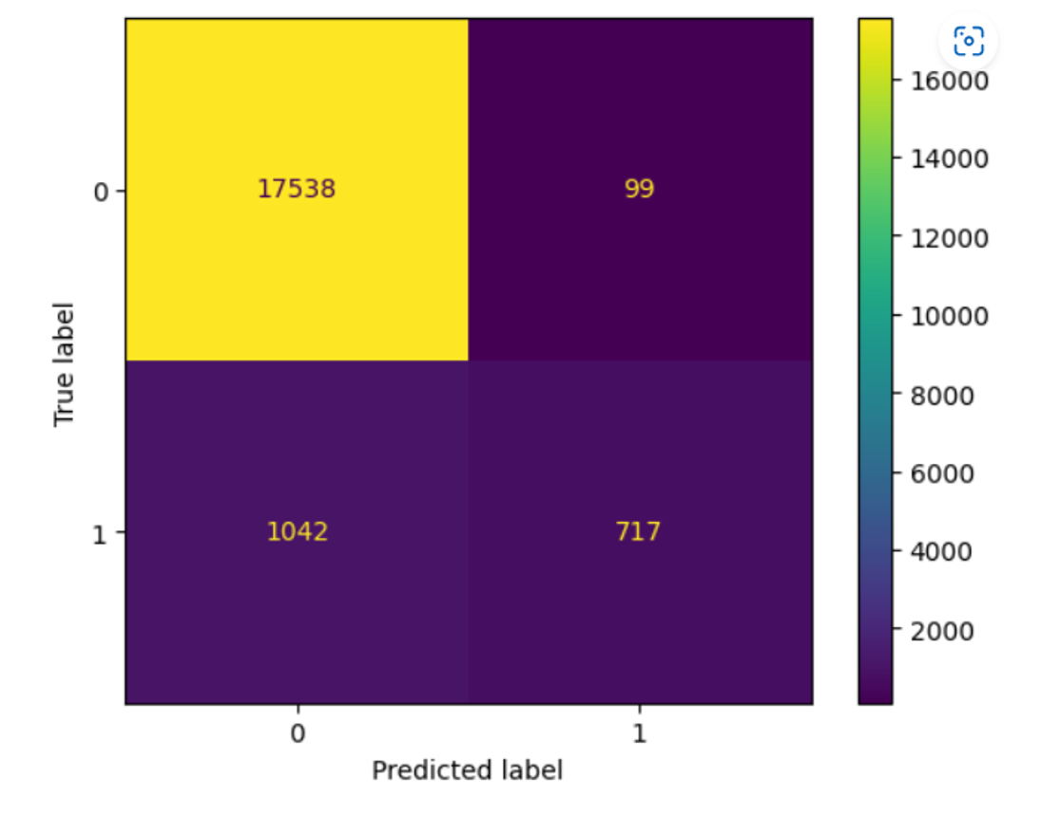

Slide 17
