Slide 1
Functional and non-functional requirements

Slide 2
Functional and non-functional requirements
Functional requirements
Statements of services the system should provide, how the system should react to particular inputs and how the system should behave in particular situations.
May state what the system should not do.
Non-functional requirements
Constraints on the services or functions offered by the system such as timing constraints, constraints on the development process, standards, etc.
Often apply to the system as a whole rather than individual features or services.

Slide 3
Functional requirements
Describe functionality or system services.
Depend on the type of software, expected users and the type of system where the software is used.
Functional user requirements may be high-level statements of what the system should do.
Functional system requirements should describe the system services in detail.

Slide 4
Non-functional requirements
These define system properties and constraints e.g. reliability, response time and storage requirements. Constraints are I/O device capability, system representations, etc.
Process requirements may also be specified mandating a particular IDE, programming language or development method.
Non-functional requirements may be more critical than functional requirements. If these are not met, the system may be useless.

Slide 5
Types of nonfunctional requirement

Slide 6
Non-functional requirements implementation
Non-functional requirements may affect the overall architecture of a system rather than the individual components.
For example, to ensure that performance requirements are met, you may have to organize the system to minimize communications between components.
A single non-functional requirement, such as a security requirement, may generate a number of related functional requirements that define system services that are required.
It may also generate requirements that restrict existing requirements.

Slide 7
Metrics for specifying nonfunctional requirements
Property | Measure
Speed | Processed transactions/second User/event response time Screen refresh time
Size | Mbytes Number of ROM chips
Ease of use | Training time Number of help frames
Reliability | Mean time to failure Probability of unavailability Rate of failure occurrence Availability
Robustness | Time to restart after failure Percentage of events causing failure Probability of data corruption on failure
Portability | Percentage of target dependent statements Number of target systems

Slide 8
Requirements engineering processes

Slide 9
Requirements engineering processes
The processes used for RE vary widely depending on the application domain, the people involved and the organisation developing the requirements.
However, there are a number of generic activities common to all processes
Requirements elicitation;
Requirements analysis;
Requirements validation;
Requirements management.
In practice, RE is an iterative activity in which these processes are interleaved.

Slide 10
Requirements elicitation

Slide 11
Requirements elicitation and analysis
Sometimes called requirements elicitation or requirements discovery.
Involves technical staff working with customers to find out about the application domain, the services that the system should provide and the system’s operational constraints.
May involve end-users, managers, engineers involved in maintenance, domain experts, trade unions, etc. These are called stakeholders.

Slide 12
Requirements elicitation
Software engineers work with a range of system stakeholders to find out about the application domain, the services that the system should provide, the required system performance, hardware constraints, other systems, etc.
Stages include:
Requirements discovery,
Requirements classification and organization,
Requirements prioritization and negotiation,
Requirements specification.

Slide 13
Problems of requirements elicitation
Stakeholders don’t know what they really want.
Stakeholders express requirements in their own terms.
Different stakeholders may have conflicting requirements.
Organisational and political factors may influence the system requirements.
The requirements change during the analysis process. New stakeholders may emerge and the business environment may change.

Slide 14
The requirements elicitation and analysis process

Slide 15
Process activities
Requirements discovery
Interacting with stakeholders to discover their requirements. Domain requirements are also discovered at this stage.
Requirements classification and organisation
Groups related requirements and organises them into coherent clusters.
Prioritisation and negotiation
Prioritising requirements and resolving requirements conflicts.
Requirements specification
Requirements are documented and input into the next round of the spiral.

Slide 16
Requirements discovery
The process of gathering information about the required and existing systems and distilling the user and system requirements from this information.
Interaction is with system stakeholders from managers to external regulators.
Systems normally have a range of stakeholders.

Slide 17
Interviewing
Formal or informal interviews with stakeholders are part of most RE processes.
Types of interview
Closed interviews based on pre-determined list of questions
Open interviews where various issues are explored with stakeholders.
Effective interviewing
Be open-minded, avoid pre-conceived ideas about the requirements and are willing to listen to stakeholders.
Prompt the interviewee to get discussions going using a springboard question, a requirements proposal, or by working together on a prototype system.

Slide 18
Stories and scenarios
Scenarios and user stories are real-life examples of how a system can be used.
Stories and scenarios are a description of how a system may be used for a particular task.
Because they are based on a practical situation, stakeholders can relate to them and can comment on their situation with respect to the story.

Slide 19
Requirements specification

Slide 20
Requirements specification
The process of writing down the user and system requirements in a requirements document.
User requirements has to be understandable by end-users and customers who do not have a technical background.
System requirements are more detailed requirements and may include more technical information.
The requirements may be part of a contract for the system development
It is therefore important that these are as complete as possible.

Slide 21
Guidelines for writing requirements
Invent a standard format and use it for all requirements.
Use language in a consistent way. Use shall for mandatory requirements, should for desirable requirements.
Use text highlighting to identify key parts of the requirement.
Avoid the use of computer jargon.
Include an explanation (rationale) of why a requirement is necessary.

Slide 22
Requirements validation

Slide 23
Requirements validation
Concerned with demonstrating that the requirements define the system that the customer really wants.
Requirements error costs are high so validation is very important
Fixing a requirements error after delivery may cost up to 100 times the cost of fixing an implementation error.

Slide 24
Requirements checking
Validity. Does the system provide the functions which best support the customer’s needs?
Consistency. Are there any requirements conflicts?
Completeness. Are all functions required by the customer included?
Realism. Can the requirements be implemented given available budget and technology
Verifiability. Can the requirements be checked?

Slide 25
Requirements validation techniques
Requirements reviews
Systematic manual analysis of the requirements.
Prototyping
Using an executable model of the system to check requirements. Covered in Chapter 2.
Test-case generation
Developing tests for requirements to check testability.

Slide 26
Requirements reviews
Regular reviews should be held while the requirements definition is being formulated.
Both client and contractor staff should be involved in reviews.
Reviews may be formal (with completed documents) or informal. Good communications between developers, customers and users can resolve problems at an early stage.

Slide 27
Review checks
Verifiability
Is the requirement realistically testable?
Comprehensibility
Is the requirement properly understood?
Traceability
Is the origin of the requirement clearly stated?
Adaptability
Can the requirement be changed without a large impact on other requirements?

Slide 28
Requirements management
Requirements management is the process of managing changing requirements during the requirements engineering process and system development.
New requirements emerge as a system is being developed and after it has gone into use.
You need to keep track of individual requirements and maintain links between dependent requirements so that you can assess the impact of requirements changes. You need to establish a formal process for making change proposals and linking these to system requirements.

Slide 29
SE 321/SE 305 SOFTWARE SPECIFICATION AND DESIGN
Context Diagrams and Data Flow Diagrams
WEEK #7

Slide 30
Context Diagram
System Context Diagrams are diagrams used in systems design to represent the more important external actors that interact with the system at hand.
This type of diagram usually pictures the system at the center, with no details of its interior structure, surrounded by all its interacting systems, environment and activities.
The objective of a system context diagram is to focus attention on external factors and events that should be considered in developing a complete set of system requirements and constraints.

Slide 31
Context Diagram (cont’d)
Identify the system and its boundaries (the context)
Identify external entities (providers, receivers of system info)
Identify external data flows (input, output)
However, NO DATA STORE !!!
Note: the whole system itself is a process (it receives input and transforms into output)

Slide 32
Vending Machine Example Assumption: There is no Revise Order Option
Submit order
Vending Machine System
Customer
Send order

Slide 33
ATM Example Assumption: ONLY Withdrawing Money (not transfer, checking balance, or other services….)
Request transaction
ATM System
Customer
Complete transaction
Or
Revise transaction

Slide 34
Food Ordering System
Draw the context diagram
System
Food order processing system
External entities
Kitchen
Restaurant manager
Customer
Processes
Customer order
Receipt
Food order
Management report

Slide 35
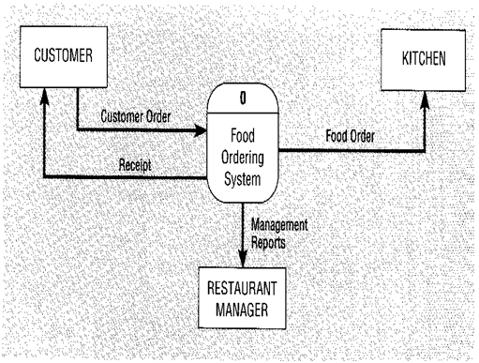
Food Order processing System

Slide 36
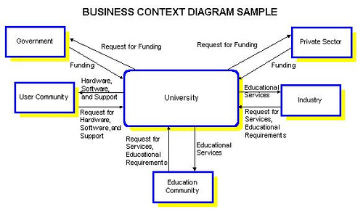
University System Example

Slide 37
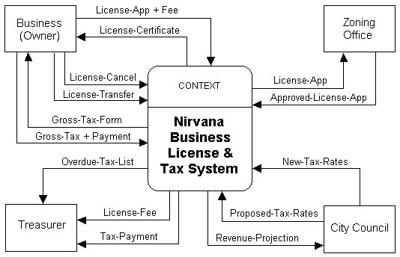
Business and Tax System Example

Slide 38
Context Diagram Example
A student sends in an application form containing their personal details, and their desired course.
The university checks that the course is available.
If the course is available and the student is enrolled in the course, the university confirms the enrolment by sending a confirmation letter that they are registered for the course to the student.
Or if the course is unavailable the student is sent a rejection letter.
What system is being modeled?

Slide 39
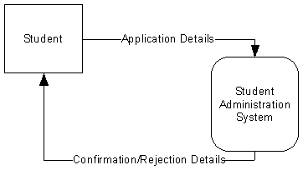
Context Diagram Example (cont’d)

Slide 40
Example: City Complaint Handling System
Letters of complaint received from citizens are entered into a complaints master file by the City Clerk’s office. The date, department code, and a complaint description are stored for each letter. Weekly reports are produced from the complaints master file and given to the City Manager. Two weekly reports are produced: a department summary and a detail report of complaint.

Slide 41
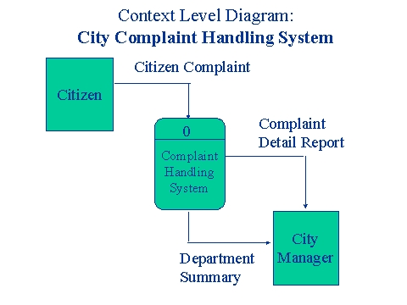
Example: City Complaint Handling System

Slide 42
Data Flow Diagram
Data flow diagram (DFD) represents the flows of data between different processes in a business.
It is a graphical technique that depicts information flow and the transforms that are applied as data move form input to output.
It provides a simple, intuitive method for describing business processes without focusing on the details of computer systems.
DFDs are attractive technique because they provide what users do rather than what computers do.

Slide 43
Data Flow Diagram Components
DFDs only involve four symbols:
Process
Data Flow
Data Store
External entity

Slide 44




DeMarco and Yourdon Symbols
Process
Transform of incoming data flow(s) to outgoing flow(s).
Data Flow
Movement of data in the system.
Data Store
Data repositories for data that are not moving. It may be as simple as a buffer or a queue or a s sophisticated as a relational database.
External Entity
Sources of destinations outside the specified system boundary.

Slide 45
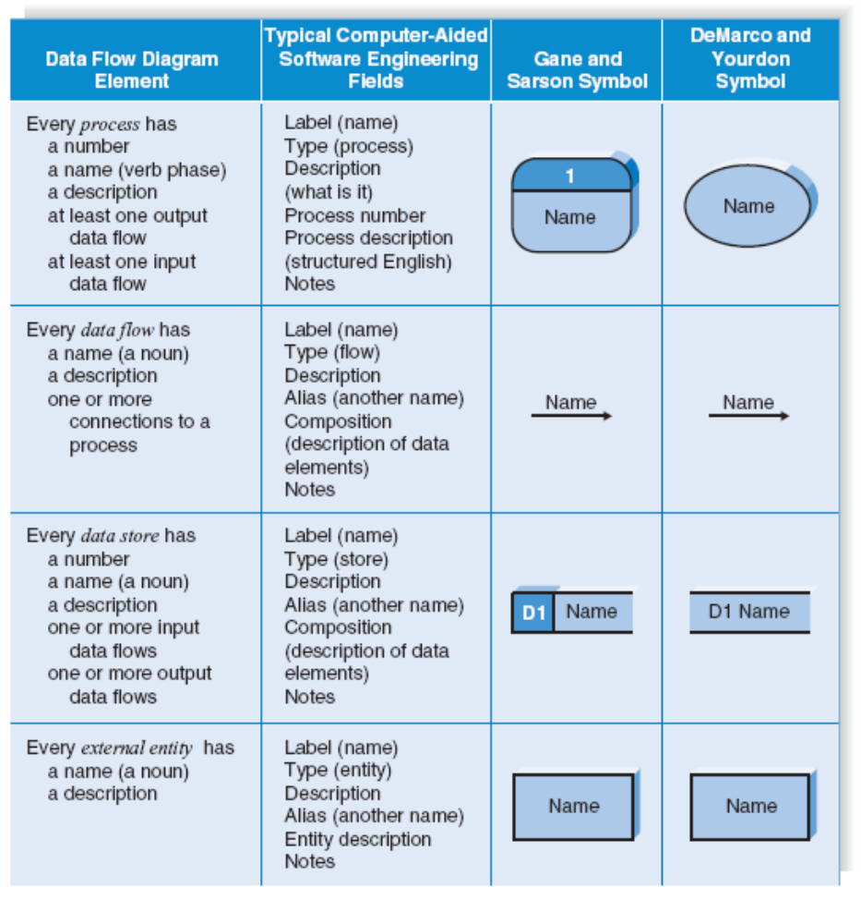
Gane and Sarson Symbol vs DeMarco and Yourdon Symbol

Slide 46
Relationship
The DFD may be used for any level of data abstraction.
DFD can be partitioned into levels. Each level has more information flow and data functional details than the previous level.

Slide 47
Context Diagram
Highest level is Context Diagram:
1 bubble (process) represents the entire system.
Data arrows show input and output.
Data Stores NOT shown. They are within the system.

Slide 48
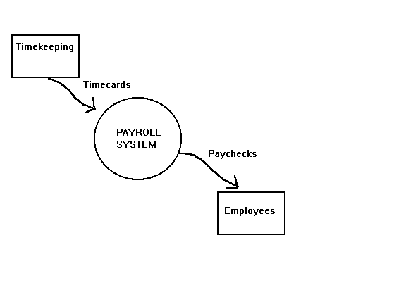
Context Diagram Example

Slide 49
Level 0 DFD
Next Level is Level 0 DFD:
Level 0 DFD must balance with the context diagram it describes.
Input going into a process are different from outputs leaving the process.
Data stores are first shown at this level.

Slide 50
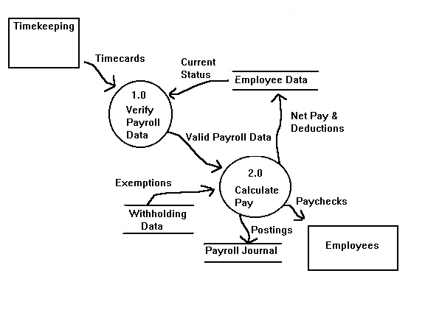
Level 0 DFD Example

Slide 51
Level 1 DFD
Next level is Level 1 DFD:
Level 1 DFD must balance with the Level 0 it describes.
Input going into a process are different from outputs leaving the process.
Continue to show data stores.

Slide 52
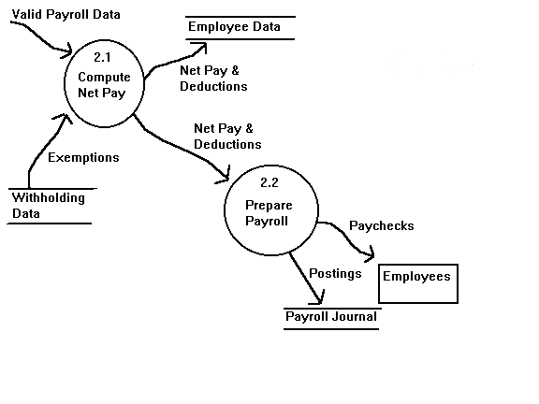
Level 1 DFD Example

Slide 53
Lemonade System Example
Start with Context Level DFD
CUSTOMER
Order
0.0
Lemonade System
Sales Forecast
EMPLOYEE
Product Served
Production Schedule
Pay
Payment
Time Worked
Received Goods
Payment
Purchase Order
VENDOR

Slide 54
Lemonade System Example (cont’d)
Construct Level 0 DFD
1.0
Sale
Customer Order
Sales Forecast
Product Ordered
CUSTOMER
Payment
2.0
Production
EMPLOYEE
Product Served
Production Schedule
Received Goods
Inventory
VENDOR
3.0
Procure-ment
Purchase Order
Order Decisions
Payment
Pay
Time Worked
4.0
Payroll

Slide 55

Lemonade System Example (cont’d)
Construct Level 1 DFD
CUSTOMER
Customer Order
ORDER
Request for Forecast
1.1
Record Order
1.3
Produce Sales Forecast
Severed Order
Payment
Sales Forecast
1.2
Receive Payment
PAYMENT

Slide 56
Lemonade System Example (cont’d)
Construct Level 1 DFD (cont’d)
Product Order
2.1
Serve Product
ORDER
Quantity Severed
Production Schedule
RAW MATERIALS
2.2
Produce Product
Quantity Used
Production Data
INVENTORTY
2.3
Store
Product
Quantity Produced & Location Stored

Slide 57
Lemonade System Example (cont’d)
Construct Level 1 DFD (cont’d)
Order Decision
PURCHASE ORDER
3.1
Produce Purchase Order
Quantity On-Hand
RAW MATERIALS
Quantity Received
Received Goods
3.2
Receive Items
RECEIVED ITEMS
Payment Approval
3.3
Pay Vendor
VENDOR
Payment

Slide 58
Lemonade System Example (cont’d)
Construct Level 1 DFD (cont’d)
Time Worked
4.1
Record Time Worked
TIME CARDS
Employee ID
EMPLOYEE
Payroll Request
4.2
Calculate Payroll
Unpaid time cards
PAYROLL
Payment Approval
4.3
Pay Employee
PAYMENTS
Payment

Slide 59
Process Decomposition
1.0
Sale
1.1
Record Order
1.2
Receive Payment
2.0
Production
2.1
Serve Product
2.2
Produce Product
2.3
Store
Product
0.0
Lemonade System
3.0
Procure-ment
3.1
Produce Purchase Order
3.2
Receive Items
3.3
Pay Vendor
4.0
Payroll
4.1
Record Time Worked
4.2
Calculate Payroll
4.3
Pay Employee
Context Level
Level 0
Level 1

