Slide 1

I/O nodes sharing between applications
Alexis Bandet, Francieli Boito & Guillaume Pallez
Inria Bordeaux Sud-Ouest, France
Per3s workshop – 13th june 2022
IMT Saclay

Slide 2
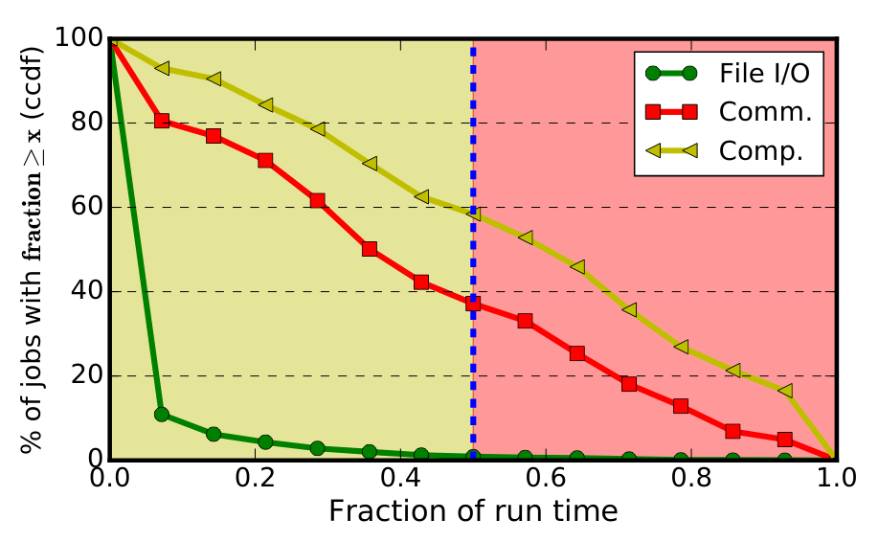
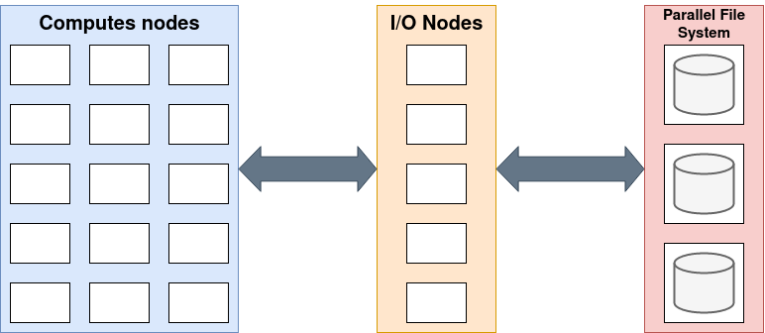
State of the art
Source : Liu, Z et al.[3]
I/O forwarding layer
Complementary cumulative distribution functions of time spent on file I/O, MPI communication and computation, expressed as a fraction of the total runtime[3]
Intermediate layer between File System and Computation machines
#I/O Nodes based on #Computes node (static method [1])
MCKP scheduling for optimal bandwidth optimization [2]
Exclusive allocation
HPC applications have relatively limited I/O time
95% of application spent less than 20% of their time doing I/O
Exclusive policy may lead to waste of ressources
Per3s workshop – 13th june 2022
IMT Saclay

Slide 3
Sharing heuristics
How to share I/O nodes between applications ?
Model :
Model :
Set of K applications { A1,...,Ak } , each defined by a number of I/O nodes ni and a ratio of time spend doing I/O operations ri
N I/O nodes
Two algorithms :
Greedy-Clairvoyant tries to balance the load (from the ri) across the I/O nodes.
Greedy-Non-Clairvoyant tries to balance the number of applications across the I/O nodes.
Per3s workshop – 13th june 2022
IMT Saclay

Slide 4
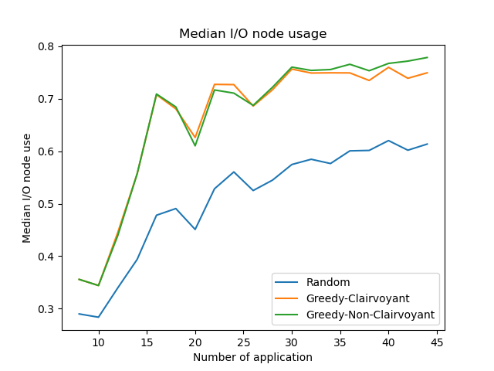
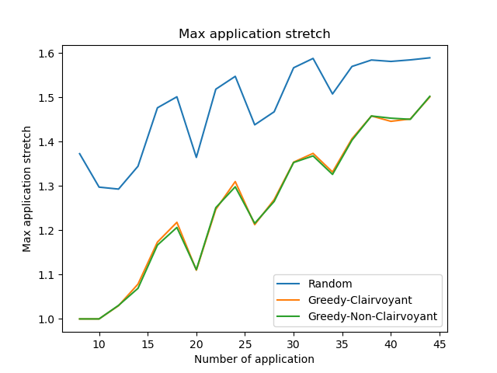
Preliminary results
Median use
Use represents fraction of time I/O nodes spent in I/O state
Shows sharing efficiency at machine level
No benefit from I/O ratio information for scheduling
Stretch acknowledge sharing penalty at user level
Once again no benefit with I/O ratio data
Per3s workshop – 13th june 2022
IMT Saclay

Slide 5
Conclusion and future works
Conclusion :
It is possible to share I/O nodes in an efficient way
This maximize ressource utilization
Limited impact on application
Future work
Refining application model
Compare to states of the art forwarding scheduling technics
Evaluate the combination of placement policies with heuristics for the selection of the number of I/O nodes
Test the sharing efficiency outside simulation
Per3s workshop – 13th june 2022
IMT Saclay

Slide 6
Thanks for your attention !
Références :
[1] Xu, W(.2014). Hybrid hierarchy storage system in MilkyWay-2 supercomputer. Frontiers of Computer Science, 8(3), 367-377.
[2] Bez, J. L.,(2021, May). Arbitration Policies for On-Demand User-Level I/O Forwarding on HPC Platforms. In 2021 IEEE International Parallel and
Distributed Processing Symposium (IPDPS) (pp. 577-586). IEEE.
[3] Liu, Z.(2020, June). Characterization and identification of HPC applications at leadership computing facility. In Proceedings of the 34th ACM International Conference on Supercomputing (pp. 1-12).

