Slide 1
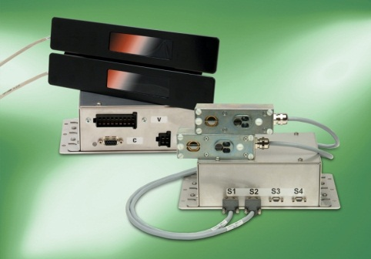
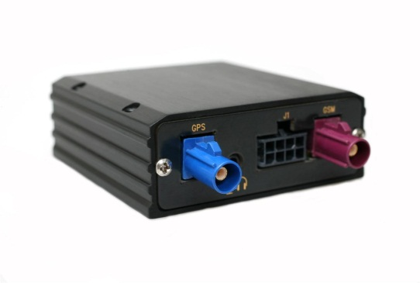
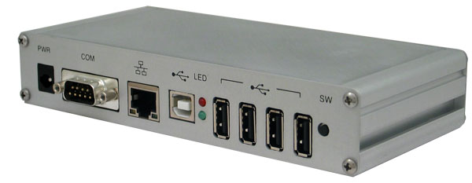
Onboard Hardware
Onboard Master PC
Underlying Hardware:
ARM SBC
Runs Linux (free!)
Easily adaptable to existing AVL or APC installations
802.11 / GPRS Capable
Designed to receive input from many onboard AVL units and APC units
Serial RS-232 & RS-485
Long range RF
USB
Automatic Vehicle Location (AVL)
GPS (Global Positioning System) Unit
Reports location of train in real time
Communicates with onboard Master PC
Automatic People Counting (APC)
Bi Directional Infrared Sensor Bars
Accurately records occupancy by tracking incoming and outgoing passengers
Communicates with onboard Master PC
Image source: Numerex
Image source: INIT systems
Image source: Technologic Systems

Slide 2
Hardware Costs
The Good News
A lot of the equipment needed for this project our customers(HRT) already have:
Door Bar Sensors
Master Control PC
Vendor average $170 per GPS unit ($1530 to outfit every Tide car)
Remaining hardware cost will be server related.

Slide 3
Server Hardware
Database server
Large disk size
Redundancy & Backups
Optimization & Decision server
Web App Server(s)
Clustered & Load Balanced w/ HA
Server | Database | Optimization | WebApps
Virtual (Hosted by them) | $3000 License per VM | Resides with DB (included in cost) | $2000 License per VM
Virtual (Hosted by Us) | Priced by CPU time | Priced by CPU time | Priced by CPU time
Physical (Hosted by them) | Quoted at $6000 | Resides with DB (included in cost) | Quoted at $4000 per node

