Slide 1
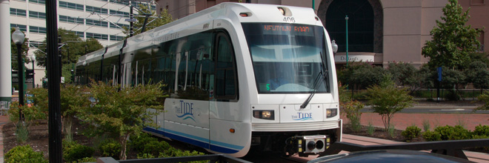
Light Rail Operation Process Flow for HRT pre TT
Onboard Sensors measure those entering/exiting Light Rail
Go to next stop/station
Problem Occurs
Drop Human Cargo & Go to Maintenance facility
Ofload rider data using non real time reader
Post alert that regularly scheduled service has been interrupted

Slide 2
Light Rail Operation Process Flow for HRT post TT
Onboard Sensors measure those entering/exiting Light Rail
Go to next stop/station
Problem Occurs
Instant Alert that service has been restored
Instant Alert that service has been interrupted
Re route human cargo
Real time GPS &
Occupancy
Reporting to remote server
Perform Maintenance on Light Rail

Slide 3
Expansion/Self Evaluation Process Flow for HRT pre TT
Need to evaluate & expand Tide Light Rail
Receive user feedback about service through traditional means
Static ridership data
Set Schedule, Stops/Stations and fare for Light Rail, determine new service areas
Light Rail normal operation

Slide 4
Expansion/Self Evaluation Process Flow for HRT post TT
Need to evaluate & expand Tide Light Rail
Receive user feedback about service through traditional means
Realtime ridership data
Realtime GPS data
More accurately set Schedule, Stops/Stations and fare for Light Rail
Light Rail normal operation

