Slide 1

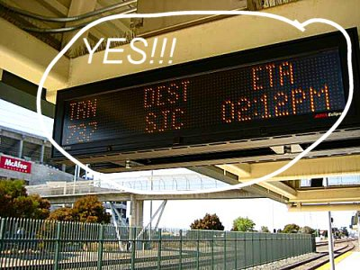
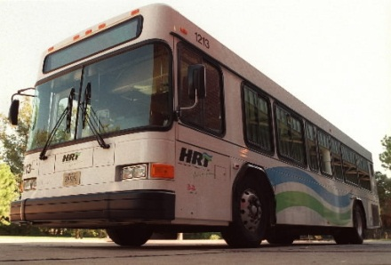

Major Functional Component Diagram
DB
Master Routing
Engine
WebApp
Server
GTFS
Central Monitoring Server
Onboard Unit
GPS Transponder
Infrared Counters

