Slide 1
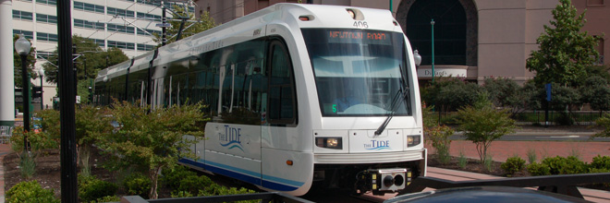
Tide Light Rail Tracker
Nathan Lutz
1-31-2012
CS410 Professional Development 1

Slide 2
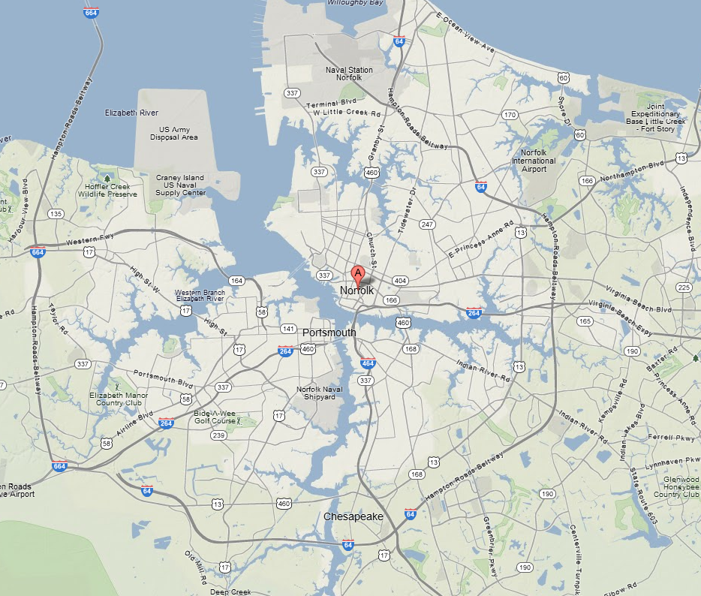
Agenda
Lack of Light Rail Knowledge
Why is this a problem?
… and it’s consequences.
Why do they care?
Groups solving this problem
What are they doing?
Tracking the Tide
Who is this for?
Resources required
What do we need?
Pros and Cons
What can go wrong?

Slide 3
The Issue at Hand
Lack of accessible, real-time and accurate information leads to loss of potential ridership on the Tide Light Rail.
Characteristics:
How the schedule works
Current positions of light rail
Locations of stations
Current occupancy of light rail
Users cannot make educated decisions, so they seek alternative transport.

Slide 4
Why is this a problem?
In 2010, Southeastern Institute of Research, Inc performed a survey of 1080 Norfolk residents, students and business owners.
The results of the survey showed that:
Awareness of The Tide is high
~90% awareness across the board
Familiarity and understanding are low
~50% of non workers did not know station locations
Workers more likely to use light rail if it saves them time
But only 35% agree strongly that it will help
Source: http://www.gohrt.com/publications/reports/sir-light-rail-summary.pdf

Slide 5
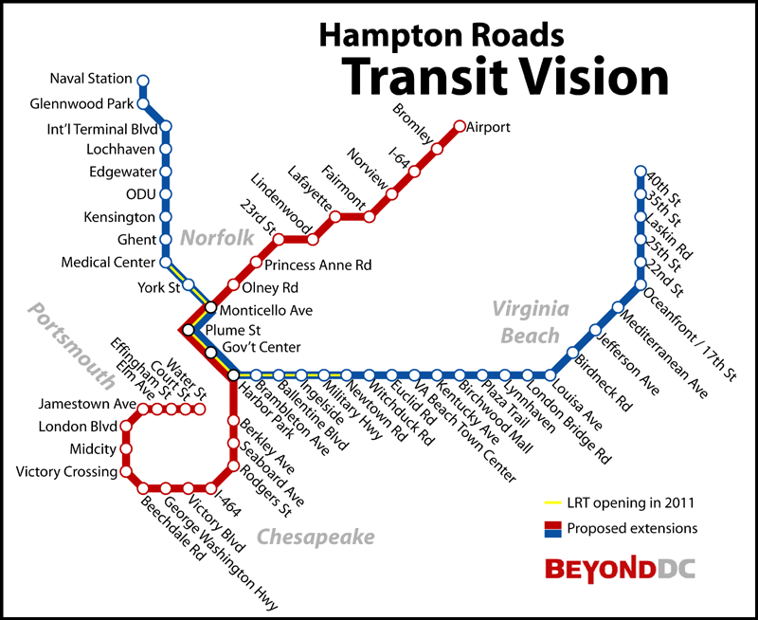
Customers
HRT
Citizens and business owners of Hampton Roads
Why do they care?
Transit is a business, efficiency is key.
Growth is inevitable
Predictions for 2034
Lack of awareness = loss of riders = loss of revenue
Bad for Hampton Roads
Source: http://www.gohrt.com/publications/reports/2011/03/hampton-roads-regional-transit-vision-plan-report.pdf

Slide 6
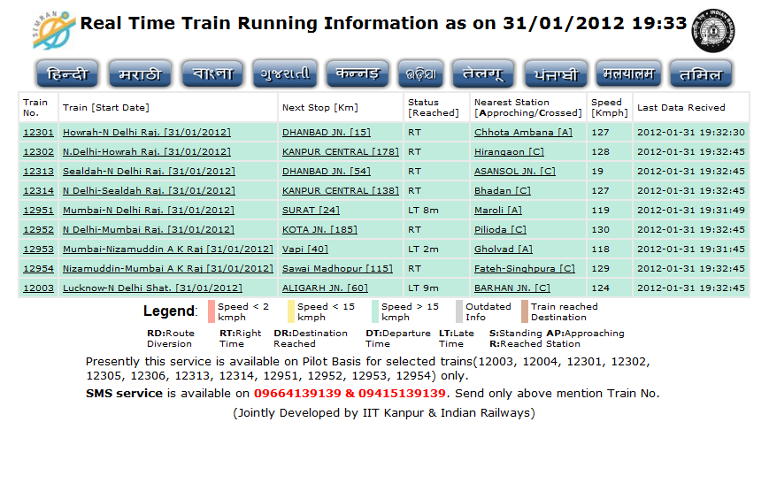
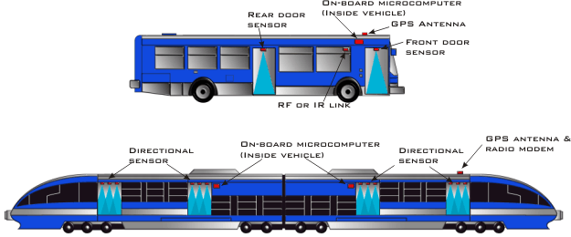
Competition
Who’s currently solving this issue?
New York MTA (GTFS)
India (http://simran.in/)
Infodev (People Counters + GPS)

Slide 7
The Solution
Provide accurate, real time Tide Light Rail information to riders through the use of paid and free mobile apps, the web, and station signage.
Characteristics:
Information everywhere the potential rider needs it
Helps HRT market the Tides successes and analyze their failures

Slide 8
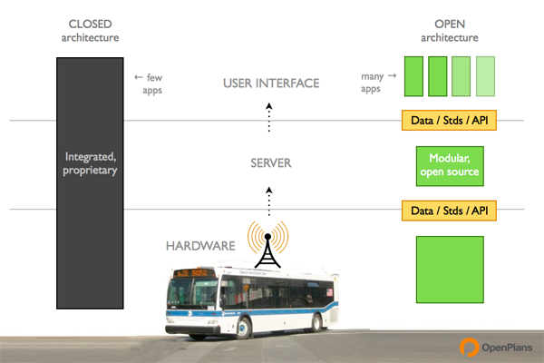
The Tech
Train Unit
GPS
Infrared People Detectors
Use existing on-board Wifi for communications
HRT Central monitoring Server
Receive light rail data
Conform and Publish data to existing open-source transit API
GTFS (Google Transit Feed Specification)
Web Server / App Server
Database
Mobile App
Networked Signage
Image Source: Open Plans http://civiccommons.org/2011/12/nyc-bus-tracking-as-platform/

Slide 9
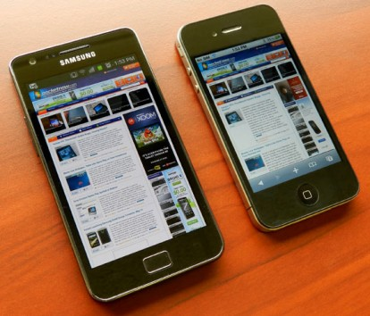
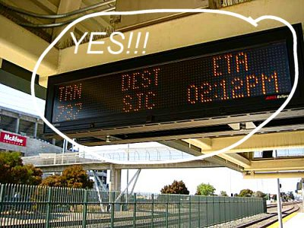
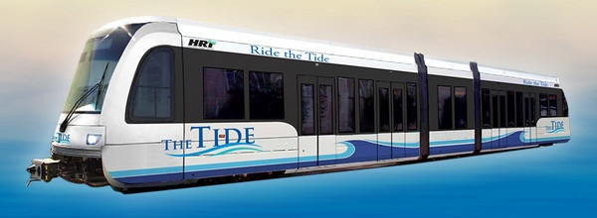
Process Flow
Central HRT
Monitoring Server
GTFS
DB
APP
Server
Onboard Unit

Slide 10
Risks & Benefits
Benefits:
Promotes awareness of the Tide
Provides a backend management system for HRT to publish transit data
Provides a way for other developers yet also brings in profit for us
Risks:
Will open the door for competition
Potentially costly

Slide 11
Conclusion
Lack of accessible, real-time and accurate information leads to loss of potential ridership on the Tide Light Rail.
Confusion is bad, leads to disinterest
Provide accurate, real time Tide Light Rail information to riders through the use of paid and free mobile apps, the web, and station signage.
Give public what it wants – open info
Drive up revenue for HRT

Slide 12
Sources
Hampton Roads Regional Transit Vision Plan
http://www.gohrt.com/publications/reports/2011/03/hampton-roads-regional-transit-vision-plan-report.pdf
HRT Transit Development Plan
http://www.gohrt.com/public-records/Planning-and-Development-Documents/Transit-Development-Plan/TDP-Executive-Summary.pdf
2011 Life in Hampton Roads Survey - The Social Science Research Center at ODU
http://al.odu.edu/ssrc/LIHR_tables_weighted_only.pdf
Hampton Roads Transit: Light Rail Marketing Research Study done by Southeastern Institute of Research
http://www.gohrt.com/publications/reports/sir-light-rail-summary.pdf
Google GTFS
https://developers.google.com/transit/gtfs/
Atrack wireless GPS Device
http://atrack.com.tw/Docs/AY5i%20Product%20Specification%20%2020111220.pdf
Indian competition
http://www.zdnet.com/blog/india/indian-railways-launches-real-time-train-tracking-website/740
Infodev
http://www.infodev.ca/vehicles/products-and-passenger-counters/installation-type/train.html
http://beyonddc.com/log/?p=1473

