Slide 1
WAE Server
Get server
hardware
Configure Server
Configure Webserver
Decision Engine
Quote from multiple Vendors
Install OS
Access Control
Interface to DB
Disk Layout
Interface to DB
Interface to Decision Engine
Networking
Interface to Decision Engine
Firewall
Install Webserver
Develop Decision Engine

Slide 2
Onboard Hardware
GPS Sensors
Automatic People Counters
Master PC
Quote from multiple vendors
Quote from multiple vendors
Quote from multiple vendors
Interface to Master PC
Interface to Master PC
Configure Device
OS Install
Networking
Reporting Agent
Interface to GPS
Interface to APC
Interface to DB

Slide 3
Database Server
Get server
hardware
Configure Server
Configure DBMS
Quote from multiple Vendors
Install OS
Access Control
Disk Layout
Design Schemas
Networking
Tables
Firewall
Fields
Backups
Keys
Install DBMS
Constraints

Slide 4
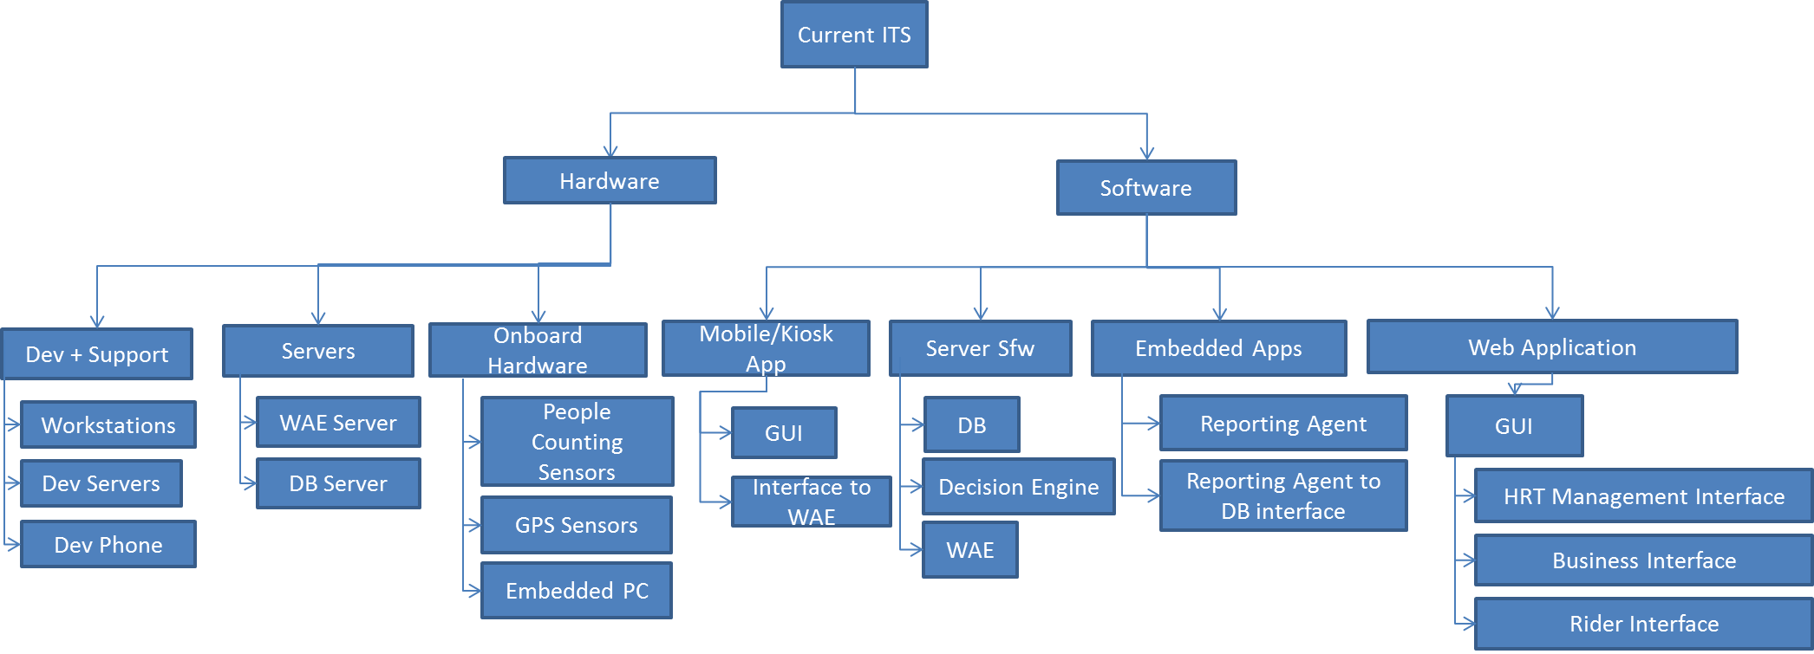

Slide 5
Current ITS
Hardware
Software
Dev + Support
Servers
Onboard Hardware
Mobile/Kiosk App
Server Sfw
Embedded Apps
Web Application
Workstations
WAE Server
People Counting Sensors
GUI
DB
Reporting Agent
GUI
Dev Servers
DB Server
Interface to WAE
Decision Engine
Reporting Agent to DB interface
HRT Management Interface
GPS Sensors
Dev Phone
WAE
Business Interface
Embedded PC
Rider Interface

Slide 6
Web Application
HRT Management Interface
Business Interface
Rider Interface
Define Routes, Stations, Cars
Advertisement
Dates
Route Planning
Map of Current Cars
Upload
Ad
Ticket Purchase
Advertisement duration
Events & Attractions
Historical Data & Reports
Payment
Alerts
Alert Push
View Map

