Slide 1
Current – Intelligent Transportation System
Where do you need to go?

Slide 2
Outline
3. Team Introduction
4. Problem Statement
5-8. Background Research
9-11. Process Flows (Pre Solution)
12-13. Solution & Objectives
14-16. Process Flows (Post Solution)
17 – 20. Market Info
21. MFCD
22-28 Hardware
29-32. Hardware WBS
33. Software Provided
- 34-38. Software Overview
39-42. Software WBS
43-44. Database Schemas
45-47. Software WBS Continued
48-51. Gantt Charts
52-54. Project Budget & Cost
55. In The Box
56. Not In The Box
57-62. Risks
63. Conclusion
65. References

Slide 3




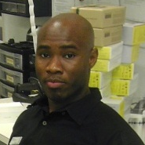

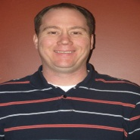
Introduction: Our Team
Nathan Lutz
- Project Manager
- Hardware Specialist
Chris Coykendall
- Web Developer
- Software Specialist
Akeem Edwards
- Financial Specialist
- Software Specialist
Brian Dunn
- Marketing Specialist
Dean Maye
- Documentation
- Software Specialist
Kevin Studevant
- Software Specialist
CJ Deaver
- Risk Analyst
Domain Expert
Kamlesh Chowdary
ITS Engineer at HRT
Domain Expert
Dr. Tamer Nadeem
Mobile Apps at ODU
Mentor
Dave Farrell
Systems Engineer at MITRE Corp.

Slide 4
Introduction: The Problem
Lack of complete information prevents transit organizations and local businesses from maximizing the potential benefits of light rail systems.

Slide 5
Background: Increased Sales
Due to increased accessibility and an influx of new customers, local businesses in light rail service areas see increased sales:
A study in Dallas showed a 33% increase in retail sales of businesses near the DART starter line.¹
Near Norfolk’s Tide light rail station on Newtown Road, a 7-Eleven owner reported a 13-14% increase in sales.²
In Salt Lake City, a restaurant owner reported annual increases of 25-30% due to their proximity to the TRAX light rail.³
In Phoenix, one business owner reported a 30% increase in revenue since the local light rails opening.⁴
However, these systems do not maximize this potential by working with local businesses and providing information to riders.
http://www.detroittransit.org/cms.php?pageid=26
http://hamptonroads.com/2012/02/some-stores-near-norfolk-light-rail-stations-see-boost
http://www.gulfcoastinstitute.org/university/LightRail_BusinessImpact.pdf
http://www.friendsoftransit.org/The-Businesses-of-Light-Rail.pdf
Notes:
The idea here is that we’ve already seen sales boosted just by the light rail existing, imagine the potential boost if we actually put effort into maximizing this.

Slide 6
Background: Jobs & Development
Over the past five years, studies have shown light rail systems as an effective stimulant for new development and jobs:
In Charlotte, over $291 million in new development was seen along their new 10-mile line with another $1.6 billion expected.¹
The Maryland Transit Administration estimated 27,000 new jobs per year over the next 30 years attributed to their new Purple Line.²
If light rail usage is maximized then the potential for further expansion can boost these numbers even further.
Dallas LRT Projected Spending vs. Impact³
Line | Spending | Impact | Jobs
Blue Line | $289 Million | $502 Million | 3,969
Orange Line | $1.18 Billion | $2.05 Billion | 16,205
Green Line | $868 Million | $1.5 Billion | 11,921
Total | $3.14 Billion | $5.65 Billion | 32,095
http://www.detroittransit.org/cms.php?pageid=26
http://washingtonexaminer.com/local/maryland/2011/11/purple-line-expected-be-major-economic-engine-md-officials-say
http://www.dart.org/about/WeinsteinClowerTODNov07.pdf
Notes:
As shown in the chart, Dallas’s expansions provided even more boosts so in places like Charlotte and Norfolk, convincing the public that expansion is worth it will boost the economy even more.

Slide 7
Background: Tide Case Study
A survey of over 1000 Norfolk residents was taken and although 90% were aware of new light rail, many lacked other information:
About 70% of downtown workers did not know the stop locations.
About 55% of other respondents did not know the stop locations.
69% of respondents ranked information about stops as an important problem.
75% of respondents ranked schedule information as an important problem.
http://www.gohrt.com/publications/reports/sir-light-rail-summary.pdf
Notes:
Our case study ties this into the Tide and shows that information is important to riders here in Norfolk.

Slide 8
Background: Tide Ridership
The Tide ridership started strong, breaking the first-year 2,900 daily rider estimate in its opening months, but has been in decline since.¹
http://www.gohrt.com/public-records/Commission-Documents/Commission-Meetings/FY2012/January-2012.pdf
Notes:
While the newspapers might be bragging about the record breaking numbers (yay PR departments), there’s still a troubling downward trend.

Slide 9


Rider Process Flow pre-Current ITS
-Visit Website
-Get Schedule Info
-Get Fare Info
-Get Stop Info
Purchase e-ticket
Buy Ticket (if not already purchased)
Go to Stop/Station
Get on Light Rail
Ride to Next Stop
If it is their stop
Disembark
Notes:
Riders have to figure out a lot on their own – and they have no way to know: where trains are, how many people are on them, any potential problems ahead, or events or attractions near their destination. Also, if problems occur during operation of the tide, riders are stuck waiting.

Slide 10
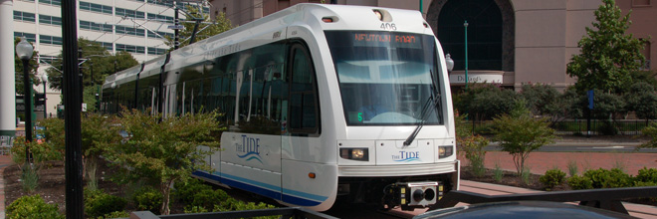
Tide Operation Process Flow pre-Current ITS
Begin Service
Go to next stop/station
Pick up / Drop off
Riders
Reach End of Service
APC
Problem Occurs
Radio Control Center for advisement
Sent to Maintenance Facility
Notes:
Currently, the tide itself is dumb – not aware of the riders around it, or on it except as a daily total. When problems occur, the riders are SOL – the tide operator will have to coordinate over hand radio to resolve the issue, with no options for rerouting of passengers

Slide 11
HRT Process Flow pre-Current ITS
Need to evaluate & expand Tide Light Rail Services
Receive user feedback about service through traditional means
Static ridership data
Set Schedule, Stops/Stations and fare for Light Rail, determine new service areas
Light Rail normal operation
Notes:
Hrt wants to make informed decisions, and they want to adapt quickly – but they cant. There is no realtime stream of data letting them know when and where trains are used the most, and no real way to account for special events that affect ridership levels. Also lack of historical data could lead to improper analysis

Slide 12
The Solution
Current Intelligent Transportation System (ITS)
Our product will provide accessible, real-time, and accurate information through transit authorities to maximize adoption and expansion of emerging light rail public transportation systems.

Slide 13
Objectives
Multiple mediums (mobile apps, station kiosks, and websites) will be used for information and communication to ensure easy access.
Provide easily accessible static information to riders regarding schedules, stop locations, and local businesses.
Provide real-time updates on train locations, seat availability, service interruptions, local events, and important announcements.
Cooperation with local businesses through targeted advertising and listing will directly contribute to local economic growth.
Direct, two-way communication with riders will allow operators to deliver important information and collect feedback from riders.
Provide transit authorities and local businesses with analysis and reports showing detailed information about riders and their habits.

Slide 14
Tide Operation Process Flow with Current ITS
Aware of:
-Trains
- Problems
- Riders
Go to next stop/station
Pick up / Drop off
Riders
Reach End of Service
Problem Occurs
GPS
APC
Begin Service
Current alerts all users including HRT
Sent to Maintenance Facility
Notes:
Now, with Current ITS, the train operators know positions of trains around them, riders waiting at stations, and potential problems ahead. They can have accurate data on occupancy down to the minute. Communication between rider and tide operator, and between tide operator and HRT becomes easy.

Slide 15
HRT Process Flow with Current ITS
Need to evaluate & expand Tide Light Rail
Receive user feedback about service through traditional means
Real-time ridership data
Real-time GPS data
Historical
Data
Event
Data
More accurately set Schedule, Stops/Stations and fare for Light Rail
Efficient Light Rail
operation

Slide 16

Rider Process Flow with Current ITS
Use Current ITS
Get on Light Rail
Go to Stop/Station
Ride to Next Stop
If it is their stop
Disembark
Notes:
Riders will know from step 1: where trains are, where stations are relative to them, how full they are, what businesses and attractions are at the endpoints, and they can buy a ticket.
There will be no issues if problems occur, because they will be advised on a the proper route to take by Current ITS

Slide 17
Trend Analysis
Our system will provide detailed information regarding light rail usage. This data can be sorted to highlight different stops, special events, and time of day trending.
While our system will not provide automatic rerouting or boost capacity in itself, it will provide operators with the necessary information to make these decisions.
For example, the Grand Illumination Parade in Norfolk generated almost 3x the amount of the normal average daily ridership but had no additional capacity made available.¹
Average Daily Boarding ²
http://www.gohrt.com/public-records/Operations-Documents/Rail/Monthly-Ridership/Rail-Ridership-Current.pdf
Debbie Messina, “The Tide.” The Virginian-Pilot. February 18th, 2012.

Slide 18
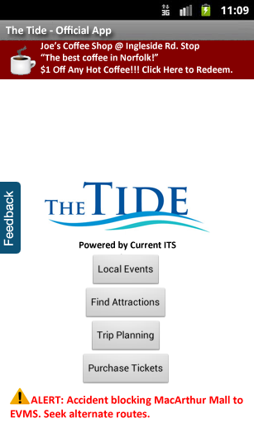
Local Businesses
Our previous data showed how much impact light rail stops can have on local businesses, but riders still lack information about them.
Through a GUI allowing users to easily find business and attractions accessible by the light rail, riders will be more likely to explore and rely on the system for recreational usage.
In addition, our business owner backend will provide opportunities for local businesses to advertise their companies through our system to further enhance exposure.

Slide 19
Our Current market?
As traffic, gas prices, and pollution rise, light rails are quickly catching on as a more efficient means of transportation.¹
As the result of Obama investing $8 Billion in stimulus funding for rail transit, even more projects are now under development and expansion.¹
New light rail development and expansion costs millions to taxpayers who demand quick results for their money.²
Light Rail Project Costs
Baltimore | Buffalo | Camden | Charlotte | Cincinnati | Denver | Detroit
$400 Million | $636 Million | $604 Million | $350 Million | $750 Million | $118 Million | $494 Million
Miami | Indianapolis | Portland | Sacramento | Salt Lake City | Minneapolis | Oakland
$340 Million | $498 Million | $214 Million | $176 Million | $300 Million | $548 Million | $320 Million
http://www.cbsnews.com/8301-503544_162-4949672-503544.html
http://www.lightrail.com/projects.htm

Slide 20
Market Outlook
Initial Target:
- The Tide (Hampton Roads Transit)
US Market:
- 35 Light Rail systems currently active and running¹
- 60 more systems in development or proposal stages²
Global Market:
- Almost 8000 miles of Light Rail track in Europe alone (some perspective: LA to NY is less than 3000 miles)³
- Light Rails are used throughout the world from South America to the Philippines
Future:
- Global Light Rail market estimated at $7.5 Billion by 2015 and is rapidly growing.³
http://apta.com/resources/statistics/Documents/Ridership/2011-q3-ridership-APTA.pdf
http://www.lightrailnow.org/success2.htm
http://www.prweb.com/releases/light_rail/light_rail_transit/prweb4253534.htm

Slide 21


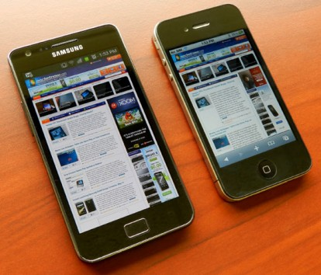
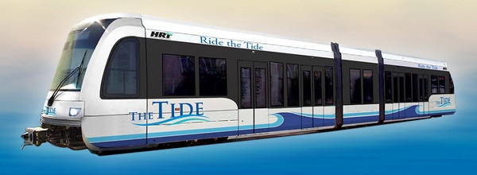
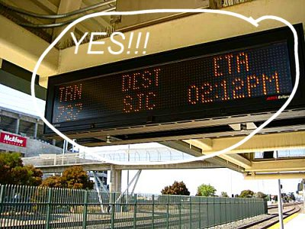
Major Function Component Diagram
Decision
Engine
Web App
Server
DB
GTFS
Onboard Unit
GPS Transponder
Infrared Counters

Slide 22
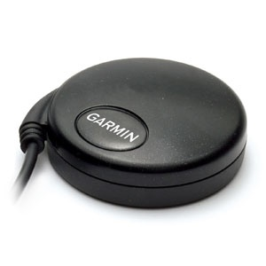
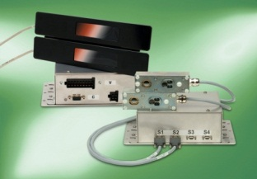
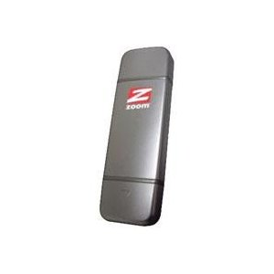
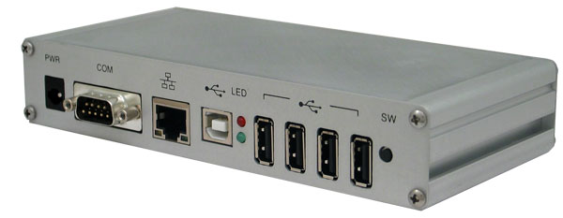
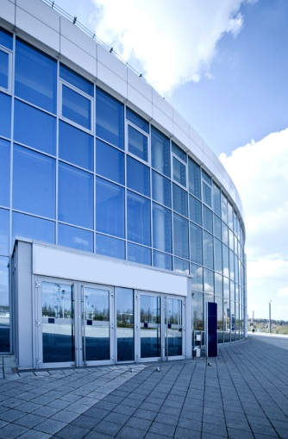

Train Hardware Option 1
GPS Antenna
Person Counter
USB to PC
Serial to PC
Onboard Computer with 3G Modem
Transit IT site
Cost: approx. $400 per train
GSM to Application Server

Slide 23
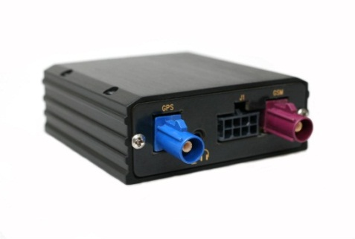
Train Hardware
Option 2
GPS Tracker
Person Counter
GSM output
Serial to PC
Onboard Computer with 3G Modem
Transit IT site
Cost: approx. $400 per train
GSM to Application Server

Slide 24
Train Hardware Costs
Option 1
Item | Cost
Onboard Computer | $170
3G Mobile Broadband Modem | $110
GPS Antenna | $85
Mounting and cabling | $50
TOTAL | $415*
Option 2
Item | Cost
Onboard Computer | $170
3G Mobile Broadband Modem | $217
GPS Tracking Device | $85
Mounting and cabling | $50
TOTAL | $522*
* Per train

Slide 25

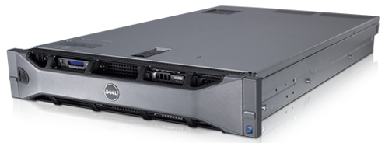
IT Department Hardware Locally hosted option
Host Server: Dell R710
Operation System: Red Hat® Enterprise Linux
Virtualization Host: Red Hat ® Enterprise Virtualization
Item | Cost
Physical Server | $8500
Virtualization software | $3000/year
Operating system software w/support* | $2000/year
Mounting and cabling | $200
TOTAL | $13700
* Unlimited Virtual Machines

Slide 26

IT Department Hardware Remotely hosted option
Database server
Large storage capacity
Redundancy & Backups
Web App Server(s)
Optimization & Decision engine
Clustered & Load Balanced w/ HA
Server | Database | Optimization | Web Apps
Virtual (Hosted by them) | $5000 License per VM | Resides with WAE (included in cost) | $3000 License per VM
Virtual (Hosted by Us) | Priced by CPU time¹ | Priced by CPU time | Priced by CPU time
Physical (Hosted by them) | Quoted at $6000 | Resides with WAE (included in cost) | Quoted at $4000 per node
1) Source: http://aws.amazon.com/ec2/pricing/

Slide 27

Station Hardware Optional
Next train is at 3:30
Transit IT site

Slide 28
Station Hardware Optional
Item | Cost
Station Computer | $170
3G Mobile Broadband Modem | $110
Weatherproof monitor | $785
Mounting and cabling | $200
TOTAL | $1265*
* Per station

Slide 29
Hardware Work Breakdown
Hardware
Development
Production Servers
Onboard Hardware

Slide 30
Hardware Work Breakdown
Hardware
Development
Production Servers
Onboard Hardware
Workstations
Dev Servers
Dev Phone

Slide 31
Hardware Work Breakdown
Hardware
Development
Production Servers
Onboard Hardware
WAE Server
DB Server

Slide 32
Hardware Work Breakdown
Hardware
Development
Production Servers
Onboard Hardware
People Counting Sensors
GPS Sensors
Embedded PC

Slide 33
Software Provided
Web Application Engine - Monitoring Report System - Capacity/Trend Forecasting - Rider Web Interface
Optimization/Prediction Server
Embedded Linux Transmission Application
Android Application

Slide 34
Software Overview
PHASE I PHASE II PHASE III PHASE IV (ASYNCHRONOUS)
Google API
GPS
Database Server
On-board Module
Wireless Sensor Network
Intranet
Optimization and Prediction Server
Web Application Engine
APC
Internet
Smart Devices
Desktop
On-Board Passenger Display
Station Display
Notes:
Here is a bird’s eye view of the overall software design phases.

Slide 35
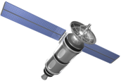
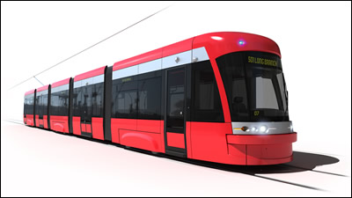
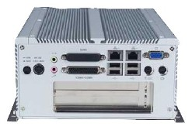
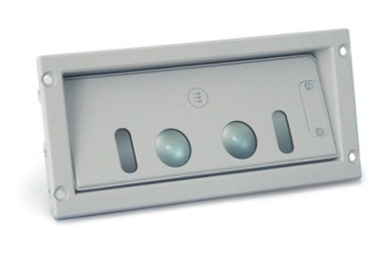
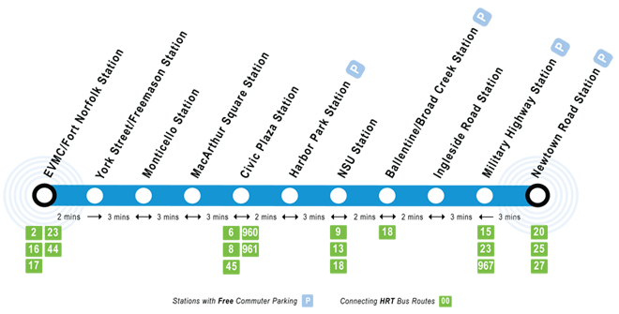
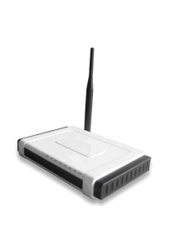
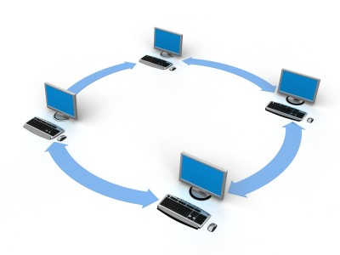
I – Embedded System
Single Board Linux Master PC with GSM communications.
GPS
Light Rail Vehicle
APC
SQL Server Database
Intranet
Wireless AP Network
Notes:
The data collected from the sensors are interpreted by the embedded Linux application, then transmitted via secure 802.11 to Wireless APs along the tracks.
The AP nodes will be connected to the transit authority local Intranet.
Monitoring information is saved into a SQL database.

Slide 36

II - Prediction
Real-time ridership and GPS coordinates of the vehicles will be retrieved from database, along with historical ridership data.
This data will be analyzed based upon various features of time, riders, waypoints and other trends.
The prediction server will generate and save a forecast to a database, as well as option routes in the event of a failure
MySQL Database Server
Decision Engine & Web Apps Server
Notes:
Calculations are performed using supervised machine learning algorithms (artificial neural network, gradient descent, etc.)
to provide optional routes and anticipate scheduling deviation. Actual data and predictions will then be made available for the next software phase.

Slide 37
Decision Engine (DE) Request Algorithms
WAE Request Received
Poll Interval Reached
SQL Database
Prediction Type?
Request new historical data
Capacity
Delay
Associate ridership/time/locations with actual reported incidents
Retrieve ridership forecast table
Retrieve delay forecast table
Generate new training sets and save to forecast tables
Apply batch gradient descent learning algorithm w/ client position vector
Reset poll clock
Return forecast result to WAE

Slide 38
Intelligent Routing Algorithm
Route Request from WAE
Establish network of nodes (train cars, stations, busses)
Associate beginning point with nearest node
SQL Database
Associate endpoint with nearest node
Assign weights to nodes
Poll db for changes
Poll DB for moving entities that intersect path
Determine fitness of path comparing weights of potential paths
Apply constraints
(schedules, capacity, alerts)
Use network to determine shortest path
Update weighted network
Advise route

Slide 39

III - Reporting
The Web Application Engine (WAE) transmits the monitoring results from the Decision Engine to the Google API using General Transit Feed Specification (GTFS).
Simultaneously, the WAE checks with the Google API to update its record of local destinations at the station waypoints from Google Places.
Internet
Decision Engine
Web Application Engine
Notes:
On scheduled intervals, the Web App Engine updates the record of local businesses and transmits the most recent information to the Internet.

Slide 40
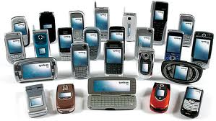
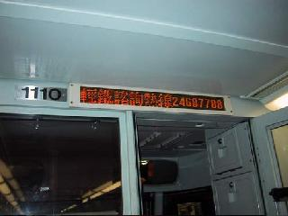
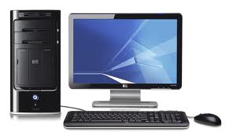
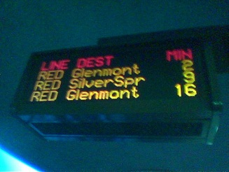
IV - Presentation
With the WAE in place and our extensible interface to it, any web-enabled device can then retrieve the monitoring and local destination results directly using a standard format (GTFS, AJAX, etc.)
The WAE will also receive rider feedback input from the end-user devices (website , Android app, etc.) Results will be written to a database for trend data and accessible via a back-end monitoring interface.
Ideally, the real-time passenger information (RTPI) will be available at every point possible to the end-user.
Internet
Web Application Engine
Notes:
Once the web server is in place, the sky is the limit.
Our customers will be able to monitor their passengers using an administration interface for displaying forecasted and real-time data.

Slide 41
Mobile App GUI Sitemap
Splash Screen
Feedback Submission Form
Main Menu & Alerts
App Settings (Menu)
Local Events
Browse Attractions
Trip Planning
Ticket Purchasing
Starred Events
Upcoming Event Calendar
Google Maps Overlay
Rail Stop List Map
Plan Trip w/ Destination
Rail Vehicle Vacancy & Delays
Google Driving Directions

Slide 42
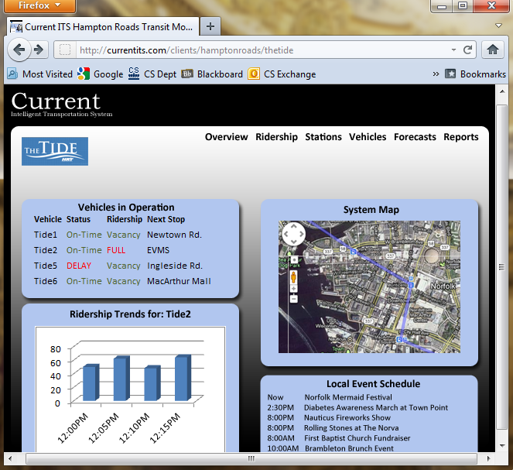
GUI Mockups

Slide 43
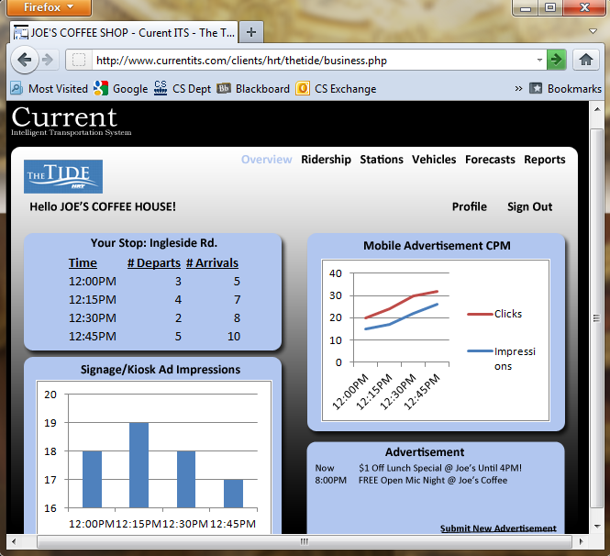
GUI Mockups

Slide 44
Software Work Breakdown
Software
Embedded Apps
Server Software
Mobile/Kiosk App

Slide 45
Software Work Breakdown
Embedded Apps
Linux Reporting Agent
Serial Interface
WAN Database I/O
GPS
Vehicle position
Ridership Data
APC
Ridership count

Slide 46
Software Work Breakdown
Software
Embedded Apps
Server Software
Mobile/Kiosk App
Database
Decision Engine
Web Application Engine

Slide 47
Software Work Breakdown
Database Server
Configure Server
Configure DBMS
Install OS
Access Control
Disk Layout
Design Schemas
Networking
Tables
Firewall
Fields
Backups
Keys
Install DBMS
Constraints

Slide 48
Database Schemas
Interface User Profile
user_id user_name Password user_permission
 |  | View Base Info | Edit Event Business Details | View Detailed System Info
1 | Admin | ✔ | ✔ | ✔
2 | HRT | ✔ | ✔ | ✔
3 | Business |  | ✔
4 | Event |  | ✔
5 | End User | ✔

Slide 49
Database Schemas
Events Info and Attractions Info
will inherit attributes from Stops
Info.
Stops Info
stop_id stop_name stop_lat stop_lon
Train Info
train_id curr_train_loc train_ontime train_capacity train_schedule
Events Info
event_id event_lat event_lon event_start event_stop event_cost event_artwork
Attractions Info
attraction_lat attraction_lon attraction_category attraction_ desc attraction_logo

Slide 50
Database Schemas
user_id
user_class
user_password
Business_ads
user_name
Classifies into
End-User
Business
Client/Mobile App
Customer_priveleges
Profile
Employee_SSN
Employee_address
End_user_prilveleges
description
Employee_first
Admin
Employee_gender
Customer
Payment_info
Preferences
Ridership
Employee_last
Employee_salary
Employee_birthdate
Controls
Max_routes
Admin_alerts
Controls
R_frequency
customer_alerts
customer_domains_and_functions
Admin_domains_and_functions
R_location
Admin_authentication
customer_authentication
customer_access
Admin_access
R_time_of_day

Slide 51
Database Schema ERD
user_id
user_password
Interface User profile
user_name
user_permissions
station_id
station_lat
Relays
event_id
station_lon
event_lat
Stations
provides
event_lon
station_name
Events Info
alerts
event_start
event_stop
Attraction_lat
train_id
Lists within radius
Attraction_lon
Surrounding Attractions
Trains
train_capacity
Attraction_category
Attraction_description
Attraction_artwork
train_ontime
train_current

Slide 52
Business ERD
user_id
user_password
Business Interface
user_name
user_phone
buys
Ad_to
Custom_design_demands
car_id
train_id
train_capacity
Ad_from
Ad
placed
consists
Ad_price
Cars
Trains
train_current
Ad_content
Next stop
train_ontime
Cc_number
Ticket_date
next
buys
Stop_next
Customer_name
Customer
Tickets
Stations
next
customer_balance
Stop_name
Stop_location

Slide 53
Software Work Breakdown
Decision Engine
Database I/O
Request Handler
Gradient Descent / Supervised Learning Algorithm
Option Route Detection
Forecast Tables
Delay Forecast
Rider Features
Shortest Path
Ridership Forecast
Historical Features
Shortest Time
Optional Routes
Location Features
GTFS Interface

Slide 54
Software Work Breakdown
Web Application
Engine
Database I/O
Web GUI
General Request Handler
Syndication Process
Rider Feedback
Administrative Interface
Capacity Check
Google Places API Checker
Schedule Delays
Retrieve Schedule
GTFS/AJAX/Etc Publication
Rail Capacity & Delay Forecast
Accept Feedback
Rider Feedback Module
Local Destinations
Ridership Counts
Retrieve Forecast
Local Event Calendar

Slide 55
Software Work Breakdown
Mobile/Kiosk Application
Local Database
GUI
Processes
GUI
Setting Shared Preferences
Schedule Delays
UI Event Handler
Rail Capacity & Delay Forecast
GPS/Triangulation Checker
Rider Feedback Module
WAE Requester (Interface)
Ridership Counts
Rider Feedback Submission
Local Places
Local Event Calendar

Slide 56
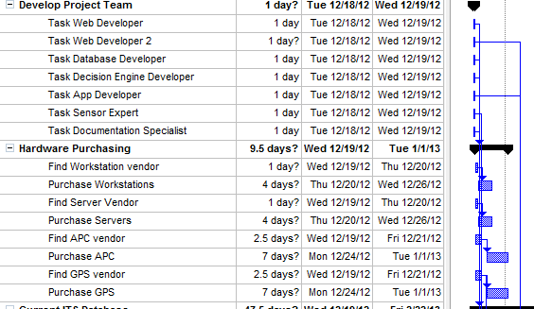
Gantt Charts

Slide 57
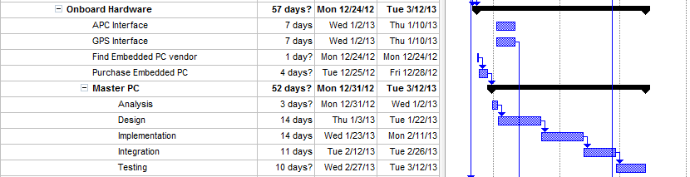
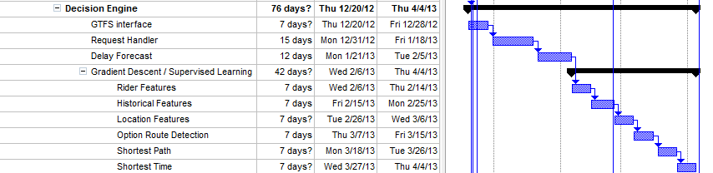
Phase 2 WBS

Slide 58
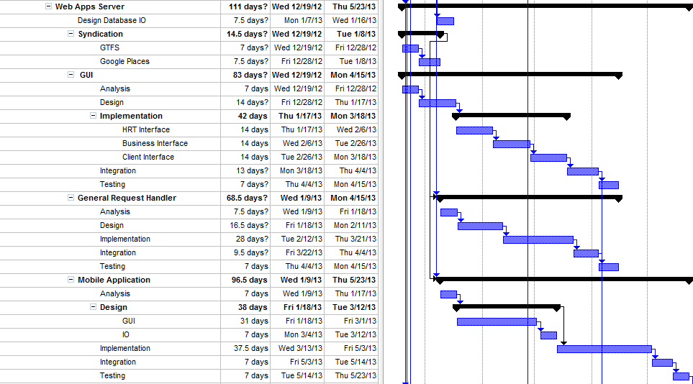
Phase 2 WBS

Slide 59
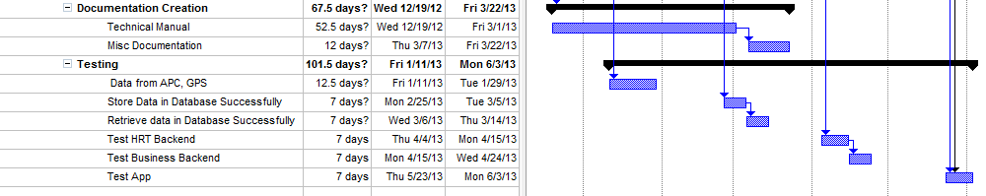
Phase 2 WBS

Slide 60
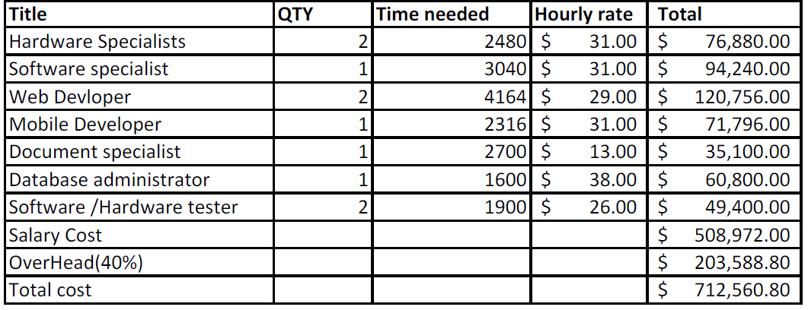
Phase 2 Staff Budget

Slide 61
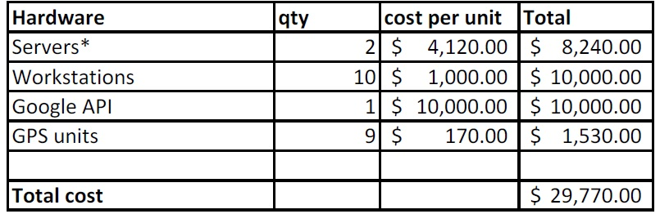
Phase 2 Resources Budget

Slide 62
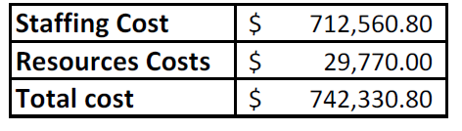
Phase 2 Total

Slide 63
In The Box
A Service to set up and maintain:
Web Application Engine
Prediction Server/ Decision Engine
Embedded Linux Transmission Application
Android Application
Real-time train tracking (GPS)
Real-time people counting (APC)
Algorithms
To Provide customized reports and forecast data
Backend to provide location based business advertisements

Slide 64
Not In The Box
Trains
Tracking System for Buses
Real-time Rerouting

Slide 65
Project Risks

Slide 66
Risk Matrix
Financial
F1: Low investment return
F2: Low development investment
F3: High implementation cost
 |  | F2
 | F1,T1,C1
S2 |  | F3
C2 | T2 | C3 | S1
Technical
T1: Data latency/accuracy
T2: Sensor availability
High
Customer
C1: Lack of transit authority interest
C2: Low rider acceptance
C3: No local business buy-in
Impact
Low
Schedule
S1: Safety adjustments
S2: Sensor availability
Low
High
Probability

Slide 67
Financial Risks
Low return on investment 2/4
Risk: Income from service changes and improved ridership not enough to provide an investment return.
Risk Strategy: Provide advertising capability within web/phone application to local businesses providing an additional income source.
Low development investment 3/5
Risk: Transportation authorities have little to no budgeting for development.
Risk Strategy: Assist in locating and applying for transportation grants.
High implementation cost 3/3
Risk: Implementing a full system has high initial costs. ~$800,000
Risk Strategy: Implement system in smaller increments to defer costs.

Slide 68
Technical Risks
Data latency/accuracy 2/4
Risk: Data provided to the end user has exceeded time of use.
Risk Strategy: Determine acceptable latency periods and provide user warning if data is time deficient.
Risk: Data is incorrect or not updating.
Risk Strategy: Provide system diagnostic capability to run during maintenance periods
Sensor availability 2/2
Risk: Sensors are out-of-stock or otherwise unavailable.
Risk Strategy: Purchase from multiple vendors if necessary and acquire additional units for repair stock.

Slide 69
Customer Risks
Lack of interest by transit authorities 2/4
Risk: Transit authorities feel current systems are efficient
Risk Strategy: Spur interest by providing granular riding data to aid in faster service changes to maximize efficiency and predict growth.
Low rider acceptance 1/2
Risk: Riders and prospective are averse to utilizing products.
Risk Strategy: Develop application to operate on multiple platforms to address customer preference range.
No local business buy-in 3/2
Risk: Local businesses choose to not support with advertising dollars.
Risk Strategy: Provide local businesses with adequate resources to update and inform prospective customers to drive up business.

Slide 70
Schedule Risks
Testing and recalibration of safety systems 4/2
Risk: Changes from application may require retesting of traffic light timing or other safety systems.
Risk Strategy: Conduct testing during non-service nighttime hours or during periods of low traffic.
Hardware delivery delays from vendors 1/3
Risk: External vendors do not deliver orders on time.
Risk Strategy: Utilize multiple vendors when possible. Accept risk for single vendor products.

Slide 71
Conclusion
Through the same mediums used for tracking information, light rail systems will now be able to communicate with the end-users directly. This will allow announcements of service interruptions, promotions, and special events.
Through our interface, users will also be able to share current information about their destinations and needs.
All of this historical data regarding ridership and timing will allow light rail systems to effectively analyze customer needs and adapt to them.
Using this information, light rail systems will realize increased revenues and the ability to engineer future expansion.

Slide 72
Questions?

Slide 73
References
http://www.gohrt.com/publications/reports/sir-light-rail-summary.pdf
http://www.gohrt.com/public-records/Commission-Documents/Commission-Meetings/FY2012/January-2012.pdf
http://hamptonroads.com/2011/11/poll-public-board-expanding-lightrail-route
http://www.metro-magazine.com/News/Story/2011/08/INIT-employees-to-serve-as-Tide-Guides-.aspx
http://hamptonroads.com/2011/07/control-room-nsu-serves-brains-light-rail
http://www.serpefirm.com/responsibilities-the-tide-light-rail-controller-operator.aspx
http://www.gohrt.com/public-records/Operations-Documents/Rail/Monthly-Ridership/Rail-Ridership-Current.pdf
http://www.metro-magazine.com/News/Story/2011/08/Va-s-The-Tide-opens-hits-30K-boardings.aspx
http://www.cbsnews.com/8301-503544_162-4949672-503544.html
http://www.lightrail.com/projects.htm
http://www.realtor.org/wps/wcm/connect/212699004205f031b404fcc7ba2f3d20/cpa_transport_090.pdf
http://hamptonroads.com/2012/02/some-stores-near-norfolk-light-rail-stations-see-boost
Debbie Messina, “The Tide.” The Virginian-Pilot. February 18th, 2012.
http://apta.com/resources/statistics/Documents/Ridership/2011-q3-ridership-APTA.pdf
http://www.lightrailnow.org/success2.htm
http://www.prweb.com/releases/light_rail/light_rail_transit/prweb4253534.htm
http://www.itscosts.its.dot.gov/its/benecost.nsf/images/Reports/$File/Ben_Cost_Less_Depl_2011%20Update.pdf
http://www.detroittransit.org/cms.php?pageid=26
http://www.dart.org/about/economicimpact.asp
http://reason.org/news/show/126773.html
http://mobility.tamu.edu/files/2011/09/congestion-cost.pdf
http://www.vtpi.org/railben.pdf

Slide 74
Background: Property Value
Both directly through increased accessibility and indirectly through area development, property values increase from light rail systems:
In Dallas, residential properties increased by an average of 39% while commercial properties increased by 53% over similar properties not located near the rail.¹
A study in Portland showed an increase of over 10% for homes within 500 meters of the MAX Eastside line.²
In Denver, the poor economy led to an average market decline of 7.5%, but homes near the light-rail stations still saw an increase of almost 4%.³
This proves that even during tough economic times, maximizing the value of light rail systems is important.
http://www.dart.org/about/economicimpact.asp
http://www.rtd-fastracks.com/media/uploads/nm/impacts_of_rail_transif_on_property_values.pdf
http://www.denverpost.com/news/ci_10850014
Notes:
This slide just ties in the fact that despite bad economies making people want to cut back on spending, light rail technology can overcome downward trends.

Slide 75
Background: Traffic & Parking
Studies estimate that a $12.5 Billion rail system subsidy returns $19.4 Billion just through reduced congestion and another $12.1 Billion in parking.¹
Local: By 2030, Virginia will need an estimated 989 new lane-miles to accommodate growing traffic which will cost $3.1 Billion.²
National: Congestion and traffic cause over $115 Billion in lost productivity and wasted fuel in the US each year.³
How? Even a reduction as small as 5% in traffic volume will reduce delays by 20% or more during peak hours.¹
In order to maximize these benefits, end-users must trust the transit systems’ reliability as an alternative to driving.
http://www.vtpi.org/railben.pdf
http://reason.org/news/show/126773.html
http://mobility.tamu.edu/files/2011/09/congestion-cost.pdf
Notes:
This slide explains that using the light rail system as an alternative to driving has huge benefits, but this can only be achieved if people have enough information/reliability from the light rail to choose it over traditional means.

Slide 76
End-User Problems
The Tide riders lack access to real-time information, which is a cost-effective measure that can reduce perceived wait times by an average of 10%.¹
No real-time or direct alerts and updates regarding service status and service interruptions.²
With no information regarding local businesses and attractions at the stops, riders have no incentive to use the light rail to new areas.
http://www.sciencedirect.com/science/article/pii/S0965856406001431
http://www.gohrt.com
Notes:
Issues that riders see in today’s implementation of the Tide.

Slide 77
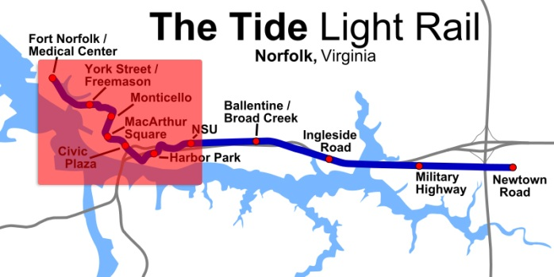
Operating Problems
The Tide tracks the number of riders entering the train, but no detailed information.¹
Operators have no form of real-time alerts or status updates.²
Dispatchers have no way of tracking train positions on the downtown portion of the rail system, so must rely on radios.³
http://www.metro-magazine.com/News/Story/2011/08/INIT-employees-to-serve-as-Tide-Guides-.aspx
http://hamptonroads.com/2011/07/control-room-nsu-serves-brains-light-rail
http://www.serpefirm.com/responsibilities-the-tide-light-rail-controller-operator.aspx
Notes:
Specific issues with the Tide and its operation that can be fixed.

Slide 78
Multiple Mediums
Our system will be fully accessible from three different mediums: mobile applications, station kiosks, and a website. This will ensure that users can access it easily from virtually any location.
All three systems will use the same underlying system and authentication process, providing appropriate tools based on the user level (rider, business owner, operator).
The key to the interfaces will be providing a way for HRT and local businesses to provide riders with the necessary data to fully utilize the light rail system.
In addition to providing static information, use of these mediums will provide riders with real-time tracking, allow operators to issue service updates, and give business owners a new way of delivering targeted advertising.

Slide 79
The Problem: Revisited
These studies show the benefits, but return on investment can be further boosted in 3 key areas:
Information: Everything from details about local businesses to train schedules during major events is vital.
Communication: Two-way, real-time communication is essential in every aspect of improving light rail systems towards further expansion.
Overall Satisfaction: Providing an easy to use system for local businesses, riders, and operators will promote maximal adoption of the light rail system.
Notes:
3 keys: information, communication, satisfaction – these are the generic categories current light rail systems are lacking.

Slide 80
Phase 2 WBS – addendum

Slide 81
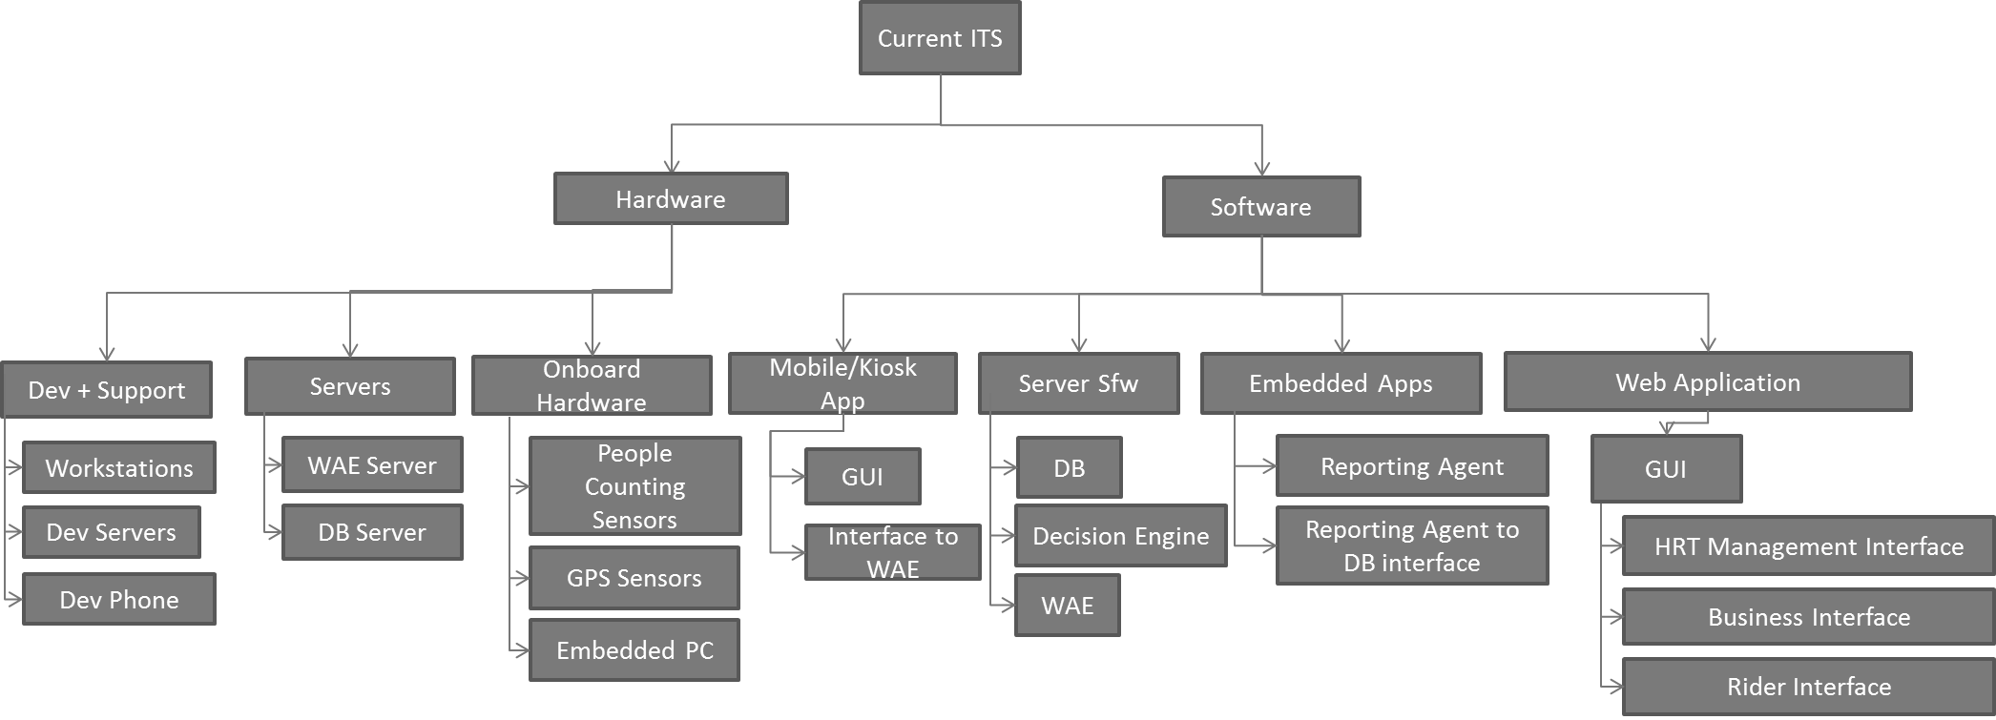
Overall WBS

Slide 82
Web Apps Server
WAE Server
Configure Server
Configure Webserver
Decision Engine
Install OS
Access Control
Interface to DB
Disk Layout
Interface to DB
Interface to Decision Engine
Networking
Interface to Decision Engine
Firewall
Install Webserver
Develop Decision Engine

Slide 83
Onboard Hardware
Onboard Hardware
GPS Sensors
Automatic People Counters
Master PC
Quote from multiple vendors
Quote from multiple vendors
Quote from multiple vendors
Interface to Master PC
Interface to Master PC
Configure Device
OS Install
Networking
Reporting Agent
Interface to GPS
Interface to APC
Interface to DB

