Slide 1
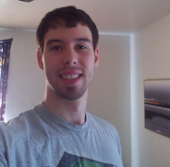
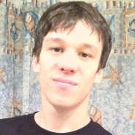
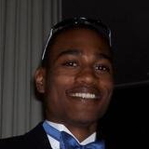
Team Organization
Nathan Lutz
- Project Manager
- Hardware Specialist
Chris Coykendall
- Web Developer
- Software Specialist
Akeem Edwards
- Financial Specialist
- Software Specialist
Brian Dunn
- Marketing Specialist
Dean Maye
- Documentation
- Software Specialist
Kevin Studevant
- Software Specialist
CJ Deaver
- Risk Analyst
Domain Expert
Kamlesh Chowdary
ITS Engineer at HRT
Domain Expert
Dr. Tamer Nadeem
Mobile Apps at ODU
Mentor
Dave Farrell
Systems Engineer at MITRE Corp.

Slide 2
Communication Methods
Direct Emails
Weekly In-person Meetings
Weekly Skype Meetings
Discussion Board

