Slide 1
Current – Intelligent Transportation System
Where do you need to go?

Slide 2
Outline
3 Team Introduction
4 Problem Statement
5-12 Background Research
13 Process Flows (Pre Solution)
14 Solution
15 Process Flows (Post Solution)
14 Prototype MFCD
17 - 19 Project Risks
22 References
23 – 36 Appendix A – Prototype
36 - 40 Appendix B – Background Research

Slide 3







Introduction: Our Team
Nathan Lutz
- Project Manager
- Hardware Specialist
Chris Coykendall
- Web Developer
- Software Specialist
Akeem Edwards
- Financial Specialist
- Software Specialist
Brian Dunn
Marketing Specialist
Web Developer
Dean Maye
- Documentation
- Database Admin
Kevin Studevant (Inactive)
- Database Admin
CJ Deaver
Risk Analyst
Hardware Specialist
Domain Expert
Kamlesh Chowdary
ITS Engineer at HRT
Domain Expert
Dave Dodson
COO at INIT Innovations in Transportation
Domain Expert
Dr. Tamer Nadeem
Mobile Apps at ODU
Mentor
Dave Farrell
Systems Engineer at MITRE Corp.

Slide 4
Introduction: The Problem
Lack of complete information prevents transit organizations and local businesses from maximizing the potential benefits of light rail systems.

Slide 5
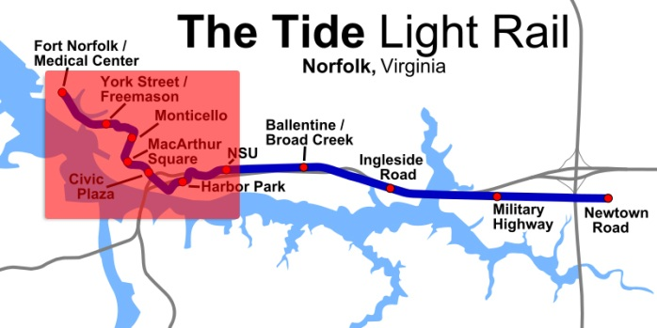
Operating Problems
The Tide tracks the number of riders entering the train, but no detailed information.¹
Operators have no form of real-time alerts or status updates.²
Dispatchers have no way of tracking train positions on the downtown portion of the rail system, so must rely on radios.³
http://www.metro-magazine.com/News/Story/2011/08/INIT-employees-to-serve-as-Tide-Guides-.aspx
http://hamptonroads.com/2011/07/control-room-nsu-serves-brains-light-rail
http://www.serpefirm.com/responsibilities-the-tide-light-rail-controller-operator.aspx
Notes:
Specific issues with the Tide and its operation that can be fixed.

Slide 6
End-User Problems
The Tide riders lack access to real-time information, which is a cost-effective measure that can reduce perceived wait times by an average of 10%.¹
No real-time or direct alerts and updates regarding service status and service interruptions.²
With no information regarding local businesses and attractions at the stops, riders have no incentive to use the light rail to new areas.
http://www.sciencedirect.com/science/article/pii/S0965856406001431
http://www.gohrt.com
Notes:
Issues that riders see in today’s implementation of the Tide.

Slide 7
Background: Tide Case Study
A survey of over 1000 Norfolk residents was taken and although 90% were aware of new light rail, many lacked other information:
About 70% of downtown workers did not know the stop locations.
About 55% of other respondents did not know the stop locations.
69% of respondents ranked information about stops as an important problem.
75% of respondents ranked schedule information as an important problem.
http://www.gohrt.com/publications/reports/sir-light-rail-summary.pdf
Notes:
Breakdown showing that users really do want more information about The Tide.

Slide 8
Background: Tide Ridership
The Tide ridership started strong, breaking the first-year 2,900 daily rider estimate in its opening months, but has been in decline since.¹
http://www.gohrt.com/public-records/Commission-Documents/Commission-Meetings/FY2012/January-2012.pdf
Notes:
While the newspapers might be bragging about the record breaking numbers (yay PR departments), there’s still a troubling downward trend.

Slide 9
Background: Increased Sales
Due to increased accessibility and an influx of new customers, local businesses in light rail service areas see increased sales:
A study in Dallas showed a 33% increase in retail sales of businesses near the DART starter line.¹
Near Norfolk’s Tide light rail station on Newtown Road, a 7-Eleven owner reported a 13-14% increase in sales.²
In Salt Lake City, a restaurant owner reported annual increases of 25-30% due to their proximity to the TRAX light rail.³
In Phoenix, one business owner reported a 30% increase in revenue since the local light rails opening.⁴
However, these systems do not maximize this potential by working with local businesses and providing information to riders.
http://www.detroittransit.org/cms.php?pageid=26
http://hamptonroads.com/2012/02/some-stores-near-norfolk-light-rail-stations-see-boost
http://www.gulfcoastinstitute.org/university/LightRail_BusinessImpact.pdf
http://www.friendsoftransit.org/The-Businesses-of-Light-Rail.pdf
Notes:
The idea here is that we’ve already seen sales boosted just by the light rail existing, imagine the potential boost if we actually put effort into maximizing this.

Slide 10
Background: Jobs & Development
Over the past five years, studies have shown light rail systems as an effective stimulant for new development and jobs:
In Charlotte, over $291 million in new development was seen along their new 10-mile line with another $1.6 billion expected.¹
The Maryland Transit Administration estimated 27,000 new jobs per year over the next 30 years attributed to their new Purple Line.²
If light rail usage is maximized, then the potential for further expansion can boost these numbers even further.
Dallas LRT Projected Spending vs. Impact³
Line | Spending | Impact | Jobs
Blue Line | $289 Million | $502 Million | 3,969
Orange Line | $1.18 Billion | $2.05 Billion | 16,205
Green Line | $868 Million | $1.5 Billion | 11,921
Total | $3.14 Billion | $5.65 Billion | 32,095
http://www.detroittransit.org/cms.php?pageid=26
http://washingtonexaminer.com/local/maryland/2011/11/purple-line-expected-be-major-economic-engine-md-officials-say
http://www.dart.org/about/WeinsteinClowerTODNov07.pdf
Notes:
As shown in the chart, Dallas’s expansions provided even more boosts so in places like Charlotte and Norfolk, convincing the public that expansion is worth it will boost the economy even more.

Slide 11

Process Flow pre-Current ITS
Static ridership data
Need to evaluate & expand Tide light rail services
Set schedule, stops/stations and fare for light rail, and determine new service areas
Light rail normal operation
Receive user feedback about service through traditional means
-Visit website
-Get schedule information
-Get fare info
-Get stop info
-Purchase e-ticket
Ride to next stop
Go to stop/station
Need to go somewhere
Embark
Disembark
Tide Rider
Want to attract Light Rail customers
Traditional
advertising
media (print, radio, TV)
Inefficient marketing
No big returns on tax payer investment in light rail
Local Business Owners
Notes:
There are serious barriers to communication between these three entities. Without Current, they can only talk to each other indirectly.

Slide 12
The Solution
Current Intelligent Transportation System (ITS)
Current will provide accessible, real-time, and accurate information to transit authorities for maximizing adoption and expansion of emerging light rail public transportation systems.

Slide 13
Process Flow with Current ITS
Historical data & event data
Need to evaluate & expand Tide light rail services
Quickly & accurately set schedule, stops/stations and fare for light rail
Real-time ridership + GPS data
Efficient light rail operation
Send alerts & receive user feedback about service through Current ITS
Current ITS provides all info needed by rider
Ride to next stop
Need to go somewhere
Go to stop/station
Tide Rider
Embark
Disembark
Advertising with
Current ITS
Realize returns on tax payer investment in light rail
Want to attract light rail customers
Effectively target market
Local Business Owners
Notes:
With Current ITS, information flows freely between HRT, riders and business owners.

Slide 14


Prototype Major Functional Component Diagram
CS Dept Virtual Machine
Decision Engine
Web App
Engine
DB
Test Harness
Simulated GPS Data
Simulated APC Data

Slide 15
Risk Matrix
 | T1,C1
C2 |  | C3
Technical
T1: Data latency/accuracy
T2: Sensor availability
High
Customer
C1: Lack of transit authority interest
C2: Low rider acceptance
C3: No local business buy-in
Impact
Low
Low
High
Probability

Slide 16
Technical Risks
T1:Data latency/accuracy 2/4
Risk: Data provided to the end user has exceeded time of use.
Risk Strategy: Determine acceptable latency periods and provide user warning if data is time deficient.
Risk: Data is incorrect or not updating.
Risk Strategy: Provide system diagnostic capability to run during maintenance periods

Slide 17
Customer Risks
C1: Lack of interest by transit authorities 2/4
Risk: Transit authorities feel current systems are efficient
Risk Strategy: Spur interest by providing granular riding data to aid in faster service changes to maximize efficiency and predict growth.
C2: Low rider acceptance 1/2
Risk: Riders and prospective are averse to utilizing products.
Risk Strategy: Develop application to operate on multiple platforms to address customer preference range.
C3: No local business buy-in 3/2
Risk: Local businesses choose to not support with advertising dollars.
Risk Strategy: Provide local businesses with adequate resources to update and inform prospective customers to drive up business.

Slide 18
Risks Mitigated by the Prototype
T1:Data latency/accuracy 2/4
Prototype test driver shows accuracy of software through simulation
C1: Lack of interest by transit authorities 2/4
Granular reporting and announcements provide tools for improving service
C3: No local business buy-in 3/2
Provides a new advertisement mechanism.

Slide 19
Questions?

Slide 20
References
http://www.gohrt.com/publications/reports/sir-light-rail-summary.pdf
http://www.gohrt.com/public-records/Commission-Documents/Commission-Meetings/FY2012/January-2012.pdf
http://hamptonroads.com/2011/11/poll-public-board-expanding-lightrail-route
http://www.metro-magazine.com/News/Story/2011/08/INIT-employees-to-serve-as-Tide-Guides-.aspx
http://hamptonroads.com/2011/07/control-room-nsu-serves-brains-light-rail
http://www.serpefirm.com/responsibilities-the-tide-light-rail-controller-operator.aspx
http://www.gohrt.com/public-records/Operations-Documents/Rail/Monthly-Ridership/Rail-Ridership-Current.pdf
http://www.metro-magazine.com/News/Story/2011/08/Va-s-The-Tide-opens-hits-30K-boardings.aspx
http://www.cbsnews.com/8301-503544_162-4949672-503544.html
http://www.lightrail.com/projects.htm
http://www.realtor.org/wps/wcm/connect/212699004205f031b404fcc7ba2f3d20/cpa_transport_090.pdf
http://hamptonroads.com/2012/02/some-stores-near-norfolk-light-rail-stations-see-boost
Debbie Messina, “The Tide.” The Virginian-Pilot. February 18th, 2012.
http://apta.com/resources/statistics/Documents/Ridership/2011-q3-ridership-APTA.pdf
http://www.lightrailnow.org/success2.htm
http://www.prweb.com/releases/light_rail/light_rail_transit/prweb4253534.htm
http://www.itscosts.its.dot.gov/its/benecost.nsf/images/Reports/$File/Ben_Cost_Less_Depl_2011%20Update.pdf
http://www.detroittransit.org/cms.php?pageid=26
http://www.dart.org/about/economicimpact.asp
http://reason.org/news/show/126773.html
http://mobility.tamu.edu/files/2011/09/congestion-cost.pdf
http://www.vtpi.org/railben.pdf

Slide 21
Appendix A
Prototype

Slide 22
DE – Ridership & Trending
Return ridership for Stop
Return Estimated Ridership + Past Event variance
yes
Is past?
yes
Past Event?
yes
no
no
Get ridership at stop during past 15 weeks on same DOW and time
Average Ridership
Future Event?
Return Estimated Ridership
no
Return Estimated Ridership

Slide 23
DE – Ontime Performance
Get any schedule info from input time
For input train
Calculate arrival variance
Calculate departure variance
Return variance

Slide 24
DE - ETA
Apply Delay
Return ETA
yes
Get speed, position of train
Get position of stop
Calculate distance
Calculate traveltime
Alerts?
yes
no
Train Active?
Return ETA
no
Return train not active

Slide 25




System Overview Legend
Station – No Alerts
Station – Alerts Present
Train – No Problems
Train – On-Board Failure

Slide 26
Ridership Report
Maximum Train Capacity is 68 riders.
Rider and Business Reports see 3 levels:
- High: 59-68 Riders
- Medium: 27-58 Riders
- Low: 0-26 Riders
Custom Report interval is based on the total time
of the request spread out over 30 rows.

Slide 27
Train Data Report
Split into two tables since arrivals and departures
Occur at separate times.
No Departures/Arrivals indicate that the selected
train did not travel to any stops during that time.
Actual Reports: On Time, x minutes early, x minutes late
Custom Report interval is based on the total time
of the request spread out over 30 rows.

Slide 28
Account Management
Account Type | Edit Self Info | Edit Other User | Change Password | Change User Type
Business User | X |  | X
Transit Authority User | X |  | X
Admin | X | X | X | X

Slide 29
Test Harness Overview

Slide 30
Test Harness Train Simulation
Simulates Trains Traversing a track.
Based on real GPS values captured while on the train
Only 3 trains in the prototype
Each Train will stop at a station between 16 – 26 seconds
Test harness has the ability to:
Activate/deactivate trains
Derail trains
Simulate GPS sensor failure

Slide 31
Test Harness Funtionality
Work: A train’s work is to travel to designated stops picking up and dropping off passengers.
Blocks: A block is an allotment of work performed by a train in active status.
Schedule: A schedule is the set of anticipated arrival times of a train to the stops within a block.
Occupancy: Occupancy is the set of recorded passenger counts, embarks and lightings for a train.

Slide 32
Test Harness Rider Generation
Simulates riders data at each stop
Based on a random number generator
Randomly Generates number of embarks and disembarks.

Slide 33
Database
Database contains tables with data critical to the functionality of the CurrentITS prototype.

Slide 34
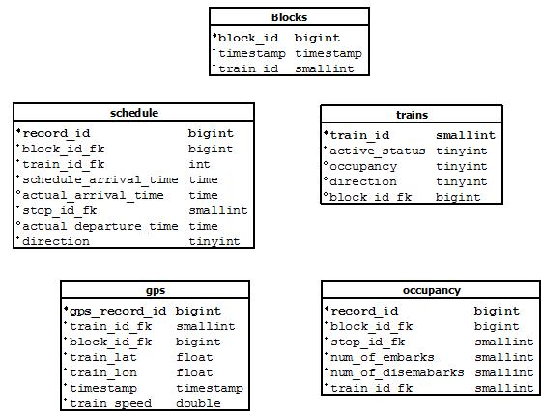
Blocks Table Schema

Slide 35
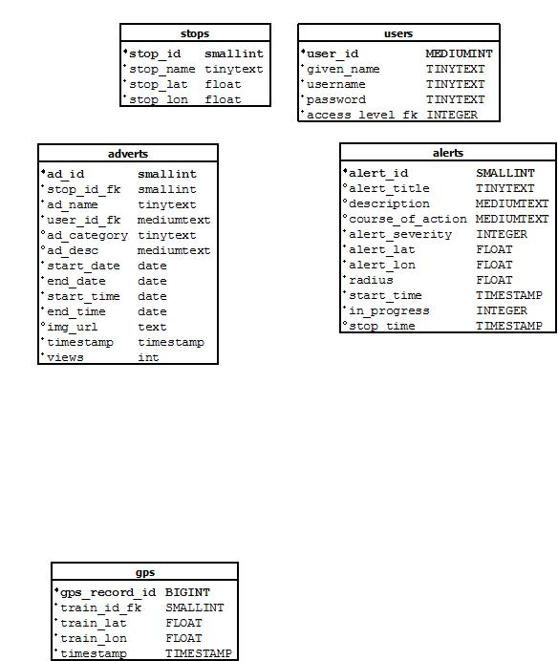
Stops Table Schema

Slide 36
Appendix B
Background Research

Slide 37
Background: Property Value
Both directly through increased accessibility and indirectly through area development, property values increase from light rail systems:
In Dallas, residential properties increased by an average of 39% while commercial properties increased by 53% over similar properties not located near the rail.¹
A study in Portland showed an increase of over 10% for homes within 500 meters of the MAX Eastside line.²
In Denver, the poor economy led to an average market decline of 7.5%, but homes near the light-rail stations still saw an increase of almost 4%.³
This proves that even during tough economic times, maximizing the value of light rail systems is important.
http://www.dart.org/about/economicimpact.asp
http://www.rtd-fastracks.com/media/uploads/nm/impacts_of_rail_transif_on_property_values.pdf
http://www.denverpost.com/news/ci_10850014
Notes:
This slide just ties in the fact that despite bad economies making people want to cut back on spending, light rail technology can overcome downward trends.

Slide 38
Background: Traffic & Parking
Studies estimate that a $12.5 Billion rail system subsidy returns $19.4 Billion just through reduced congestion and another $12.1 Billion in parking.¹
Local: By 2030, Virginia will need an estimated 989 new lane-miles to accommodate growing traffic which will cost $3.1 Billion.²
National: Congestion and traffic cause over $115 Billion in lost productivity and wasted fuel in the US each year.³
How? Even a reduction as small as 5% in traffic volume will reduce delays by 20% or more during peak hours.¹
In order to maximize these benefits, end-users must trust the transit systems’ reliability as an alternative to driving.
http://www.vtpi.org/railben.pdf
http://reason.org/news/show/126773.html
http://mobility.tamu.edu/files/2011/09/congestion-cost.pdf
Notes:
This slide explains that using the light rail system as an alternative to driving has huge benefits, but this can only be achieved if people have enough information/reliability from the light rail to choose it over traditional means.

Slide 39
End-User Problems
The Tide riders lack access to real-time information, which is a cost-effective measure that can reduce perceived wait times by an average of 10%.¹
No real-time or direct alerts and updates regarding service status and service interruptions.²
With no information regarding local businesses and attractions at the stops, riders have no incentive to use the light rail to new areas.
http://www.sciencedirect.com/science/article/pii/S0965856406001431
http://www.gohrt.com
Notes:
Issues that riders see in today’s implementation of the Tide.

Slide 40
The Problem: Revisited
These studies show the benefits, but return on investment can be further boosted in 3 key areas:
Information: Everything from details about local businesses to train schedules during major events is vital.
Communication: Two-way, real-time communication is essential in every aspect of improving light rail systems towards further expansion.
Overall Satisfaction: Providing an easy to use system for local businesses, riders, and operators will promote maximal adoption of the light rail system.
Notes:
3 keys: information, communication, satisfaction – these are the generic categories current light rail systems are lacking.

