Slide 1

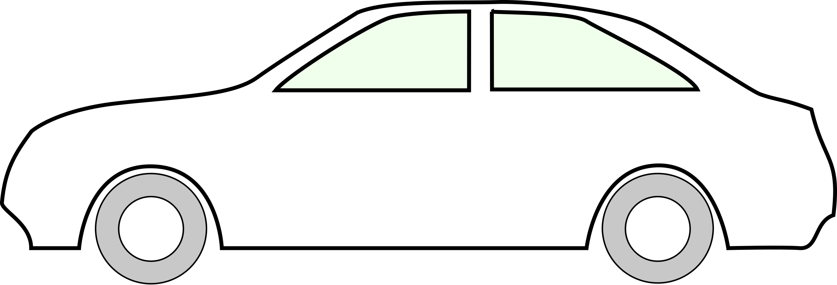
starting_time
starting_position
measured_time
distance_travelled

