Slide 1
Kuja
An AI-Powered Grant Management System
Built for the Global South
MARKET ANALYSIS
v5.0 · May 2026
INTERNAL · FOR TEAM AND PARTNERS

Slide 2
Where We Started — The Original Vision
Kuja launched as a two-product play backed by a back-office service, with an aggressive sell-to-NGOs-and-donors GTM.
KujaLink
Kuja ERP
Back-Office Services
The Marketplace
Built on Odoo 17
Managed Service Layer
• Two-sided NGO ↔ donor discovery platform
• Capacity profiles, opportunity matching
• Originally framed as the demand-side wedge
• Full back-office stack: HR · Finance · Ops · Procurement
• Customised for NGOs with grant-aware budgeting
• Intended as the recurring-revenue engine
• Consultancy for NGOs without internal capacity
• HR, finance, operations run by Adeso team
• Wraparound for orgs adopting Kuja ERP
ORIGINAL GTM
Sell aggressively to NGOs AND donors · monetise marketplace, ERP licences, and managed services in parallel.
STATUS TODAY
KujaLink shipped and is live in production. The ERP build is still in development after four years — over USD 3M invested. Back-office services remain a small, bespoke engagement.
Kuja · AI-Powered Grant Management for the Global South
Market Analysis · v5.0 · May 2026

Slide 3
Investment to Date — Where the USD 3M+ Went
Four years of spend on Kuja ERP, concentrated in consultants and staff.
USD 4.23M
total invested in Kuja ERP, 2022 – Mar 2026
BY YEAR (USD)
BY COST DRIVER (USD)
2022
$334K
Consultants & Pro Services
$1.91M
Staff Salaries & Benefits
$1.71M
2023
$1.38M
Indirect Cost Allocations
$472K
2024
$1.17M
Programmatic Delivery
$62K
2025
$1.17M
Travel & Accommodation
$57K
2026 YTD
$166K
Ops & Admin Support
$24K
≈85% of spend went to consultants and staff. The product has yet to reach commercial release.
Kuja · AI-Powered Grant Management for the Global South
Market Analysis · v5.0 · May 2026

Slide 4
Market Reality — Why Selling ERP to NGOs Is Hard
A saturated market of nonprofit accounting tools, sold at deep discount, with high switching costs.
THE CROWDED MARKET
WHY NGOs WON'T SWITCH
THE PRICING SQUEEZE
NGOs already have many strong, NGO-tuned options:
Even when a better option exists, the math rarely works:
Incumbents have neutralised price as a wedge:
• QuickBooks Online Class tracking + fund accounting; free/discounted via TechSoup
• Aplos Built for nonprofits; ~USD 60–190/mo
• Sage Intacct for NPOs High-end, dimension-based fund accounting
• Blackbaud Financial Edge NXT Long-standing nonprofit ERP standard
• MIP Fund Accounting Community Brands; strong in mid-size INGOs
• NetSuite for Nonprofits Oracle SuiteSuccess SKU
• Xero · Zoho Books · Wave · Odoo Community Low-cost / free SMB tier
• Already on something Migration cost ≫ marginal feature gain
• Indirect-cost caps Donors cap overheads at 7–15%; software competes with salaries
• Donor reporting Funders demand familiar exports — Blackbaud, Sage, QB
• Country-by-country complexity Local tax, payroll, statutory reporting — hard to centralise
• Capacity to operate Many lack the finance team to run any ERP at all
• TechSoup discounts 60–90% off list for QB, Sage, Microsoft, Blackbaud
• Google for Nonprofits Free workspace + Workspace Marketplace add-ons
• Microsoft for Nonprofits Free / steeply discounted M365 + Dynamics 365 grants
• Free tier ERPs Odoo Community, ERPNext — same engine, USD 0 licence
• Bundled finance services Big-4 / regional consultancies bundle their own stacks
Takeaway: even an NGO-customised ERP is a feature competing in a commoditised category against deeply discounted, donor-trusted incumbents.
Kuja · AI-Powered Grant Management for the Global South
Market Analysis · v5.0 · May 2026

Slide 5
The Strategic Pivot
Keep the grant platform as the wedge. Re-channel the ERP to a buyer who can actually fund it.
THEN — Original Strategy
NOW — Refocused Strategy
• Two products in parallel KujaLink + Kuja ERP, both sold direct
• Buyer = NGOs and donors Both products pushed to both sides
• ERP as recurring revenue Bet on NGOs paying licences
• Back-office service alongside Bundled where needed
• Lead with grant management Kuja Grant Platform = the wedge product
• Two-sided market NGOs (capacity + visibility) + donors (oversight + AI)
• ERP repositioned Sold to donors / INGOs as a service THEY fund for grantees
• Services + ERP bundled for donors Capacity-building line item in grants
TWO DISTINCT GO-TO-MARKET MOTIONS
Kuja Grant Platform (SaaS)
Kuja ERP-as-a-Service (Donor-funded)
• Sold to NGOs + donors directly
• Subscription + per-grant pricing
• Network effects: more donors → more NGOs → more donors
• Already shipped and live in production
• Sold to donors / INGOs, not to NGO buyers
• Donor sponsors ERP + back-office service for selected grantees
• Funded from existing capacity-building grant line items
• Aligns Odoo 17 customisation with who values grant budgeting most
Why this works: donors have budget for grantee capacity-building. NGOs don't have budget for ERP licences. Match the product to the wallet.
Kuja · AI-Powered Grant Management for the Global South
Market Analysis · v5.0 · May 2026

Slide 6
The Problem We Address
Grant funding for Global South non-profits is structurally inefficient.
FOR NGOs
FOR DONORS
FOR REVIEWERS
• Capacity assessment fatigue — answer the same 80–120 questions across CHS, UN-HACT, NUPAS, STEP, and donor-specific variants
• Application overhead with no help to know if their answer is strong
• Compliance evidence scattered across email, drives, and binders
• Reporting templates that vary by donor with no guidance on what each donor cares about
• Decision opacity — most applications rejected with little or no feedback
• Language exclusion — donor portals are English-only
• Sourcing is slow and intuition-driven — finding strong NGOs requires personal networks
• Capacity signal is non-standard — every donor maintains their own framework
• Application quality variance comes from language proficiency, not programme quality
• Compliance is reactive — sanctions, registry, document validation happen at the last minute
• Reports do not roll up — aggregating outcomes requires manual extraction
• No early-warning signal when grants drift off track
• Each application takes hours to read carefully
• Rationales drift — reviewers anchor on each other, not the rubric
• Patterns across the portfolio are invisible
• No standardised way to cite specific evidence per criterion
• Suspect quality cannot be flagged with confidence
Kuja · AI-Powered Grant Management for the Global South
Market Analysis · v5.0 · May 2026

Slide 7
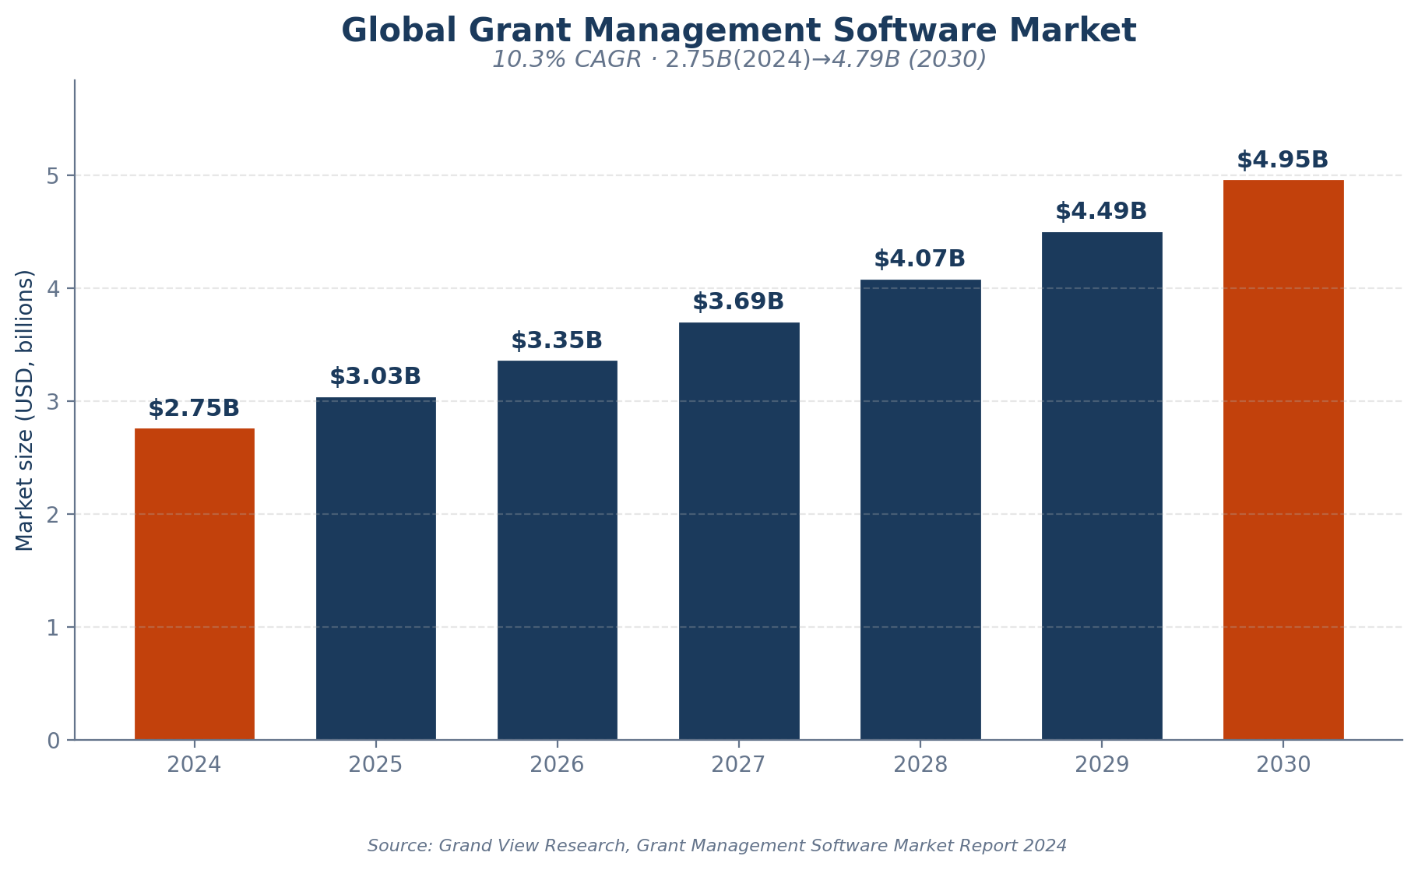
Market Opportunity
$2.75B today · $4.79B by 2030 · 10.3% CAGR
Why it matters now
• Sector disruption. USAID dissolution in 2025 with 83% of programmes cancelled has created urgent demand for diversified funding infrastructure.
• AI inflection. 92% of nonprofits use AI in some capacity, but 76% lack formal AI strategy — there is a window for an AI-native platform.
• Cloud shift. 65% of new grant management deployments are cloud-based.
• Localisation pressure. Grand Bargain 2.0 targets 25% direct local funding; actual <5%.
Kuja · AI-Powered Grant Management for the Global South
Market Analysis · v5.0 · May 2026

Slide 8
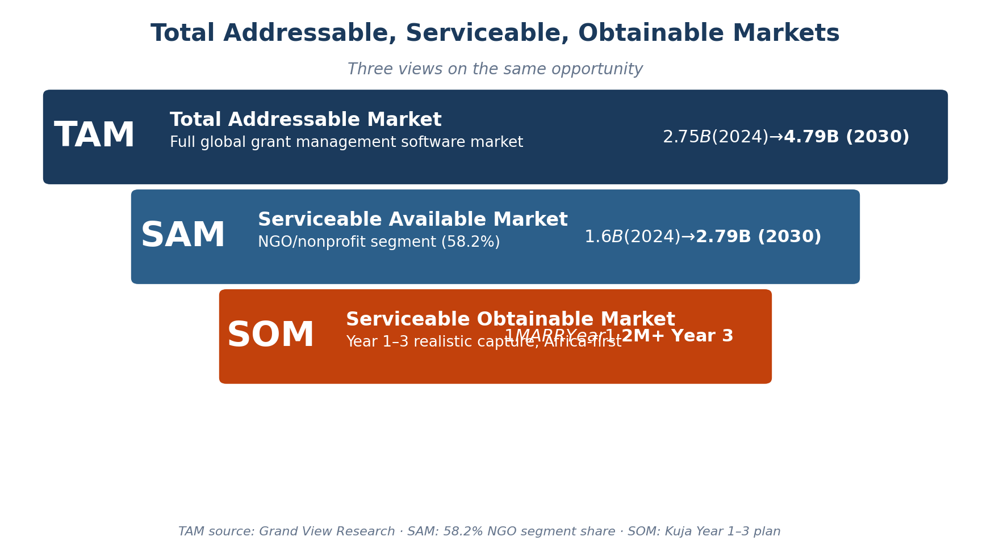
Total / Serviceable / Obtainable Market
Three views on the same opportunity
Kuja · AI-Powered Grant Management for the Global South
Market Analysis · v5.0 · May 2026

Slide 9
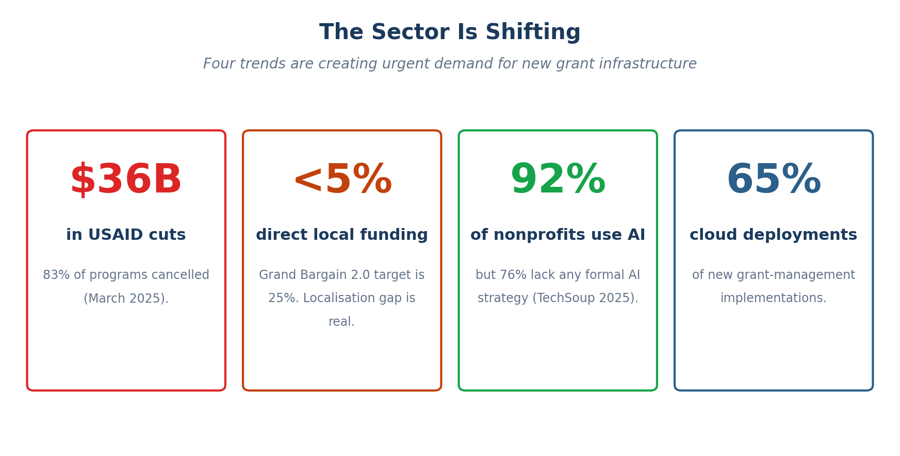
The Sector Is Shifting
Four trends are creating urgent demand for new grant infrastructure
Kuja · AI-Powered Grant Management for the Global South
Market Analysis · v5.0 · May 2026

Slide 10
What Kuja Is
An end-to-end platform anchored on three category-defining commitments.
TWO-PILLAR TRUST PROFILE
EMBEDDED AI INTELLIGENCE
COMPLIANCE FOR BOTH SIDES
Every NGO presents a Capacity Profile ("can they execute?") and a Due Diligence Profile ("are they safe to fund?"). Both pillars passport across applications.
Twenty-one AI surfaces woven into every workflow. Action-oriented, grounded in user data, traceable to sources, editable end to end.
Simplifies compliance and risk for the entire relationship — NGOs are supported through every obligation; donors get pre-assessed reports + portfolio health.
• Five capacity frameworks built in
• Custom donor framework builder
• Sanctions / AML / CTF
• Registration & standing
• Beneficial ownership + COI
• Adverse media monitoring
• Application & report drafting
• Real-time document scoring
• Pre-submission readiness
• Reviewer one-screen summary
• Compliance pre-empt + pre-flight
• Portfolio insights
• AI compliance calendar
• Proactive reminders
• AI report drafting
• 4-pillar health score
• Trajectory + slips forecast
• Risk register with owners
Kuja · AI-Powered Grant Management for the Global South
Market Analysis · v5.0 · May 2026

Slide 11
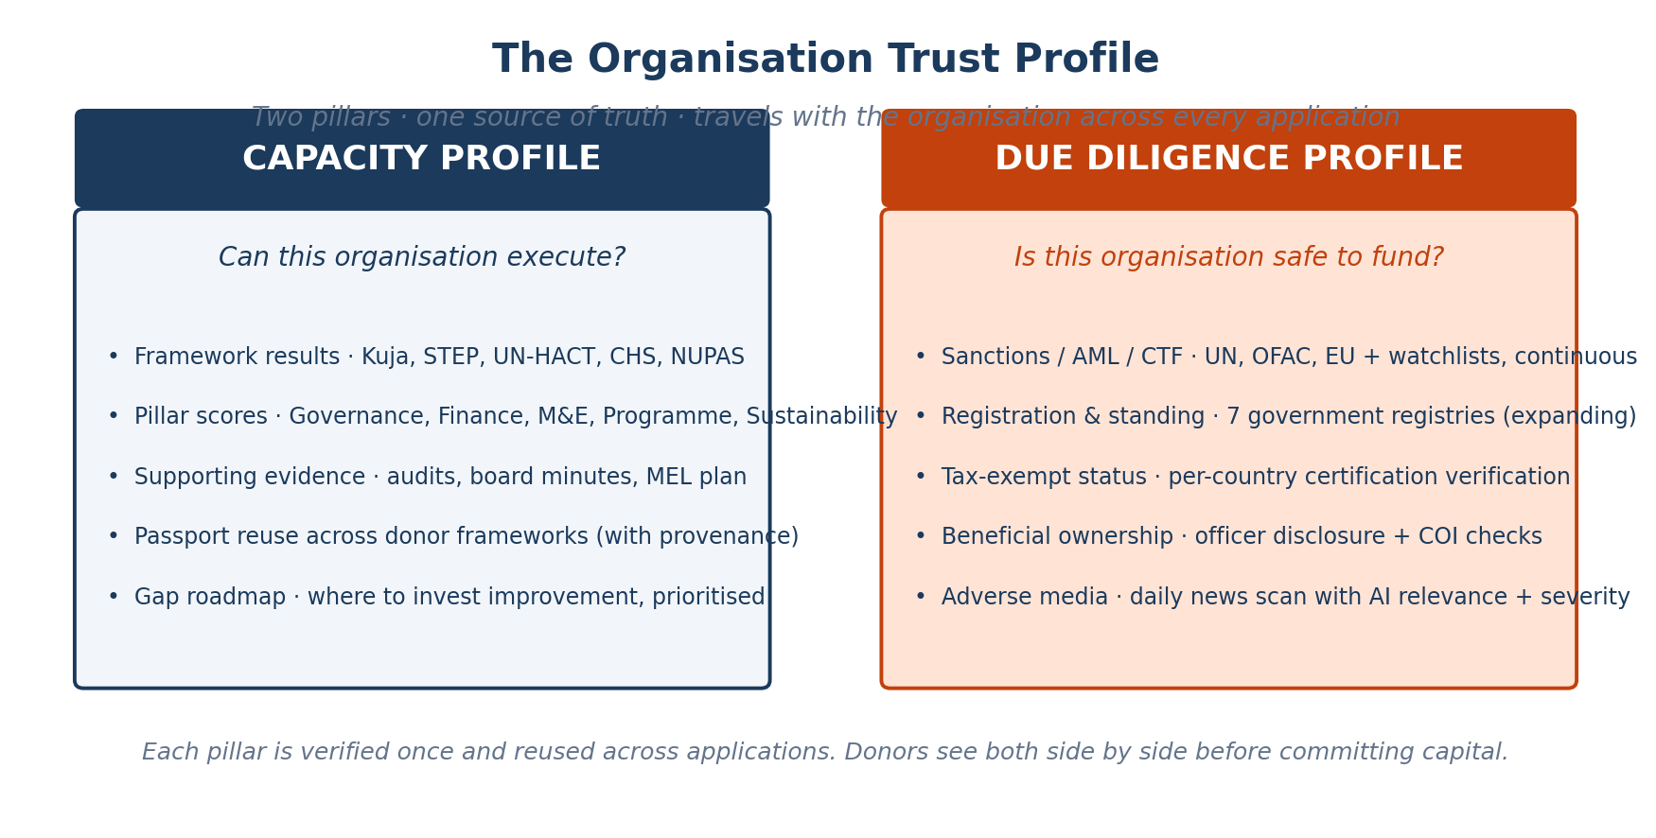
The Organisation Trust Profile
Two pillars · one source of truth · travels with the organisation
Kuja · AI-Powered Grant Management for the Global South
Market Analysis · v5.0 · May 2026

Slide 12
Capacity Passporting
Do the assessment once. Carry it forward to every donor's framework.
STEP 3 — Prefilled across any donor framework
STEP 2
STEP 1
UN-HACT
Capacity Passport
NGO completes the Kuja Capacity Framework once · stored on the org profile
STEP
Framework-neutral facts · AI maps across target frameworks · provenance traced to source
CHS
NUPAS
Donor custom
Effort reduction per subsequent application
12 hours of duplicated work → under 1 hour of review and refinement
Kuja · AI-Powered Grant Management for the Global South
Market Analysis · v5.0 · May 2026

Slide 13
Due Diligence Beyond Sanctions
Four sub-pillars · passported across applications · auditable end to end
Sanctions, AML & CTF
Registration & Standing
UN · OFAC · EU + watchlists + CTF designations.
7 government registries today · expanding to all jurisdictions with public portals.
Continuous re-screening on schedule, on change, and on every new application. Coverage includes declared beneficial owners and named officers.
Legal name, status, number verified against organisation-claimed values. Tax-exempt certification verified per country.
Beneficial Ownership
Adverse Media
Officer disclosure + ownership-chain transparency.
Daily news scan with AI-classified relevance and severity.
Conflict-of-interest checks against donor staff directories surface conflicts before award. Historical preservation for retrospective audit.
Auto-raised risk register entries above configured thresholds. Plain-language context summary with source link and suggested next steps.
Kuja · AI-Powered Grant Management for the Global South
Market Analysis · v5.0 · May 2026

Slide 14
Embedded AI Intelligence
21 AI-driven surfaces woven into every workflow — grounded, traceable, action-oriented.
NGO
DONOR
REVIEWER
Match scoring
Grant brief from 2-line prompt
One-screen summary
Application co-author
Grant import from PDF/DOCX/TXT
Evidence extraction
Real-time document scoring
Median-NGO preview
Comparable signal
Submission readiness
Burden critique
Decision-changers
Compliance pre-empt
Portfolio insights
Per-criterion rationale
Report co-author
Cross-grant patterns
Red-flag detection
Donor-perspective pre-flight
Compliance explanation
Suggest-criteria
Compliance to-do list
Health narrative
Audit-ready record
Kuja · AI-Powered Grant Management for the Global South
Market Analysis · v5.0 · May 2026

Slide 15
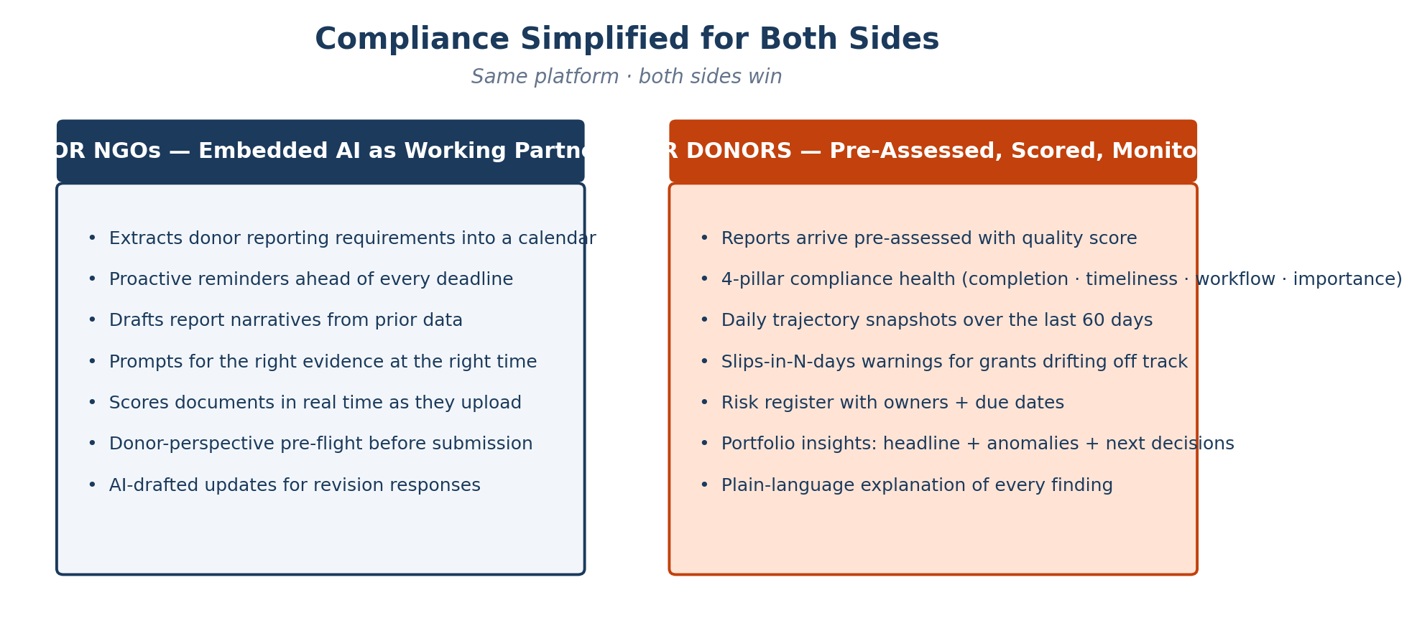
Compliance — Simplified for Both Sides
The platform's flagship: NGOs are supported, donors are confident.
Kuja · AI-Powered Grant Management for the Global South
Market Analysis · v5.0 · May 2026

Slide 16
Mobile-First, Offline-First
The operating reality of Global South CSOs — not an afterthought.
WHY IT MATTERS
Progressive Web App
Offline-first
Installable on phone home screen · same login as desktop
Draft applications, complete assessments, write reports without a network
The primary device for most Global South NGO staff is a phone. Connectivity is intermittent. Bandwidth is limited. The platform treats this as a first-class scenario rather than a degraded mode.
Continuous auto-save
Background sync
Every keystroke saved to local device storage
Queued uploads transmit automatically on reconnection
Field officers draft, capture evidence, and complete reports without a connection — the system syncs in the background when the network returns.
Camera as evidence
Low-bandwidth optimised
Photographs of consent forms, beneficiaries, before/after — vision-based extraction
Heavy AI work runs async; core flows work on slow 3G
Kuja · AI-Powered Grant Management for the Global South
Market Analysis · v5.0 · May 2026

Slide 17
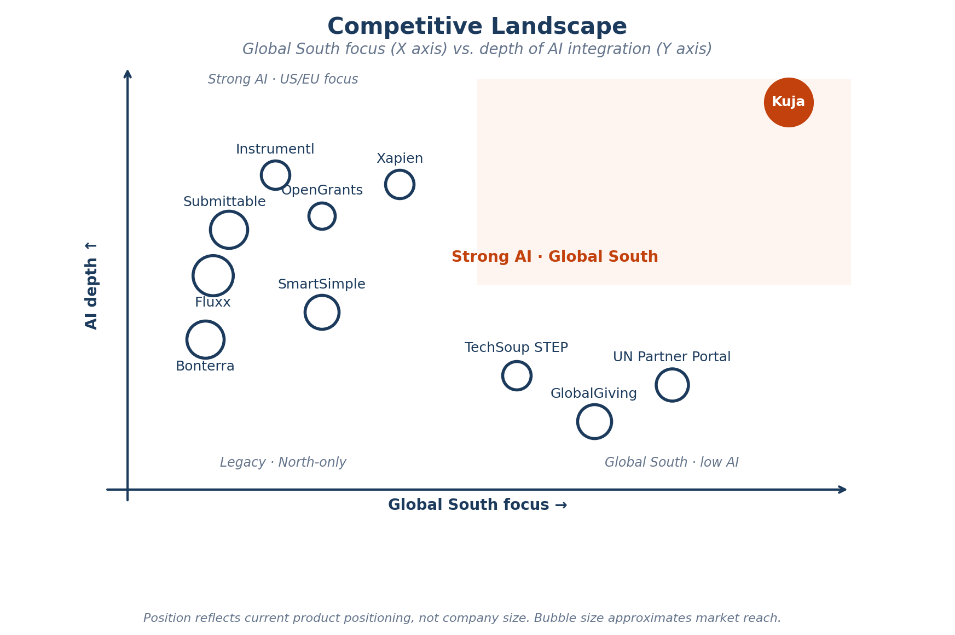
Competitive Landscape
No competitor combines Global South focus with deep AI integration.
Kuja · AI-Powered Grant Management for the Global South
Market Analysis · v5.0 · May 2026

Slide 18
Most Competitors Are Donor-Centric
The NGO is the structurally underserved side of the market.
DONOR-CENTRIC GRANT MANAGEMENT
NGO-DISCOVERY ONLY
TWO-SIDED / SPECIALIST
Optimised for the funder's workflow. NGOs see a submission portal — not a working partner.
Tools that help NGOs find grants — but stop there. No application, review, reporting, or compliance.
Rare. None combine marketplace, trust profile, embedded AI, and compliance support.
• Fluxx
Enterprise; deep donor lifecycle
• Instrumentl
450K+ funders, 31K+ RFPs
• GlobalGiving
Marketplace, 175 countries — no GM
• Submittable
Proven scale (25M apps)
• OpenGrants
AI matching + writer marketplace
• UN Partner Portal
UN ↔ CSO only, no AI
• SmartSimple
Configurable, 45+ languages
• GrantHub
Affordable pipeline tracker
• TechSoup STEP
Assessment only, no GM
• Foundant GLM
Donor-friendly, user-friendly
• Xapien
Due diligence specialist, no GM
• Benevity
Corporate CSR, $14B+ donations
• Bonterra
Grantmaker product launched Feb 2026
KUJA — THE ONLY DUAL-SIDED PLATFORM WITH NGO-FIRST AI
Marketplace · Two-pillar Organisation Trust Profile · Embedded AI Intelligence working partner for NGOs AND donors · Compliance simplified for both sides · Mobile + offline · ERP. No competitor combines these — most never tried to serve the NGO at all.
Kuja · AI-Powered Grant Management for the Global South
Market Analysis · v5.0 · May 2026

Slide 19
Core Feature Matrix
Y = fully supported · P = partial · — = not available. Kuja column highlighted.
Feature | Kuja | Fluxx | Submit- table | Smart- Simple | Bonterra | UN Partner Portal | Global- Giving | Instrumentl
Embedded AI Intelligence (action-oriented) | Y | P | P | P | P | — | — | P
Two-Pillar Organisation Trust Profile | Y | — | — | — | — | — | — | —
Capacity Passporting (one assessment, many frameworks) | Y | — | — | — | — | P | — | —
Custom Donor Framework Builder | Y | P | P | Y | P | — | — | —
AI Application Co-Author with Provenance | Y | — | — | — | — | — | — | —
Real-Time Document Scoring on Upload | Y | P | P | P | P | — | — | —
Pre-Submission Readiness + Compliance Pre-Empt | Y | — | — | — | — | — | — | —
Reviewer One-Screen Summary + Evidence Extraction | Y | — | — | — | — | — | — | —
Sanctions / AML / CTF Screening | Y | — | — | — | — | — | — | —
Govt. Registry & Standing Verification | Y | — | — | — | — | — | — | —
Beneficial Ownership + Adverse Media | Y | — | — | — | — | — | — | —
AI Compliance Calendar + Reminders | Y | — | — | P | — | — | — | —
AI Report Drafting + Donor Pre-Flight | Y | — | — | — | — | — | — | —
4-Pillar Health + Slips Forecast | Y | — | — | — | — | — | — | —
Two-Sided Marketplace + Match Scoring | Y | — | — | — | — | P | Y | Y
Mobile-First PWA + Offline-First | Y | — | — | — | — | P | Y | Y
Six-Language UI with Role-Aware Tone | Y | P | — | Y | — | Y | P | —
Audit Chain + 2FA + GDPR-Erasure | Y | Y | Y | Y | P | Y | — | —
Kuja delivers every feature fully. Closest competitor (Fluxx / SmartSimple) covers fewer than half — and none on the differentiators specific to Global South NGOs.

Slide 20
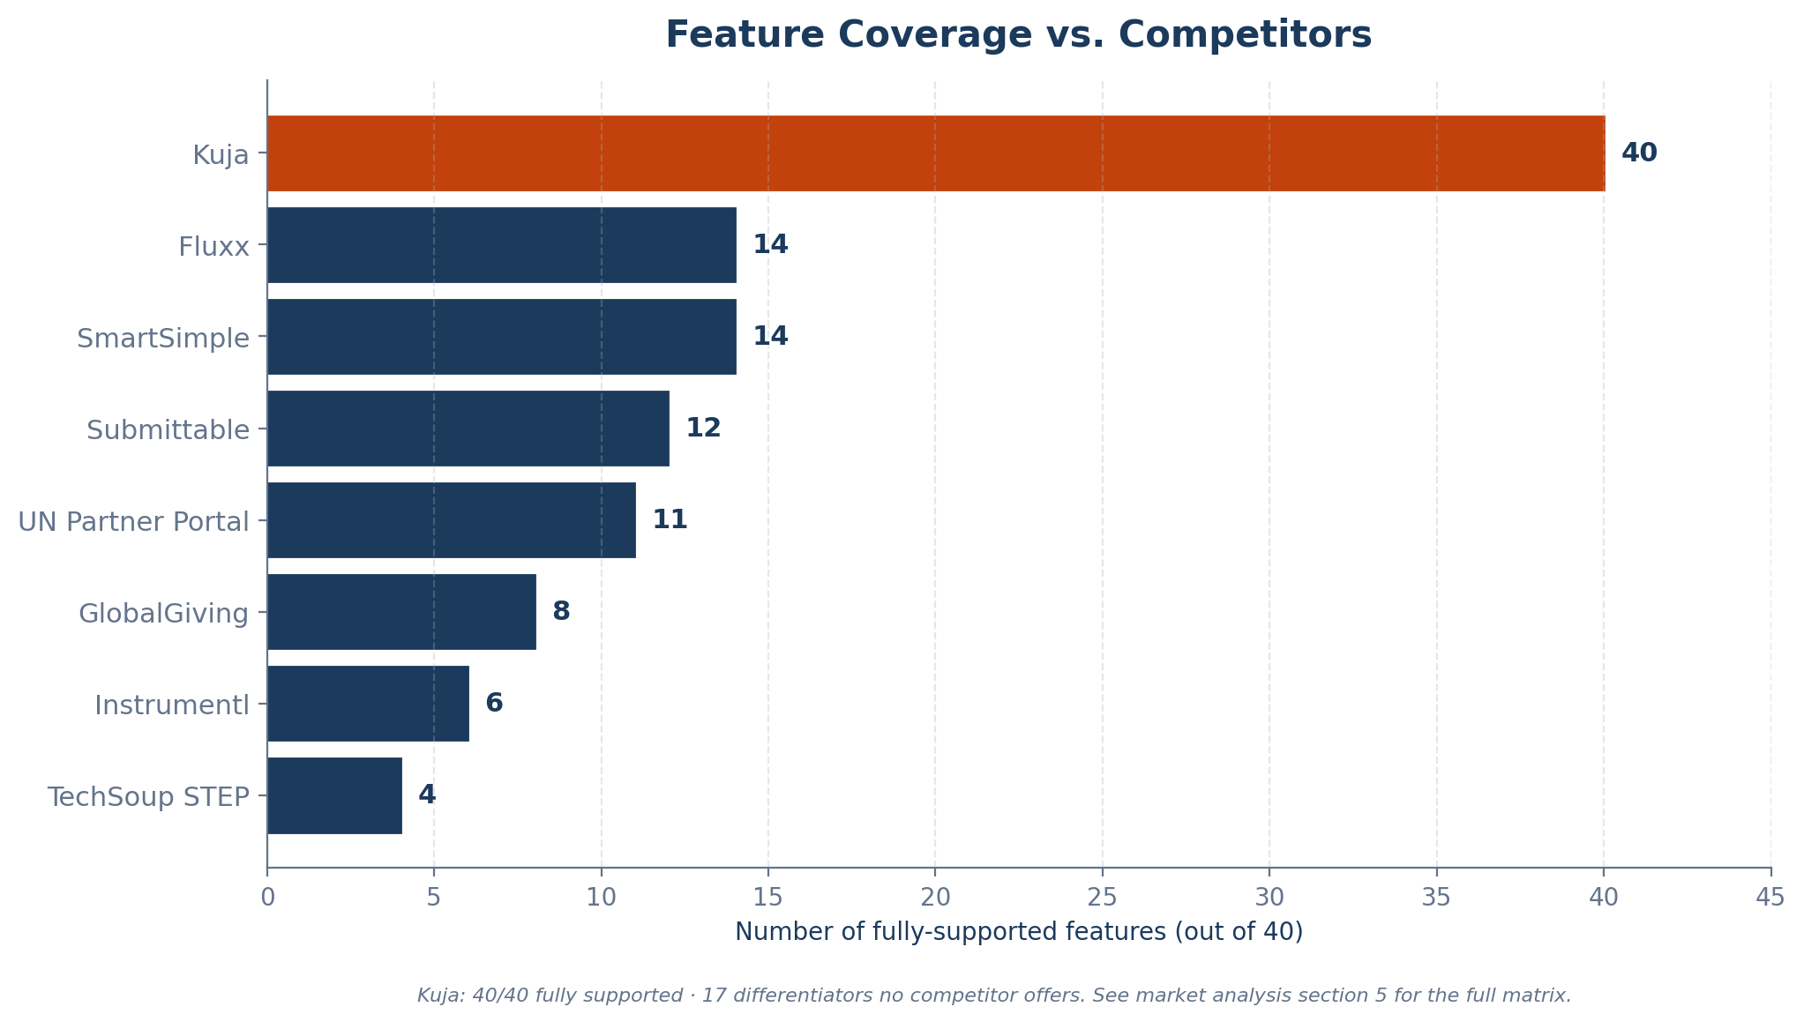
Feature Coverage vs. Competitors
40/40 fully supported · 17 differentiators no competitor offers.
Kuja · AI-Powered Grant Management for the Global South
Market Analysis · v5.0 · May 2026

Slide 21
Competitive Advantages — Category-Defining
Three commitments no competitor matches.
1
Embedded AI Intelligence, Not a Chatbot
AI is woven through every workflow as a working partner. Grounded in user data, traceable to sources, action-oriented (an editable starting point), and falls back gracefully when the AI service is unavailable. Competitors offering AI today provide chatbots or analytics dashboards — not a working AI partner.
2
Two-Pillar Organisation Trust Profile
Every NGO presents Capacity + Due Diligence side by side, both passported across applications. No competitor offers both pillars together. No competitor offers passporting on the due-diligence side.
3
Compliance Simplified for Both Sides
NGOs get an AI compliance working partner (extract obligations → calendar → reminders → drafting → scoring → pre-flight → revision guidance). Donors get pre-assessed scored reports, 4-pillar health, trajectory forecasting, slips-in-N-days warnings, and a risk register. The donor is never surprised; the NGO is never blocked.
Kuja · AI-Powered Grant Management for the Global South
Market Analysis · v5.0 · May 2026

Slide 22
Competitive Advantages — Structural
Seven additional structural strengths.
4
Only End-to-End Platform
5
Mobile-First, Offline-First
6
Built By and For the Global South
7
Dual-Sided Network Effects
Marketplace, trust profile, AI applications, dual-scoring review, AI-supported reporting + health, ERP — single platform.
Progressive web app · auto-save · background sync · vision-based evidence extraction.
Six languages at parity with role-aware tone · Adeso's 30+ years of humanitarian experience.
CSOs gain visibility, AI working partner, calendar of obligations. Donors gain vetted pipeline + portfolio health.
8
Auditable by Construction
9
Seamless ERP Conversion
10
Credibility of Adeso
Provenance on every AI claim · tamper-evident hash-chained audit log · donor override transparency.
KujaBuild (Odoo 17) onboards seamlessly because most data is already captured in earlier stages.
Somali-founded · NEAR Network co-founder · three decades of African humanitarian impact.
Kuja · AI-Powered Grant Management for the Global South
Market Analysis · v5.0 · May 2026

Slide 23
Target Market Segments
Five segments · phased geographic expansion · dual-sided model.
African CSOs / NGOs
100,000+ registered
Free marketplace tier + paid assessment + ERP option
Global South CSOs (LatAm, Asia)
500,000+
Phase 2–3 geographic expansion
Bilateral / multilateral donors
50+ major institutions
Premium end-to-end solution
Private foundations
200,000+ globally
Application portal + matching
INGOs seeking local partners
1,000+
Marketplace + assessment integration
Kuja · AI-Powered Grant Management for the Global South
Market Analysis · v5.0 · May 2026

Slide 24
What Just Shipped — May 2026 Launch Wave
Phase 24-31 · 153 smoke tests · 100+ browser specs · 0 prod regressions.
CONVERSATION
REVIEWER OPS
DONOR INTEL
METRICS + TRUST
• Sustained AI chat (Phase 24B)
• Per-entity chat on grant/app/report (25B, 26A)
• Anti-hallucination discipline footer
• Reset + per-user thread isolation
• Auto-assign on submit (Phase 25A)
• Nightly safety-net cron (Phase 26B)
• Side-by-side reviewer scoring (23A)
• Panel calibration cards (21A)
• Cohort analytics — your NGOs vs cohort (24C)
• Risk heatmap by sector × country (23B)
• Admin path on /donors/[id] (25C)
• Sparse-honest below MIN_COHORT
• UserEvent backbone + 6 funnels (29-30)
• NPS micro-survey at submit (31)
• WebAuthn biometric re-auth (26C)
• Per-language parity breakdowns
Ship → measure → decide → ship next. Real-user data drives the next round of investment.
Kuja · AI-Powered Grant Management for the Global South
Market Analysis · v5.0 · May 2026

Slide 25
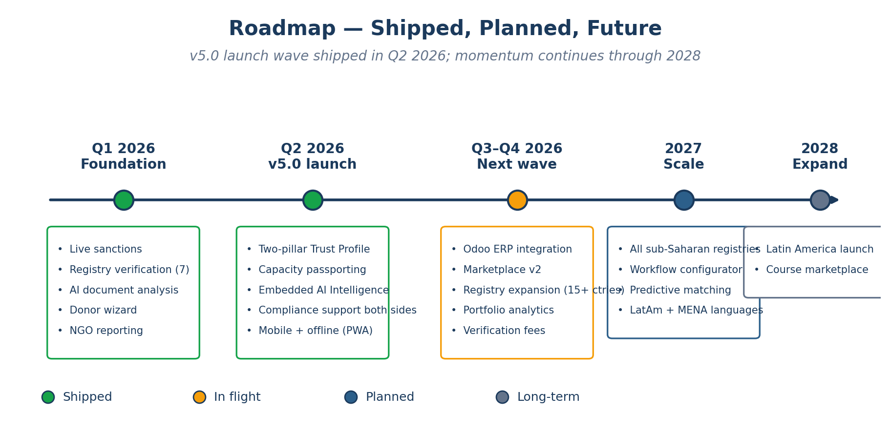
Roadmap
v5.0 launch wave shipped Q2 2026 · momentum continues through 2028.
Kuja · AI-Powered Grant Management for the Global South
Market Analysis · v5.0 · May 2026

Slide 26
Why Adeso · Why Now
Right team · right moment · right product.
WHY ADESO
WHY NOW
WHY KUJA
Somali-founded African social enterprise. 30+ years of humanitarian impact. Co-founder of the NEAR Network — the largest network of national and local organisations in the Global South. Built by the communities Kuja serves.
USAID dissolution in 2025 ($36B cut, 83% of programmes cancelled) has created urgent demand for diversified funding infrastructure and direct donor-to-NGO connections. 92% of nonprofits already use AI but 76% lack a strategy.
The only platform combining marketplace, two-pillar Trust Profile, Embedded AI Intelligence, compliance simplified for both sides, mobile-first delivery, and ERP operations — purpose-built for the Global South.
Findable. Fundable. Trusted.

