Slide 1

KiWi: A Key-Value Map for Massive Real-Time Analytics
Dmitry Basin, Edward Bortnikov, Anastasia Braginsky, Guy Golan Gueta, Eshcar Hillel, Idit Keidar, Moshe Sulamy

Slide 2
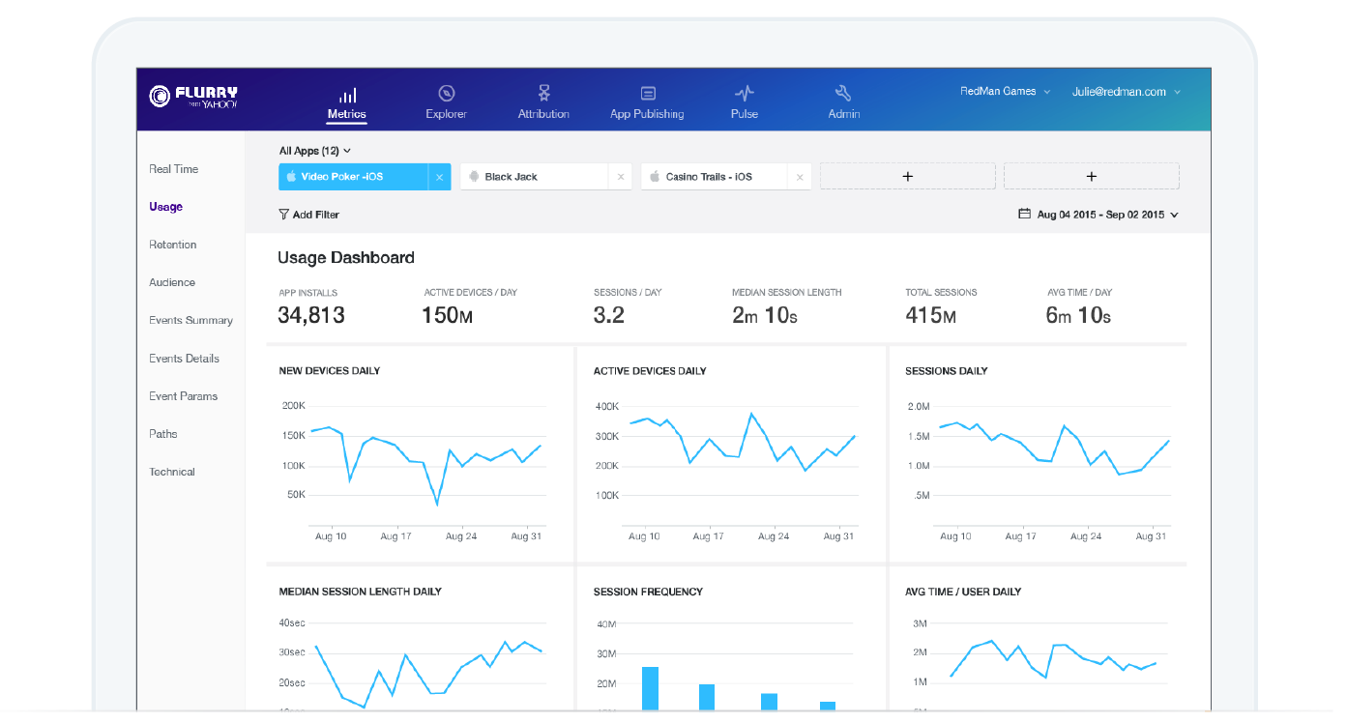

Motivation: Massive Real-Time Analytics
Reports over real-time data about 830,000 mobile apps on 1.6 billion user devices

Slide 3
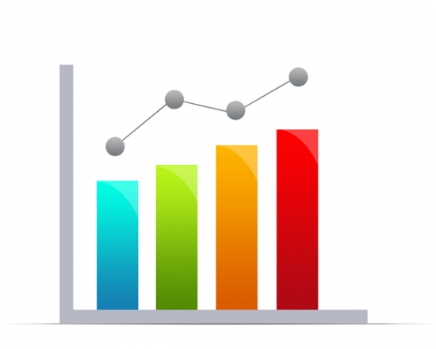





Real-Time Analytics Architecture
scan
KV-Store
put
Content Processing

Slide 4
KiWi : Concurrent KV-Map
Simultaneous scans and updates
High performance, scalability
1st KV-Map to achieve this
wait-free
atomic
scan
KiWi
put
light-weight
lock-free

Slide 5
Design
Multi-versioning
But, puts create new versions only if scans need them
Versions managed by scans – keep puts light-weight
Optimize memory organization
Periodically compact/split/merge/sort chunks
Subtle synchronization & helping
Index
chunk
chunk
chunk
chunk

Slide 6
Chunk
minKey: 15
key:
ver:
15
0
19
2
23
0
26
0
24
4
26
4
17
4
⊥
⊥
⊥
⊥
sorted

Slide 7
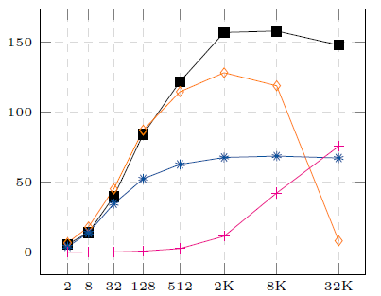
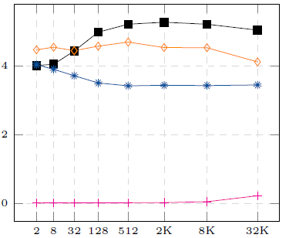
Results – Simultaneous Scans & Puts
KiWi is best for long scans
not atomic

Slide 8
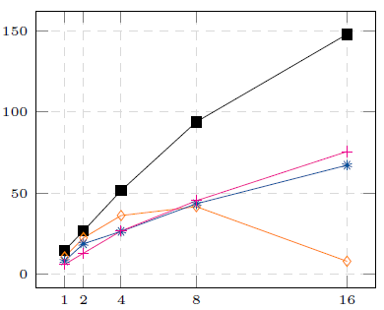
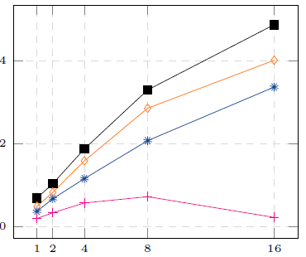
Results – Simultaneous Scans & Puts - Scalability

