Slide 1
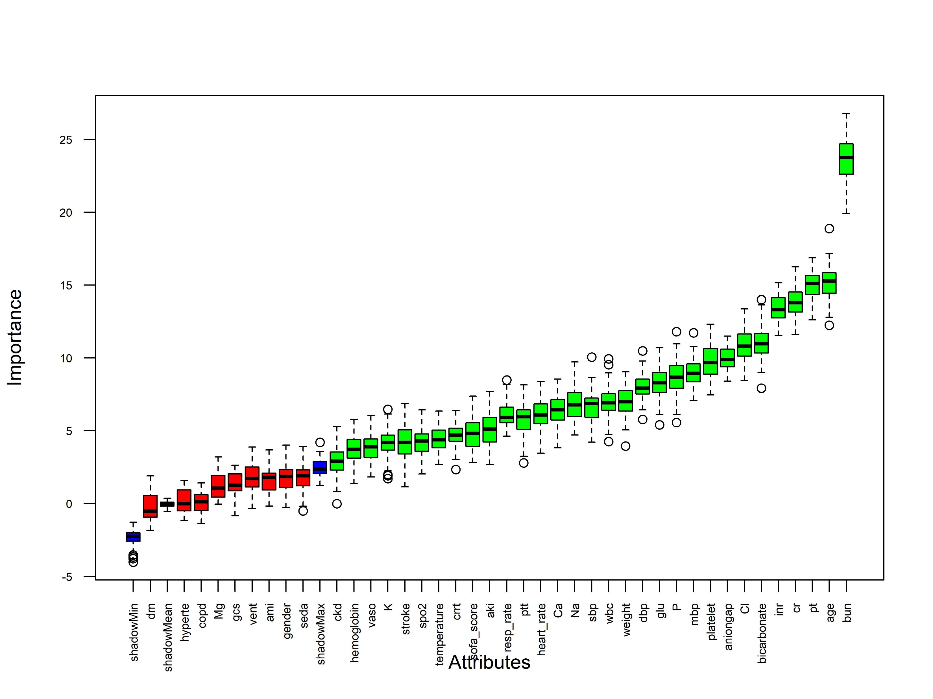
Figure 2: Selection of clinical feature variables using the Boruta algorithm.
Abbreviations: dm: diabetes, hyperte: hypertension, Mg: magnesium, gcs: Glasgow coma scale, vent: mechanical ventilation, ami: acute myocardial infarction, seda: sedation, ckd: chronic kidney disease, vaso: vasopressor, K: potassium, crrt: continuous renal replacement therapy, aki: acute kidney injury, resp_rate: respiratory rate, Ca: total calcium, Na: sodium, sbp: systolic blood pressure, wbc: white blood cell count, dbp: diastolic blood pressure, glu: glucose, P: phosphate, mbp: mean arterial blood pressure, aniongap: anion gap, Cl: chloride, cr: creatinine, pt: prothrombin time, bun: blood urea nitrogen.

