Slide 1
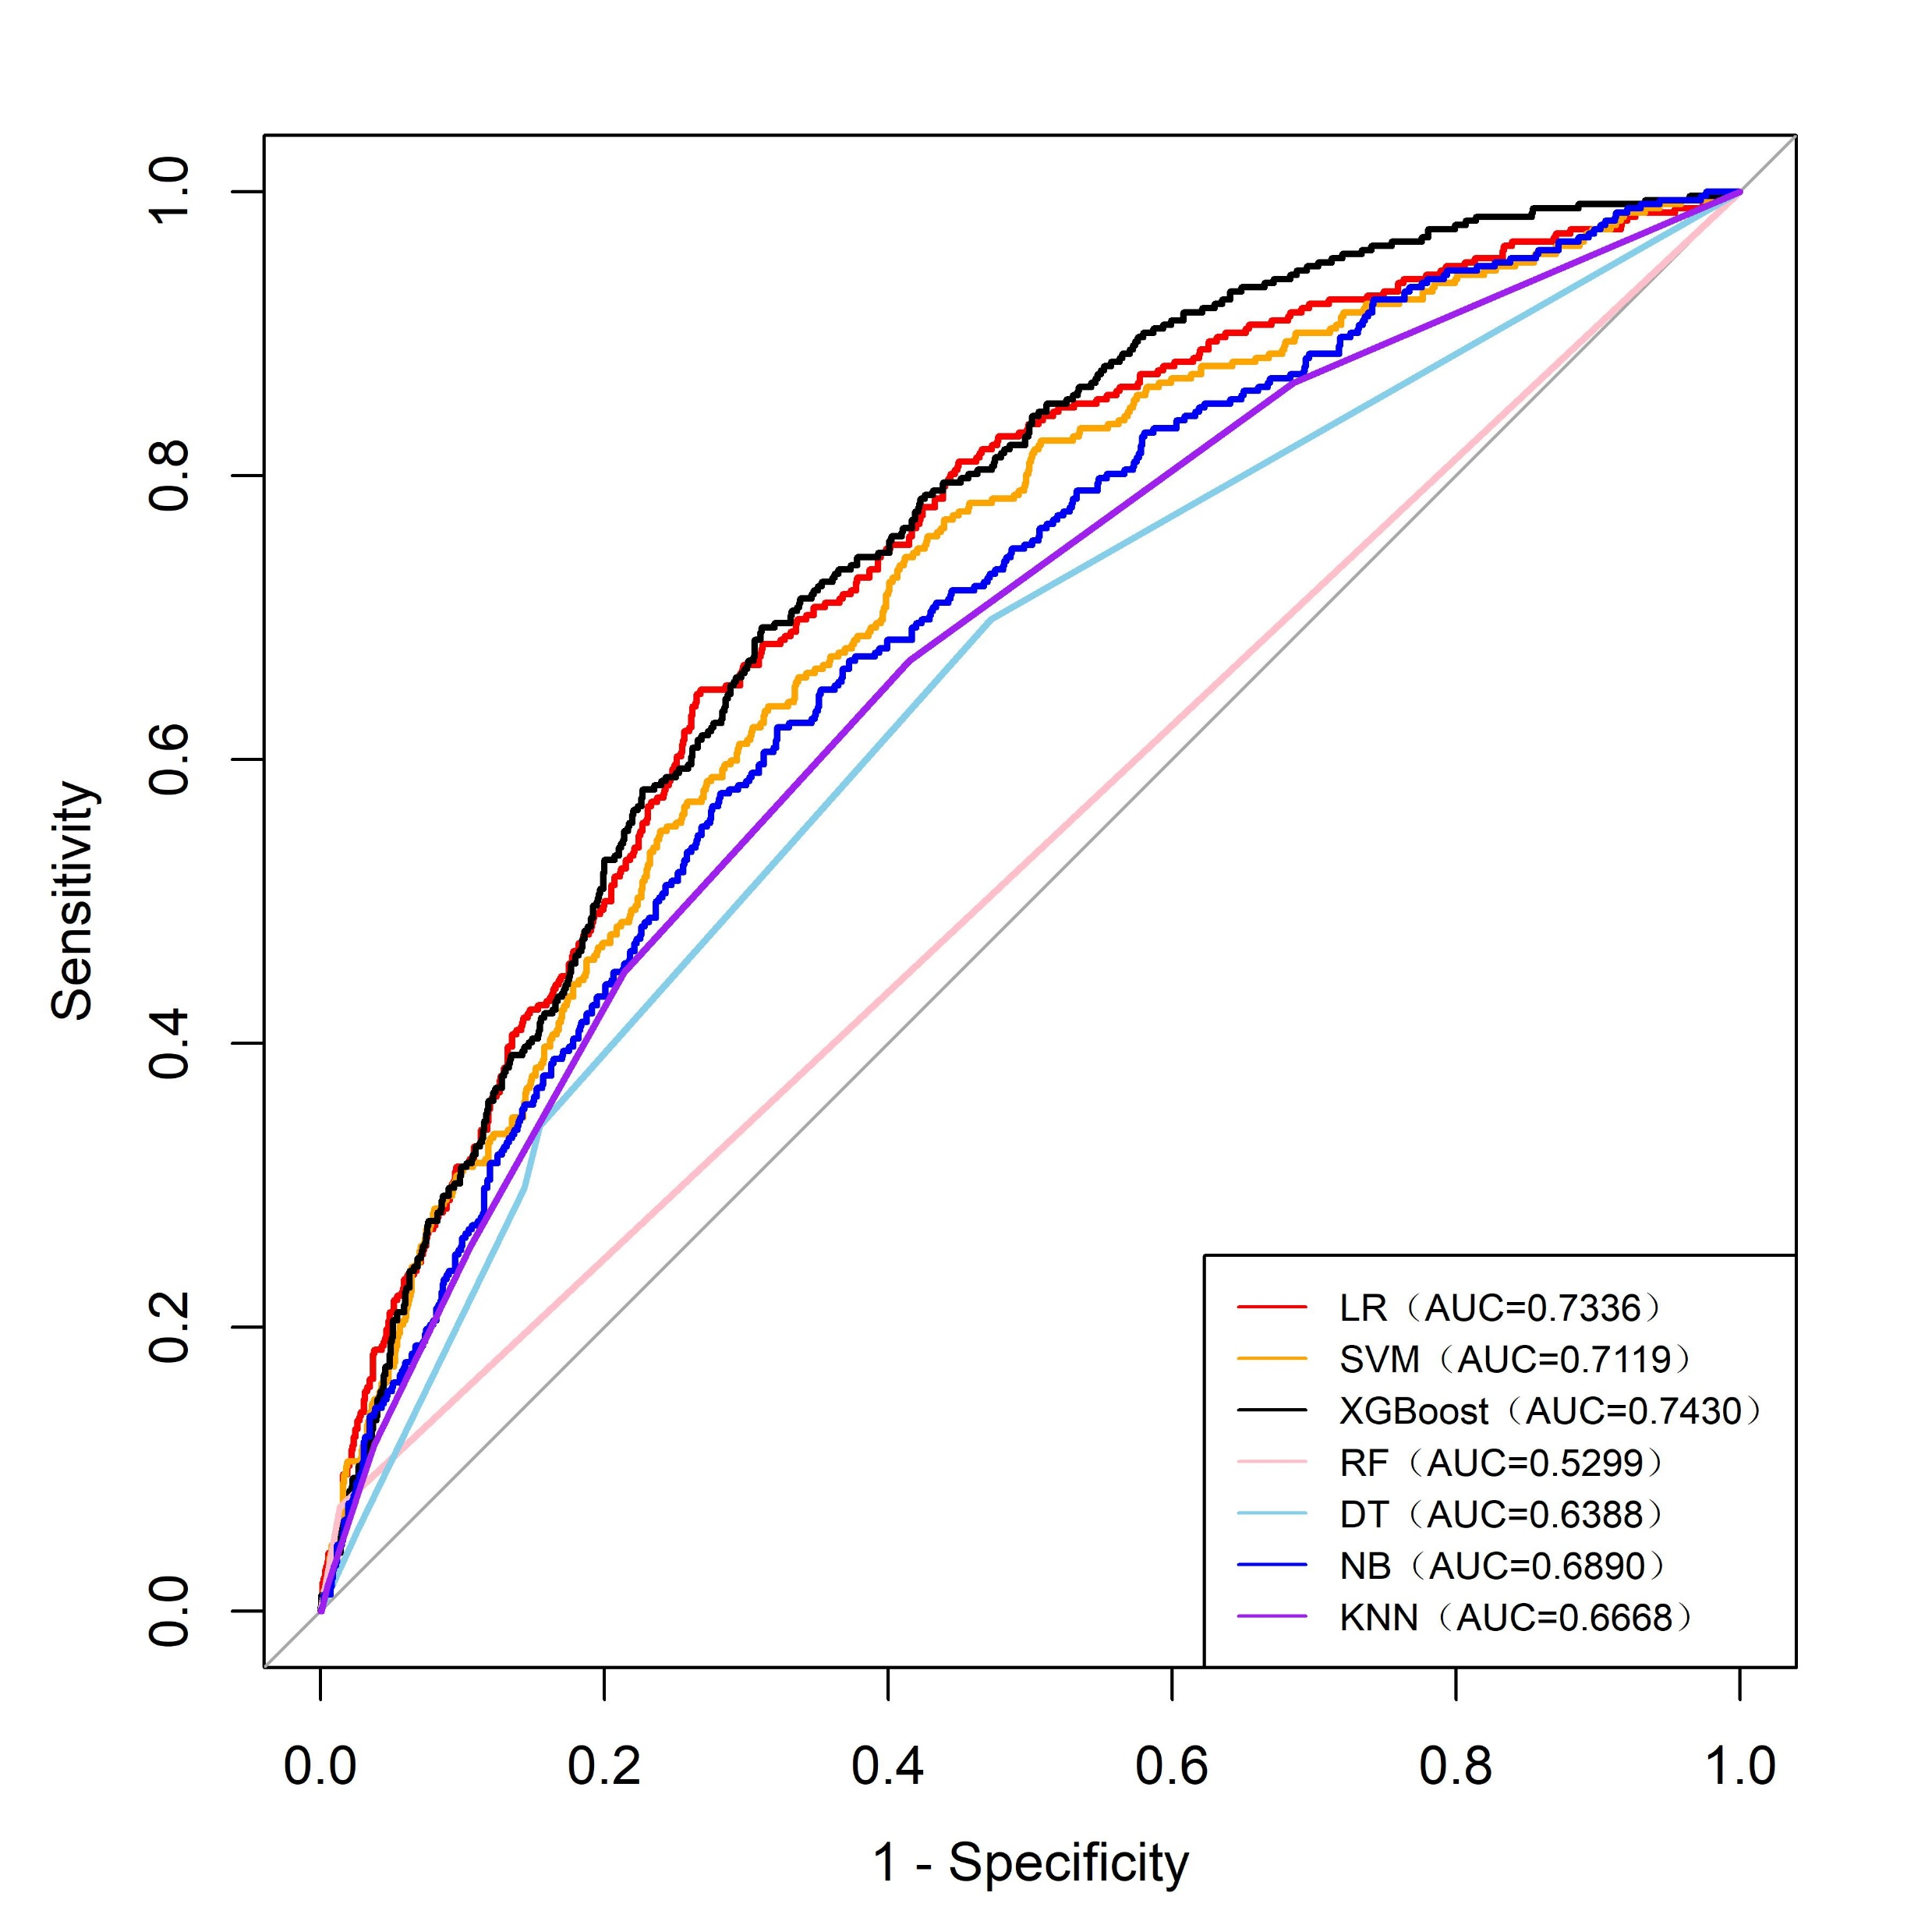
Figure 3：The receiver operating characteristic (ROC) curves of the LR, SVM, XGBoost, RF, DT, NB, and KNN models on the validation set.
Abbreviations: LR: logistic regression model; SVM: support vector machine model; XGBoost: extreme gradient boosting model; RF: random forest model; DT: decision tree model; NB: naive Bayes model; KNN: k-nearest neighbors model; PPV: positive predictive value; NPV: negative predictive value.

